Slide 1
Coffee Quality Analytics Dashboard Project
Analyzing coffee quality scores, origins, regions, processing methods and defects
Dataset: 207 coffee samples
Sharanya Bandi - B Tech(DS)
1

Slide 2
1. Project Overview
Objective: understand what factors are associated with higher coffee quality scores.
Analyze quality attributes such as Aroma, Flavor, Acidity, Body, Balance and Overall score.
Compare coffee performance across Country of Origin, Region, Variety and Processing Method.
Monitor defect categories and identify quality patterns.
Present the results through an interactive Power BI-style dashboard.
2

Slide 3
2. Dataset Overview
Structure of the Coffee Quality dataset
207
Samples
31
Columns
22
Countries
120
Regions
10
Processing methods
Geography: Country of Origin, Region, Altitude
Coffee details: Variety, Harvest Year, Processing Method
Quality scores: Aroma, Flavor, Aftertaste, Acidity, Body, Balance
Quality totals: Overall, Total Cup Points, Defects
Defect indicators: Category One Defects, Category Two Defects, Quakers
3

Slide 4
3. KPI Summary
207
Total Sample
83.71
Avg. Total Cup Points
7.68
Avg. Overall
7.72
Avg. Aroma
7.74
Avg. Flavor
0
Total Defects score
4

Slide 5
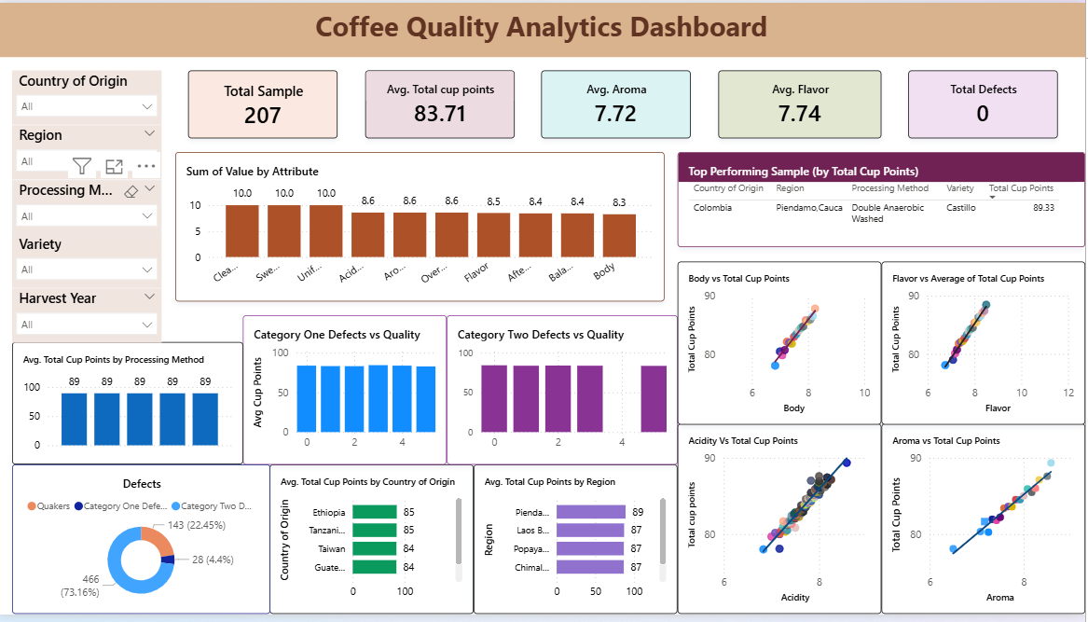
4. Power BI Dashboard
Interactive dashboard designed for quality, origin and process analysis
5

Slide 6
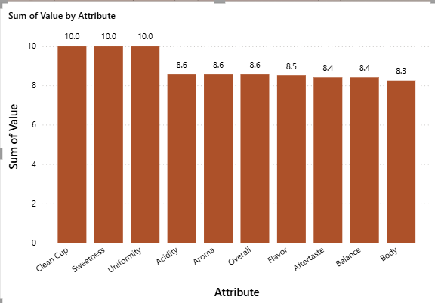
5. Quality Attribute Analysis
Average scores across the main cup-quality attributes
Clean Cup, Sweetness and Uniformity are at approximately 10.0 on average.
Aroma averages 7.72 and Flavor averages 7.74.
Overall quality averages 7.68.
The attribute profile shows consistently strong cup-quality scores.
6

Slide 7
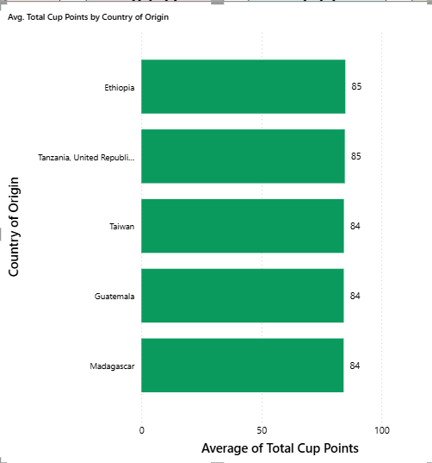
6. Origin & Regional Analysis
Comparing average Total Cup Points across origins
The dataset contains 22 countries and 120 regions.
Among the displayed leading origins, Ethiopia has the highest average at about 84.96.
Regional filters in the dashboard allow users to drill down from country to specific producing regions.
The highest individual sample is from Colombia, Piendamo, Cauca.
7

Slide 8
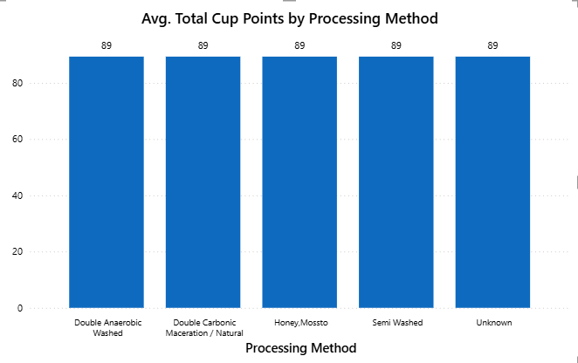
7. Processing Method Analysis
How processing methods relate to average cup quality
Washed / Wet is the most common processing method in the dataset.
Among methods with at least 3 observations, Natural / Dry has the highest average shown.
Processing method should be interpreted together with origin, variety and sample size.
The dashboard supports interactive comparison of processing methods.
8

Slide 9
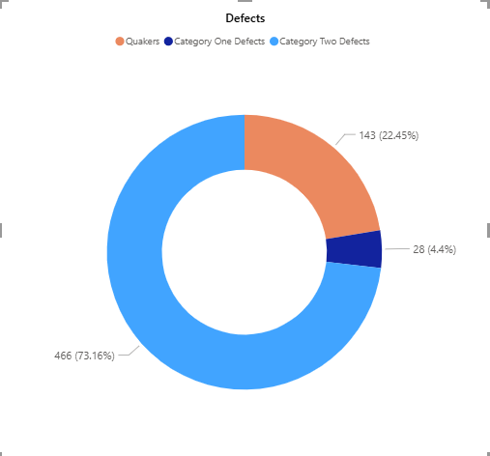
8. Defect Analysis
Category-level defect indicators in the dataset
Category One Defects total: 28.
Category Two Defects total: 466.
Quakers total: 143.
The separate Defects score column is 0 for all 207 records.
This distinction is important when interpreting the dashboard KPI.
9

Slide 10
10. Top-Ranked Sample
Highest Total Cup Points in the available dataset
89.33 Total Cup Points
Colombia • Piendamo,Cauca • Castillo • Double Anaerobic Washed
Rank | Country | Region | Variety | Total Cup Points
1 | Colombia | Piendamo,Cauca | Castillo | 89.33
2 | Taiwan | Chiayi | Gesha | 87.58
3 | Laos | Laos Borofen Plateau | Java | 87.42
4 | Costa Rica | Los Santos,Tarrazu | Gesha | 87.17
5 | Colombia | Popayan,Cauca | Red Bourbon | 87.08
11

Slide 11
11. Key Insights & Conclusion
What the analysis tells us
Key Findings
Next Steps
207 samples were analyzed across 22 countries and 120 regions.
Average Total Cup Points = 83.71; Average Overall = 7.68.
Flavor, Acidity, Aroma and Body have strong positive relationships with Total Cup Points.
Category-level defect counts exist even though the overall Defects field is 0.
Power BI makes it easy to filter by country, region, processing method, variety and harvest year.
The dashboard supports quality benchmarking and exploratory comparison.
Future work: add time-series analysis, sample-size-aware comparisons and predictive quality modeling.
Potential extension: build a regression model to estimate Total Cup Points from sensory and production features.
12

