Slide 1
SIM-004
The Customers We Paid For
Marketing Performance & Customer Acquisition Quality
B SHARANYA - B.TECH(DS)
K GREESHMIKA - B.TECH(CSE)
N MALAVIKA - B.TECH(CSE)
UrbanNest India | SIM-004 | Slide 1

Slide 2
1. Executive Summary
Gross revenue: ₹6.51 crore; 2024 grew 53.5% YoY, while 2025 grew only 0.8%.
Affiliate Referral Network: 89.7% one-time buyer rate; CLV ₹570.
Influencer refund-to-gross return rate: 42.7%; realized profit margin 24.2%.
High CSAT repeat rate: 52.2%; low CSAT: 29.6%.
30% Influencer budget = ₹2,612,099; modeled incremental profit from moving it to Paid Social = ₹201,264.
UrbanNest India | SIM-004 | Slide 2

Slide 3
2. Business Dilemma
67,086 raw order rows contained 150 duplicates.
8,701 of 20,000 customers (43.5%) have missing campaign IDs.
Acquisition volume must be evaluated together with repeat behavior, refunds, COGS and realized profit.
The manager statements in the case were treated as hypotheses and tested against the data.
UrbanNest India | SIM-004 | Slide 3

Slide 4
3. Data Preparation & Quality Log
Orders de-duplicated before financial and retention calculations.
Channel casing/underscore variants standardized.
Affiliate/referral variants consolidated; influencer variants consolidated.
Blank promo codes and campaign IDs retained rather than deleted.
Mixed date formats parsed consistently.
UrbanNest India | SIM-004 | Slide 4

Slide 5
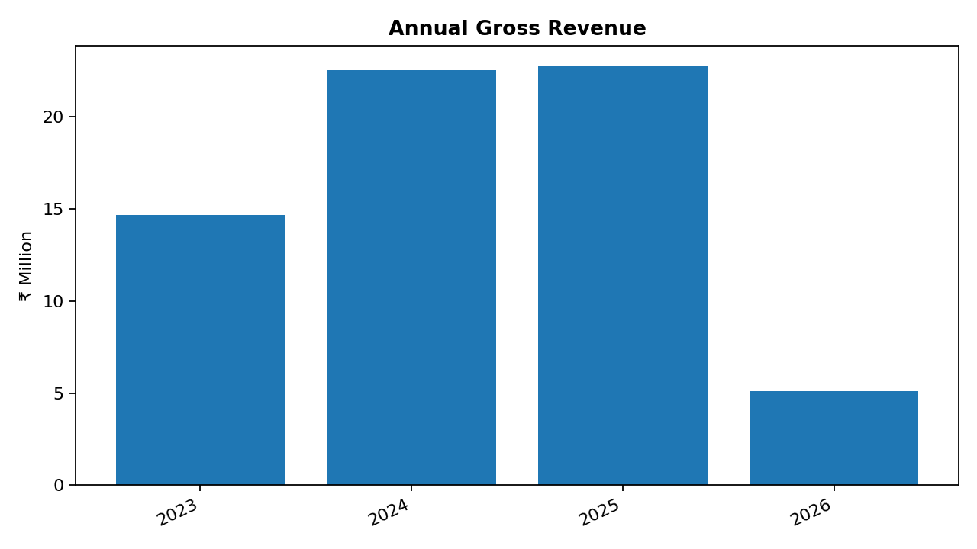
4. YoY Financial Performance
2026 is a partial year in the supplied data.
2024 gross revenue growth: 53.5%.
2025 gross revenue growth: 0.8%.
Total refunds: ₹1.02 crore.
Overall realized profit margin: 48.1%.
UrbanNest India | SIM-004 | Slide 5

Slide 6
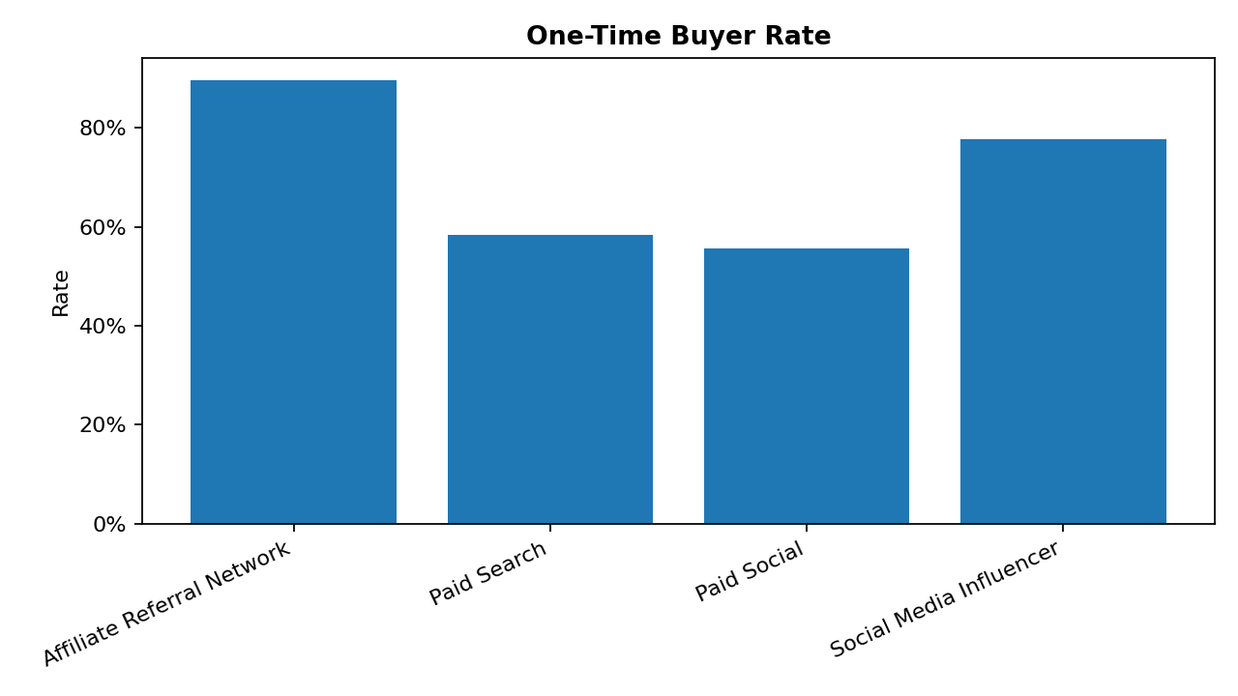
5. Story 1 — CAC vs CLV & One-Time Buyers
CAC = campaign spend / attributed customers.
CLV = realized profit / signups in the standardized customer channel.
Affiliate/Referral: CAC ₹442; CLV ₹570; one-time 89.7%.
Paid Social: CAC ₹374; CLV ₹1,844; one-time 55.6%.
UrbanNest India | SIM-004 | Slide 6

Slide 7
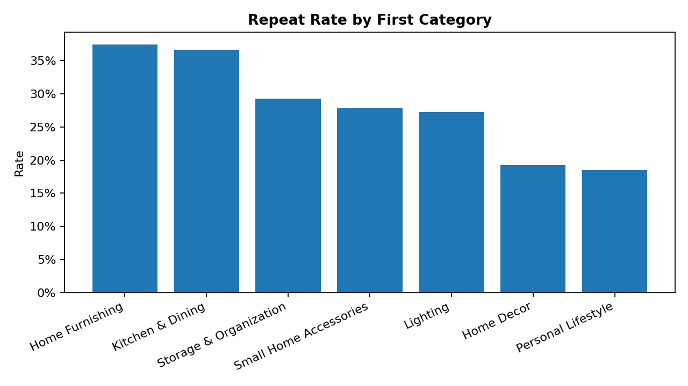
6. Story 2 — First-Purchase Category & Repeat Behavior
Home Furnishing: highest repeat rate 37.5%.
Personal Lifestyle: lowest repeat rate 18.5%.
First-purchase category is therefore associated with different long-term customer behavior.
Highest-repeat category CLV: ₹1,788.
UrbanNest India | SIM-004 | Slide 7

Slide 8
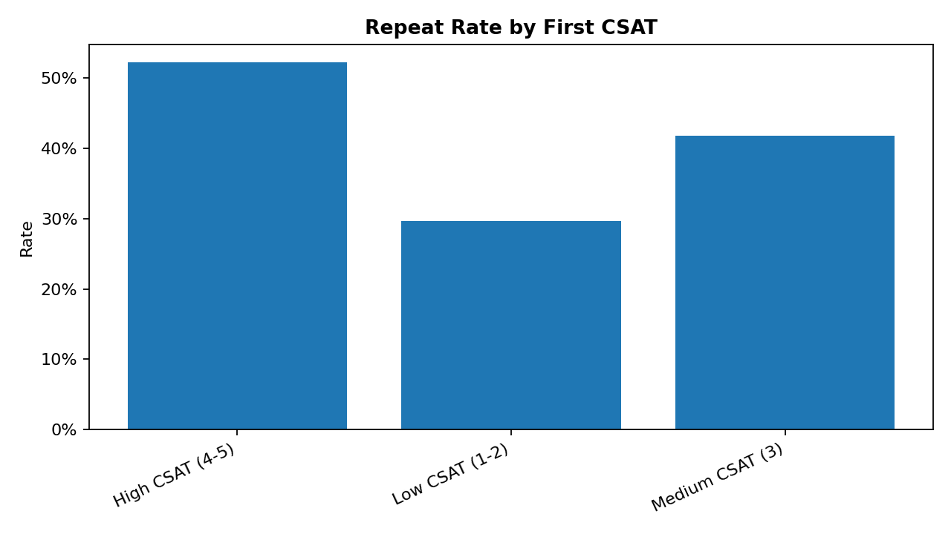
7. Story 3 — Support CSAT & Delivery Experience
High CSAT repeat rate: 52.2%; Low CSAT: 29.6%.
Gap: 22.5% percentage points.
Delivery issue in first 30 days: 15.1% repeat vs 30.2% without one.
These are observational associations, not proof of causation.
UrbanNest India | SIM-004 | Slide 8

Slide 9
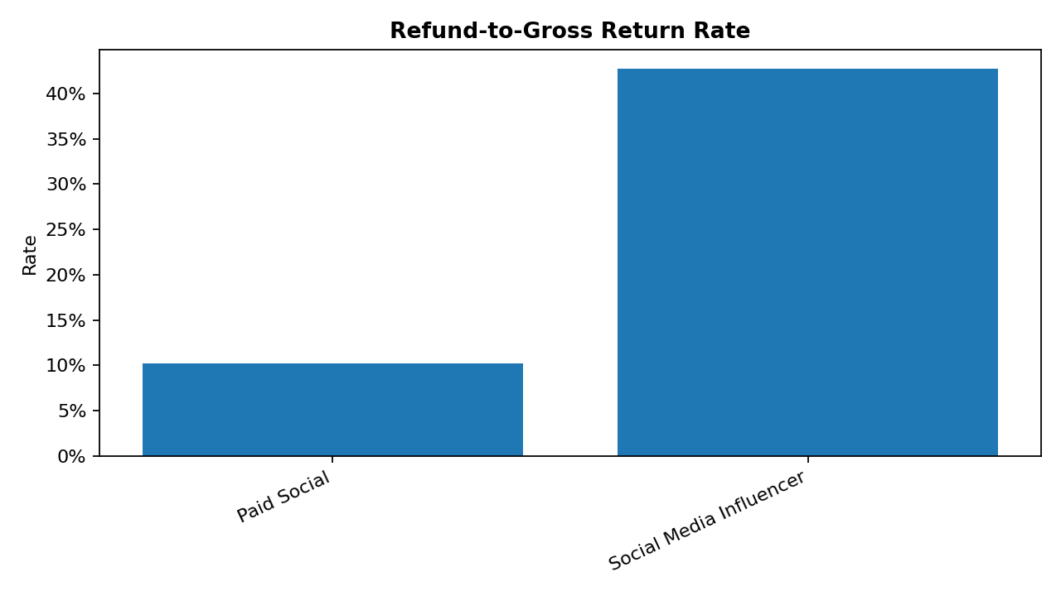
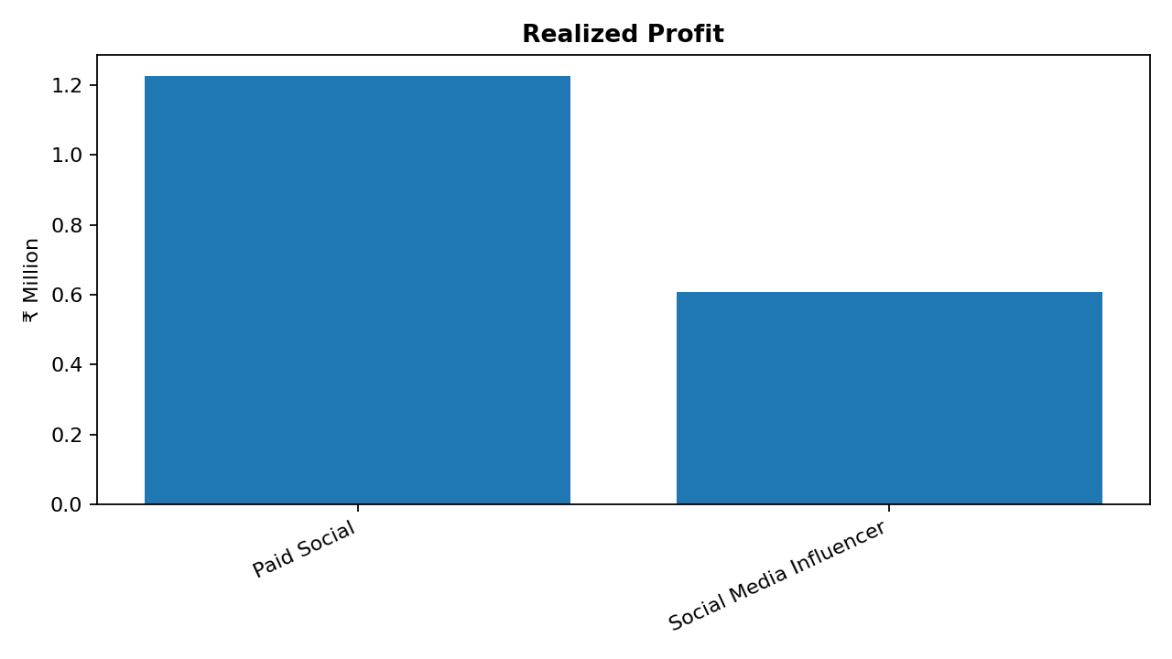
8. Story 4 — Influencer Return Trap
Influencer gross revenue: ₹0.47 crore; refunds ₹0.20 crore.
Influencer realized profit margin: 24.2%.
Paid Social realized profit margin: 53.3%.
UrbanNest India | SIM-004 | Slide 9

Slide 10
9. Root Causes & Management Implications
Acquisition quality differs materially by channel; conversion volume alone is not enough.
Affiliate/referral has a high one-time buyer rate in the observed customer base.
Influencer refunds materially reduce realized revenue and profit relative to Paid Social.
High CSAT and absence of early delivery issues coincide with higher repeat purchase rates.
Campaign attribution is incomplete for 43.5% of customers.
UrbanNest India | SIM-004 | Slide 10

Slide 11
10. Recommendations & Implementation Priorities
Next 30 days: enforce campaign-ID capture, promo governance, and weekly refund/one-time-buyer monitoring.
Next 60 days: introduce support SLA and CSAT monitoring by cohort.
Next 90 days: controlled test of Influencer vs Paid Social budget mix.
Model 30% Influencer-to-Paid-Social reallocation as an experiment, not a guaranteed outcome.
UrbanNest India | SIM-004 | Slide 11

Slide 12
11. Implementation Priority Matrix
Impact vs feasibility
HIGH IMPACT / HIGH FEASIBILITY
• Promo governance
• Support SLA + CSAT
HIGH IMPACT / LOWER FEASIBILITY
• Budget-mix experiment
• Product expectation setting
Priority: fix attribution and promo leakage first; then test channel budget shifts with controlled measurement.
LOWER IMPACT / HIGH FEASIBILITY
• Campaign-ID capture
• Channel taxonomy
LOWER IMPACT / LOWER FEASIBILITY
• Long-term assortment tests
UrbanNest India | SIM-004 | Slide 12

