Slide 1

LEVERAGING GENERATIVE AI TO ENSURE MDR COMPLIANCE IN MEDICAL DEVICE DEVELOPMENT
Sharanya Adiga (s0585849)

Slide 2
INTRODUCTION
🩺 Background
MDR ensures safety & compliance of medical devices.
Traditional documentation is time-consuming & error-prone.
🤖 AI-Powered Compliance
Automated document creation & updates (T5, GPT-4).
Ensures accuracy, efficiency, and regulatory alignment.
🚀 Impact
Faster approvals & reduced manual effort.
Lower costs & quicker market entry.

Slide 3
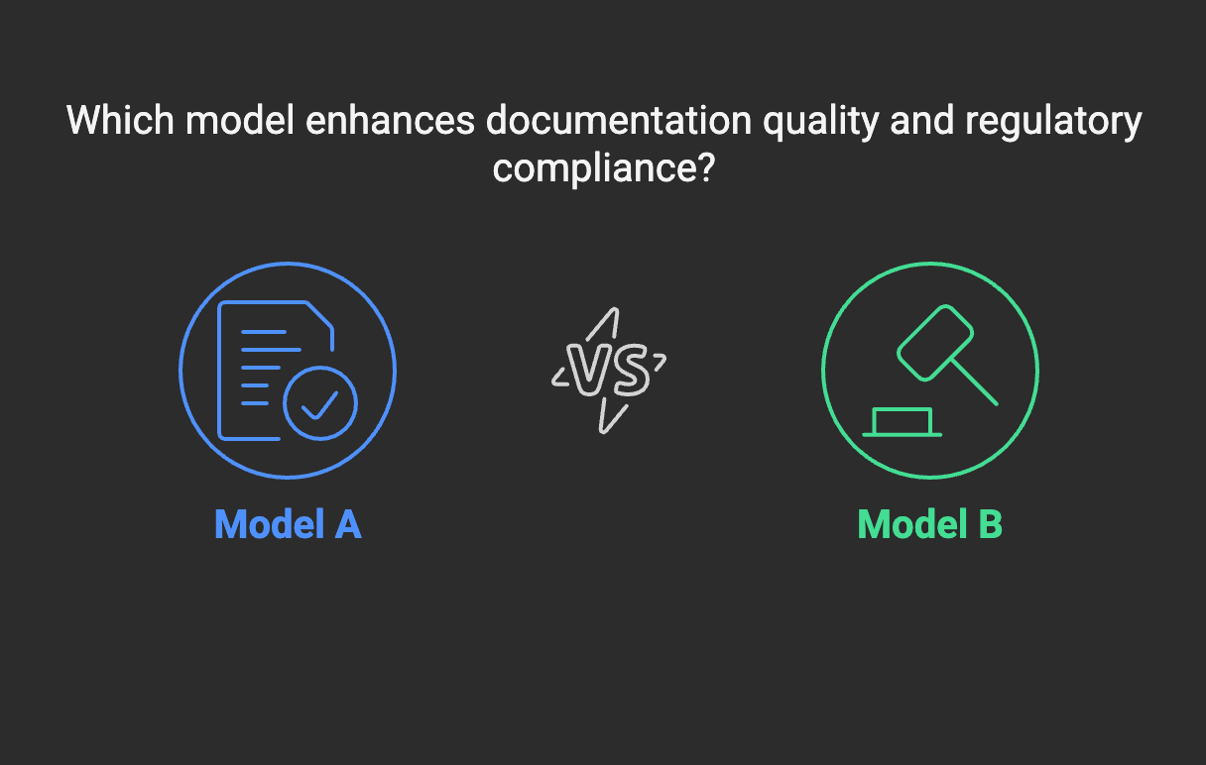
OBJECTIVES & RESEARCH QUESTIONS
🎯 Research Focus
Evaluates T5 & GPT-4 for MDR compliance documentation.
Addresses efficiency, accuracy, and resource utilization.
📌 Key Objectives
Assess Text Quality – Coherence, relevance, accuracy (BLEU, ROUGE).
Measure Execution Time – Speed & consistency of document generation.
Analyze Resource Usage – CPU, memory, and scalability.

Slide 4
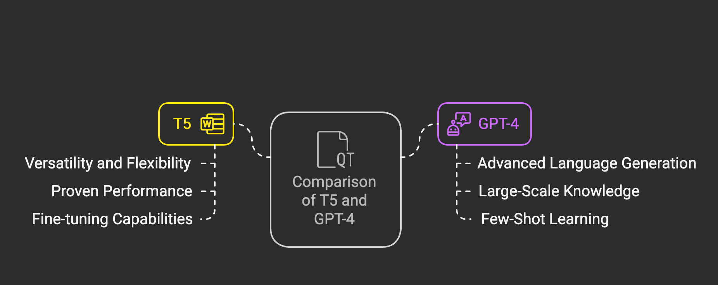
AI MODELS USED
Why NOT BERT and XLNet? Excel in classification and comprehension but are not suited for generating lengthy compliance documents.

Slide 5
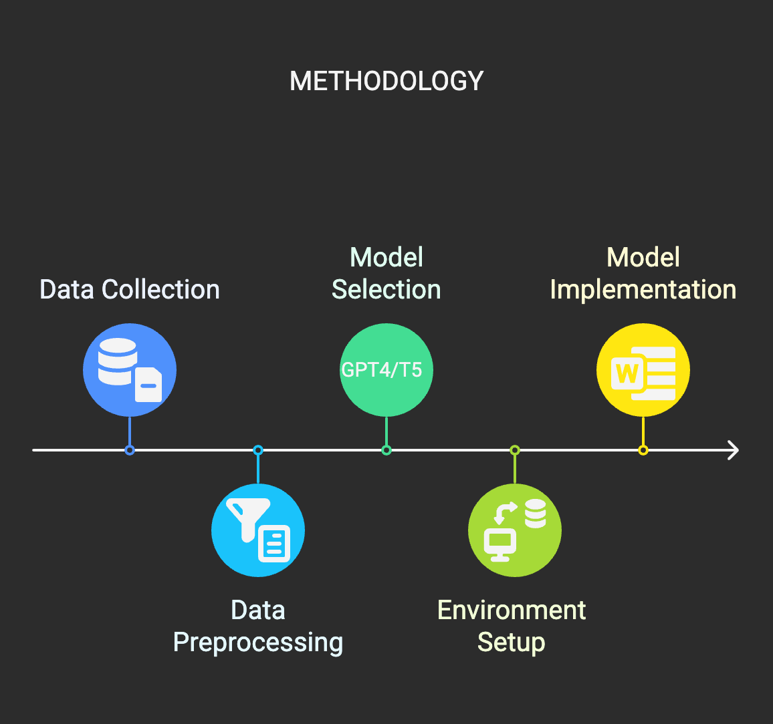
METHODOLOGY
🔹 Data Collection – Gather MDR guidelines & sample compliance docs.
🔹 Preprocessing – Extract & clean text using NLP techniques.
🔹 Model Selection – Compare GPT-4 (human-like text) & T5 (text-to-text format).
🔹 Implementation – Use Hugging Face for AI model setup & text generation.

Slide 6
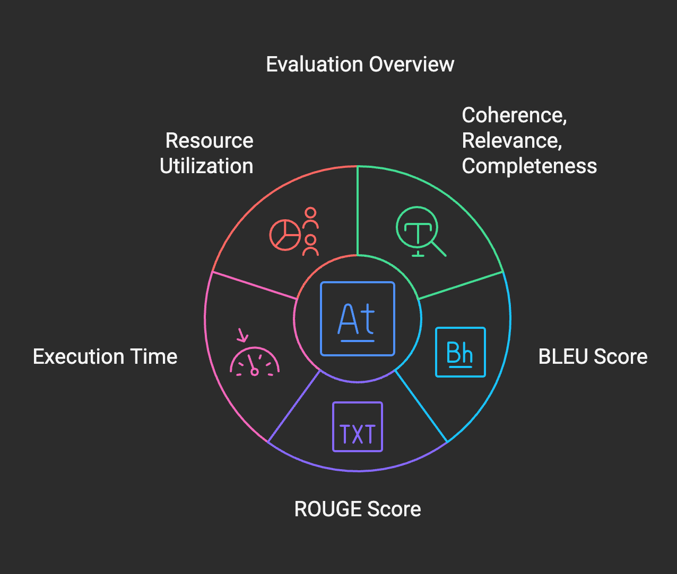
EVALUATION
✔ Coherence, Relevance, Accuracy – Ensures logical flow, MDR alignment & full coverage. ✔ BLEU Score – Measures accuracy by comparing AI text with reference text. ✔ ROUGE Score – Evaluates text overlap between AI & reference documents. ✔ Execution Time – Tracks how fast AI generates compliance documents. ✔ Resource Utilization - CPU & memory consumption during generation.

Slide 7
COMPARISON & KEY FINDINGS
Quantitative Analysis
📌 Execution Time
T5: 4.2 sec/document
GPT-4: 6.5 sec/document
📌 Resource Utilization
T5: CPU 45%, Memory 60% (More efficient )
GPT-4: CPU 60%, Memory 80% (Higher consumption )
📌 Text Quality (BLEU & ROUGE Scores)
T5: BLEU = 0.75, ROUGE-L = 0.68
GPT-4: BLEU = 0.82, ROUGE-L = 0.74 (Better quality ✅)
Qualitative Analysis
📌 Coherence
T5: Some abrupt transitions
GPT-4: Well-structured.
📌 Relevance
T5: Include irrelevant content
GPT-4: Highly regulation-focused
📌 Accuracy
T5: Occasional errors
GPT-4: Aligns with regulations, fewer errors

Slide 8
CASE STUDIES
🔹Use Case 1: Automating Compliance Documentation 💡 AI generates MDR-compliant reports (clinical, technical, risk) faster & more accurately. ⚡ Impact: Saves time, cuts costs, speeds up market entry.
🔹 Use Case 2: Updating Documents for Regulatory Changes 💡 AI detects MDR updates & revises documents automatically. ⚡ Impact: Ensures compliance, reduces manual effort, avoids legal risks.

Slide 9
CONCLUSION
The research explored the potential of AI models like T5 and GPT-4 in evaluating medical device regulation documents. While these models offer promising capabilities, several challenges limit their effectiveness. The reliance on synthetic data, the high computational demands, evolving regulations, and legal constraints highlight the need for continuous improvements in AI deployment for regulatory compliance.
To enhance the practical application of AI in this field, future efforts should focus on accessing real-world data, refining evaluation metrics, and developing adaptable AI systems that can keep up with regulatory changes. Despite these challenges, AI remains a powerful tool with the potential to streamline compliance processes and improve efficiency in regulatory analysis.

Slide 10

THANK YOU!

