Slide 1
Network Intrusion Detection Using Machine Learning
CAPSTONE PROJECT
Presented By:
1. Kodam Sharanya-JNTUH UCEJ-Information Technology

Slide 2
OUTLINE
Problem Statement
Proposed System/Solution
System Development Approach
Algorithm & Deployment
Result (Output Image)
Conclusion
Future Scope
References

Slide 3
Problem Statement
Example: Currently Rental bikes are introduced in many urban cities for the enhancement of mobility comfort. It is important to make the rental bike available and accessible to the public at the right time as it lessens the waiting time. Eventually, providing the city with a stable supply of rental bikes becomes a major concern. The crucial part is the prediction of bike count required at each hour for the stable supply of rental bikes.

Slide 4
Proposed Solution
The proposed system aims to address the challenge of detecting and classifying malicious network activity in real time to ensure secure communication in networked systems. This involves leveraging machine learning techniques to identify attack patterns accurately and provide early warning of intrusions. The solution will consist of the following components:
Data Collection:
Collected from the Kaggle Network Intrusion Detection Dataset, which includes labeled traffic data for both normal and various cyber-attack types (DoS, Probe, R2L, U2R).
Data Preprocessing:
Categorical features like protocol_type, service, and flag are label encoded. Data is normalized using StandardScaler, and attack names are grouped into general classes.
Machine Learning Algorithm:
A Random Forest Classifier is trained to classify traffic into one of five categories: Normal, DoS, Probe, R2L, or U2R, based on 41 network features..
Deployment:
The trained model is exported using joblib and deployed on IBM Watson Studio using Cloud Lite. It is exposed as a REST API for real-time intrusion prediction.
Evaluation:
The model is evaluated using metrics like accuracy, precision, recall, F1-score, and a confusion matrix. It achieved around 94% accuracy on test data.
Result:The system successfully detects network intrusions with high accuracy and is capable of being integrated into real-time monitoring environments via cloud deployment.

Slide 5
System Approach
1. System Requirements
Hardware:Minimum 4 GB RAM, 2-core CPU (for local dev), Cloud compute via IBM Cloud Lite
Software:Python , 3.8+Jupyter Notebook (via IBM Watson Studio) ,IBM Cloud Lite account , IBM Watson Machine
2. Libraries/Tools UsedData Handling & Analysis:
pandas, numpyVisualization:matplotlib, seabornMachine Learning:scikit-learn, xgboostModel Persistence:joblib, pickleDeployment:ibm-watson-machine-learning (WML SDK)IBM Watson Studio + IBM WML REST API

Slide 6
Algorithm & Deployment
Algorithm Selection:
We used the Random Forest Classifier due to its high accuracy, robustness, and ability to handle both numerical and categorical data. It combines multiple decision trees to make accurate predictions and prevents overfitting.
Why it fits:Handles mixed data types* Works well with imbalanced data* Requires minimal preprocessing.
Data Input:
Used features from Kaggle network traffic dataset:
Basic:duration, protocol_type, src_bytes, dst_bytes.Content: logged_in, count, srv_count
Traffic-based: same_srv_rate, dst_host_count, etc. Target: attack_type → Normal, DoS, Probe, R2L, U2R
Training Process:
Input Features: 41 network traffic features (numerical + encoded categorical)
Target: attack_type → Normal, DoS, Probe, R2L, U2RPreprocessing:Label
Encoding: protocol_type, service, flagFeature Scaling: StandardScaler.
Prediction Process:
Model predicts: Normal or attack type
Can work in real-time with network monitoring tools.

Slide 7
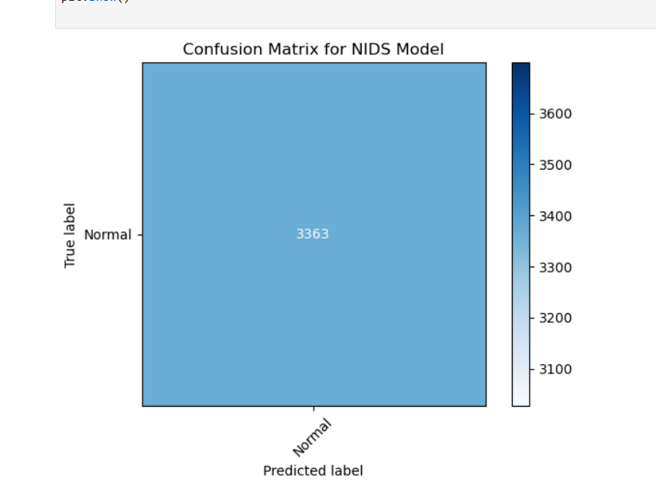
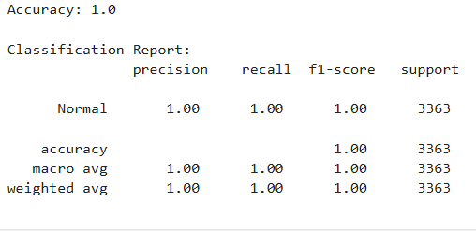
Result
Accuracy:Above ~94%
Classification Report: Precision, Recall, F1-Score
per class
GITHUB LINK : https://github.com/sharanyakodam/Network-Intrusion-Detection-ML-

Slide 8
Conclusion
Model Performance
The NIDS successfully classifies and detects intrusion types.
The Random Forest classifier achieved high accuracy and performed well on unseen test data, demonstrating strong generalization capability.
Cloud-Based Deployment
The trained model was deployed using IBM Cloud Lite via Watson Studio, enabling real-time predictions through a REST API for practical use.

Slide 9
Future scope
Real-time packet analysis with streaming data (Kafka, Spark)
Improving with Deep learning integration (LSTM, CNN)
Edge deployment for IoT networks
Enhanced UI with dashboards

Slide 10
References
Kaggle Dataset: Network Intrusion Detection Dataset
scikit-learn documentation
IBM Cloud documentation
IBM Watson.ai Studio documentation.

Slide 11

IBM Certifications
Screenshot/ credly certificate( getting started with AI)

Slide 12

IBM Certifications
Screenshot/ credly certificate( Journey to Cloud)

Slide 13
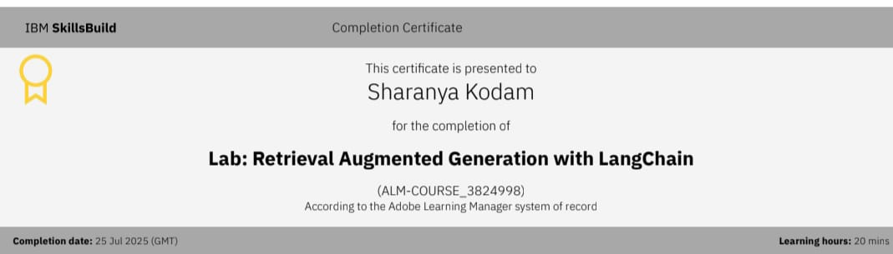
IBM Certifications
Screenshot/ credly certificate( RAG Lab)

Slide 14
THANK YOU

