Slide 1
A Machine Learning approach for Detection Of potential Low Birth Weight cases
Sharanya Venkat PES1201700218
Anagha Ananth PES1201700301
Aishwarya M A Ramanath PES1201700872

Slide 2
Implementations
Artificial Neural Network with Gradient Descent as Optimizer
K-NN (K Nearest Neighbours)
K-Nearest Neighbours | Artificial Neural Networks
Requires No training Time but might take much longer time during evaluation | ANNs are training and time intensive
Very simple model with only one hyper parameter K | Model has many hyper parameters controlling size and structure of the network and optimization procedure
Once a neural network is trained on one task, its parameters can be used as a good initializer for another (similar) task. This is a form of transfer learning that cannot be achieved with k-NN
Once a neural network is trained, the training data is no longer needed to produce new predictions. This is obviously not the case with k-NN

Slide 3
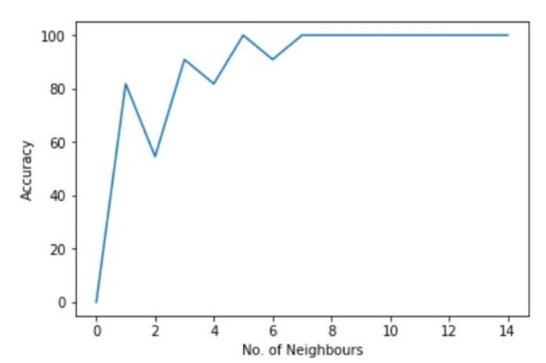
KNN architecture & Highlights
0
1
K =3 value chosen by brute force (many runs of the classifier algorithm to check for consistently high accuracy)
Measure of distance - Euclidean distance
Disadvantage: Inconsistent accuracy with different test-train splits (since the model isn’t trained)
?
K =1
K =3
K =5
Accuracy(k=3) :90.9%
Evaluation time:0.018 sec
* Diagram not to scale

Slide 4
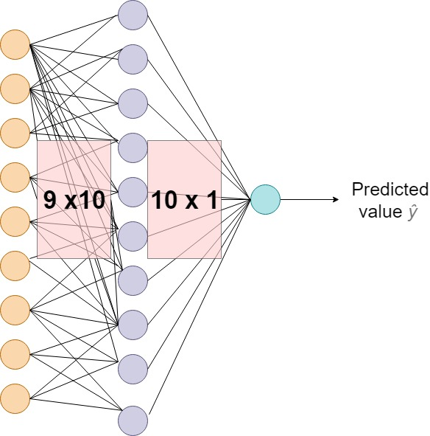
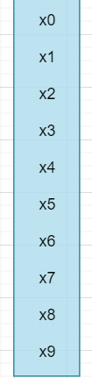
ANN Architecture
Input Features
Number of nodes
Input Layer : 9
Hidden Layer : 10
Output layer : 1
Activation Functions used:
ReLU
Sigmoid
Error Metric Used:
MSE (Mean Squared Error)
Optimizer:
Gradient Descent
1x9

Slide 5
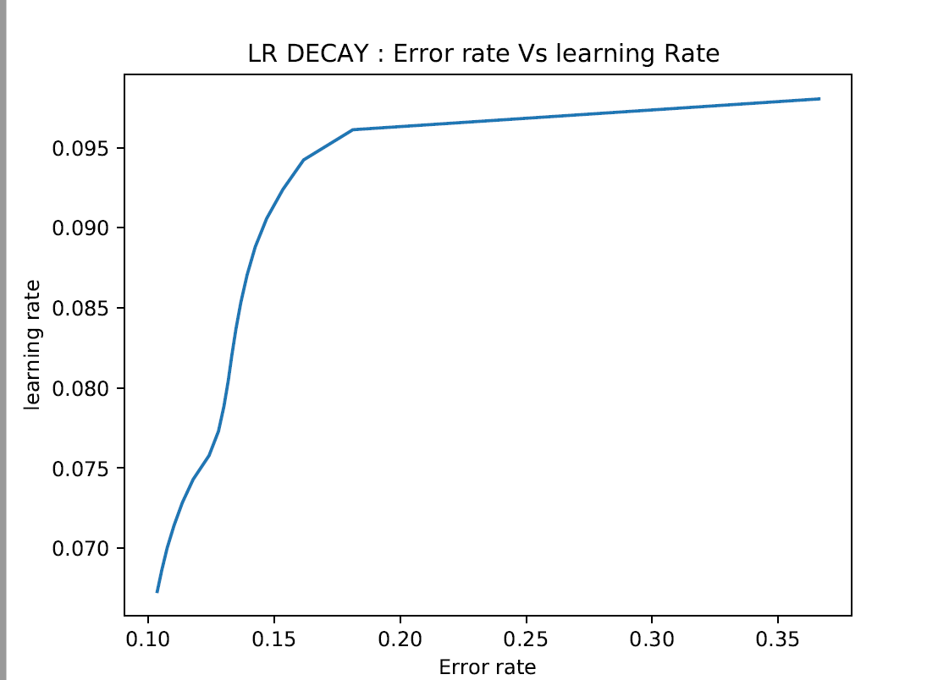
Highlights
Time Based Decay: lr=lr*(1./(1. + decay* iterations))
Implemented Adaptive Learning Rate methods
Learning rate starts with a high value (i.e we start by taking big steps towards minima) and updates itself every epoch as error rate decreases (i.e we start taking smaller steps when we reach close to the minima)
Faster Convergence and lesser Training cost
Trained for 20 epochs
Time taken: 0.028 sec
Accuracy on Train set: 92.3%

