Slide 1
DESIGN OF AVL TREES
DAA PROJECT

Slide 2
Submitted by
Name: Shreya Banerjee (Roll Number: 14)
SRN: PES1201700198
Name: Sharanya Venkat (Roll Number: 15)
SRN: PES1201700218
SECTION : 4F

Slide 3
Problem definition
Given a student record, with student id and marks, insert or search it in Binary search tree and AVL tree. Find and compare the time complexities in worst case scenario and analyze which data structure is better in terms of time complexity.

Slide 4
INTRODUCTION
GETTING STARTED WITH AVL TREES AND BST

Slide 5
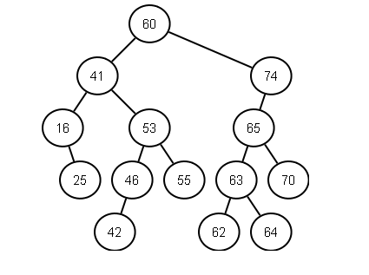
BINARY SEARCH TREES
Binary Search Tree, is a node-based binary tree data structure which has the following properties:
The left subtree of a node contains only nodes with keys lesser than the node’s key.
The right subtree of a node contains only nodes with keys greater than the node’s key.
The left and right subtree each must also be a binary search tree.

Slide 6
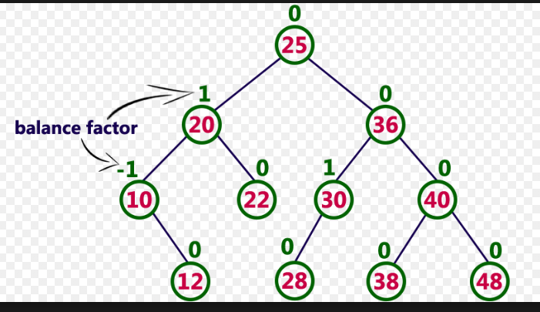
AVL TREES
AVL tree is a self-balancing Binary Search Tree (BST) where the difference between heights of left and right subtrees cannot be more than one for all nodes.
Balance factor
The balance factor of any node of an AVL tree is in the integer range [-1,+1]. If after any modification in the tree, the balance factor becomes less than −1 or greater than +1, the subtree rooted at this node is unbalanced, and a rotation is needed.

Slide 7
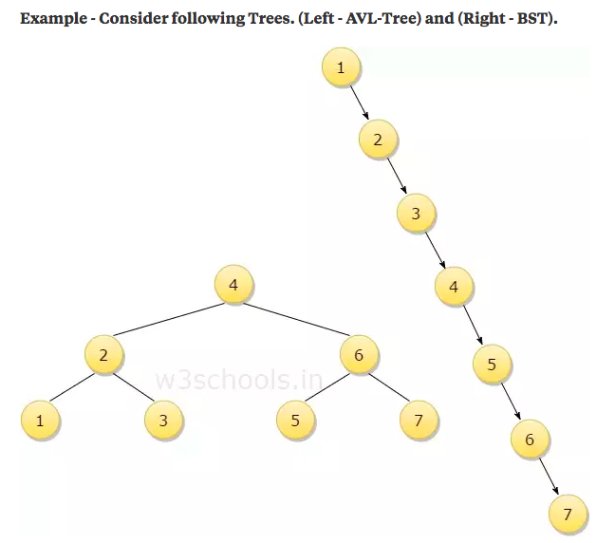
Why AVL trees?
Consider you want to insert 8 in the tree -
BST Comparisons - 7 comparisons to insert 8.
AVL-Tree - 3 comparisons to insert 8.
Consider you want to search for 6.
BST - After 5 comparisons you get 6.
AVL - After 1 comparison you get 6.
So for each operation the performance of AVL-Tree is better than BST.

Slide 8
DESIGN

Slide 9
Insertion in AVL tree
The balance factor of any node of an AVL tree is in the integer range [-1,+1]. If after any modification in the tree, the balance factor becomes less than −1 or greater than +1, the subtree rooted at this node is unbalanced, and a rotation is needed.

Slide 10
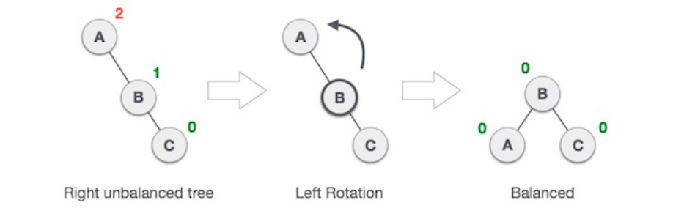
Left rotation

Slide 11
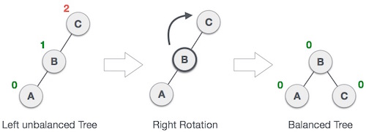
Right Rotation

Slide 12
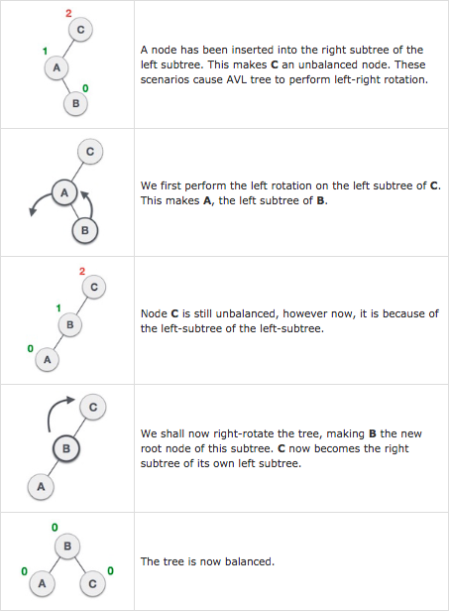
Left-Right Rotation

Slide 13
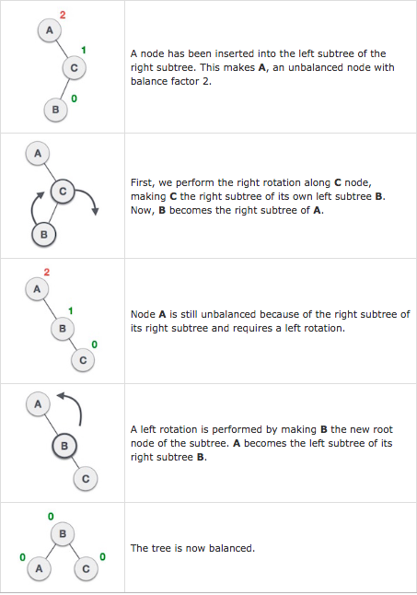
Right-left rotation

Slide 14
Structures Defined
We have defined two structures:-
Structure student contains two fields, id and marks.
Structure node is used to build Binary Search Tree and AVL tree. It contains four fields:-
Structure student
A pointer to the left node
A pointer to the right node
Balance factor

Slide 15
IMPLEMENTATION
CODE SNIPPETS, I/O SNAPSHOTS

Slide 16
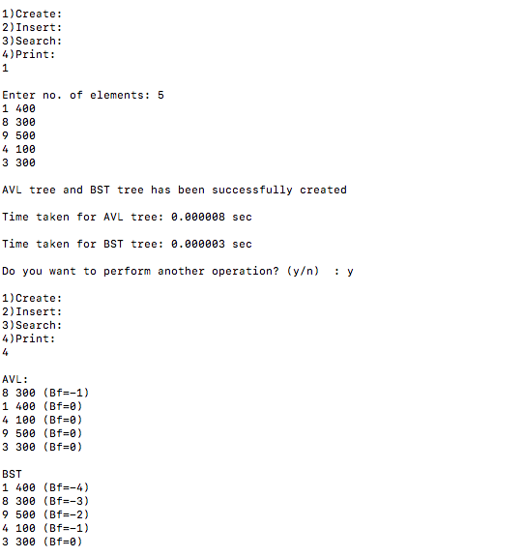
User Interface

Slide 17
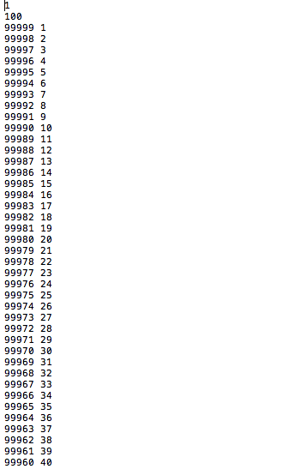
Input File
The input file consists of 1000 student records in lexicographic order which is the worst case input

Slide 18
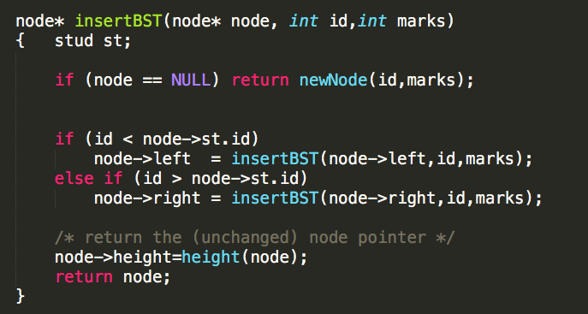
Insertion in Binary Search Tree
The function declared is a recursive implementation that inserts given nodes into the BST

Slide 19
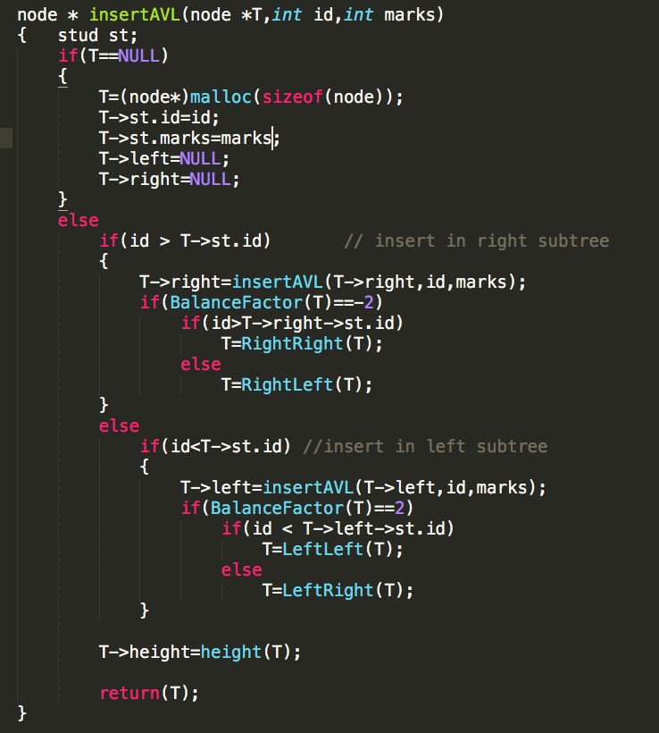
Insertion in AVL tree
The function declared is a recursive implementation that inserts given nodes into the AVL Tree.
It also checks the Balance Factor and performs rotation if the tree is unbalanced after the insertion of a node

Slide 20
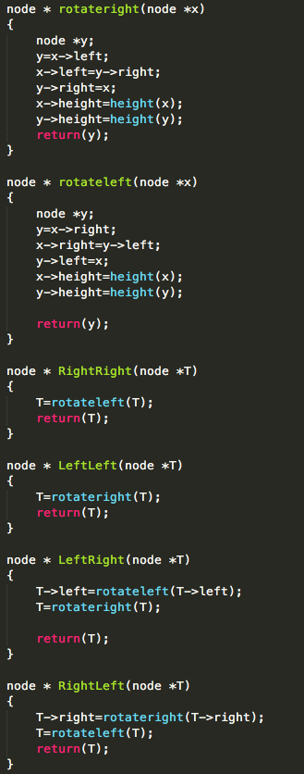
Functions for rotation
Consists of 4 rotation functions for Left, Right, Left Right and Right Left cases.

Slide 21
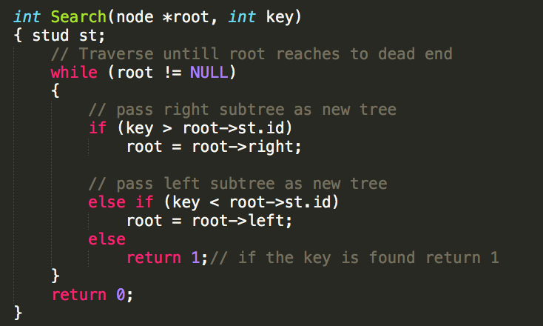
Searching a record in a tree

Slide 22
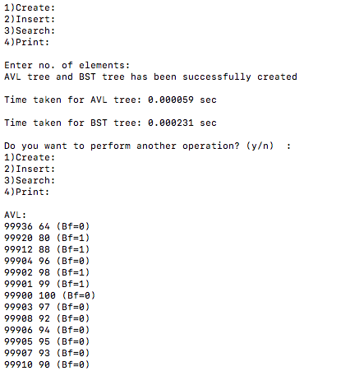
Output

Slide 23
Conclusion
AVL tree is a special case of Binary Search Tree (BST). That specialty comes from the fact that it is also self-balancing in nature. So we can say every AVL tree exhibits two fundamental properties:
It is a Binary Search Tree in itself.
It is a balanced tree. It rebalances itself whenever addition of a node causes imbalance in the tree.
In worst case scenarios, i.e, if the data is sorted in increasing or decreasing order, Binary Search Tree is skewed , hence more number of comparisons are required for insertion and search operations than an AVL tree.

