Slide 1
Google Fiber
A BI visualization that will address the Google Fiber customer service team’s questions.

Slide 2
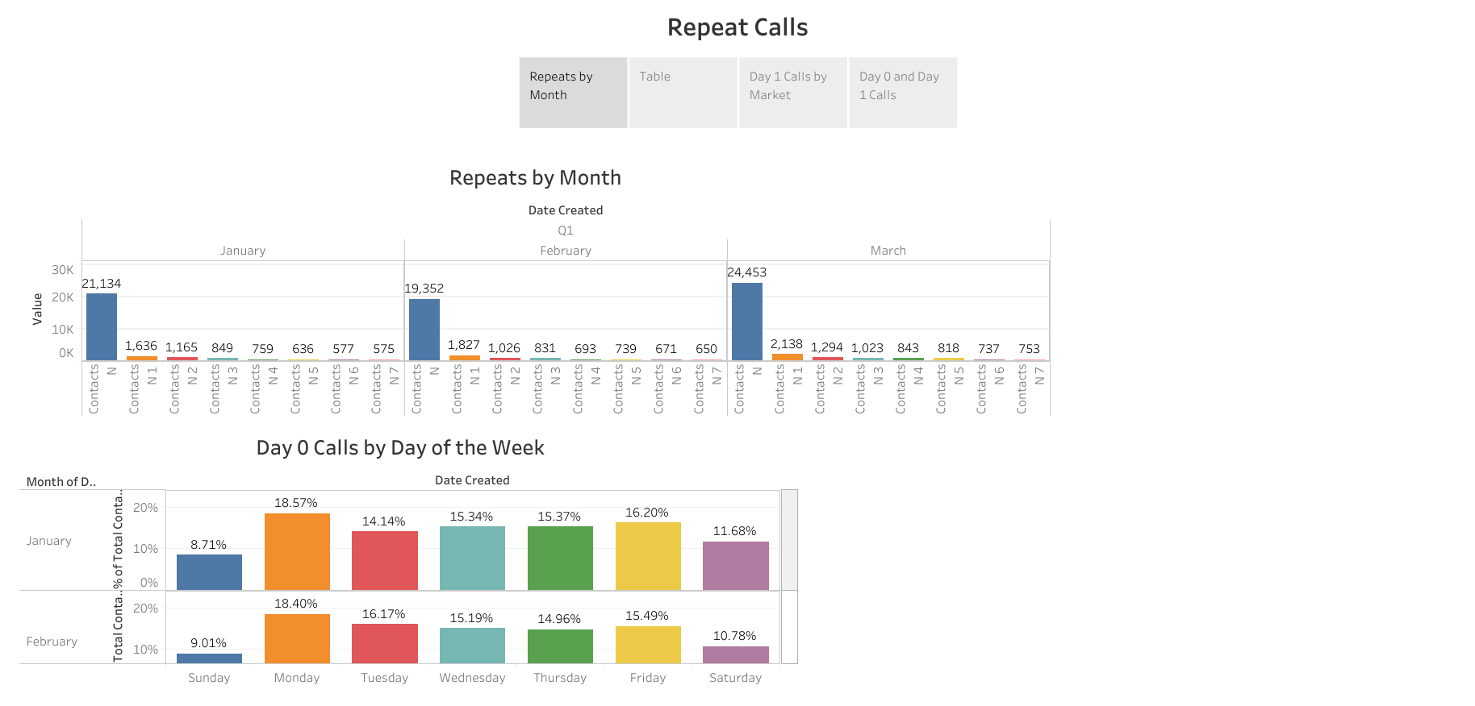
Repeats by Month
The Trend:
Initial call volume (Contacts N) peaked in March with 24,453 contacts, following a slight dip in February.
The Decay:
Across all three months, repeat call volume drops sharply after Day 1 (Contacts N 1).
Weekly Peak:
Monday is consistently the busiest day for first contact, accounting for ~18.5% of total weekly volume.

Slide 3
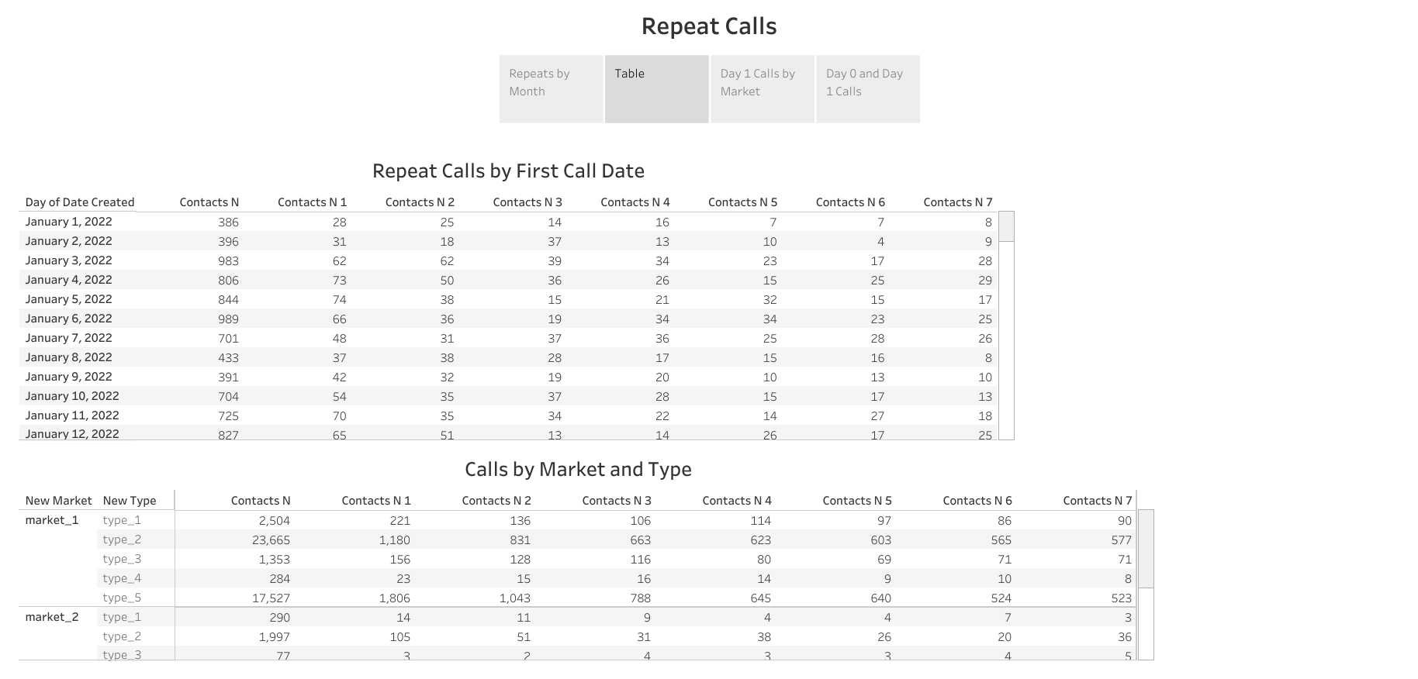
Repeat by Calls & Market Type
Resolution Tracking:
The "Repeat Calls by First Call Date" table shows that while volume is high, the vast majority of issues are resolved without a call-back within the first 48 hours.
Market Dominance:
Market_1 handles the highest volume of calls across all problem types, particularly for Type 2 (Technician Troubleshooting) and Type 5 (Internet/Wi-Fi).

Slide 4
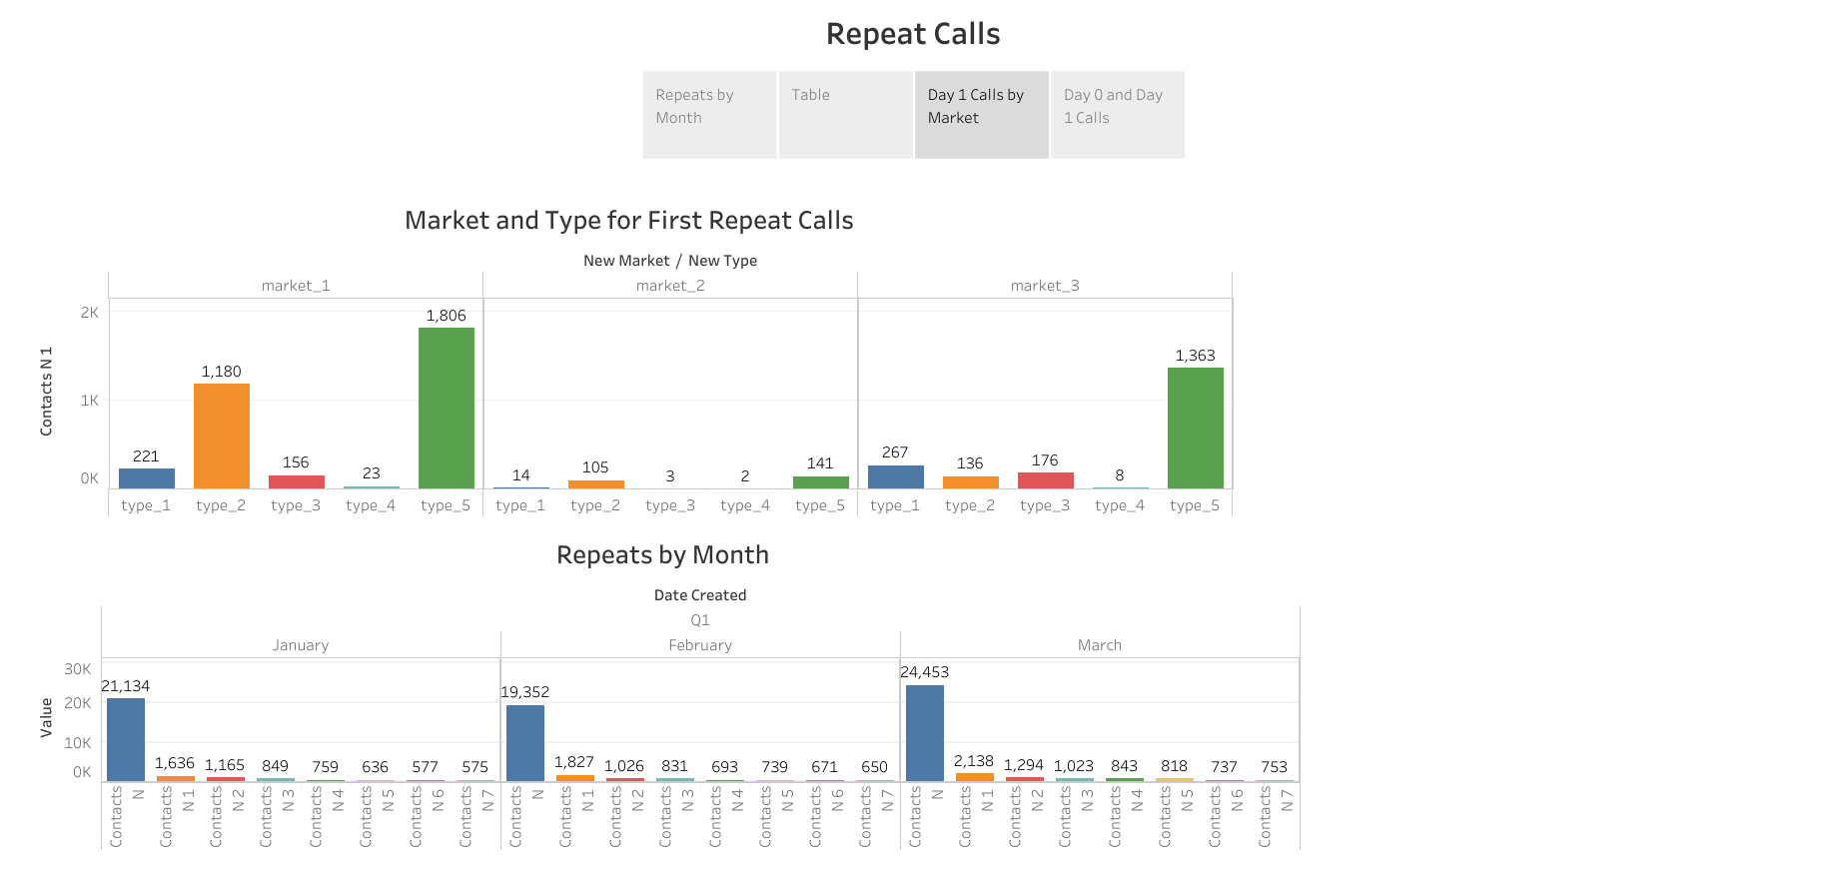
Day 1 Calls by Market
Primary Repeat Driver:
Type 5 issues generate the most immediate repeat calls (Day 1) across all markets, with Market_1 seeing 1,806 follow-ups for this issue alone.
Secondary Driver:
Type 2 troubleshooting is the second most frequent reason for Day 1 repeats in Market_1 (1,180 calls) and Market_2 (105 calls).

Slide 5
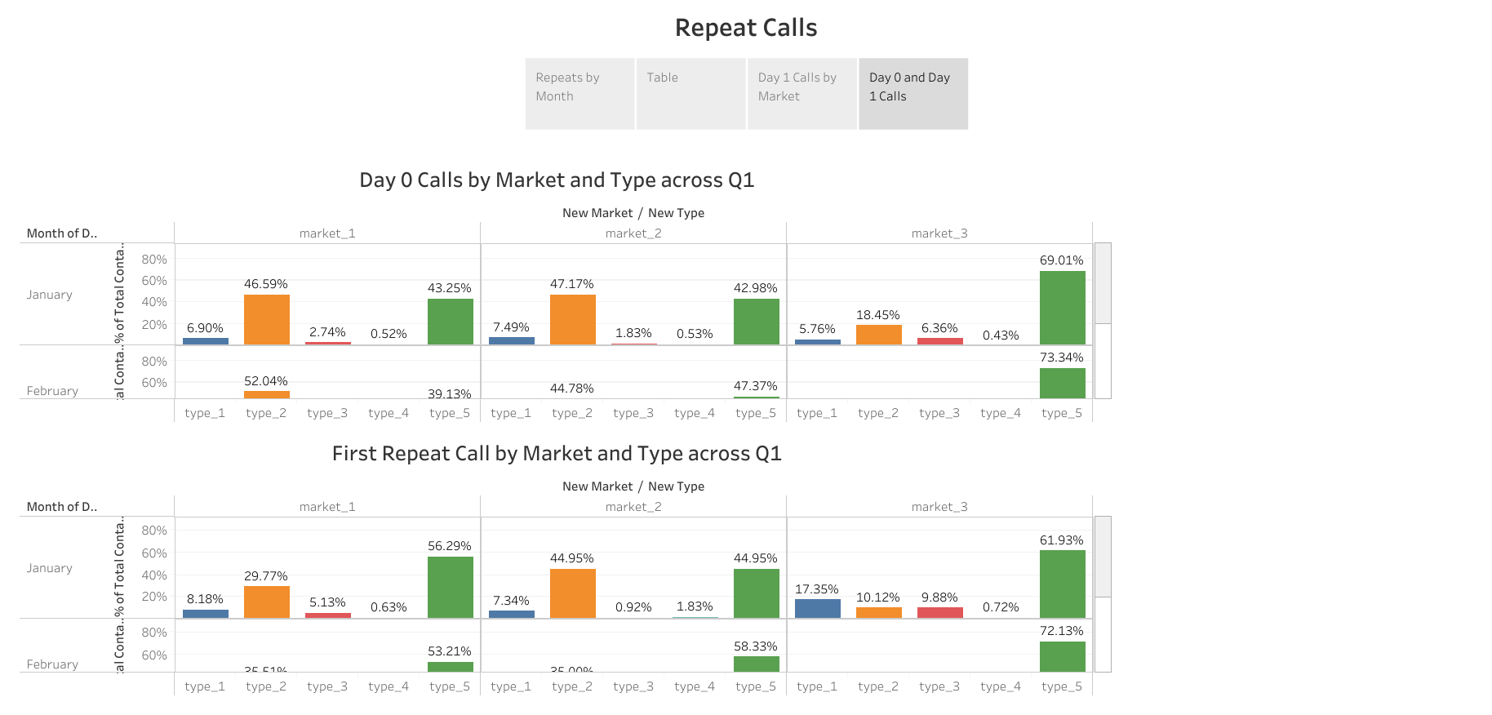
Day 0 & Day 1 Calls
Market 3 Anomaly:
While Market 3 has lower overall volume, its Type 5 calls represent a massive 69-73% of its total market activity.
Impact Analysis:
Type 5 issues consistently represent a larger percentage of "First Repeat Calls" than they do "Day 0" calls, indicating that Internet/Wi-Fi issues are the hardest to resolve on the first attempt.

