Slide 1

Rajalakshmi Institute of Technology

Slide 2
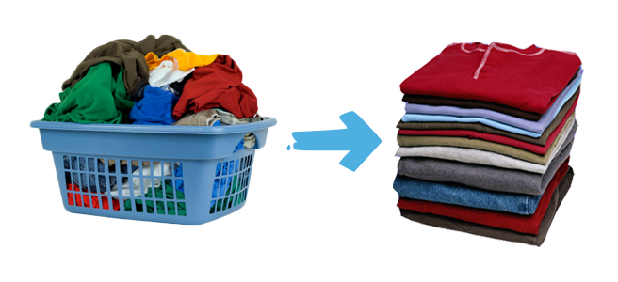
PEHAL
A LAUNDRY FACILITY

Slide 3


PEHAL when translated from पहल means an initiative.
Our Pehal aims to create a better, and a brighter future.
A future of promises instead of hope.

Slide 4

The Problem
We are students who live in hostel. We are going through the same problems that each of the hostellers has ever gone through: food issues, sanitation issues, home sickness, and many more to state. But, there is something else.
We also have a major issue.

Slide 5

The Laundry Crisis

Slide 6

The charges of the laundry are very high and unaffordable by almost every hosteller. We are charged Rs. 40/- for a salwar-kameez set, which most of us cannot afford. This happens to be the minimum laundry cost in most of the colleges in the city.

Slide 7
We have also identified another problem, a completely different one. Women on a daily basis are subjected to financial crisis, domestic violence, abuse, etc.
It is just because they do not know another alternative. They do not believe they can fend off for themselves without any help.
We give them a promise and an escape.

Slide 8

The Solution
We learnt that the women wanted to earn their own bread and support their families.
After closely analyzing the two problems we came up with a permanent solution.
What we need:
Laundry services
Affordable pricing
What the less-privileged women need:
Financial stability
Moral support

Slide 9

We aim to provide laundry facilities at the most affordable rates in the hostel, meanwhile providing around 10 under-privileged women a chance to stand on their own feet by presenting them with an opportunity to become masters of their own destinies.

Slide 10

Present Trends
According to the reports, when both the girls and boys hostel in a college are taken into consideration, the revenues generated in one month:
EARNINGS OF EACH WASHER, when we employ 20 washers would be around Rs. 5,000/-
The cost that has to be re-invested into the business (washing powder, buckets, brushes): Rs. 2,000/-
The net PROFIT of the organization: Rs. 6,000/-

Slide 11

These figures were calculated keeping both the students and the workers in mind and making our rate card very affordable and appealing.

Slide 12

Expansion and Sustainability
According to the shown trend, we plan to expand to other colleges on the Bangalore highway belt, after a year of our initiation when we have a stable profit base and understand the market trends.
Our next goal is to expand PEHAL to all the colleges in our belt, making it a high revenue generating business.
Eventually we wish to see, PEHAL as a successful dry cleaning start-up, with its branches all over Chennai.

Slide 13
Thank You

