Slide 1

We have only one passion,
The rise of a great Nation

Slide 2

NIRMAAN BKBIET
NIRMAAN succeeded in adding more people to a great cause of society upliftment, by starting a new chapter in BKBIET Pilani. This chapter started as an expansion team under NIRMAAN BITS in September, 2013 but became an official chapter of NIRMAAN in March, 2014.
Presently there are 3 running projects under this chapter:
UDAY: The Teaching Project
This project is focused on the migrating working labours at the construction site of the college and their kids
POSHAN: The Nourishment Project
This project is also focused on the kids of the labour and was started keeping in mind the adverse effects of malnutrition.
AMBEDKAR BASTI: The Community Project
This project is focused on the development of the nearby basti called the Ambedkar Basti.

Slide 3
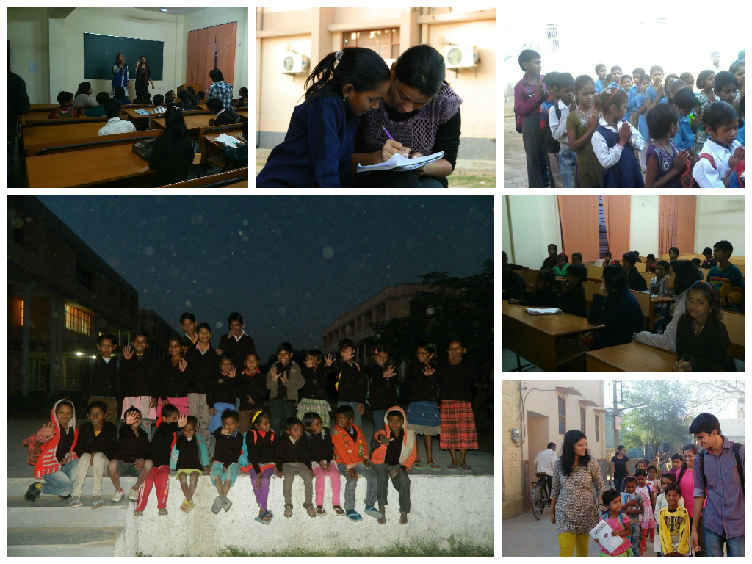
UDAY

Slide 4
UDAY
The Teaching Project
Objective
- Proper education to the kids of these labours so that they do not suffer in future like their parents and also to inculcate proper health, hygiene and moral values in both the parents and their children.
Ways Adopted
- Giving evening tuitions to the children in proper classrooms within the college itself.
- Providing them study material, stationary and small gifts to encourage them to give their best.
- Participation of children in the college fest to keep them ahead in extra curricular activities as well.
- Regular class tests and updating the parents about the progress to make them more responsible.
- Admission of the non-school going kids to the government school nearby.
-Providing them with stationary for school and transportation fees as well.
- Celebrating all the festivals with them so that they know the importance of all the festivals and socialism.

Slide 5
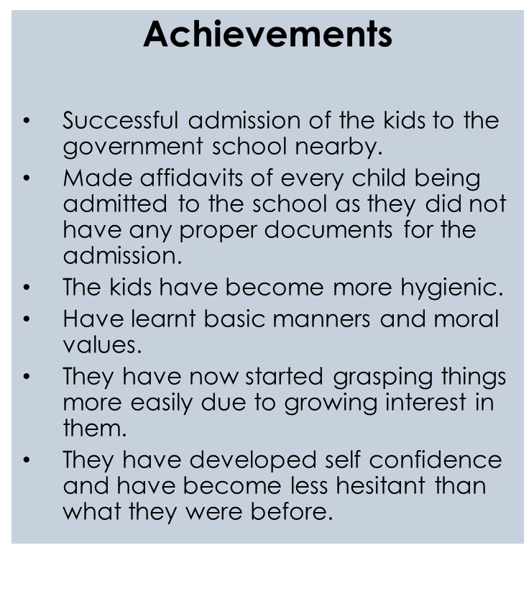

Slide 6
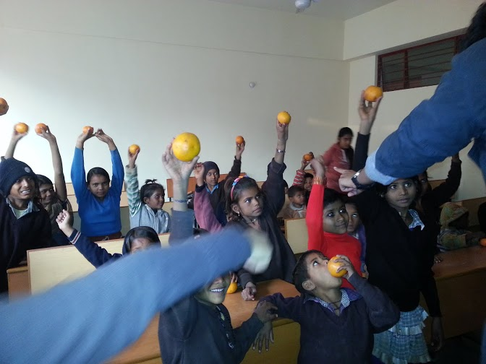
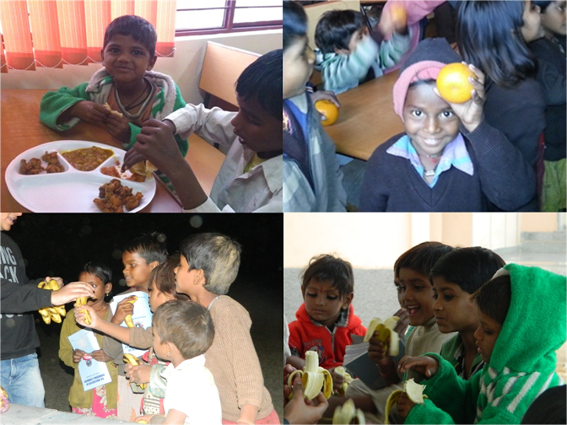
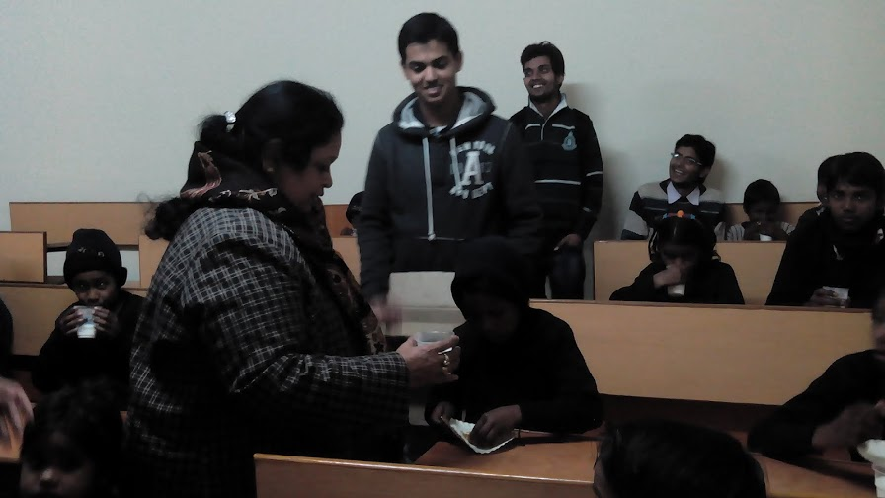
POSHAN

Slide 7
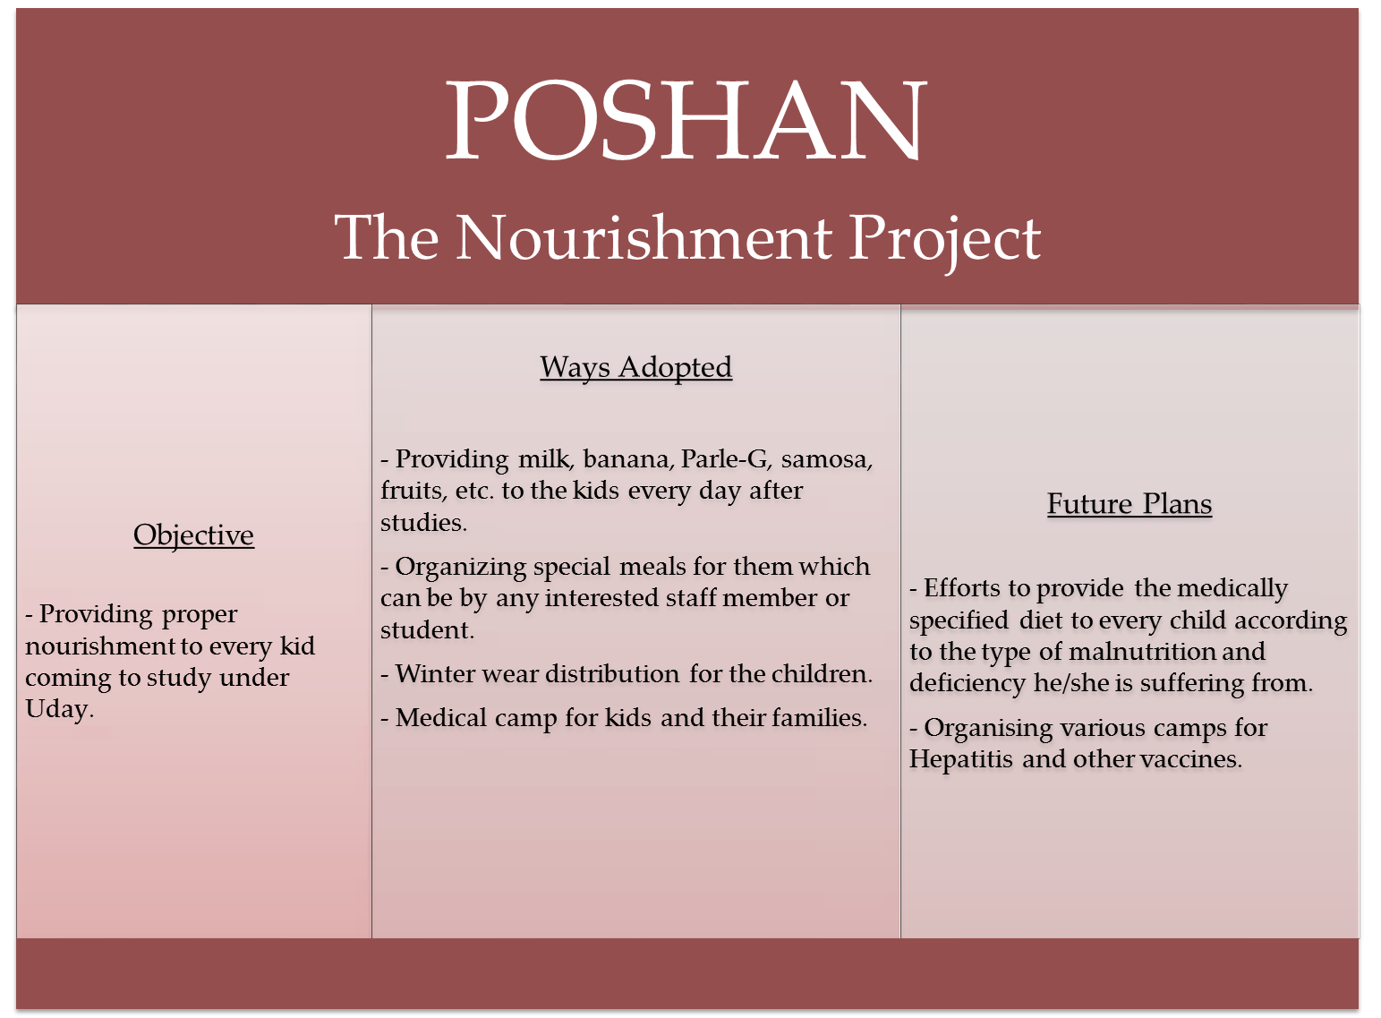

Slide 8
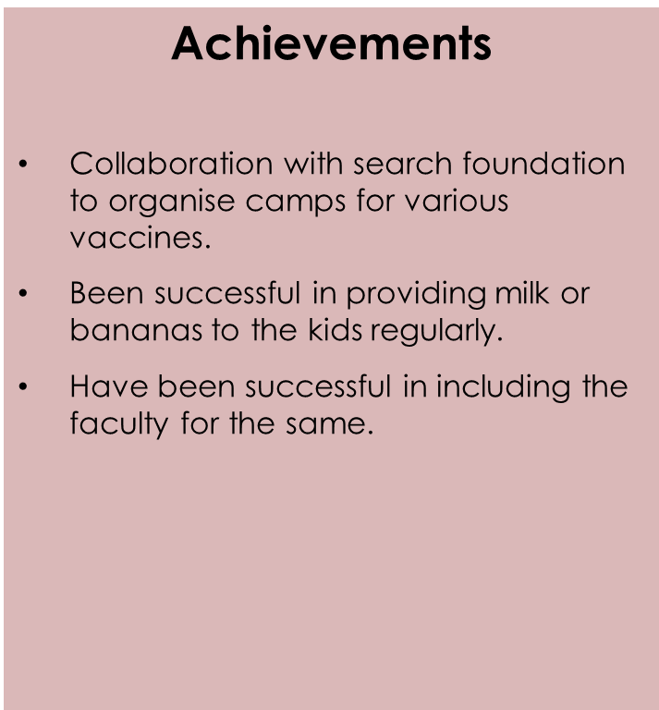

Slide 9
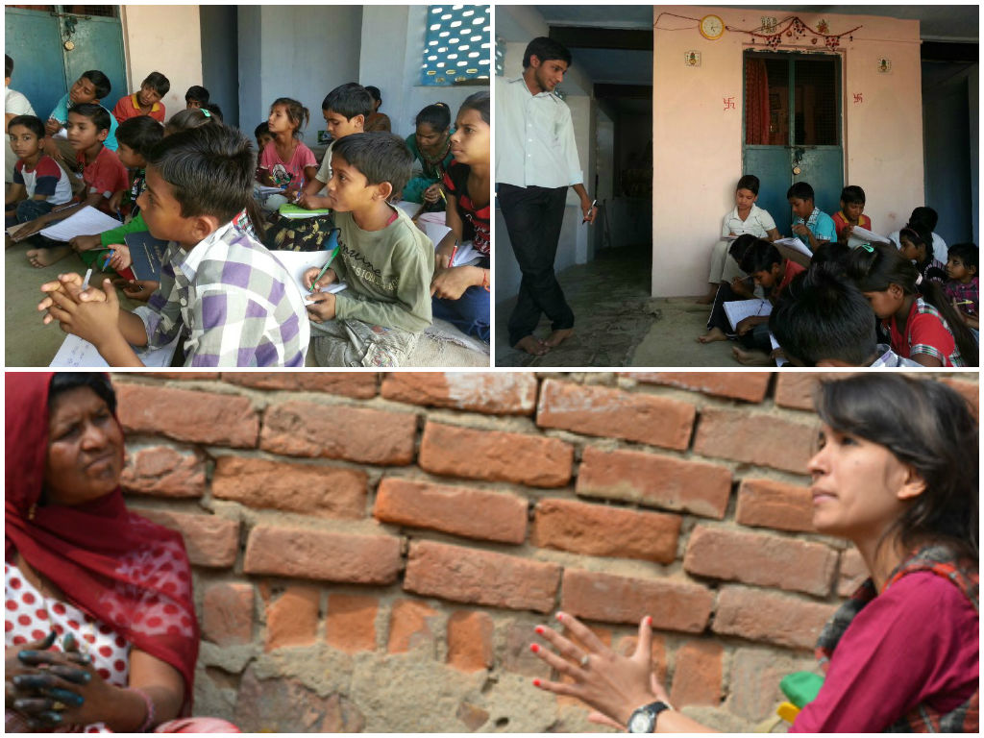
Ambedkar Basti

Slide 10
AMBEDKAR BASTI
The Community Project
Objective
- To make the community self sufficient and independent with proper roads, lights, water and education facilities.
Ways Adopted
- Adopted the PCD approach by interacting with the people through regular house visits to gain confidence.
- Giving evening tuitions to the kids, in the temple within the community.
- Encouraging parents to keep a track of the study of their children in school and protest against the teachers of the school for not teaching properly.
- Survey on what the working women of the community do and encourage the others to study..
Future Plans
-To organize more cultural activities in the community to interact more with the people.
- To get all the children to proper schools.
- To help the working women and expand their livelihood through a SHG centre.
- To work on the problems of dirty water supply and garbage dumping of the community.
NUMBER OF BENEFICIARIES= 35

Slide 11
ACTIVITIES
Cloth distribution.
Nanhi Udaan: An initiative to interact with community people.
Republic day and Independence day celebration.
Swatch Basti Abhiyan.
Anti Swine flu drop camp.
Basant Stalls
Rakhi Celeb.
Holi Celeb.
Teacher’s day celeb.
ICCS Stalls
Joy Of Giving Week.
Khel Mahotsav.
X- Mas Celeb and many more…..

Slide 12
“We have only one passion,
The rise of a great Nation”
www.nirmaan.org

