Slide 1
Ovation Test Presentation
This presentation will test several common slide formats (although many of them are also examples of what you shouldn’t do in a PowerPoint show).
The content of these slides is based upon real-world conditions.
All text should be crisp and clear, and all animations should be smooth, professional and non-distracting.
Be sure to add Walk-In, Title, Intermission and Walk-Out slides to your shows to test out the full capabilities of the themes!
Notes:
Let’s be sure to test some notes, too!
Here is my test presentation, and every Ovation theme should be able to gracefully handle just about everything in here (including the word “everything” as it is displayed in the teleprompter, because it is bolded, italicized and underlined!)
Ovation will turn your old, boring PowerPoint shows into bold and compelling presentations. The text will be clean and easily readable. Beautiful and exciting transitions between slide elements will capture your audience’s attention. And the Presenter interface will ensure that you stay on time and on point for your entire presentation.
With over 200 themes to choose from, you can be sure to find an Ovation environment to match your message. Ovation will come with color and complexity variations to suit any audience.
So, tell your friends about Ovation and have them sign up to be a Beta Tester. Just send them to:
www.seriousmagic.com/ovationbeta.htm

Slide 2
Lots of Bullets (26 to be exact)
This is the 1st bullet
This is the 2nd bullet
This is the 3rd bullet (making sense so far?)
This is the 4th bullet (and it should be bold!)
This is the 5th bullet (and it should be underlined)
This is the 6th bullet (and it should be italicized)
7th bullet (this is a good test of superscript text, too)
8th bullet
9th bullet
10th bullet
11th
12th
13th
14th
15th
16th (one of my favorite numbers)
17th
18th
19th
Twentieth
21st (I remember when I turned 21 <sigh>)
22nd
23rd
24th
25th
26th (can you see them all?)
Notes:
This slide tests Ovation’s ability to present a lot of text on a single slide.
This is normally not a good idea, because it makes it harder for your audience to read your words. But Ovation will shrink up the text so that it will still be clean and readable, even from across the room.
Bold Text
Underlined Text
Italicized text
Bold and Italic
Bold and Underline
Italic and Underline
Bold, Italic and Underline
Did the teleprompter in the Presenter tab show all of the above text properly?
Have you tried using the auto-scrolling feature of the teleprompter yet? It’s great if you want to read a script or need lots of cues during your presentation.

Slide 3
There is no Title on this slide. It tests margins and different levels of bullets.
Just a bunch of bullets (this line should be italicized, and the word “should” should be underlined).
I boldly hope they show up ok.
And these are numbered….
So you should see some numbered bullets
  This uses capital letters
  So does this
  And this, too.
  So this should be line D
    This is a Capital Roman Numeral bullet
    So is this…
      This is lower case roman numeral
      And this is too
      And this
      Do we handle ‘v’s?
        How about lower-case alpha bullets with a parenthesis?
        Hope so!
Back out to the main level
Line 4 here.
Notes:
This slide is for testing sub-bullets and making sure that all of them are properly tagged and indented, and that their text gets slightly smaller with each indentation level.
Here are some more notes:
After a few blank lines, here is some bolded text.
And here is some underlined text.
And here is some ugly italicized text.
Does the teleprompter show it all properly?

Slide 4
7 Long Bullets (Text Resizing)
This slide is certainly not very easy to love. There is waaay too much text all over this slide. Poor little text RenderEngine. It is sweating…
These bullets are very long and the lines should wrap around at least once or twice in most themes. Here is more than one sentence per bullet. Even though that is not recommended for a good presentation.
Just one sentence here.
We need to support long bullet points in Ovation. I thought Ovation was supposed to encourage better presentations. Do good presentations keep a slide to 3-5 bullets by making each bullet 1 page long?
Man, this presentation would either put me to sleep or fry my brain. Too much info on one slide, so I would either shut down or burn out. Can’t the presenter summarize these bullets and just put some of this info in their teleprompter notes?
I need to make this slide as long as possible to make sure I test the line wrapping and text resizing (when it’s available … it’s not in the product at this point.) Perhaps not having it encourages people to make smaller, more concise slides.
But then again, we need to make sure that someone who really has important things to say doesn’t feel cramped. So, we will support insanely long slides like this just to please such presenters (although their audiences won’t be as pleased)!
Notes:
This slide is similar to slide 2, except that now we’re talking about having to display a lot of text in a pretty small area.
Ovation will resize the text appropriately, and also make sure that it stays within the bounding area that the theme creates for it.
But, once again, remember that making this kind of slide is not a very good idea for your real-life presentations. Your audience will get frustrated or bored…or both! In your presentations, you can talk as long as you need to about any topic, but always make sure that only your key points are displayed in your show. This way, your audience will pay attention to you as you elaborate, and your presentation won’t have to do the talking for you.

Slide 5
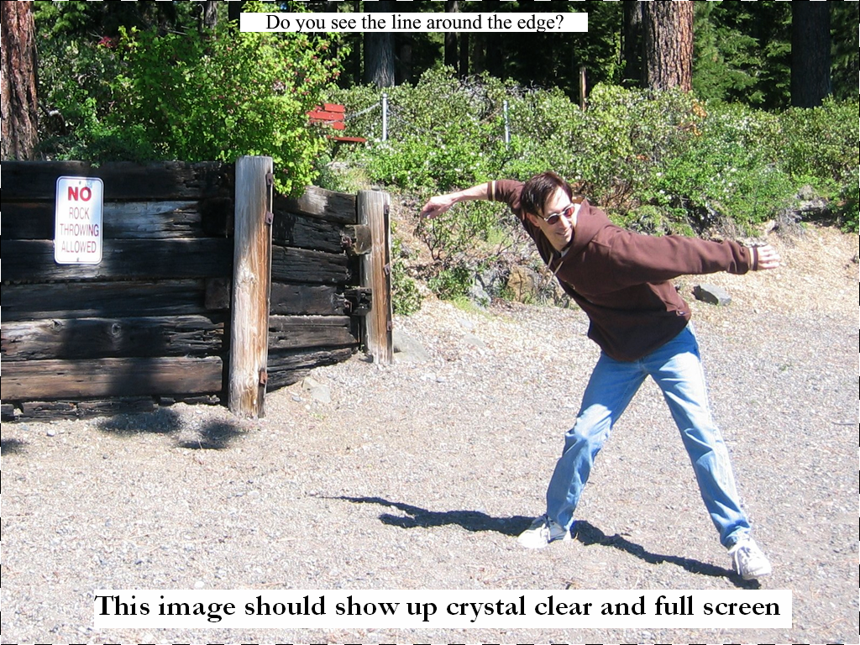
Notes:
This slide is for testing a full-screen image, which is a very common occurrence in a PowerPoint slide.
The image should be clean and clear on any display, and you should be able to easily see the black and white dotted line that surrounds the image. If you cannot see it, then there is likely something wrong with your computer display or your projector, so if there is a problem you should calibrate it right away. If, after aligning your display, you are still unable to see the dotted line, then it’s time to report a bug!
Remember to report bugs as soon as you find them, so they will be fresh in your mind and you won’t have to go back and remember how you got the bug to occur.

Slide 6
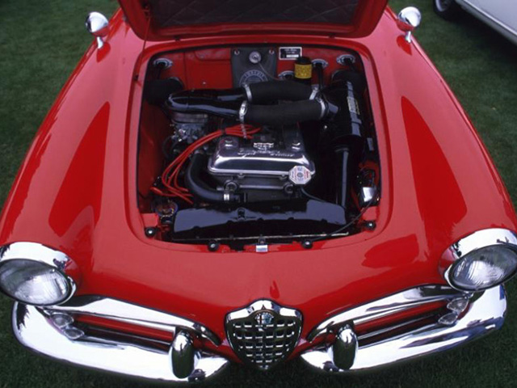
This slide has a Title and one Large Image
Notes:
This slide also tests a very common slide content organization – a title with a single image. The title should be displayed in the theme’s font treatment, and the image should be centered on the screen in the content area that the theme provides for it.
One other thing you should be looking for when testing is to make sure that all transitions (for individual slide elements as well as between slides) are smooth and not distracting. The point of Ovation is to enhance your presentation, and not distract from it.
Once again, the image should be clear, but in this case there is no dotted line around it.
Pretty Alfa Romeo, isn’t it? Anybody know what model it is?

Slide 7

Santa Cola
Merry Xmas Everybody! And to all a Good Night! Ho-ho-ho-ho!
Drink Coke! Leave the Milk for Santa! And the Cookies!
Ask Santa for Ovation! Remember, your friends might want a copy of Ovation, too!
Will this text run into Santa’s Head? It doesn’t in PowerPoint. So it shouldn’t in Ovation, right?
I think Santa might be in trouble, kids!
Notes:
This slide tests another relatively common slide orientation – a title, a single image, and some text surrounding or adjacent to the image.
The bulleted should wrap around the image (in this case, on the top and left) in a reasonable manner, such that the text and image do not overlap or even end up particularly close to each other.
Ovation will always try to place your content in such a way that is pleasing to the eye and fits in with the atmosphere of the chosen theme. Remember, it’s your message that is the most important thing!

Slide 8


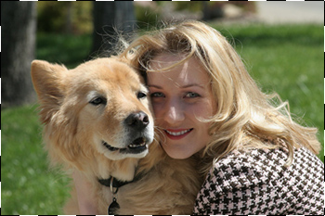
Ok, how about a slide to test the ppt layout
This slide is intentionally formatted horribly
  With some of the text under the pictures and some of it over the pictures.
  And lots of blank lines between bullets.
  Doesn’t matter, because 2+ pix will punt (and there are three on this page – in PowerPoint this text is on top of the blue picture but it is underneath the girl & dog picture).
  Look for the dashed lines around the edge of the girl and dog picture.
Notes:
This slide is a disaster. It is intentionally made in such a way that the text overlaps the three images and the overlap each other. Really ugly, right? Well, Ovation really doesn’t know what to do with this slide because, once again, it is your message that is most important.
So Ovation says “well, it must be that way for a reason”. Ovation has a display method that will display a slide’s content exactly as it is shown in PowerPoint if the slide’s content is laid out in a particularly bizarre manner. Ovation calls this the “PowerPoint layout”.
We also like to call this the “punt” method, in honor of the start of the football season.

Slide 9
“Shaded” Org Chart to test Auto Shapes
Big Large Boss
Medium Guy 1
Medium Guy 2
Medium Guy 3
Little Guy 1
Notes:
This, to many people, might simply be another test of a “title and one image” slide. However, this is not the case.
This is actually a test of Ovation’s ability to display something other than a slide or an image. PowerPoint provides many ways to display data. Graphs and charts are the most common after text and images. Ovation will “natively” import all data that isn’t text or an image, and then should display it exactly the way it looks in PowerPoint.
If you have some data that doesn’t look as good in Ovation as it does in PowerPoint, then please send us a bug report along with your presentation file so we can make sure that your data will look great with the final version.

Slide 10
Final slide (or is it?)
If you made it here
You didn’t break
Congratulations!
Don’t forget to test a Walk-Out Slide!
Notes:
Well, that’s it.
On behalf of the Ovation Development Team and all of us at Serious Magic, we thank you for all of your assistance and testing time. Thanks in part to your help, Ovation will be the next standard in presentation software and you will be proud to tell your friends that you saw it first!
Many thanks again,
The Serious Magic Team

