Slide 2
L-O-T-T-E-R-Y
The Game
Ramesh is a college student pursuing computer science and only has knowledge of programming in C language. In his summer holidays, he decides to use his skills and make some extra pocket money by setting up a shop in nearby fair (mela). The rules of the game are as follows :-
the player will enter 6 numbers between 1-40.
the system chooses 6 numbers of its own between 1-40.
more the numbers of matches between the two sets of numbers, bigger the prize.
NOTE: Available for people of all ages

Slide 3
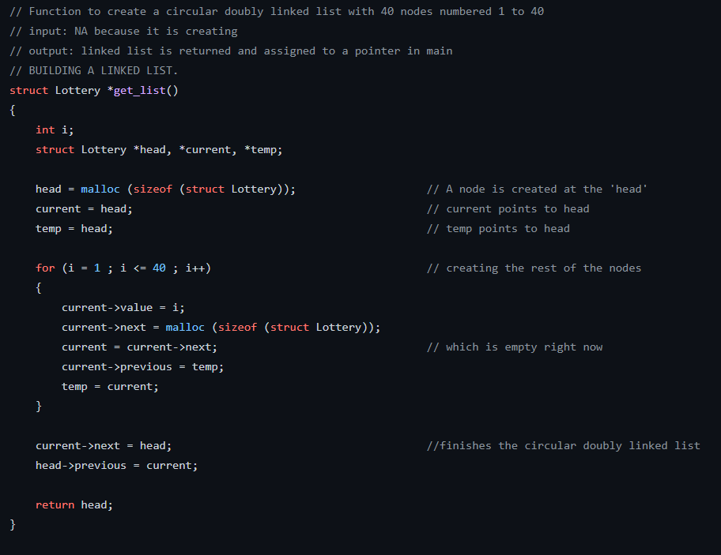
HOW IT WORKS
The program creates a doubly linked list and stores integer values from 1-40 in increasing order in the created nodes.

Slide 4
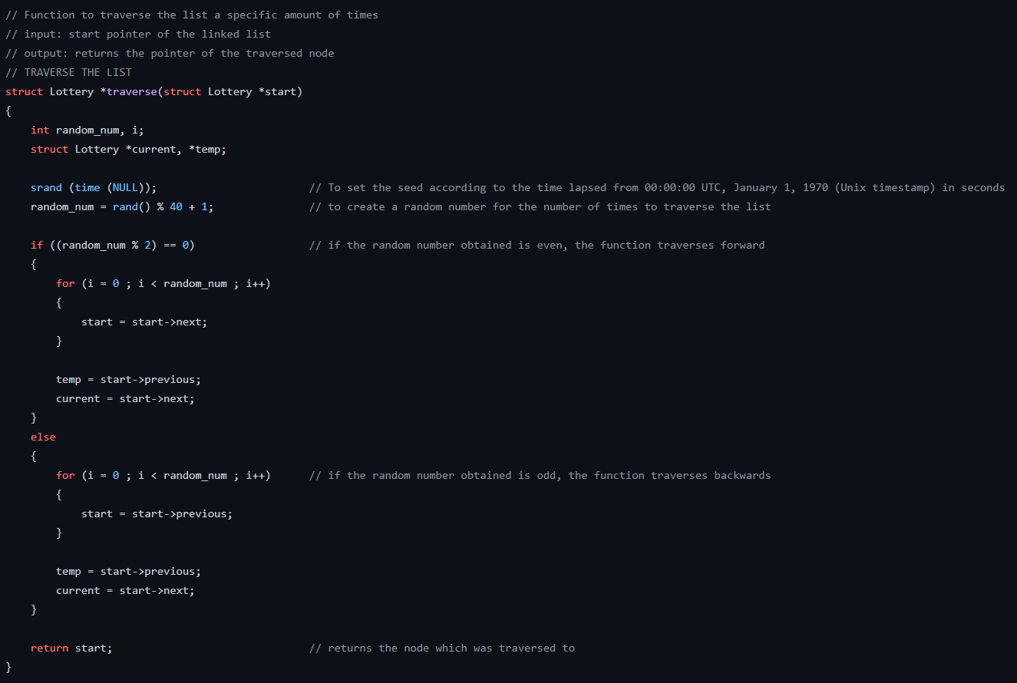
HEART OF THE PROGRAM
The program uses rand() function to draw a number between 1-40 randomly, say ‘n’ and traverses the list uptil nth node and returns the integer value stored in the node.
rand() function uses a starting value called ‘seed’ to return random numbers and if kept same, returns the same set of numbers for each run.
To Avoid this, the seed is set to change with changing time using the function
srand (time (NULL));

Slide 5
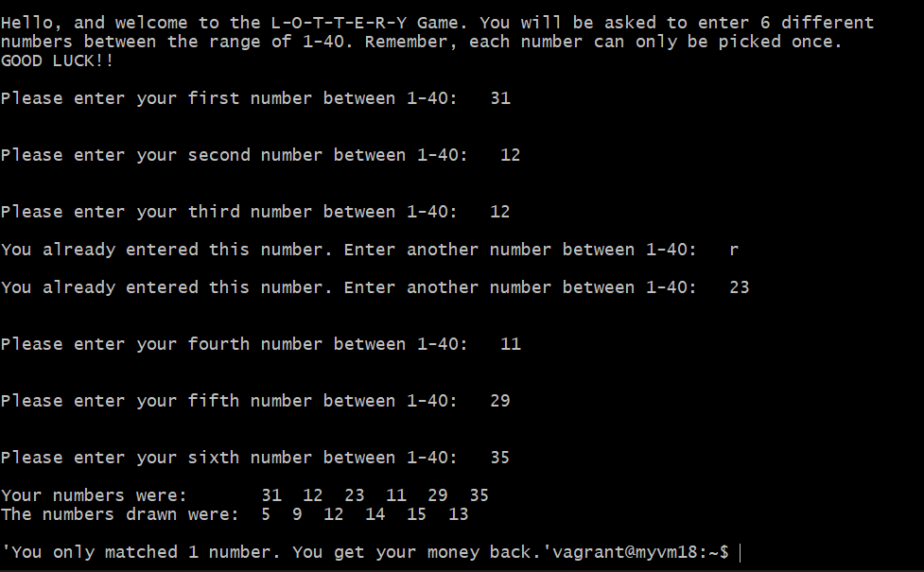
DEMO

