Slide 1
GDG CHENNAI · DEVFEST ROADSHOW #6
anomaly
The Millisecond
Mind
Giving AI agents a streaming reflex and an analytical brain on Google Cloud
T+0s
T+45s
Streaming reflex
Analytical brain
[Your Name] · [Role, Company] · 26 Sep 2026
Notes:
TIME: ~2 min (running total 2:00)
GOAL OF THIS SLIDE: Set the stakes. The audience should hear "agents are blind to the present" within the first 60 seconds.
SCRIPT:
"Good morning, Chennai! Quick show of hands: how many of you have built, or are building, something with an AI agent this year?
[pause, look around]
Keep your hand up if that agent reads live operational data. Not documents, not a wiki. Live data.
[most hands drop — that's the point]
That's the gap I want to talk about. We've gotten very good at agents that read PDFs. But drop an agent into a payment system, a fraud system, a live microservice, and feed it data from last night's batch job, and it's functionally blind.
Today I'll show you one way to give an agent two things: a streaming reflex, so it knows what's happening right now, and an analytical brain, so it can check that against historical truth before it acts. Everything runs on Google Cloud, and I'll show screenshots from a working version I built."
DELIVERY CUES:
- Do the hand-raise. It wakes the room and buys you 10 seconds to settle nerves.
- Point to the waveform: "That spike is our story today. By the end, you'll see what happens in the 45 seconds after it."
IF THE HAND-RAISE FLOPS: "No hands? Perfect — then this is the talk for you." Move on.

Slide 2




PART 1 · THE USE CASE
The RAG agent: great with documents
Documents
Why it works
policies, wikis, PDFs
The documents mostly hold still. A refund policy doesn't change while the agent is answering a question about it. Retrieval doesn't need to be fresh to the second — it needs to find the right passage.
Chunk + embed
text → vectors
Vector DB
SUM() ≠ cosine similarity
nearest-neighbor search
Ask it "what's our failure rate across APAC in the last 15 minutes" and it finds rows that sound like "failure". It cannot compute a SUM or a GROUP BY over your data. For numbers, you need SQL, not similarity search.
LLM answer
grounded in retrieved text
Notes:
TIME: ~1.5 min (running total 3:30)
GOAL: Establish common ground before contrasting with the live-systems problem. Most of the room has built or used a RAG agent; let them recognize it, then show its edge.
SCRIPT:
"Let's start with the agent pattern most of us have actually built: RAG, retrieval-augmented generation.
[Left] You take your documents — policies, wikis, PDFs — chunk them, turn each chunk into an embedding, a vector, and put those in a vector database. When someone asks a question, you find the nearest chunks by similarity and hand them to the LLM to answer from.
[Right, top] This works well for one big reason: the documents mostly hold still. A refund policy doesn't change while the agent is mid-answer. Retrieval doesn't need to be fresh to the second, it needs to find the right passage.
[Right, bottom] But it has a specific blind spot. Ask it a numeric, aggregate question — a failure rate, a sum, a trend — and it breaks down. Similarity search finds text that sounds related. It cannot compute a SUM or a GROUP BY. For numbers, you need SQL, not vectors.
So: great for static knowledge. Not built for live, numeric, operational questions. Keep that gap in mind — we're about to walk toward it."
WHAT YOU NEED TO UNDERSTAND (prep guide §2.9):
- Embedding: a piece of text converted into a list of numbers (a vector) such that semantically similar text ends up at nearby points. Cosine similarity measures the angle between two vectors — smaller angle, more similar.
- RAG's core assumption is that retrieval quality matters more than retrieval freshness. That's true for most document Q&A and false for live operational monitoring — which is exactly the pivot the next slide makes.

Slide 3


PART 1 · THE USE CASE
So point it at a database instead?
✗ NOT the production (OLTP) database
A heavy analytical query competes with real checkout traffic for the same rows
Its schema is internal app plumbing, not something built for a model to query safely
The blast radius of a bad generated query lands directly on production
✓ Use a data warehouse instead — but:
Loaded in batches
Or loaded live, but slow to query
Nightly ETL means the agent reasons about yesterday. A live outage isn't in its world yet.
Even with fresh data, an OLAP query typically costs a second or more per step. Too slow mid-incident.
2:05 PM payments failing. Last ETL: 2:00 AM. Agent: “All systems green.”
Notes:
TIME: ~2.5 min (running total 6:00)
GOAL: Walk the audience through the two obvious next ideas and show why each falls short, landing on the punchline that sets up the whole talk.
SCRIPT:
"So if a document-style agent can't answer live numeric questions, the obvious next idea is: point it at a real database.
[Top, OLTP] Not the production database. Not for obvious reasons, but worth naming them: a heavy analytical query run by an agent competes for the same rows real checkout traffic is using. The schema is internal app plumbing that was never designed for a model to query safely. And if the agent generates a bad query, the blast radius lands directly on production. Nobody wants an LLM anywhere near that.
[Middle] So the standard answer is: use a data warehouse, BigQuery, for analytics instead. Good instinct. But it fails in one of two ways.
[Card 1] Most warehouses are loaded in batches, nightly ETL. The agent is reasoning about yesterday. A live outage simply isn't in its world yet.
[Card 2] Or say you've solved that, and you're loading data continuously. You still have a cost problem: an analytical warehouse is built to scan a lot of data, and a query typically takes a second or more. An agent that reasons in multiple steps pays that cost on every step, right when speed matters most.
[Bottom bar, pause before reading] Here's what that actually looks like. 2:05 PM, payments failing. Last ETL: 2 AM. And the agent says... all systems green.
That gap — between what's happening right now and what the agent can see — is exactly what the rest of this talk closes."
WHAT YOU NEED TO UNDERSTAND (prep guide §2.1, §2.8):
- OLTP (online transactional processing) vs OLAP (online analytical processing): OLTP databases are tuned for many small, fast reads/writes (one checkout at a time); OLAP/warehouses are tuned for scanning large amounts of data for aggregates. Using one for the other's job is why this doesn't work well either direction.
- "Seconds per step": BigQuery is an OLAP engine. Even small queries carry job overhead, typically around a second or more. Fine for a dashboard a human refreshes; too slow for a tight reasoning loop.
- Batch vs streaming: batch processes accumulated data on a schedule; streaming processes each event continuously as it arrives. The rest of the talk is about building the streaming half properly.
DELIVERY CUE (the punchline bar): Your strongest hook — don't rush it. Pause before the line, then read it in three beats with a pause after each: "2:05 PM, payments failing." [pause] "Last ETL: 2 AM." [pause] "And the agent says... all systems green." Let it land for two full seconds.
CAREFUL: Say "typically" rather than a precise number for warehouse query latency — someone will have a sub-second BigQuery query thanks to caching or BI Engine.

Slide 4
WHAT WE'LL COVER
Agenda
01
The use case
RAG, OLTP and the warehouse gap — just covered
02
The mental model
Reflex vs. reflection, rules vs. judgment, and a System 1 model
03
The reflex
A streaming pipeline: Pub/Sub, Apache Beam, sliding windows, a fast state store
04
The brain
Gemini + BigQuery: grounded tools, function calling, self-healing SQL
05
Putting it together
A worked incident timeline, and what I actually built for this talk
06
Before you ship
Four guardrails for autonomous data agents
Notes:
TIME: ~0.75 min (running total 6:45)
GOAL: Orient the room quickly. This slide is a map, not content — move fast.
SCRIPT:
"That was the problem. Here's the map for the rest of the talk, and the numbers match the part labels you'll see top-left on every slide. We'll start with the mental model that shapes every design choice today. Then build the reflex, the streaming side. Then the brain, the reasoning side. Then put it together with a worked incident and show you what I actually built. And close with the guardrails you need before any of this goes near production."
DELIVERY CUE: This slide should take well under a minute. Don't explain each row in depth — you're about to spend the next 30 minutes doing that. Just point and move.

Slide 5


PART 2 · THE MENTAL MODEL
Reflex vs. reflection
REFLEX · fast path
REFLECTION · slow path
Always on; reacts in seconds
Filters noise into live state
Answers: what is happening right now?
Woken on demand; takes its time
Computes exact answers over history
Answers: is this normal? what do we do?
wakes
Pub/Sub → Dataflow → key-value store
Gemini + BigQuery
Analogy: a reflex pulls your hand off the hot stove; reflection works out why the stove was on (Kahneman's fast System 1 vs. deliberate System 2).
Notes:
TIME: ~2.5 min (running total 9:15)
GOAL: Give the audience ONE mental model they'll remember and that explains every design decision later.
SCRIPT:
"Here's the mental model for the rest of the talk. Touch a hot stove, and your hand pulls back before you've consciously thought anything. That's a reflex: fast, always on, cheap. Later, you think it through: why was the stove on, who left it, does this happen often? That's reflection: slow, deliberate, and it uses memory.
Psychologist Daniel Kahneman called these System 1 and System 2 thinking. We'll build both.
[Left] The reflex is a streaming pipeline. Pub/Sub and Dataflow run all the time, squeeze millions of raw events into a small live picture, and notice when something crosses a line.
[Right] The reflection is an agent: Gemini, with tools to query BigQuery. It doesn't run all the time. The reflex wakes it up. Then it takes the time to check history and do exact math before acting.
[Arrow] The key design choice: the fast system wakes the slow system. The LLM never watches the raw firehose."
WHAT YOU NEED TO UNDERSTAND (prep guide §2.13):
- Kahneman's System 1 is fast, intuitive thinking, not literally the spinal reflex. The stove story is an analogy stacked on top. If anyone pushes, say: "Fair — the spinal reflex is the vivid version; Kahneman's point is the same split between fast-and-cheap vs slow-and-careful."
- Why this split matters in engineering: LLM calls are slow (seconds) and cost money per token. A streaming pipeline is cheap per event. So you let the cheap thing watch everything and call the expensive thing only when needed.
TRANSITION: "Before we build the fast side, one design choice worth making explicit: how does a reflex decide something is wrong?" (leads into the next slide, Rules or judgment)

Slide 6


PART 2 · THE MENTAL MODEL
Rules, or judgment?
The reflex layer has to decide: is this an anomaly? Two ways to answer that.
DETERMINISTIC
FUZZY / PROBABILISTIC
code, not a model
a narrow, fast model
if error_rate >= 0.20: alert
Exact, explainable, cheap
Great when the line between OK and not-OK is genuinely a clean threshold
“given this pattern, 0.86 probability of a real anomaly”
Handles context a hard threshold can't: is this Tuesday's flash sale, or a real outage?
Needs a model built for fast, calibrated judgment — not a full conversational LLM
Notes:
TIME: ~1.75 min (running total 11:00)
GOAL: Go one level deeper on the reflex you just introduced: how does it decide? Don't over-claim: this pipeline, as built today, is fully deterministic. The fuzzy side is a "worth knowing about" category, not something in the live demo.
SCRIPT:
"So the reflex watches everything. But how does it decide something is actually wrong?
[Left] The straightforward answer, and the one I used, is deterministic: a plain threshold in code. Error rate crosses 20%? Alert. It's exact, it's explainable to anyone who reads the code, and it's nearly free to run. When the line between fine and not-fine is genuinely a clean number, this is the right tool, don't reach for a model.
[Right] But not every judgment is a clean threshold. Is a spike during a Tuesday flash sale actually abnormal, or just Tuesday? That's contextual, fuzzy. There's a growing category of models built specifically for this: fast, narrow, and instead of generating text, they return a calibrated probability. Not a chatbot, a judgment engine. A System 1 you can actually call.
My pipeline today uses the deterministic side, on purpose, because I can test it and explain it to you in one line. But this fuzzy category is worth knowing about, and there's a brand-new example."
WHAT YOU NEED TO UNDERSTAND (prep guide §2.15):
- "Calibrated probability" means: when the model says 80% confidence, it's actually right about 80% of the time across many predictions, not just a number that sounds right on any one case.
- This slide builds on the previous one: reflex vs. reflection named the split; this slide asks how the fast side makes its call. The next slide (Jev) gives a concrete, very recent example of the fuzzy option.
- Be honest if asked: "Does your pipeline use one of these?" No — the demo's threshold is deterministic. This is presented as an emerging option for the reflex layer, not a claim about what's already built.

Slide 7
PART 2 · THE MENTAL MODEL
A concrete example: Jev
TypeSafe AI's Jev — a “System One Model”
Where it could fit here
Announced Sept 15, 2026. First model in a category TypeSafe coined themselves — literally named after Kahneman's System 1.
Instead of a hard-coded threshold, ask a System 1 model:
“Given this window's pattern, is this a real anomaly?”
→ a calibrated probability, in well under 500ms, at a fraction of an LLM call's cost.
Input
Program state + a set of typed questions (boolean, score, or a choice among up to 255 options)
Output
Calibrated probabilities for every question, in one parallel pass — no generated text
Speed
70–500 ms, 32K context — roughly two orders of magnitude cheaper than a frontier LLM for this job
Not in my build. Weeks old — worth watching, not yet proven at scale.
Not for
Chat, code, or anything needing a written explanation
Notes:
TIME: ~1.75 min (running total 12:45)
GOAL: Make the "fuzzy System 1" idea concrete without overselling it. This is a real, very recent example, but it's not part of the working demo — be explicit about that so you keep credibility.
SCRIPT:
"So who actually builds these fast, narrow judgment models? Here's one, and it's brand new. TypeSafe AI, a startup founded by an ex-OpenAI researcher, came out of stealth about ten days before this event with a model called Jev. They call it a 'System One Model' — they're deliberately borrowing Kahneman's term.
Here's what it does differently from a normal LLM. Instead of generating text, you give it your program's state and a set of typed questions, boolean, a score, or a choice among up to 255 options, and it returns calibrated probabilities for all of them in one pass. No text to parse. TypeSafe claims 70 to 500 millisecond responses and roughly two orders of magnitude lower cost than a frontier model, for exactly this kind of repeated, narrow decision.
[Point right box] So in our architecture, instead of a hard-coded 'error rate above 20%' rule, you could ask a model like this: 'given this window's pattern, how likely is this a real anomaly?' and get back a number you can act on, fast and cheap.
[Point red box] To be upfront: this is not in the pipeline I actually built and I'm demoing today. It's ten days old as of this event. I'm showing it because it's a concrete, real example of the fuzzy side of the split we just drew, not because I'm recommending you bet production on it yet.
Now let's build the whole thing."
TRANSITION: the last line above leads straight into the architecture slide.
WHAT YOU NEED TO UNDERSTAND (prep guide §2.16):
- Jev's inventor, Diogo Almeida, was a co-inventor of RLHF (reinforcement learning from human feedback) at OpenAI — worth mentioning only if asked who's behind it.
- "System One Model" is TypeSafe's own coined category name, not an industry-standard term yet. Say "they call it" rather than presenting it as established vocabulary.
- The comparison point that matters for your architecture: a threshold rule can't weigh context (is this Tuesday's flash sale normal?); a full LLM call could, but costs seconds and real money per judgment; a narrow model like Jev is aimed at exactly the gap between those two.
IF ASKED "have you tried it / does it actually work well?": "I haven't tested it myself, it's very new. I'm flagging it as a category to watch, not making a claim about how well it performs." Never bluff enthusiasm you don't have evidence for.
IF ASKED "isn't this just classification / anomaly-detection ML, dressed up?": Fair challenge. The pitch is less about the underlying technique and more about the packaging: typed multi-question API, calibrated probabilities, and speed/cost aimed squarely at high-volume repeated decisions inside an application — rather than a general-purpose classifier you'd have to build and host yourself.

Slide 8
PART 3 · THE BLUEPRINT
A nervous system on Google Cloud
writes state
Checkout services
Cloud Pub/Sub
Dataflow (Beam)
Bigtable / Redis
raw telemetry
shock absorber
window · compact · detect
live state, ms reads
breach → alert wakes agent
agent reads state
On-call engineer
Action
Gemini agent
BigQuery
gets a verified report
reroute · notify
Cloud Run · tool calls
history · ground truth
SQL via function calls
Dataflow also streams raw events into BigQuery, so the agent's history stays current.
Notes:
TIME: ~2.5 min (running total 15:15)
GOAL: One picture the audience can photograph. Walk it left-to-right on top (the reflex), then bottom (the reflection).
SCRIPT:
"Here's the whole system on one slide. Top row is the reflex; bottom row is the brain.
[Top, left to right] Checkout services emit events: every payment attempt, which gateway, success or error, latency. They publish into Cloud Pub/Sub, which absorbs spikes. Dataflow, running Apache Beam, reads that stream, groups it into short time windows, squeezes it into per-gateway summaries, and checks thresholds.
[Point to the 'writes state' arrow] Every few seconds, Dataflow writes the latest summary for each gateway into a fast key-value store, Bigtable or Redis. That happens all the time, alert or no alert.
[Point to the vertical arrow] Separately, when a summary crosses a threshold, say error rate above 20%, Dataflow publishes a small alert message to Pub/Sub, and that triggers the agent on Cloud Run through Eventarc or a push subscription. So Dataflow does two different things: it keeps the state fresh, and it rings the doorbell.
[Point to the diagonal arrow] The agent wakes up and its first move is to read the live state from Bigtable. Instant.
[Bottom] Then it uses function calling to query BigQuery for history. If the evidence says 'real outage', it takes a bounded action, like rerouting traffic, and sends a verified report to a human.
[Caption] Dataflow also streams the raw events into BigQuery, so history is always fresh. Two stores, two jobs: one for speed, one for truth."
WHAT YOU NEED TO UNDERSTAND (prep guide §2.2–2.8):
- Pub/Sub: managed message queue. Producers publish to a TOPIC; consumers read through a SUBSCRIPTION.
- Dataflow = Google's managed runner for Apache Beam pipelines. Beam is the programming model; Dataflow runs it at scale.
- Cloud Run: runs a container on demand; scales to zero when idle. Eventarc or a Pub/Sub push subscription can trigger it.
- Why two stores? BigQuery is optimised for scanning lots of data; Bigtable/Redis for reading one key instantly.
- The three flows people mix up: (1) Dataflow WRITES state continuously; (2) Dataflow EMITS an alert only on breach, which triggers the agent; (3) the agent READS state after waking. Say these three verbs clearly and the diagram will make sense to everyone.
LIKELY QUESTION: "Why wake Gemini on Cloud Run via an alert, instead of doing it all inside Dataflow, or with a BigQuery continuous query?"
ANSWER: "Because they're different kinds of work. Counting and threshold checks are deterministic, so they belong in the stream, where they're cheap and run in seconds on every event. The LLM is reserved for the non-deterministic part that only happens on an alert: deciding if this is abnormal, choosing which history to query, checking alternatives, and acting within guardrails. You could call a model from inside the pipeline or from SQL, but you'd be making a single stateless call per row or window. You'd lose multi-step tool use, retries, and a place to enforce action guardrails. And a separate agent service can be deployed, versioned, and rate-limited on its own." (Full answer: prep guide Q&A #18.)
HONESTY NOTE: In your demo build, Redis stands in for Bigtable and a local subscriber script stands in for Cloud Run. Say so on slide 20 (the stack bar), not here — keep this slide about the production design.

Slide 9



PART 3 · THE REFLEX
Ingestion: Pub/Sub as the shock absorber
Decouples producers from consumers
checkout-svc
Services publish and move on. Processing can slow down or restart without losing events.
payments-svc
topic
Absorbs bursts
payment-events
cart-svc
Failures arrive as a flood, not a trickle. Pub/Sub buffers and scales with no servers to manage.
fraud-svc
Validates at the door
subscription → Dataflow
Topic schemas (Avro / Protobuf) reject malformed messages before they reach the pipeline.
Watch out: delivery is at-least-once. Expect duplicates and make downstream steps idempotent.
Notes:
TIME: ~1.5 min (running total 16:45) — keep this one brisk, it's the most familiar part for this crowd. If asked about duplicates, use the dedup bullet below.
SCRIPT:
"Every streaming system lives or dies at ingestion. When a gateway starts failing, error events don't trickle in, they flood in.
Pub/Sub is the shock absorber. Checkout services publish and move on. If our pipeline is slow or restarting, messages wait in the subscription instead of being lost.
It scales without you managing any servers. And you can attach a schema to the topic, so malformed messages are rejected at the door instead of poisoning the pipeline.
[Callout] One gotcha: Pub/Sub delivers at least once. You will occasionally get duplicates. Design every downstream step so processing the same event twice doesn't break anything. That's called idempotency."
WHAT YOU NEED TO UNDERSTAND (prep guide §2.2):
- Topic vs subscription: a topic is where messages are published; each subscription gets its own copy of every message. Two subscriptions = two independent consumers.
- Ack: a consumer acknowledges a message after processing. Unacked messages are redelivered — that's why duplicates happen.
- Ordering: Pub/Sub does NOT guarantee order by default. You can enable ordering keys (order within a key). This is why Beam uses event timestamps, not arrival order (next-but-one slide).
- Pub/Sub has no "partitions" you manage (unlike Kafka). Don't say "partition auto-scaling" — someone from a Kafka background will catch it.
- How duplicates are handled in practice: Dataflow deduplicates Pub/Sub redeliveries using each message's Pub/Sub message ID. If the PUBLISHER might send the same event twice (e.g. a client retry), give each event its own ID in a message attribute and pass it as id_label to ReadFromPubSub; Dataflow then deduplicates on that ID too. For anything else, design sinks to be idempotent (next bullet). Beam's stateful processing can dedupe by key if you need full control.
- Idempotent = doing it twice has the same effect as doing it once. In our demo: writing "latest state" to a key is naturally idempotent; alerts use a cooldown key so duplicates don't page twice.

Slide 10
PART 3 · THE REFLEX
Never stream raw logs into an LLM
{"ts":"14:02:29.981","gw":"FastPay","status":"504"...
{"ts":"14:02:29.983","gw":"FastPay","status":"504"...
{"ts":"14:02:29.984","gw":"SecurePay","status":"OK"...
{"ts":"14:02:29.986","gw":"FastPay","status":"OK"...
{"ts":"14:02:29.990","gw":"FastPay","status":"504"...
{"ts":"14:02:29.991","gw":"QuickPay","status":"OK"...
{"ts":"14:02:29.993","gw":"FastPay","status":"504"...
{"ts":"14:02:29.994","gw":"FastPay","status":"502"...
{"ts":"14:02:29.997","gw":"SecurePay","status":"OK"...
{"ts":"14:02:29.998","gw":"FastPay","status":"504"...
{"ts":"14:02:30.001","gw":"FastPay","status":"504"...
{"ts":"14:02:30.003","gw":"SecurePay","status":"OK"...
{"ts":"14:02:30.004","gw":"FastPay","status":"504"...
{"ts":"14:02:30.006","gw":"FastPay","status":"504"...
{"ts":"14:02:30.009","gw":"QuickPay","status":"OK"...
{"ts":"14:02:30.011","gw":"FastPay","status":"504"...
{"ts":"14:02:30.012","gw":"FastPay","status":"OK"...
{"ts":"14:02:30.015","gw":"FastPay","status":"504"...
{"ts":"14:02:30.017","gw":"SecurePay","status":"OK"...
... 14,181 more in this window
{
"window_end": "14:02:30Z",
"gateway": "FastPay",
"sample_size": 14200,
"error_rate": 0.784,
"top_error": "504_TIMEOUT",
"p95_latency_ms": 4820
}
window +
combine
14,200 → 1
events in, one ~200-byte summary out, every few seconds
Notes:
TIME: ~2.5 min (running total 19:15)
GOAL: This is your most quotable idea. Slow down. Let the left box "feel" noisy before you reveal the right.
SCRIPT:
"If you remember one rule from this talk, make it this one: never stream raw logs into an LLM.
[Left] This is one minute of payment events. Fourteen thousand of them. If you send this to a model, three things happen: you hit rate limits, you pay for every token, and the model drowns in noise. Models are bad at counting across thousands of lines anyway.
[Right] This is what we send instead. Beam groups the events by gateway and by a time window, and boils each group down to a handful of numbers: how many events, error rate, the most common error, and the 95th-percentile latency.
Fourteen thousand events in. One small summary out. The data engineering pipeline has done the counting. The model only has to reason about it.
That, to me, is the new job of data engineering in the AI era: turning noise into small, trustworthy facts that a model can use. I call it semantic compaction."
WHAT YOU NEED TO UNDERSTAND (prep guide §2.4, §2.5):
- Combine / aggregate: Beam's CombinePerKey groups elements by key (gateway) and reduces them with a function you write (count, sum errors, compute percentile).
- p95 latency: sort all latencies in the window; the value 95% of the way up. "95% of payments were faster than this." Better than average, because averages hide the slow tail.
- "Semantic compaction" is a phrase for the idea, not an official product term. Say "I call it", as the script does.
- The ~200-byte size is realistic for that JSON. Earlier drafts said "high-entropy" summary — avoid that phrase; "information-dense" is the accurate way to say it.

Slide 11
PART 3 · THE REFLEX
Sliding windows & watermarks
Each bar is a 60 s window. A new one starts every 5 s, so every event counts in 12 windows.
Watermark: Beam's estimate that data up to here has arrived
14:01:00
14:01:40
14:02:20
14:03:00
● late event: happened 14:01:12, arrived ~90 s later, still counted in the right windows
Event time ≠ processing time
Watermark
Allowed lateness
When it happened vs. when we saw it. On processing time, a backlog flush looks like a fake spike.
Beam's moving estimate of “input complete up to T”. A window's result fires once the watermark passes its end.
Stragglers within the limit update the result. Later ones are dropped; malformed ones go to a dead-letter path.
Notes:
TIME: 2.5 min HARD CAP (running total 21:45). Checkpoint: advance to slide 12 by 21:45 on your timer.
GOAL: Show you understand streaming properly, without turning it into a lecture. This slide is dense; its job is to earn trust, not to teach all of Beam. Everything under "ONLY IF ASKED" below stays out of the talk.
TIME BOX:
- Bars (sliding windows): ~20 s
- Red dot + outage story: ~50 s. The story is 4 sentences. Don't embellish.
- Watermark: ~30 s
- Cards (trigger + lateness + dead letter): ~40 s
If you're running behind when you reach this slide, skip the outage story entirely; the red-dot sentence alone makes the event-time point. Slide 16 (the timeline) is worth more than this slide. Protect it.
SCRIPT:
"How does Beam compute that summary correctly? Time in distributed systems is messy.
[Bars] We use sliding windows: the last 60 seconds, recomputed every 5 seconds. The reflex updates every 5 seconds but smooths over a full minute, so one bad second doesn't cause panic.
[Red dot] Events arrive late. This red one happened at 14:01:12 but reached us 90 seconds later.
[Outage story, exactly four sentences] Here's why that matters for alerting. Say a network link drops for two minutes and then recovers. Two minutes of backlog arrives in one burst. Group by arrival time and that burst looks like a spike, and you page someone for an outage that never happened.
So Beam groups by event time: when it actually happened.
[Dashed line] How does Beam know a window is finished? It tracks a watermark: a moving estimate of 'I've probably seen everything up to here.' When the watermark passes the end of a window, Beam emits the result.
[Cards] For stragglers after that, we allow two minutes of lateness: the window fires again with a corrected number. Anything later is dropped. And messages we can't even parse go to a dead-letter path, so one bad message never crashes the pipeline."
WHAT YOU NEED TO UNDERSTAND (prep guide §2.3):
- Fixed (tumbling) windows: back-to-back, no overlap (e.g. each minute). Sliding (hopping) windows: overlap (60 s long, every 5 s). Session windows: grouped by gaps in activity.
- Triggers decide WHEN a window emits. Default: once at the watermark, then again for late data if lateness is allowed. Written out explicitly in Python: trigger=AfterWatermark(late=AfterCount(1)) with allowed_lateness=Duration(seconds=120) in beam.WindowInto. (Java calls it withAllowedLateness; in Python it's the allowed_lateness argument.)
ONLY IF ASKED (don't present these):
- Accumulation mode: DISCARDING (default) means a late firing contains only the new late elements; ACCUMULATING means each firing re-emits the full, updated window. For an always-overwrite state store, accumulating is the cleaner choice in production; the demo's minimum-sample check covers the discarding case.
- Early firings: you can also emit speculative results before the watermark, e.g. AfterWatermark(early=AfterProcessingTime(10)), trading accuracy for speed.
- A late firing might contain only a few events. In the demo code, the alert requires a minimum sample size so a 3-event late pane can't trigger a false alarm. Good Q&A material.
- Dead-letter queue (DLQ): a side path for messages that failed processing (e.g. bad JSON). It's for malformed data, not for late data — keep those two ideas separate.

Slide 12
PART 3 · THE REFLEX
The reflex store: live state in milliseconds
BigQuery query
~2,000 ms
key gw_state:FastPay
value {latest window JSON}
ttl 5 min
Relational query
~200 ms
Dataflow overwrites the latest window every 5 s
The agent's first read is instant: no warehouse round-trip
Bigtable at scale; Redis / Memorystore for small, hot state
Bigtable point read
~6 ms
Redis / Memorystore
~1 ms
Typical orders of magnitude, log scale. Not a benchmark.
Notes:
TIME: ~2 min (running total 23:45)
SCRIPT:
"Once Dataflow has a summary, where does it go? Not only to BigQuery.
[Chart] Look at the scale. It's logarithmic: each step is ten times bigger. A key-value read from Redis or Bigtable is around a millisecond to single-digit milliseconds. A BigQuery query is typically a second or more. BigQuery is built to scan terabytes; it's not built to answer 'what's the current value for this one key' a thousand times a second.
[Right] So Dataflow keeps one key per gateway, gw_state:FastPay, and overwrites it with the latest window every five seconds. When the agent wakes up, the first thing it reads is already there. No waiting. It starts the investigation already knowing the current error rate.
Bigtable is the choice at large scale. For small, hot state like this, Memorystore for Redis works well too, and it's what I used in my build."
WHAT YOU NEED TO UNDERSTAND (prep guide §2.6):
- Point read = fetch one row by its key. Key-value stores are designed for this.
- TTL (time to live): the key expires automatically. If the pipeline dies, stale state disappears instead of lying to the agent. Good answer if asked "what if the pipeline stops?"
- Bigtable row-key design matters at scale: for time-series you'd use keys like gateway#reversed_timestamp so the newest rows sort first. Mention only if asked.
- The chart numbers are ballpark, labelled as such. If someone says "my BigQuery query takes 300 ms": "Absolutely — with cache or BI Engine it can. The point is the order of magnitude and the variability."

Slide 13
PART 4 · THE BRAIN
Gemini + BigQuery: tools, not guesses
Tools the agent can call
Grounding beats guessing
describe_table()
Columns, types, descriptions, partitioning
OPAQUE
txn_stat_cd STRING
ts_1 TIMESTAMP
dry_run_query()
Validates SQL; reports bytes it would scan. Free.
→ model guesses “status”, query fails
GROUNDED
execute_query()
Runs read-only SQL under a hard byte cap
hour_ts TIMESTAMP
-- start of hour, UTC. Partition key.
failed_txns INT64
-- payments not ending in SUCCESS
failure_rate = failed_txns / total_txns
Function calling: the model proposes a call → your code runs it → the result goes back to the model.
Notes:
TIME: ~2.5 min (running total 26:15)
GOAL: Introduce the tools and the "semantic layer" idea. The mechanics of function calling get their own slide next, so keep the italic line short here. Colour shift to amber = we're in the brain now.
SCRIPT:
"Now the brain. Say the alert says FastPay is at 78% errors. Before the agent does anything drastic, like moving real money to another gateway, it has to ask: is this actually abnormal? Maybe error rates always spike at this hour during flash sales.
[Left] We don't let the model make up an answer. We give it tools. Three of them: describe_table to see what columns exist, dry_run_query to check SQL and cost without running it, and execute_query to run read-only SQL with a hard cap on how much data it can scan.
[Italic line] Important: the model never touches the database. It asks, and your code decides. I'll show you exactly what that looks like in code in a moment.
[Right] The other half is grounding. Text-to-SQL fails when the schema is cryptic. Give a model a column called txn_stat_cd and it will guess 'status' and fail. Give it columns with descriptions, and a definition of what 'failure rate' means in your business, and the SQL it writes becomes consistent and correct. BigQuery lets you store those descriptions on the table itself, so describe_table hands them straight to the model."
NOTE: 78% is the illustrative number used through slides 13–16. Your real run (slides 18 and 20) triggered at 25.6%. Both are fine; just don't present 78% as your measured result.
WHAT YOU NEED TO UNDERSTAND (prep guide §2.9–2.11):
- Function calling = the model outputs a structured request (function name + arguments as JSON). The Google Gen AI SDK can run your Python function automatically and feed the result back ("automatic function calling"), which is what the demo uses.
- Dry run: BigQuery parses and plans the query and tells you total_bytes_processed, without running it and without charge.
- maximum_bytes_billed: job setting; if the query would bill more, BigQuery fails it instead of running it.
- Semantic layer: a shared definition of business metrics ("failure rate = ..."), so every consumer — human or agent — computes it the same way. Dataplex can hold richer catalog metadata; column descriptions are the simplest version.

Slide 14
PART 4 · THE BRAIN
Function calling, in code
def execute_query(sql: str) -> dict:
"""Read-only SQL, hard byte cap."""
if not is_read_only(sql):
return {"error": "read-only only"}
cfg = bigquery.QueryJobConfig(
maximum_bytes_billed=100 * 2**20)
try:
rows = bq.query(sql, job_config=cfg)
return {"rows": [dict(r) for r in rows]}
except Exception as e:
return {"error": str(e)} # as data
resp = client.models.generate_content(
model=MODEL, contents=alert,
config=GenerateContentConfig(tools=[
describe_table, dry_run_query,
execute_query, reroute_traffic]))
What Gemini sends back
function_call:
name: "execute_query"
args:
sql: "SELECT ..."
1
The SDK turns the signature and docstring into a tool schema
2
The model replies with a structured call, not prose
3
Your code runs it; the result goes back to the model
Notes:
TIME: ~2.5 min (running total 28:45)
GOAL: Demystify function calling. Many people in the room have heard the term but think the model "runs code". Show that it's just a structured request that your code handles.
SCRIPT:
"Let me show you how little code this takes, because function calling sounds more magical than it is.
[Left, top] This is the actual execute_query tool from my build. It's a normal Python function. Three things to notice. It refuses anything that isn't read-only. It sets maximum_bytes_billed, so BigQuery itself enforces a 100 MB cap. And [point to the green comment] if the query fails, it doesn't raise an exception, it returns the error as data. That one line is what makes self-healing possible, which you'll see on the next slide.
[Left, bottom] To give the model tools, I just pass the functions in a list. The Google Gen AI SDK reads each function's name, type hints and docstring, and turns them into a schema the model understands.
[Right box] When Gemini decides it needs data, it doesn't answer in prose. It sends back a structured function call: the name, and the arguments as JSON.
[Steps] The SDK runs my function with those arguments and sends the result back to the model as the next turn. The model keeps going until it has an answer. So the model never has database credentials. It can only ask for what these functions allow, and each function decides whether to do it."
WHAT YOU NEED TO UNDERSTAND (prep guide §2.10):
- The docstring matters: it's the tool's description for the model. Vague docstrings lead to wrong tool use.
- This is "automatic function calling" in the google-genai SDK. You can also turn it off and handle each function_call yourself, which gives you a place to add logging, approvals or rate limits.
- 100 * 2**20 = 100 MB (104,857,600 bytes). The real agent.py uses the same value via config.MAX_BYTES_BILLED.
- The code is trimmed for legibility: 2-space indentation (the real file uses 4), a one-line docstring, and datetime conversion and trace logging removed. Iterating a BigQuery QueryJob waits for and yields the result rows, so dropping .result() is still correct. GenerateContentConfig lives in google.genai.types.
IF ASKED "why not return a DataFrame / JSON string?": "A dict of rows is easy for the SDK to pass back and keeps dependencies minimal. to_dataframe() would need pandas and db-dtypes."

Slide 15
PART 4 · THE BRAIN
Self-healing SQL: the agent debugs itself
1 GENERATE
2 FAIL
3 REASON
4 RETRY ✓
WHERE hour_ts >=
DATE_SUB(
CURRENT_DATE(),
INTERVAL 30 DAY)
400 No matching signature for operator >= for argument types: TIMESTAMP, DATE
The error comes back to Gemini as the tool result. TIMESTAMP compared with DATE, so it casts the date.
WHERE hour_ts >=
TIMESTAMP(
DATE_SUB(
CURRENT_DATE(),
INTERVAL 30 DAY))
→ baseline 0.8%
The harness never crashes on a SQL error: it returns the error as data. Cap the retries (e.g. 3) so a confused agent can't loop forever.
Notes:
TIME: ~2.5 min (running total 31:15)
GOAL: The "wow, it fixed itself" moment.
HONESTY NOTE: in your recorded run (slide 20) the agent got the SQL right first time, so there's no screenshot of a retry. That's fine: present this slide as a real class of error the harness is built to handle, not as something from your run. If asked "did you see this happen?", say: "In the run I'm showing you, it got the query right first time. This is the failure mode the harness is designed for, and it's a real BigQuery error you can reproduce."
SCRIPT:
"Even with good grounding, models write broken SQL sometimes. Here's a real class of error, and what the harness does about it.
[1] The agent wants the last 30 days, and writes DATE_SUB of CURRENT_DATE. Looks reasonable.
[2] But our hour_ts column is a TIMESTAMP, not a DATE. BigQuery rejects it: no matching signature for comparing TIMESTAMP with DATE.
[3] In a normal app, that exception crashes the request. In our harness, as you saw on the last slide, the tool returns the error to the model as its result, just text. Gemini reads it, the same way you would: a TIMESTAMP is being compared with a DATE.
[4] And it makes the smallest possible fix: it wraps the date in TIMESTAMP(), a cast, and keeps everything else the same. It runs it and gets the baseline: 0.8% failure rate at this hour over the last 30 days. 78% versus 0.8%. That's a real outage.
[Bottom] This pattern, reason, act, observe the result, reason again, is often called a ReAct loop. Two rules make it safe: errors are returned as data, never as crashes, and retries are capped so it can't spin forever."
WHAT YOU NEED TO UNDERSTAND (prep guide §2.12):
- ReAct = "Reasoning + Acting": the model alternates between thinking and calling tools, using each tool result to decide the next step.
- Why this exact error: in BigQuery, TIMESTAMP and DATE are different types and >= between them has no matching signature. The fix is to compare timestamp to timestamp.
- Why the cast is the better fix: TIMESTAMP(DATE_SUB(CURRENT_DATE(), INTERVAL 30 DAY)) keeps the original meaning (from midnight UTC, 30 days ago). The alternative, TIMESTAMP_SUB(CURRENT_TIMESTAMP(), INTERVAL 30 DAY), also works but silently changes the boundary to "exactly 30 days before this second". A good repair fixes the type without changing the question. If a sharp audience member raises this, agree: it's exactly why you chose the cast.
- TIMESTAMP(date) converts at midnight in UTC by default; you can pass a time zone, e.g. TIMESTAMP(d, "Asia/Kolkata"). (An earlier draft used a STRING vs TIMESTAMP example — that one often doesn't error, because BigQuery coerces a string literal to a timestamp. Don't use it.)
- Your demo table also has require_partition_filter = true. If the agent forgets a filter on hour_ts, BigQuery refuses the query — another natural self-healing moment you might capture.
IF ASKED "does it always fix itself?": "No. That's why the retry cap exists, and why the agent has to escalate to a human with its evidence if it can't get an answer."

Slide 16
PART 5 · PUTTING IT TOGETHER · ILLUSTRATIVE SCENARIO
The 45-second outage
T+00s
T+08s
T+26s
FastPay starts timing out mid flash sale
Breach → alert; agent wakes with live state
SecurePay confirmed healthy → reroute_traffic()
T+05s
T+16s
T+45s
Window shows FastPay errors jump 0.8% → 78%
BigQuery: same hour, 30-day baseline 0.8%. Real anomaly.
Failures back to ~0.4%; verified report posted
A worked example to show the flow, not a production benchmark.
Notes:
TIME: ~3 min (running total 34:15). PROTECTED: never shorten this slide to recover time.
GOAL: Tell it as a story, with energy. This is your climax. Use pauses at T+16s and T+26s.
SCRIPT:
"Let's put it all together. This is an illustrative scenario, but every step is something the system I built actually does.
[T+0] Flash sale. FastPay, our main gateway, starts timing out. Thousands of customers are watching a spinner.
[T+5] Within one window update, Dataflow's summary for FastPay jumps from under 1% errors to 78%.
[T+8] That crosses the threshold. An alert is published. The agent wakes up, and the live state is already there.
[T+16] The agent does not panic. It queries BigQuery: what's normal for this gateway, at this hour, over the last 30 days? 0.8%. So 78% is not a flash-sale quirk. It's an outage.
[pause]
[T+26] Before acting, it checks the backup gateway, SecurePay, in the live state: healthy. Only then does it call reroute_traffic, a narrow, pre-approved action.
[T+45] Checkout failures drop back to normal. The on-call engineer gets a report with the evidence: live numbers, the baseline query, and what was done.
[pause]
Forty-five seconds, before a human has even unlocked their laptop. And notice what the human gets: not a vague alert, but a verified diagnosis.
And this isn't just a nice round number. In the real run I'm about to show you, from the moment the outage started to the moment traffic moved, it took 46 seconds."
WHAT YOU NEED TO UNDERSTAND:
- Say "illustrative" out loud once. It buys you credibility for everything else.
- The 45 s includes LLM calls (usually a few seconds each), 1–3 BigQuery queries, and a routing change.
- Your real run backs this up: the publisher shows the outage injected at t+90s and traffic rerouted by t+136s, 46 seconds end to end (slide 18). The illustrative 78% differs from your run's 25.6% trigger point because the real alert fired on the first window to cross 20%, while the outage was still ramping up inside the 60-second window.
- If asked "would you really let an agent reroute payments?": see Q&A #1. Short answer: only a pre-approved, reversible action, with checks inside the tool, and many teams start in "recommend-only" mode where a human clicks approve.

Slide 17
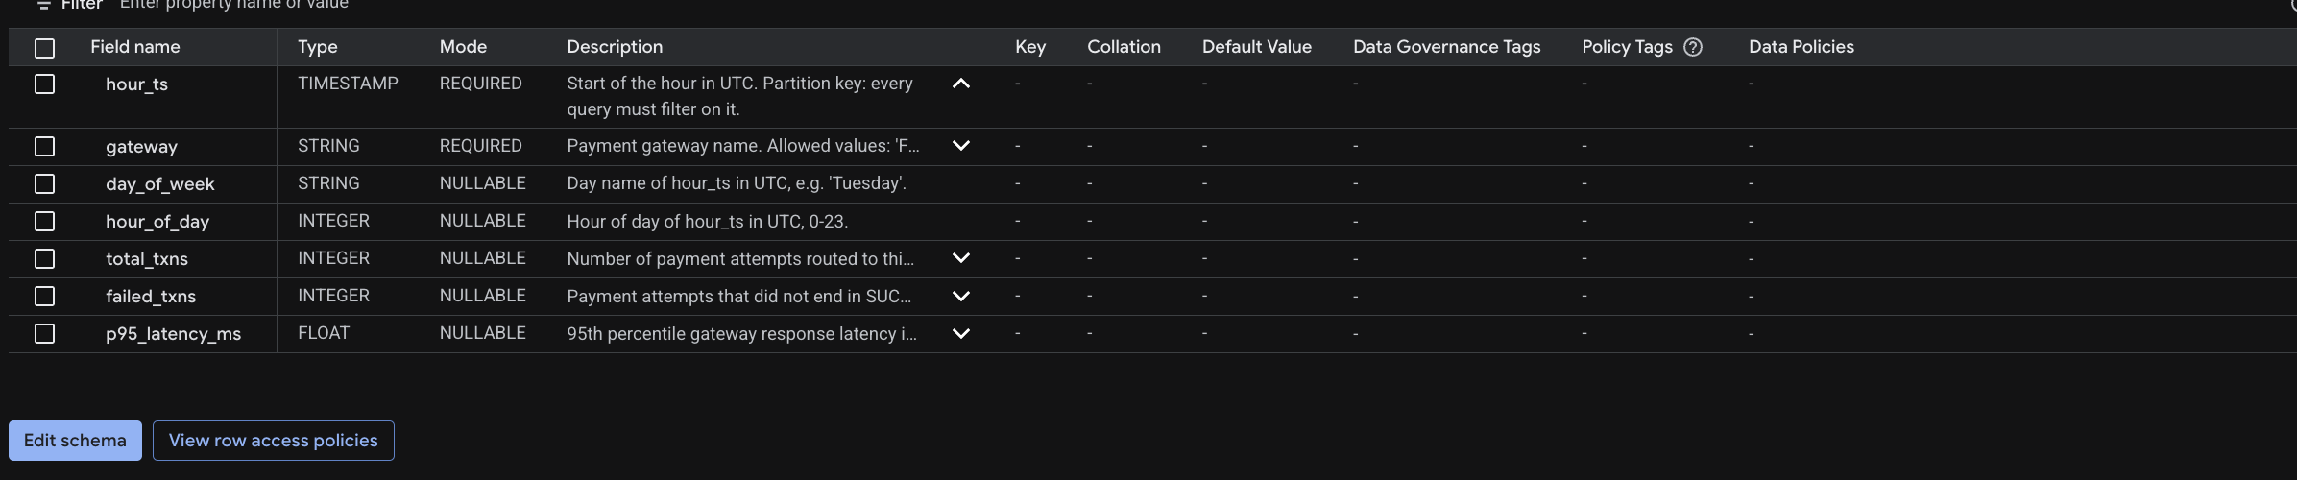
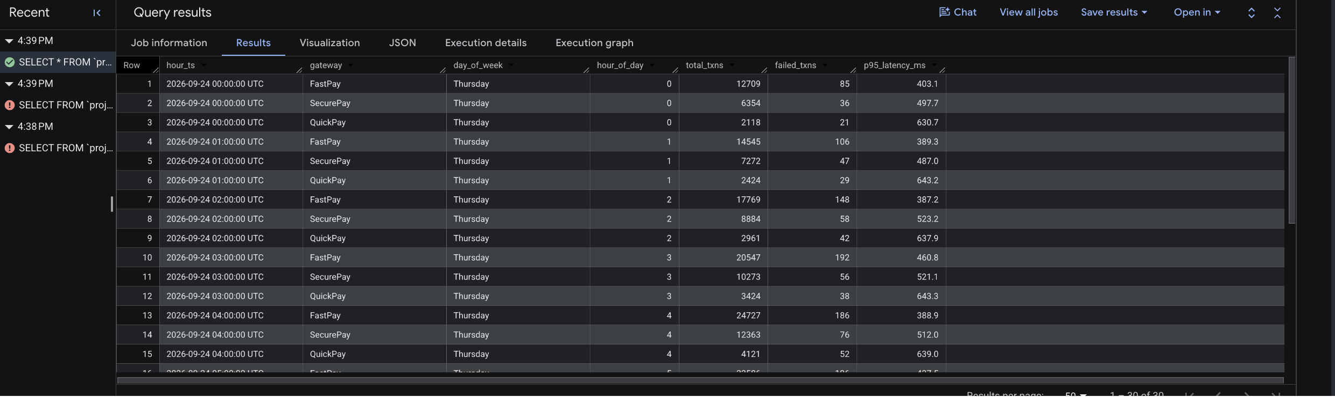
PART 5 · PUTTING IT TOGETHER
What I built: the history the agent queries
Schema: a description on every column; hour_ts is the required partition key
30 days of hourly stats per gateway, loaded into checkout_ops.gateway_hourly_stats
Notes:
TIME: ~1 min (running total 35:15)
GOAL: Open the real-run section. Show that the "grounded" schema from slide 13 is real, then move on quickly.
SCRIPT:
"Everything so far was the design. Now let me show you a real run, in the order the data flows.
[Top] First, the history the agent queries. This is the BigQuery table exactly as describe_table sees it: every column has a description, and hour_ts is the partition key that every query must filter on. That's the grounding from a few slides ago, for real.
[Bottom] And this is what's in it: thirty days of hourly stats for each gateway. Synthetic data, but shaped like real checkout traffic."
WHAT YOU NEED TO UNDERSTAND:
- The data is synthetic (generate_history.py), loaded with a free BigQuery load job. Say "synthetic" if asked; don't imply it's production data.
- This slide ties back to slide 13 ("Grounding beats guessing"). One sentence is enough; don't re-explain grounding.

Slide 18
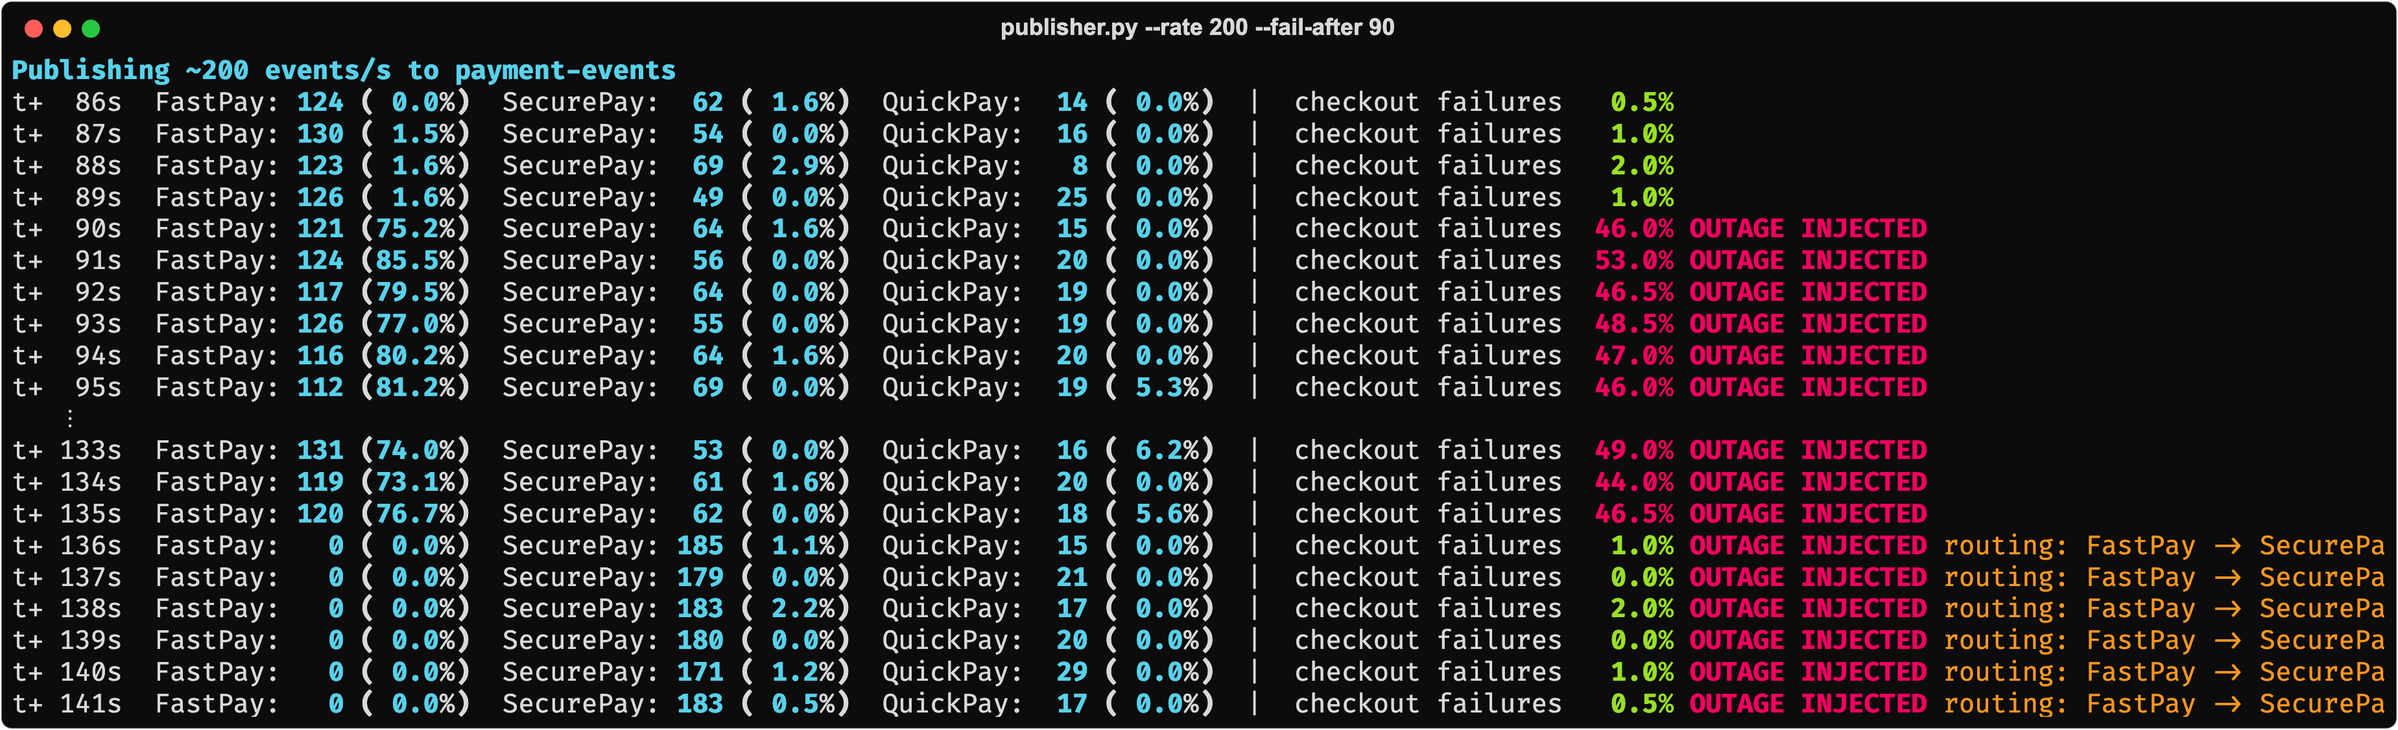
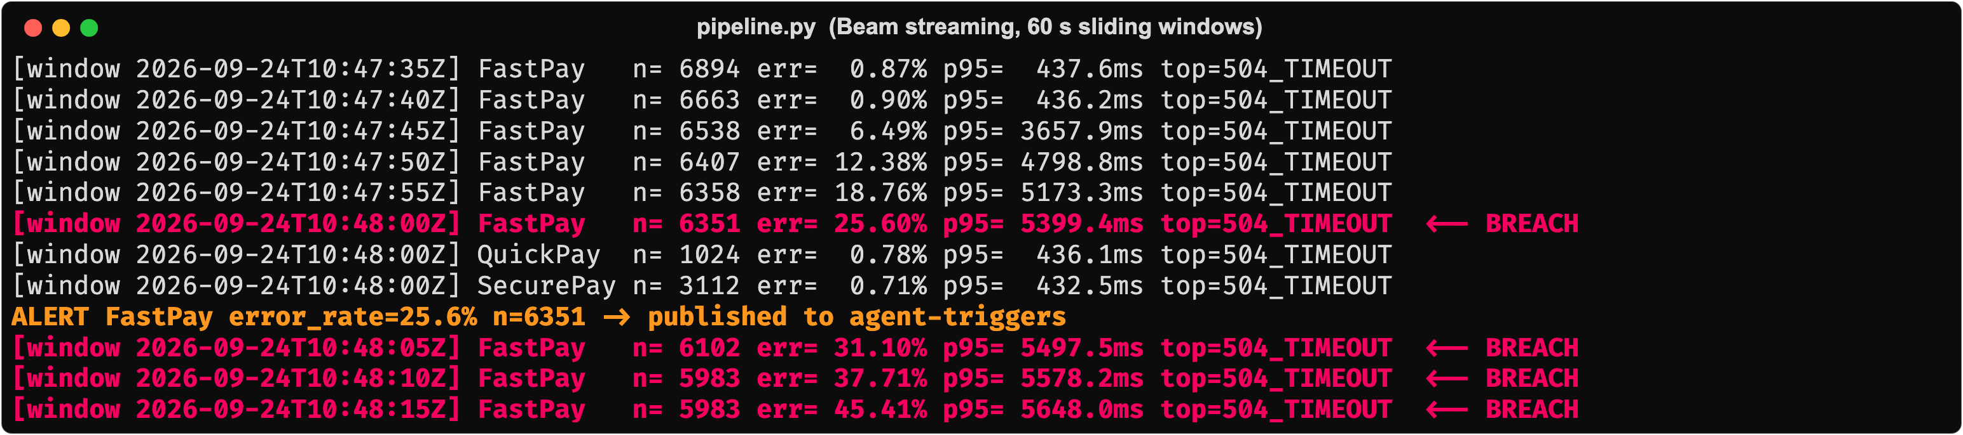
PART 5 · PUTTING IT TOGETHER
What I built: detecting the outage
Publisher: outage injected at t+90s; back to green after the reroute
Beam's own log: error rate climbing window over window, then BREACH and the alert fires
Notes:
TIME: ~2 min (running total 37:15)
GOAL: Prove the reflex side actually runs, with your real terminal output.
NUMBERS FROM YOUR RUN (so you can quote them confidently):
- Outage injected at t+90s; FastPay failures 75-85% per second from then on
- Beam windows: 0.87% → 6.49% → 12.38% → 18.76% → 25.60% BREACH (10:47:40 → 10:48:00, 20 seconds)
- Alert published at the 25.6% window; reroute visible in the publisher at t+136s (46 s after injection)
- Why the alert fired at 25.6%, not 78%: each window averages the last 60 seconds, so early windows mix normal and failing traffic. The threshold is 20%, so the first window over it triggers.
SCRIPT:
"Now the traffic.
[Top] This is the traffic publisher. Normal checkout failures under 2%, then at t+90 seconds I inject the outage — FastPay's failure rate jumps to the 70-80% range. Later, once the agent reroutes, watch the right-hand failure column drop back to near zero and the routing note appear.
[Bottom] This is the Beam pipeline's own log, watching the same traffic. Each line is a five-second window update. Watch the error rate climb window over window — 0.9%, then 6%, 12%, 18% — until it crosses the threshold and you see BREACH, then the ALERT line publishing to agent-triggers. That's the reflex doing its job: cheap, constant, and the alert fired 20 seconds after the first window showed anything unusual.
And back to the top screenshot: outage in at t+90, traffic rerouted by t+136. 46 seconds, end to end."
HONESTY NOTE: this really is your own run — Beam on the local DirectRunner, Redis standing in for Bigtable, but the same Beam code that would run on Dataflow. Say so if asked "did you actually build this?" The next slide shows the same run from Pub/Sub's console.

Slide 19
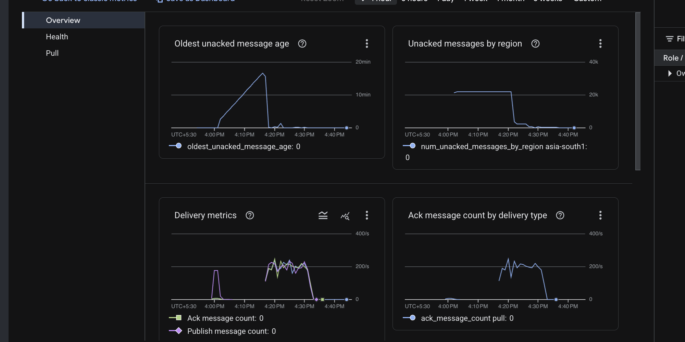
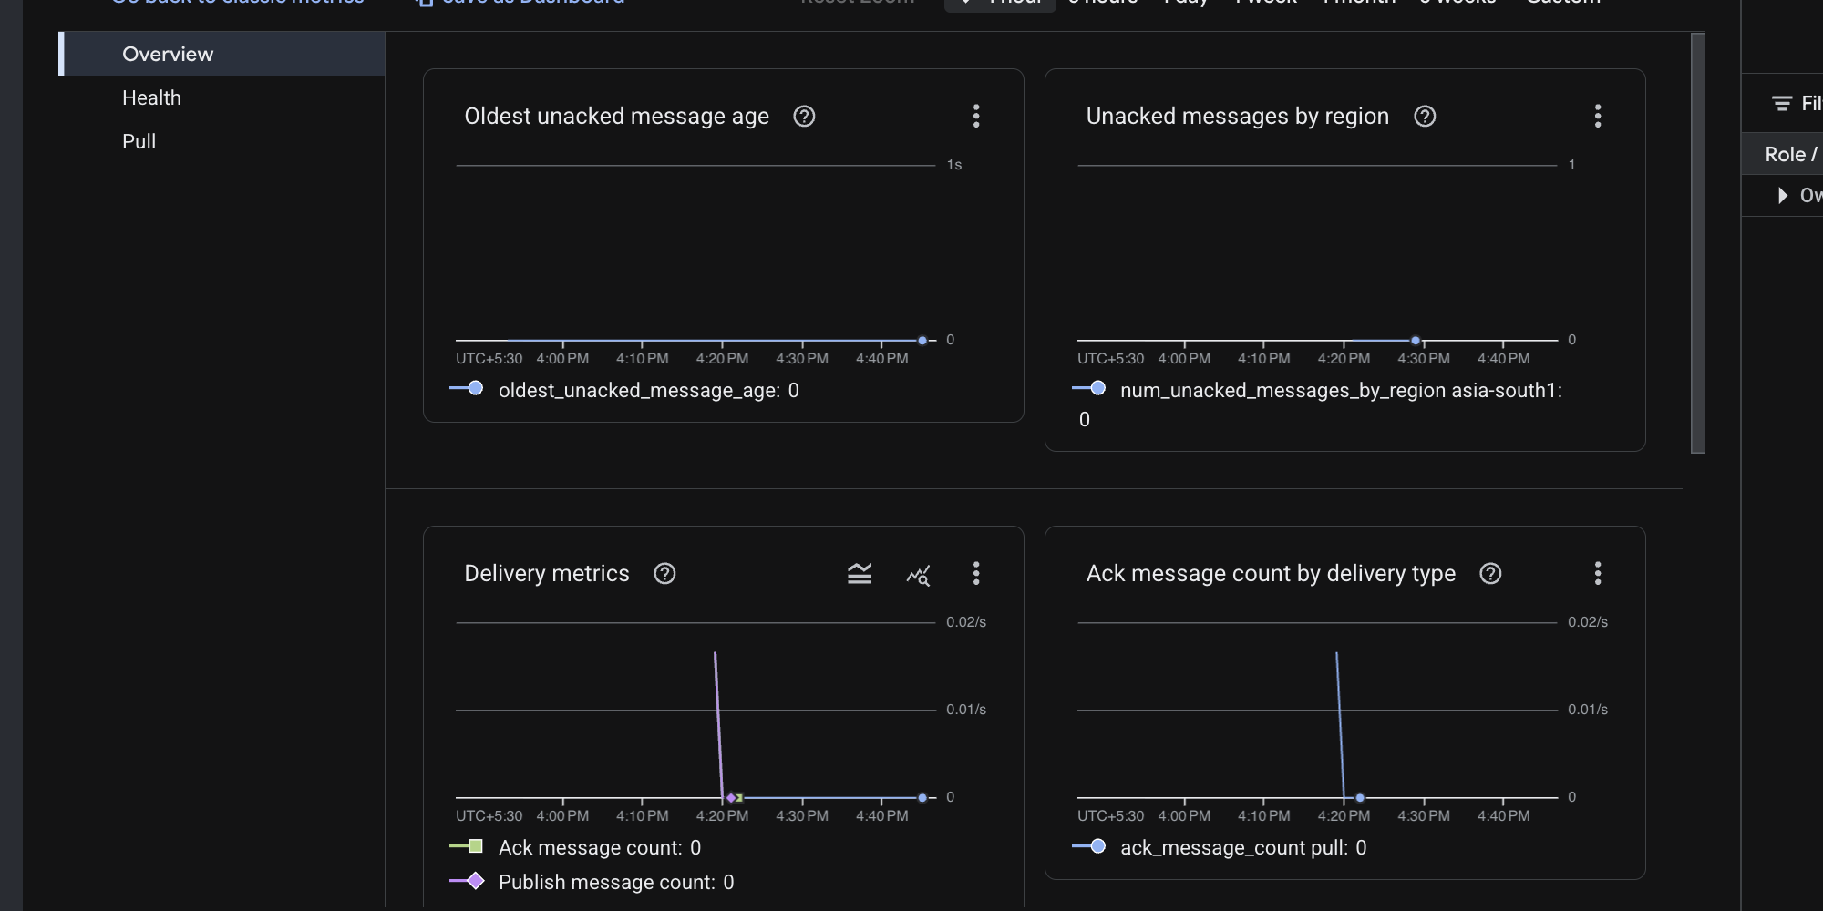
PART 5 · PUTTING IT TOGETHER
What I built: Pub/Sub, from the console
payment-events-beam: ~200 events/s in; the backlog drains as Beam keeps up
agent-triggers-sub: silent, apart from the single alert that wakes the agent
Same system, two very different shapes: a constant firehose into the reflex, and one small message into the brain.
Notes:
TIME: ~1 min (running total 38:15)
GOAL: Make the reflex/reflection split visible in real infrastructure metrics.
SCRIPT:
"Here's the same run from Pub/Sub's own console.
[Left] This is the subscription feeding the Beam pipeline. Around two hundred events a second, continuously. The backlog chart shows messages piling up and then draining as the pipeline catches up, which is exactly the shock-absorber job from earlier.
[Right] And this is the subscription that wakes the agent. Almost nothing, all the time. That one tiny spike is the single alert message.
[Bottom] That's the whole design in two charts: a constant firehose into the cheap, fast side, and one small message into the expensive, slow side. The LLM never sees the firehose."
WHAT YOU NEED TO UNDERSTAND (prep guide §2.2):
- "Oldest unacked message age" climbing then dropping = messages waiting, then being processed. It spiked while earlier test runs left a backlog; it returns to zero once the pipeline is consuming.
- The agent-triggers chart's y-axis is in hundredths of a message per second. That's the point: the brain's input is tiny.

Slide 20
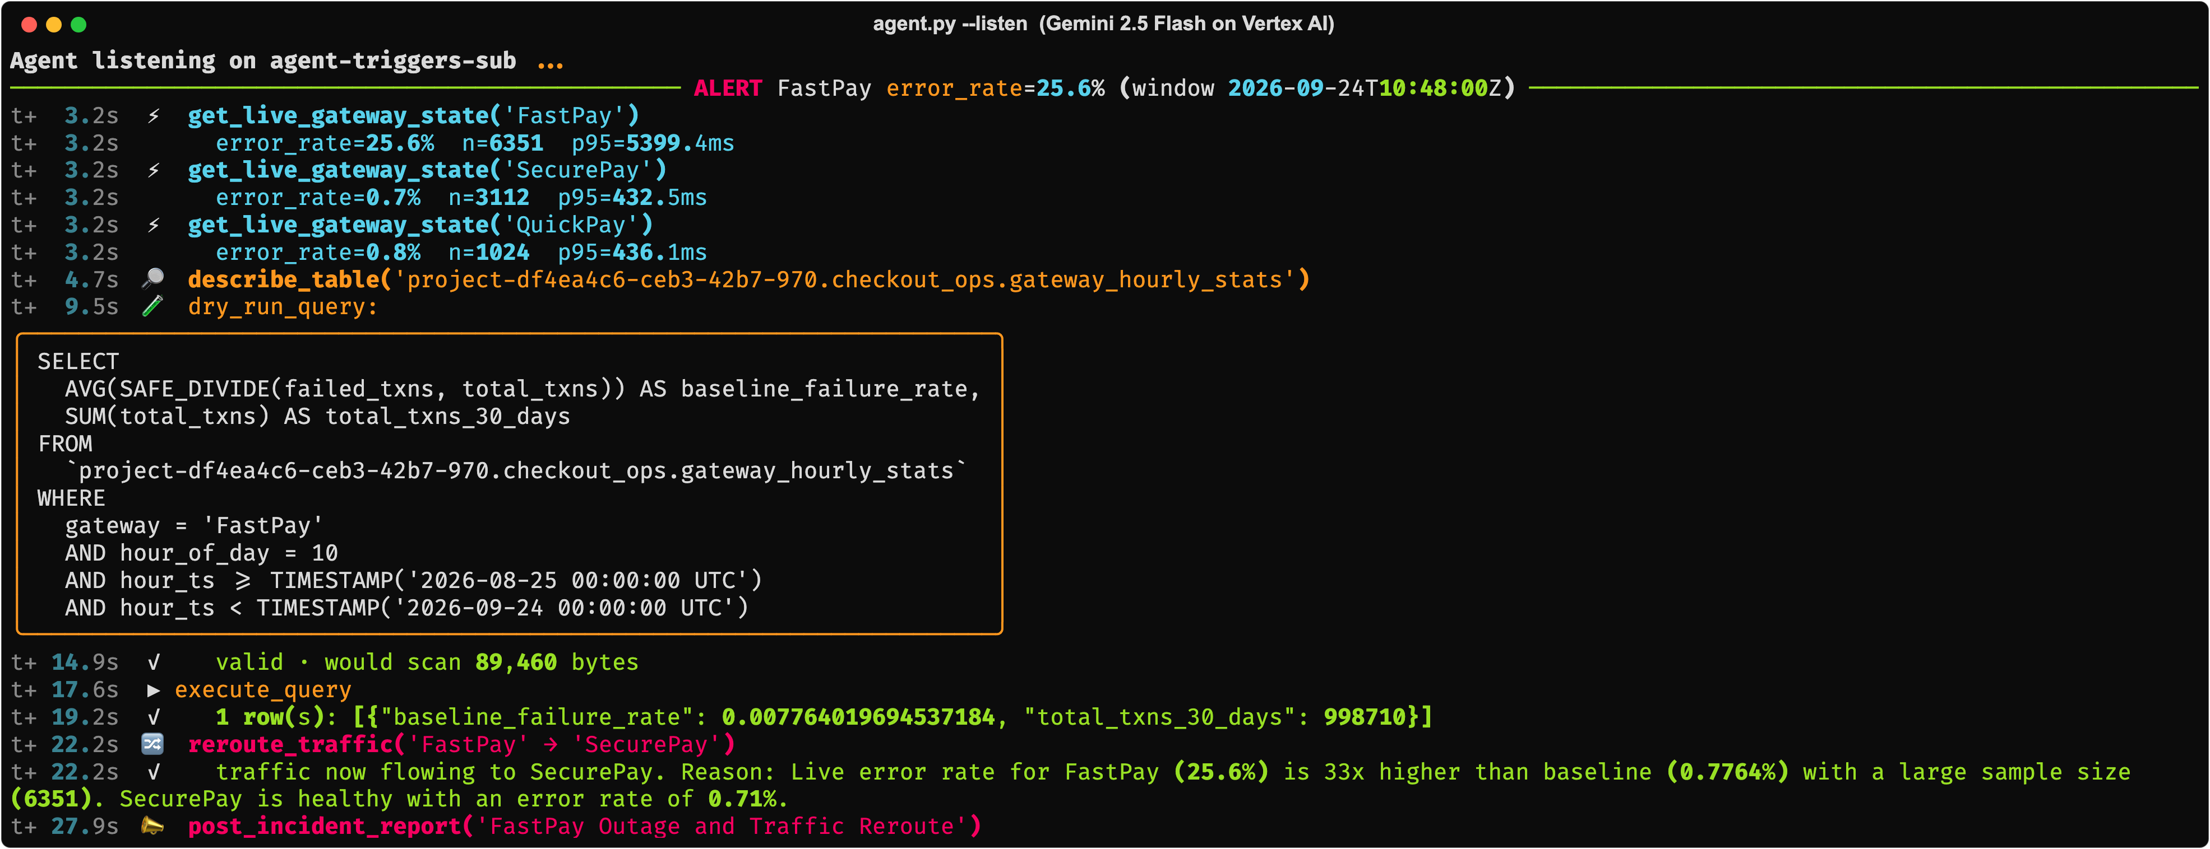
PART 5 · PUTTING IT TOGETHER
What I built: the agent responds
Live state reads, describe_table, a dry-run, the baseline query, then reroute_traffic and the report — under 30 seconds
Stack: Pub/Sub · Apache Beam (local runner) · Redis standing in for Bigtable · BigQuery · Gemini 2.5 Flash via Vertex AI
Notes:
TIME: ~1.5 min (running total 39:45)
GOAL: Land the payoff — the agent's own reasoning trace, end to end, in one shot.
SCRIPT:
"And here's the agent picking up that alert. It reads its own live state for all three gateways first — FastPay at 25.6%, the other two healthy. It calls describe_table, dry-runs a baseline query against thirty days of history, gets back 0.78%, and does the comparison itself: 25.6 versus 0.78 is about thirty-three times normal, with a large sample size, so it calls reroute_traffic and writes the report. About twenty-eight seconds from the alert to the report, and every number in that reasoning came from a real tool call, not something the model made up.
[Stack bar] To be upfront about what's simplified here: Beam ran locally instead of on Dataflow, and Redis stood in for Bigtable. Gemini itself is not simplified — that's a real Vertex AI call, same as production would use. Let me show you the receipts."
TRANSITION: "Let me show you the receipts" leads into the BigQuery job slide.
WHY THIS SLIDE MATTERS: this is the single most convincing image in the deck — slow down and let people actually read a couple of lines before moving on.

Slide 21
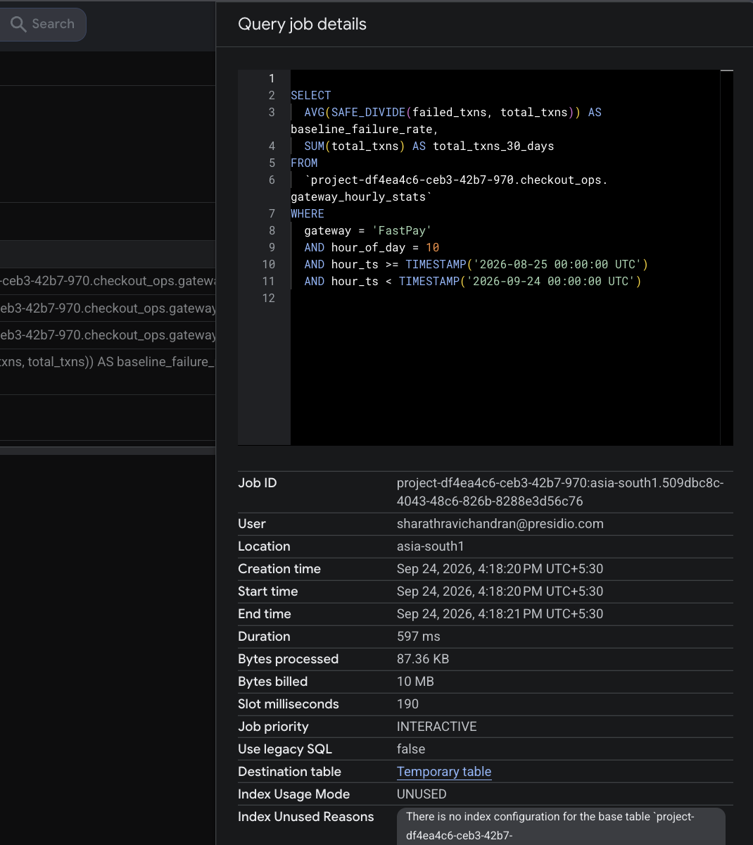
PART 5 · PUTTING IT TOGETHER
What I built: the query the agent ran
From BigQuery's own job history
597 ms
87 KB
query duration
actually scanned
10 MB
100 MB
billed (BigQuery's minimum)
the agent's hard cap
The SQL on the left was written by Gemini, not by me. BigQuery recorded it like any other job.
Notes:
TIME: ~1 min (running total 40:45)
GOAL: Independent proof that the agent's SQL really ran, and how cheap it was.
SCRIPT:
"This is BigQuery's own job history. The SQL on the left wasn't written by me. It's the query Gemini generated during that run, and BigQuery logged it like any other job.
[Stats] It took about six hundred milliseconds and scanned 87 kilobytes, thanks to the partition filter. BigQuery bills a 10 MB minimum, so that's what it charged. The agent's hard cap is 100 MB, so even this minimum is a tenth of what it's allowed."
WHAT YOU NEED TO UNDERSTAND (prep guide §2.8):
- Bytes processed vs bytes billed: BigQuery rounds each query up to a 10 MB minimum charge. 87 KB is the real scan.
- Why so small: the WHERE clause filters on hour_ts (the partition key), gateway and hour_of_day, so BigQuery only reads 30 days of partitions for a tiny table.
BEFORE THE TALK: your work email is visible in the "User" row of this screenshot. Blur or crop it if you don't want it on the projector.

Slide 22
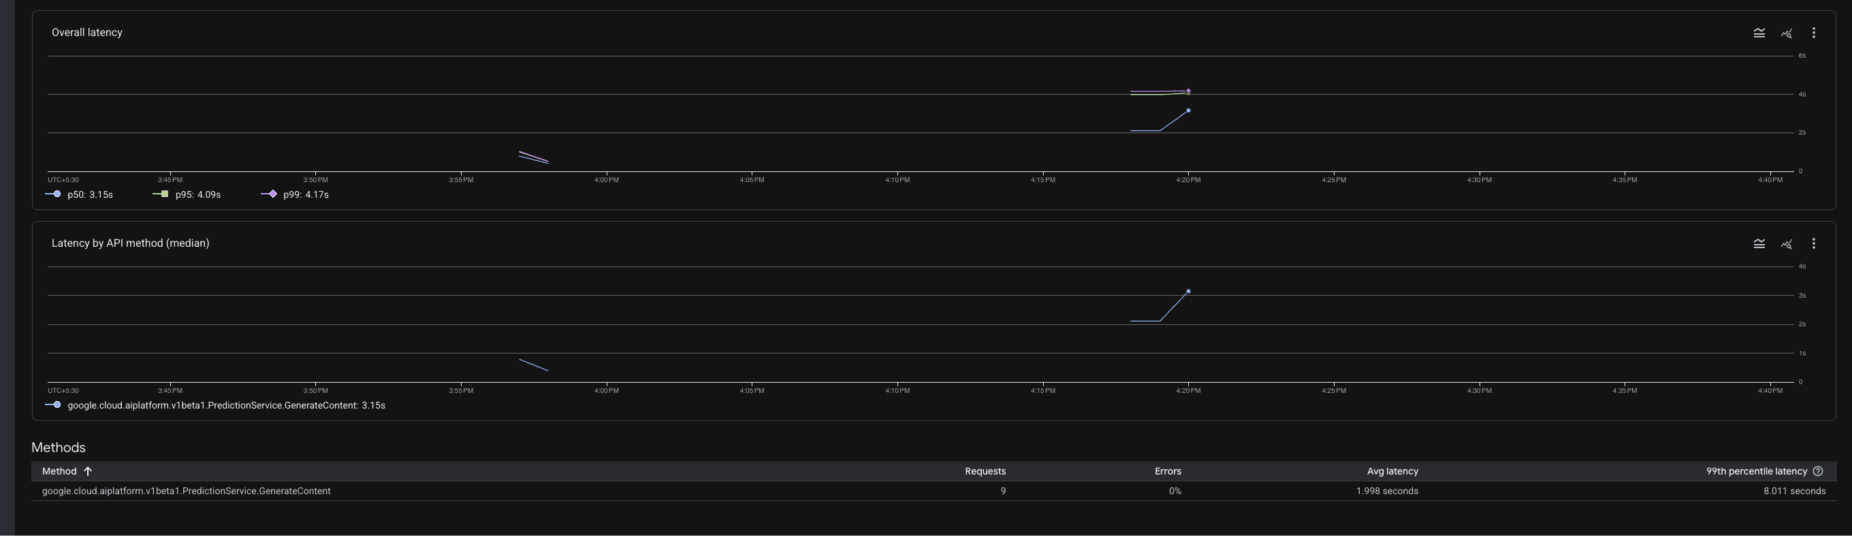
PART 5 · PUTTING IT TOGETHER
What I built: Gemini calls on Vertex AI
Vertex AI's own API dashboard for the GenerateContent method during the run
9
0%
2.0 s
8.0 s
Gemini requests
errors
average latency
p99 latency
Notes:
TIME: ~1 min (running total 41:45)
GOAL: Show the cost and speed of the "brain" from Google's own metrics, not the agent's logs.
SCRIPT:
"And this is Vertex AI's own dashboard for the same run. Nine Gemini requests for the whole investigation: one per reasoning step, including each tool call. Zero errors. About two seconds on average.
That's why the LLM isn't in the reflex path. Two seconds a step is fine for an investigation that happens once per incident. It would be hopeless for watching two hundred events a second."
WHAT YOU NEED TO UNDERSTAND (prep guide §2.10):
- With automatic function calling, each round trip (model asks for a tool → your code runs it → result goes back) is one GenerateContent request. Nine requests = the model's steps through the investigation.
- The 8 s p99 is the slowest request, probably the first call (cold start) or the long final report. Don't over-explain it; say "the slowest single step" if asked.

Slide 23
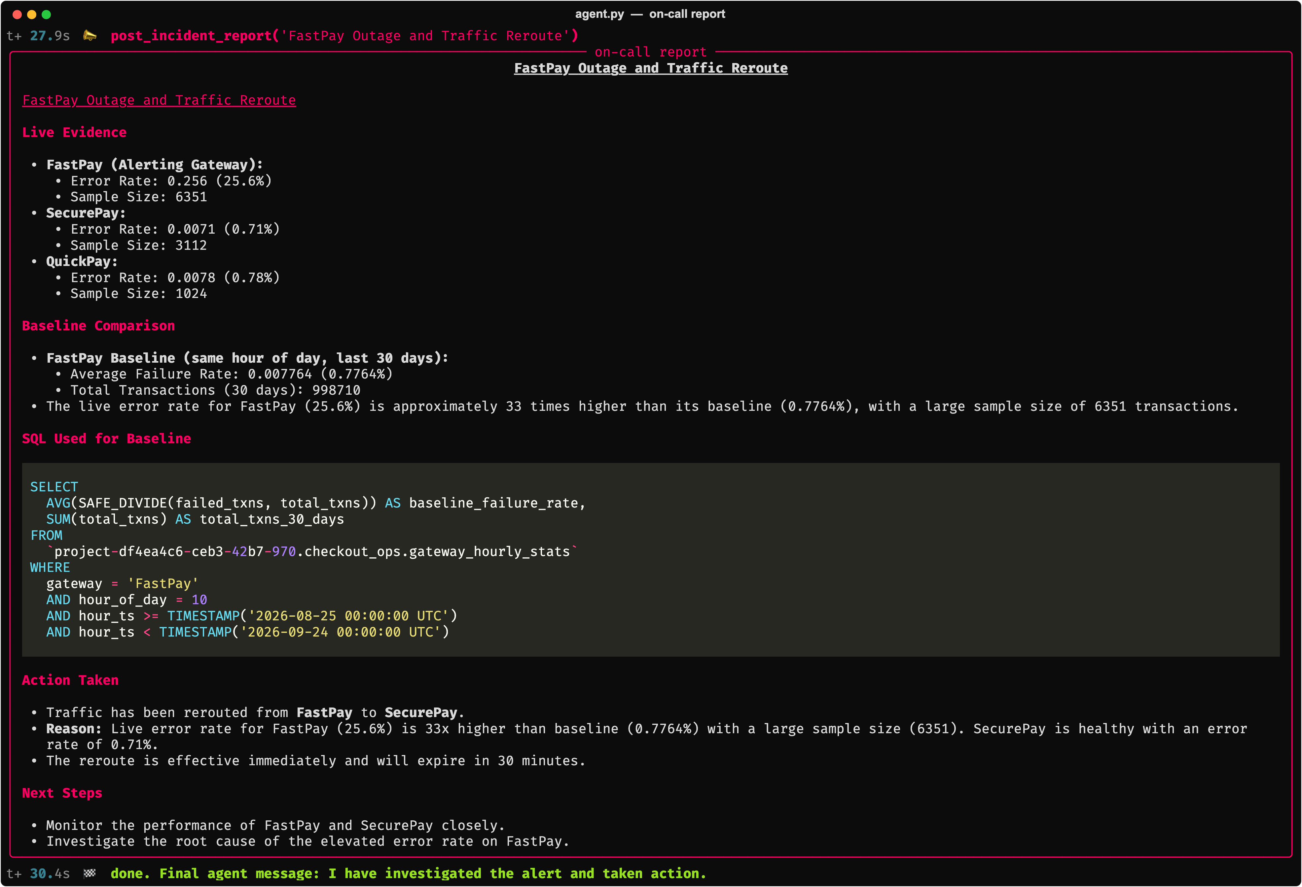
PART 5 · PUTTING IT TOGETHER
What I built: the report on-call receives
Every section traces to a tool call
Live Evidence
get_live_gateway_state
Baseline Comparison
execute_query
SQL Used
the exact query it ran
Action Taken
reroute_traffic
Not a vague alert: a verified diagnosis.
Notes:
TIME: ~1 min (running total 42:45)
GOAL: Close the real-run section on what the human actually gets.
SCRIPT:
"And this is what lands with the on-call engineer. Not 'FastPay error rate high'. A report.
[Right, point down the list] Live evidence for all three gateways, from the reflex store. The baseline comparison, from BigQuery. The exact SQL it used, so anyone can re-run it. And the action it took.
Every number in there came from a tool call. The system prompt ends with 'never invent numbers', and the tools are what make that possible.
That's the whole loop: detect, investigate, act, explain, in under a minute."
WHAT YOU NEED TO UNDERSTAND:
- The report is generated by the post_incident_report tool; the markdown is written by Gemini using only numbers returned by earlier tool calls.
- If asked "how do you know it didn't make a number up?": the SQL is in the report, so a human can re-run it; for production you'd also check the report's numbers against the tool outputs before posting (prep guide Q&A #3).

Slide 24




PART 6 · BEFORE YOU SHIP
Four guardrails for autonomous data agents
Cap every query
Force partition filters
Set maximum_bytes_billed on every job. Over-budget queries fail before they cost anything.
require_partition_filter = true on big tables. No accidental full scans.
Least-privilege identity
Bounded actions
bigquery.dataViewer on the dataset + bigquery.jobUser on the project. Never admin, never write.
Allowlisted tools that validate inside. Cooldowns stop flapping. Humans approve anything irreversible.
Notes:
TIME: ~2 min (running total 44:45)
GOAL: Leave the senior folks with the "grown-up" part. This is what makes the talk production-credible.
SCRIPT:
"Before anyone takes this to production on Monday: four guardrails.
[1] Cap every query. BigQuery has a setting, maximum_bytes_billed. If a query would scan more than your limit, it fails instead of running. An agent will eventually write a query that scans far more than it should. This makes that mistake free.
[2] Force partition filters. Mark big tables so every query must filter on the partition column, usually date. No accidental full-history scans. My demo table is set up exactly this way: a query without a date filter is rejected before it scans anything.
[3] Least privilege. The agent runs as its own service account with exactly two roles. BigQuery Data Viewer, granted on just this one dataset, so it can read these tables and nothing else. And BigQuery Job User, granted on the project, because running a query is a job, and jobs are billed and created at the project level. Nothing else. It cannot drop a table, because it's not allowed to, not because we asked it nicely in the prompt.
[4] Bounded actions. The agent can only call tools you've written, and each tool validates its inputs itself. My reroute tool refuses if the target gateway isn't healthy, whatever the model says. Cooldowns stop it flipping back and forth. And anything irreversible goes to a human.
The theme: guardrails live in code and permissions, not in the prompt."
WHAT YOU NEED TO UNDERSTAND (prep guide §2.8, §2.14):
- Roles: roles/bigquery.dataViewer lets it read table data and metadata; grant it on the specific DATASET, not the project. roles/bigquery.jobUser lets it create query jobs; that permission (bigquery.jobs.create) only exists at the PROJECT level, so it must be granted there. Knowing this split is a nice signal of GCP maturity if someone asks.
- Example commands: gcloud projects add-iam-policy-binding PROJECT --member=serviceAccount:agent@PROJECT.iam.gserviceaccount.com --role=roles/bigquery.jobUser ; dataset-level access is granted in the dataset's Sharing → Permissions panel, or with bq add-iam-policy-binding.
- Flapping: an automated system switching back and forth (reroute → looks healthy → reroute back → fails again). Cooldowns and hysteresis (different thresholds for switching and switching back) prevent it.
- Also worth knowing if asked: cap Dataflow autoscaling with max workers, and set a GCP budget alert.

Slide 25
THREE THINGS TO TAKE HOME
1
Streams are the reflex
Thank you, Chennai!
Agents can't act on now without streaming and compaction.
[ QR code ]
2
Warehouses are the truth
Aggregates come from SQL, not similarity search.
slides + demo code
3
Data engineers build the nervous system
[Your Name]
[LinkedIn / X handle]
Pipelines, semantics and guardrails decide if an agent is safe.
Questions?
Notes:
TIME: ~1 min, then Q&A (talk ends ~45:45 as written; see the prep guide's timing note)
SCRIPT:
"Three things to take home.
One: streams are the reflex. An agent can't act on what's happening now without a streaming pipeline that compacts the noise.
Two: warehouses are the truth. When the question is a number, the answer comes from SQL, not from similarity search.
Three, and this is the one I care most about: data engineers build the nervous system. AI isn't replacing our work — the pipelines, the semantics, the guardrails are exactly what decide whether an agent is useful or dangerous.
Thank you, Chennai! The QR code has the slides and the demo code. I'd love to take your questions."
BEFORE THE TALK: Generate a QR code (e.g. to a GitHub repo or Drive folder with slides + code) and paste it over the placeholder. Fill in your name and handle.
Q&A TIPS:
- Repeat each question into the mic before answering — the room can't hear the asker.
- If you don't know: "Great question — I haven't tested that. My guess is X, but come find me after and let's look at it." Never bluff to a room of engineers.
- Prepared answers are in the prep guide, §4.

