Slide 1
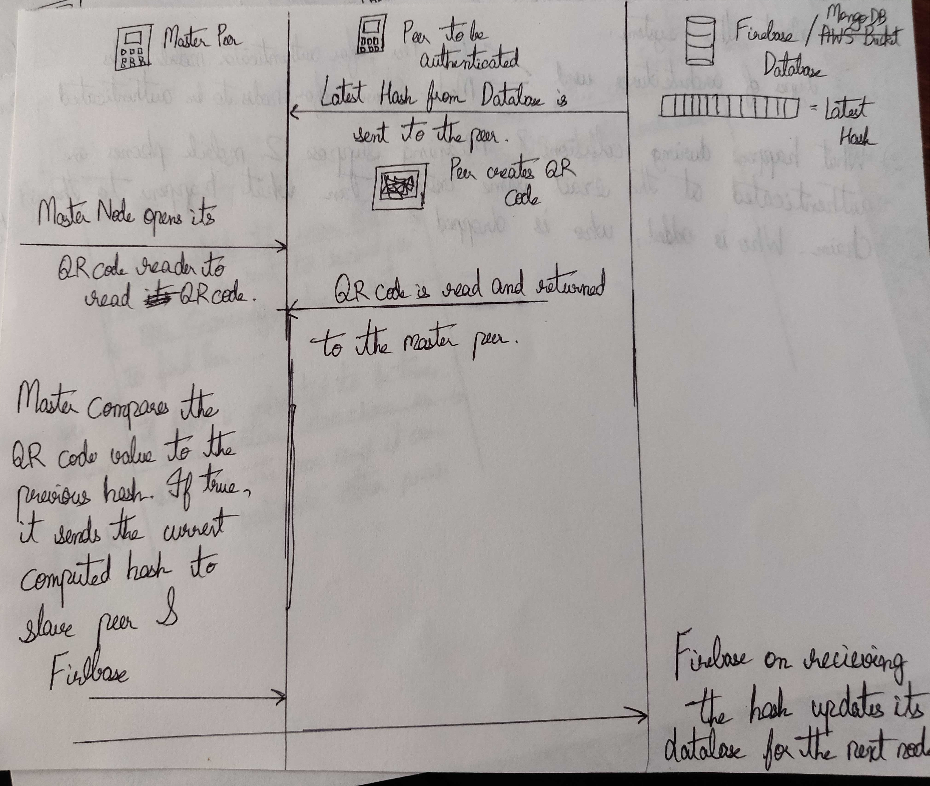
First Architecture

Slide 2
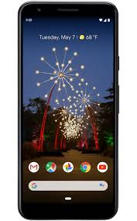


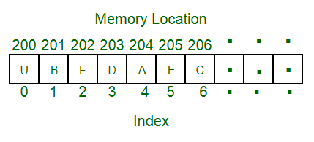
Peer Node A
Peer Node B
Database
Latest Hash from the database is updated to the Peer Node
Opens Blockchain app to read QR Code
QR Code is read and returned to the Peer Node A
Peer Node A verifies the QR Code against the Hash of the latest block. In this case, if the Hash encoded in the QR Code matches that of the latest block’s hash, then the Peer Node B is notified that the Hash is correct and the notification has a key as well as the entire block to unlock the second stage of the Application.
The latest block’s hash are sent to the Database so that the next few nodes can update their QR Codes to that containing the corresponding Hash

Slide 3
Pros and Cons
2 Types of architectures are used:
Peer-Peer for the authenticators
Master-Slave, for nodes to be authenticated
What happens during Collisions ? Meaning suppose 2 mobile phones are authenticated at the exact same instant. Then what happens to chain ? Who is added and who is dropped ?

Slide 4
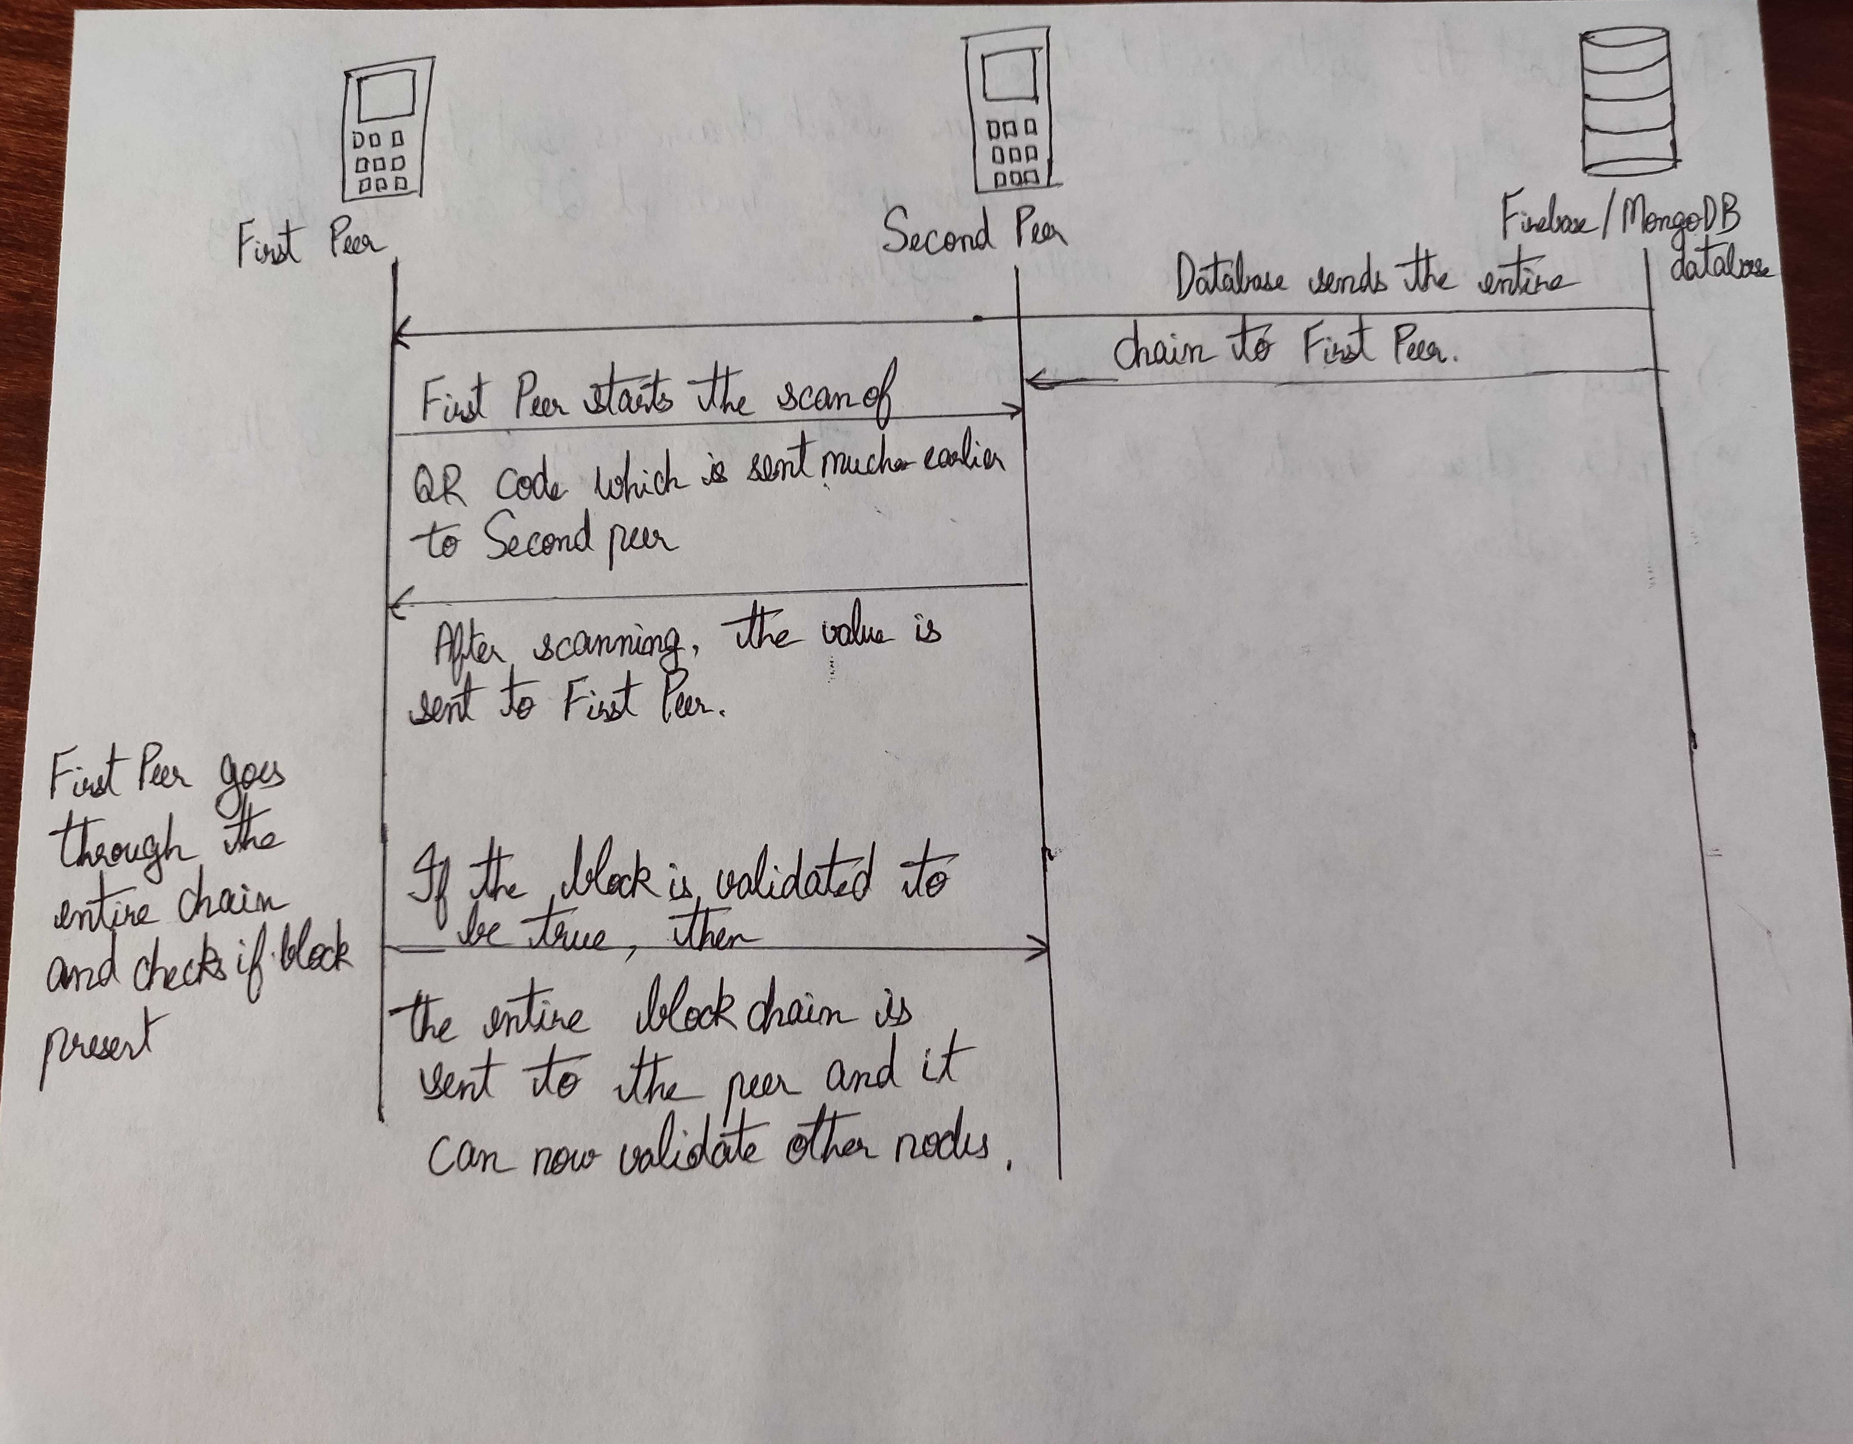
Second Architecture

Slide 5
Pros and Cons
Prior Setup is needed :
Entire chain needs to be sent to first peer
Each node should get the hash based on which the QR Code needs to be displayed.
MiTM attacks can cripple the entire system
Truly Peer-Peer Connection System.
Entire chain needs to be scanned for every iteration of the authentication.

Slide 6
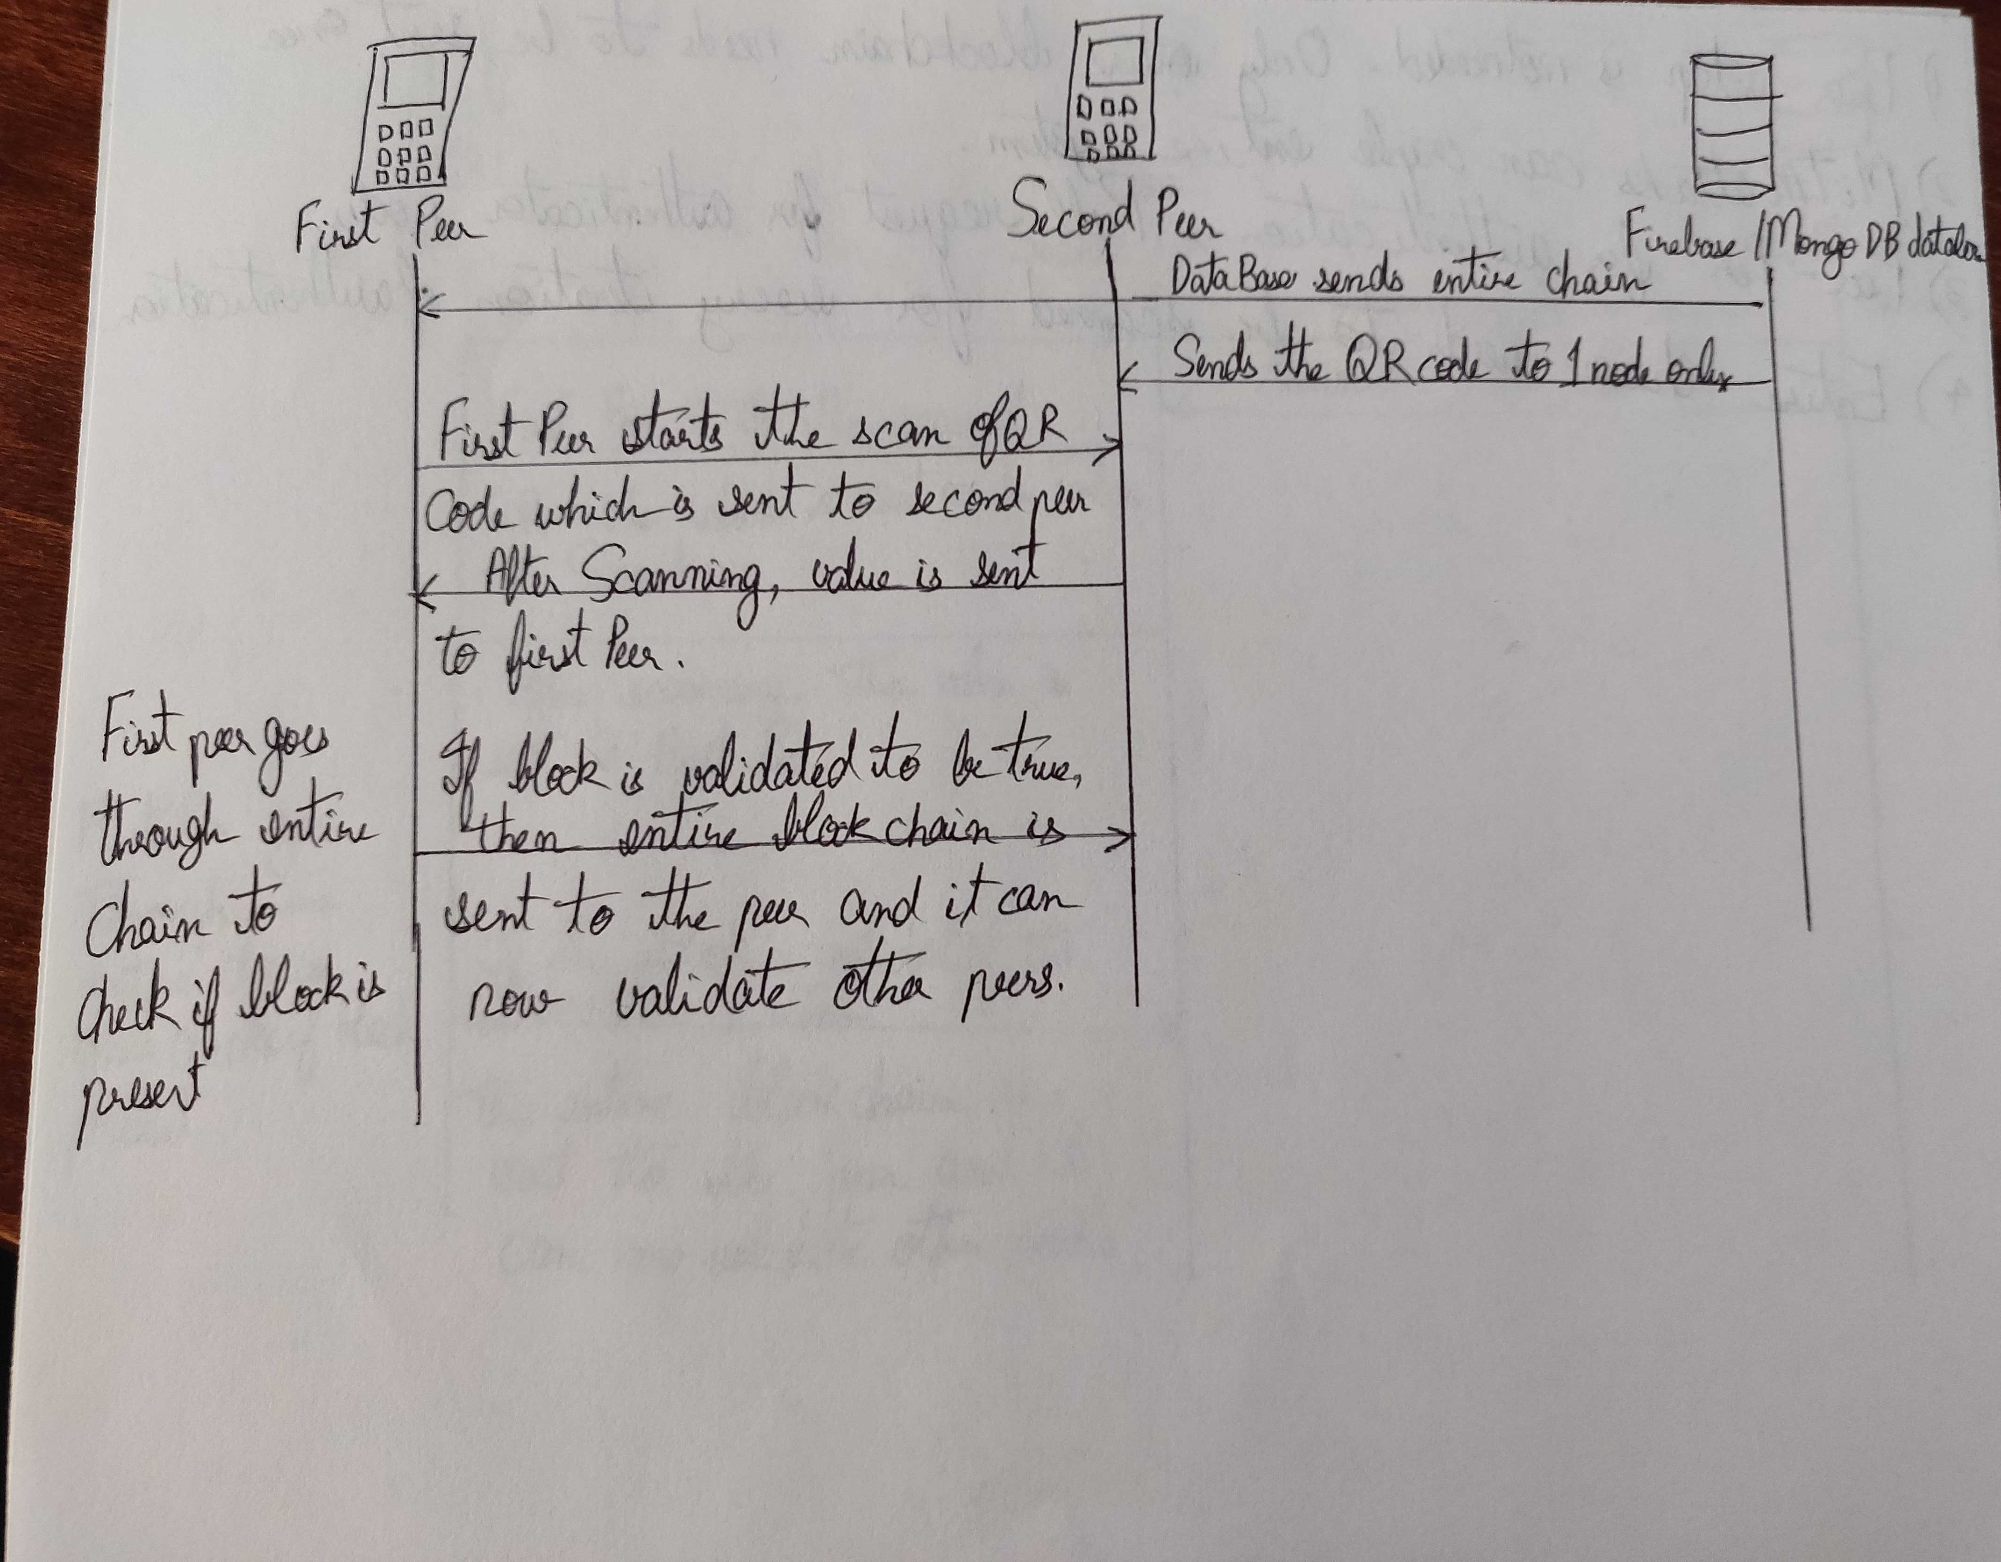
Third Architecture

Slide 7
Pros and Cons
Prior setup is needed only on one end. Entire Blockchin needs to be sent once only.
MiTM attacks can cripple entire system.
Peer-Peer for authenticator nodes. Pull Request for nodes undergoing authentication.
Entire chain needs to be scanned for every iteration of authentication.

Slide 8
Next Steps of action
Based on the architecture chosen, I can proceed and build the system peripherals.
Need more mobile devices to make it truly peer-peer
Need some information on what to write in the Report.
You feedback on current progress
Pace of Work
Quality of Work
Areas that have been done well
Areas to improve

