Slide 1
LEAD SCORE CASE Study
Group Member Name
Sharath
Shreyas
Shreya Simon

Slide 2
AGENDA
Problem Statement​
Business Objective
​Solution Methodology
Data Manipulation
​EDA
Categorical Variable Relation
Data Conversion
Model Building
ROC Curve​

Slide 3
Problem Statement​
X Education sells online courses to industry professionals. On any given day, many professionals who are interested in the courses land on their website and browse for courses. To make this process more efficient, the company wishes to identify the most potential leads, also known as „Hot Leads‟.
If they successfully identify this set of leads, the lead conversion rate should go up as the sales team will now be focusing more on communicating with potential leads rather than making calls to everyone.
The CEO, in particular, has given a ballpark of the target lead conversion rate to be around 80%.

Slide 4
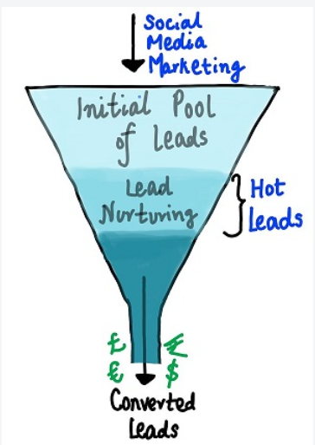
Business Objective
X Education wants to know the most promising leads.
For that, they want to build a Model which identifies the hot leads.
Deployment of the model for the future use. Education

Slide 5
Solution Methodology
Data cleaning and data manipulation
Check/handle all duplicate data.
Check/handle NA values and missing values.
Drop columns, if they contain a large amount of missing values and are not useful for the analysis.
Check and handle outliers in data.
EDA
Univariate data analysis
Bivariate data analysis
Feature Scaling and dummy Variables and encoding of the data.
Classification technique: logistic regression is used for the model making and prediction.
Validation of the model.
Model presentation.
Conclusions and recommendations.

Slide 6
Data Manipulation
Total Number of Rows =37, Total Number of Columns =9240.
Dropping the “Prospect ID” and “Lead Number” which are not necessary for the analysis.
After checking for the value counts for some of the object type variables, we find some of the features which have no enough variance, which we have dropped, some of the features are: “Do Not Call”, “Search”, “Newspaper Article”, “X Education Forums”, “Newspaper”, “Digital Advertisement” etc.
Dropping the columns having more than 30% as missing values.

Slide 7
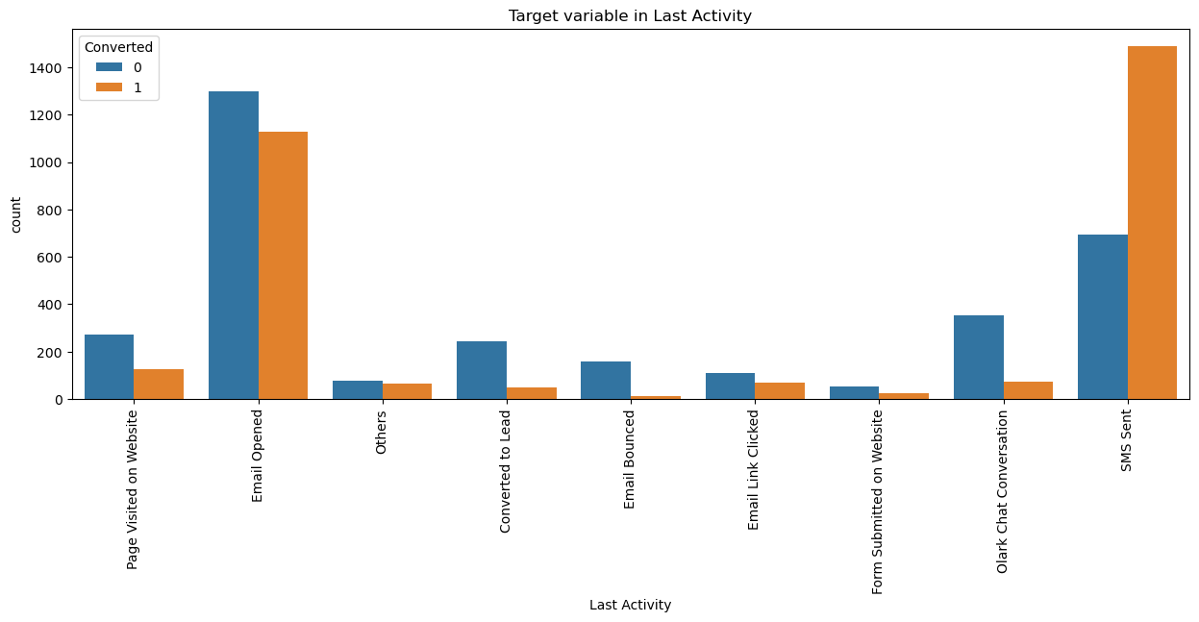
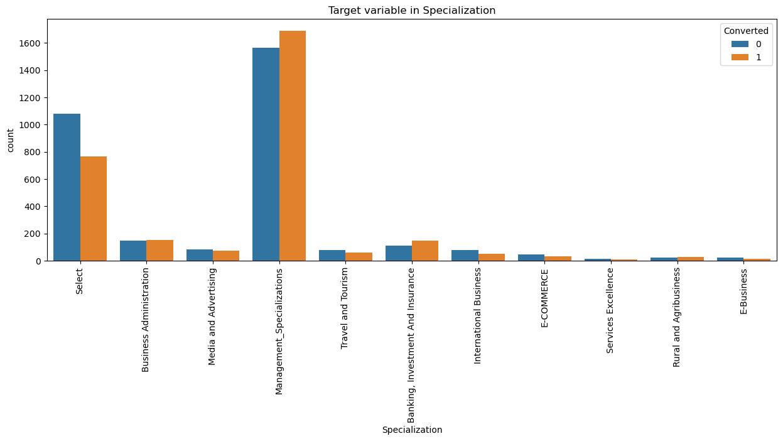
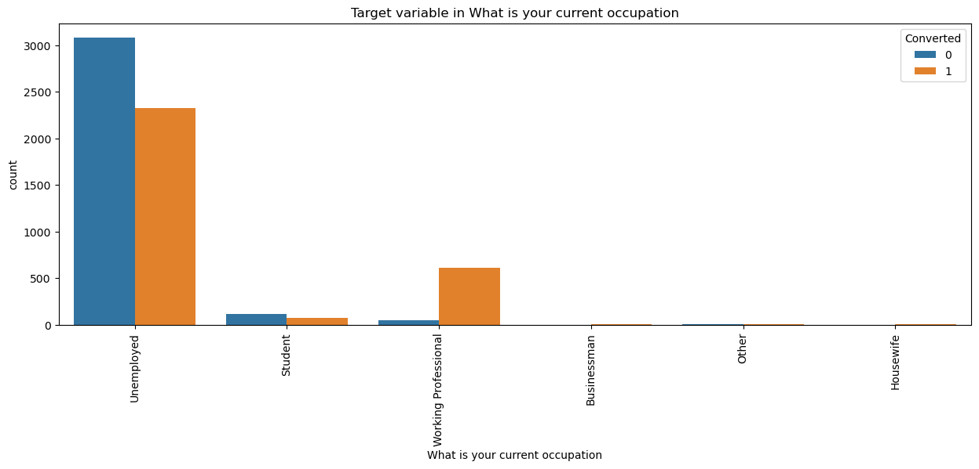
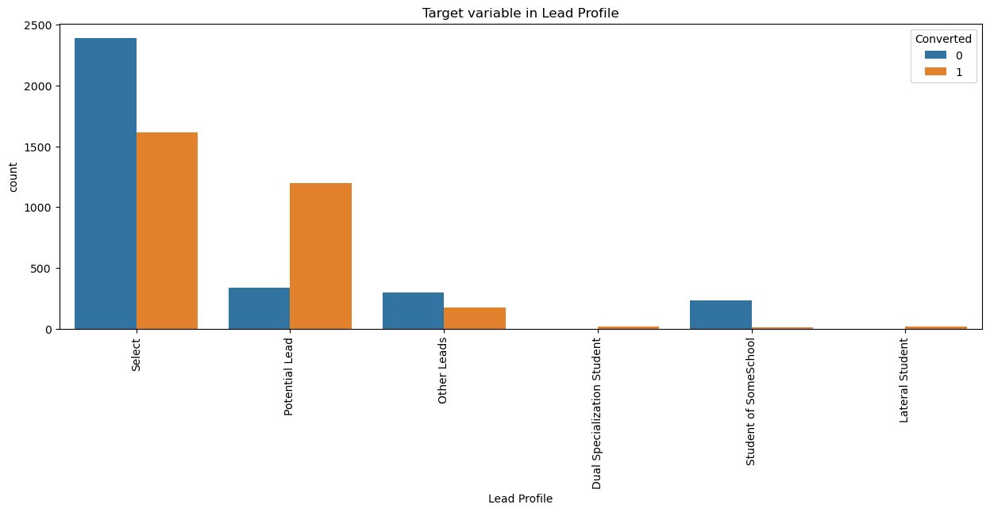
VISUALISING THE CATEGORICAL VARIABLES
People who are identified as Potential leads and followed up seems to be converting as a customer to the website
People who have interacted with a SMS being sent in showing an interest seems to be enrolling more in the courses They have a higher conversion ratio.
People who have been referred have a higher chance of converting into a customer
Working Professionals seem to be in the higher conversion ratio compared to the other categories of the people

Slide 8
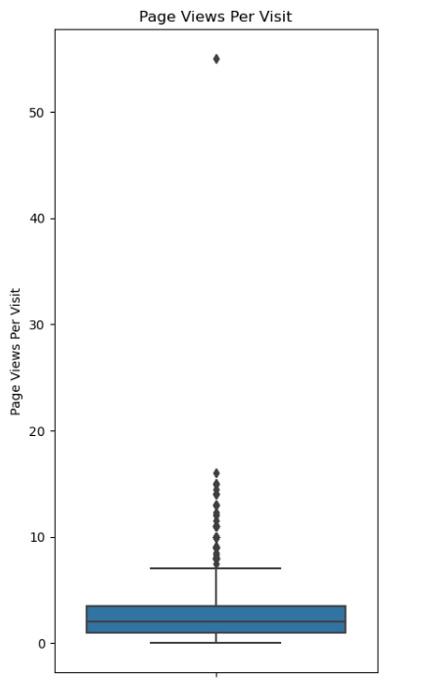
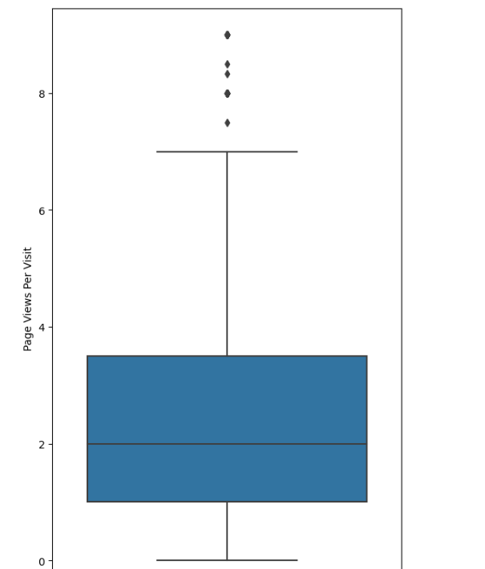
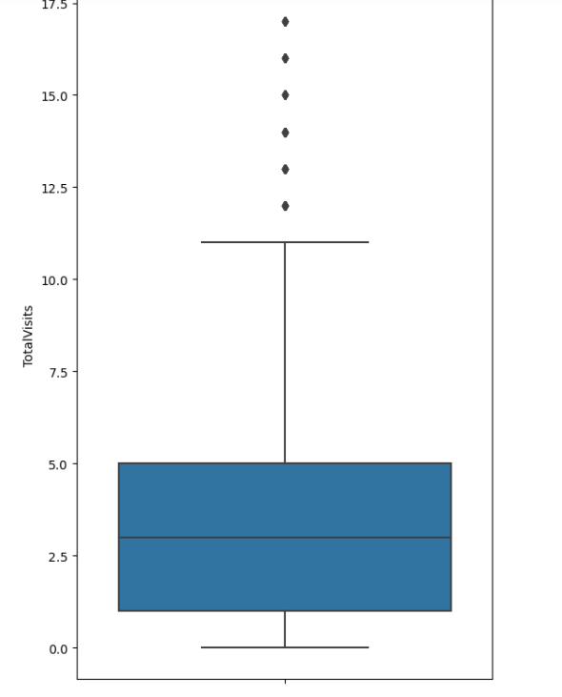
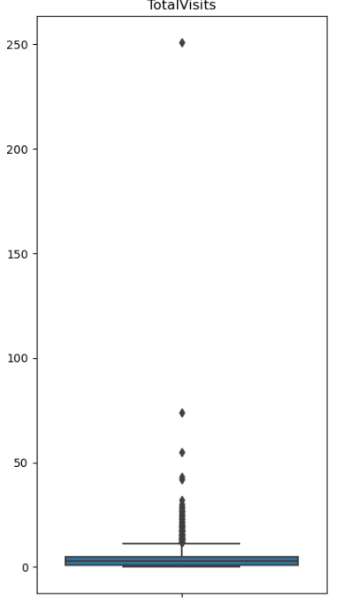
OUTLIER TREATMENT
AFTER
AFTER
Before
Before

Slide 9
EDA
Creating a Dummy Variables for the Categorical Variables
* In order to make it easier for analysis, we will be converting the categorical variables into dummy variables so that it holds easy as to what sort of variable has a much better influence on the target variable
* Converting the Leads Origin, Lead Source, Last Activity, Specialization, How did you hear about X Education, What is your current occupation and the Lead Profile categorical variables into dummy variables and then dropping these.
Test-Train Split Logistic Regression
Dividing the entire dataset into test and train set for logistic regression.
We will be using the Standard Scaler to scaling the values down to comparable values for further correlation and other such values.
The X-train size is [4404,64] and the y-train size is [4404,]

Slide 10
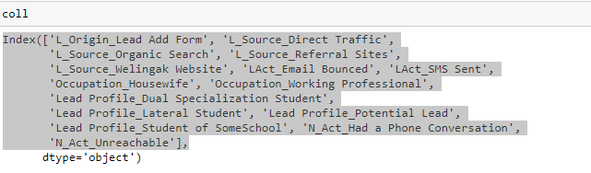
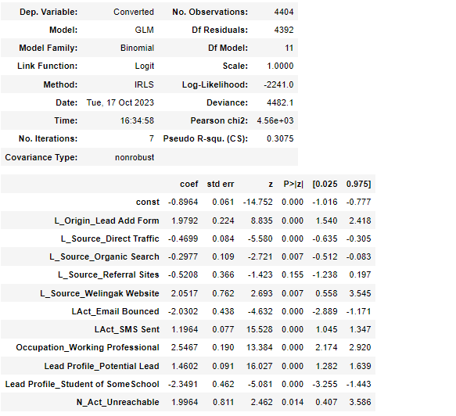
RFE METHOD
Columns that have been chosen by the RFE method
After running a few iterations and removing the feature variables which have a high p-value and the VIF values, we are down to the Model 5 where we have finalised the model on which we will be training the train and test set.

Slide 11
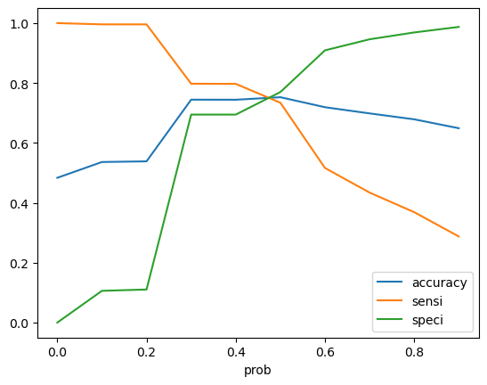
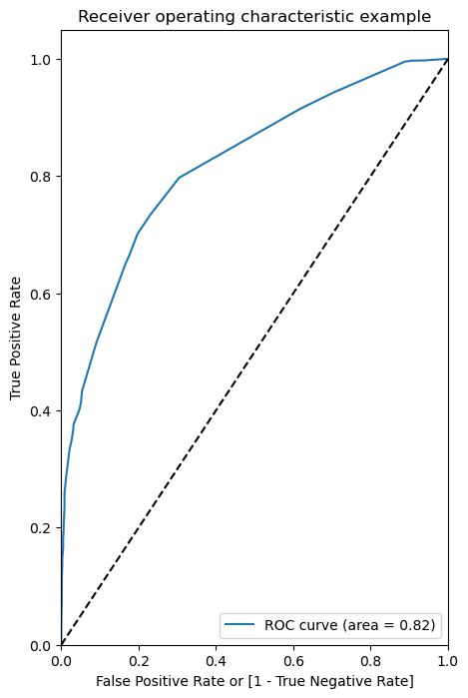
ROC Curve and the measurement of the factors
The area under the ROC curve is 0.82
The optimal cut-off value for the three graphs is 0.48

Slide 12
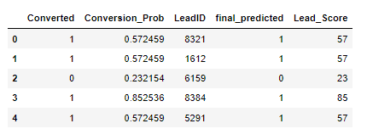

Conversion Probability
The data has been converted and the lead IDs have been assigned and further after predicting the score and calculating the conversion probability, we are able to assign the Lead Score for each of the Lead IDs

Slide 13
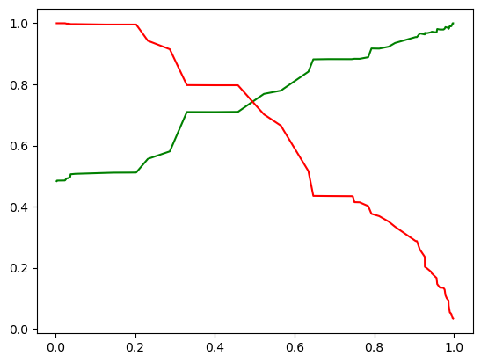


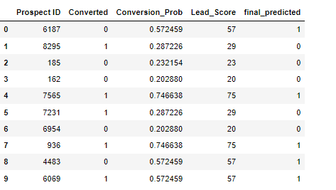
Predictions on the Test Set
Precision
Recall
After predicting it on the test set , we have an accuracy of 76% coupled with a precision of 76% and a recall value of 73%.
Conversion Probability Table on the Test Set

Slide 14
THANK YOU

