Slide 1

DreamDEX Reclaim
Settlement recovery and oracle auditing for DreamDEX Event Contracts
Somnia × DreamDEX Event Contracts Hackathon
Read-only public demo on Somnia Shannon testnet
01
Notes:
Project source: DreamDEX Reclaim repository and public application.

Slide 2
Winning positions can disappear from discovery
The live-market experience ends before every holder completes the settlement workflow.
1
2
3
Market trades
Market finalizes
Winning tokens remain
The position appears in the live Event Contract list.
The finalized binary leaves normal live discovery.
A holder can still have redeemable outcome tokens.
The missing product surface: post-settlement discovery and verification
DreamDEX Reclaim
02
Notes:
Source: dreamDEX Event Contracts recipes and gotchas. https://app.dreamdex.io/docs/developers/event-contracts/recipes and https://app.dreamdex.io/docs/developers/event-contracts/gotchas

Slide 3
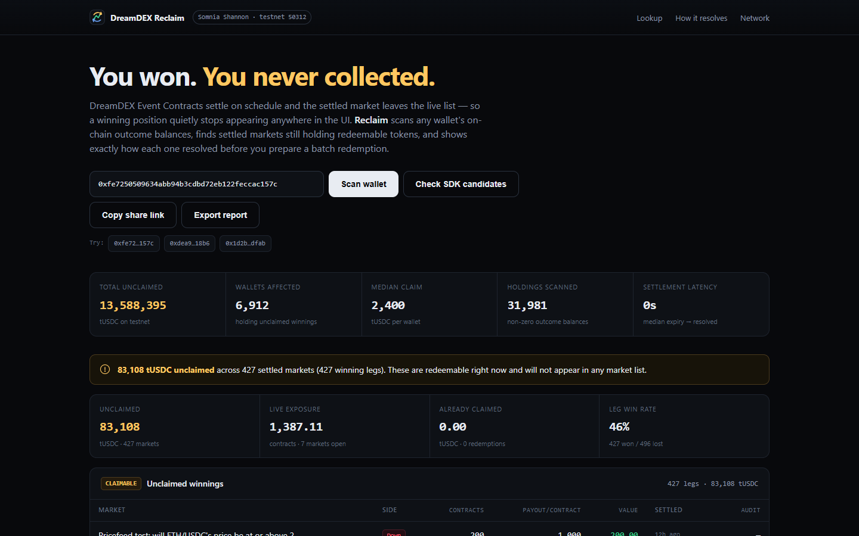
One address opens the recovery workspace
No wallet connection, authentication, or signature is required for discovery.
Address lookup
Scan any Somnia address and classify its indexed outcome-token positions.
Immediate evidence
The first screen shows a dated network snapshot while live scans run independently.
Share or export
Create a direct wallet URL or download a structured recovery report.
DreamDEX Reclaim
03
Notes:
Screenshot captured from the local DreamDEX Reclaim application using the demo address 0xfe7250509634abb94b3cdbd72eb122feccac157c.

Slide 4
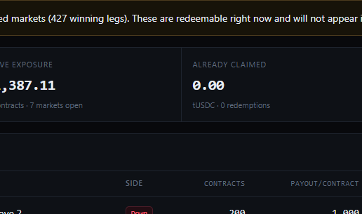
The wallet view separates every settlement state
A non-zero outcome-token balance does not automatically mean a winning claim.
UNCLAIMED
Finalized positions with a non-zero payout, ranked by estimated value.
LIVE EXPOSURE
Positions in markets that remain open for trading.
REDEMPTION HISTORY
Completed collections stay separate from balances that may still need action.
DreamDEX Reclaim
04
Notes:
Screenshot captured from the local DreamDEX Reclaim application. Values reflect changing Shannon testnet state.

Slide 5
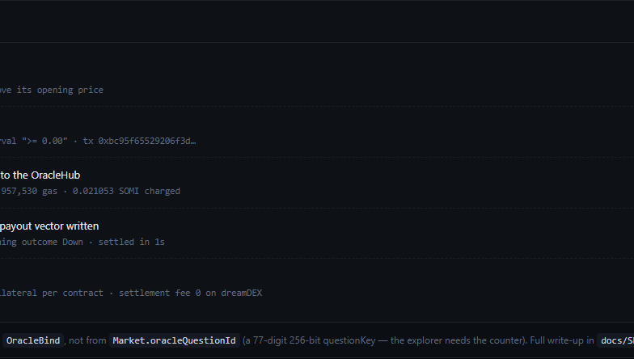
Every claim includes a settlement audit
The interface connects the payout to the oracle record and resolution evidence.
Market.id
OracleBind
OracleQuestion
This join produces the numeric question identifier required by the oracle explorer.
256-bit identifiers remain strings to prevent precision loss.
DreamDEX Reclaim
05
Notes:
Sources: DreamDEX Reclaim SDK feedback report and dreamDEX settlement documentation. https://app.dreamdex.io/docs/trading/event-contracts/settlement-and-voids

Slide 6
86% of represented wallets had an indexed claim
Dated Shannon testnet snapshot from 2026-09-11. Testnet tUSDC has no customer-dollar value.
13,588,395
estimated unclaimed tUSDC
31,981
non-zero balance rows
p50 0s
expiry to resolution
6,912 of 8,081 represented addresses
DreamDEX Reclaim
06
Notes:
Source: DreamDEX Reclaim network scan snapshot captured on 2026-09-11. Figures describe Shannon testnet state and change over time.

Slide 7
Two read paths with limits shown
The product uses each source for the job it can support.
Indexer
Settlement audit
SDK compatibility
Fast wallet discovery
OutcomeBalance joined to Market
Paginated recovery view
OracleBind resolution join
Payout vector classification
Oracle explorer evidence
getClaimable candidates
redeemMany payload preview
Public demo stays read-only
SDK v0.30.0 limits its portfolio query to 200 outcome-balance rows. Reclaim labels the result as bounded.
DreamDEX Reclaim
07
Notes:
Source: inspected @somnia-chain/markets-sdk v0.30.0 behavior documented in docs/SDK-FEEDBACK.md. The compatibility path is not presented as independent on-chain authority.

Slide 8
A visible recovery path for finalized positions
User outcome
TRY THE PRODUCT
Holders can find indexed winnings that normal live discovery no longer shows.
dream-dex-reclaim.vercel.app
Ecosystem outcome
SOURCE CODE
DreamDEX gains a clearer post-settlement experience and reproducible SDK feedback.
github.com/sharath2525/DreamDEX-Reclaim
Somnia Shannon testnet
08
Notes:
Live URL: https://dream-dex-reclaim.vercel.app/ Repository: https://github.com/sharath2525/DreamDEX-Reclaim

