Slide 1
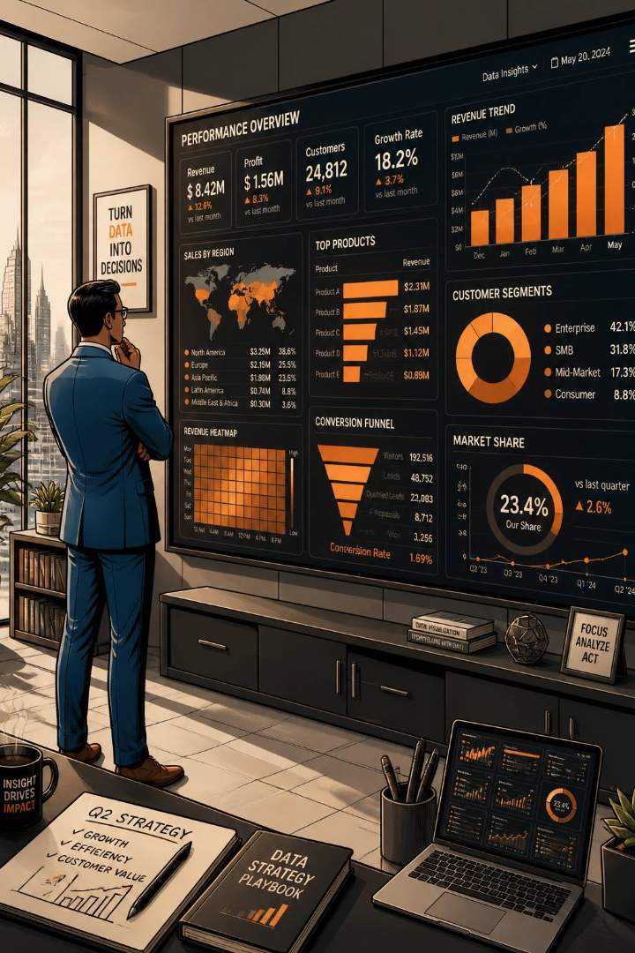
Customer Shopping Behavior Analysis
Analysis of 3,900 transactions to reveal spending patterns, segments, product preferences, and subscription behavior to guide strategic decisions.

Slide 2
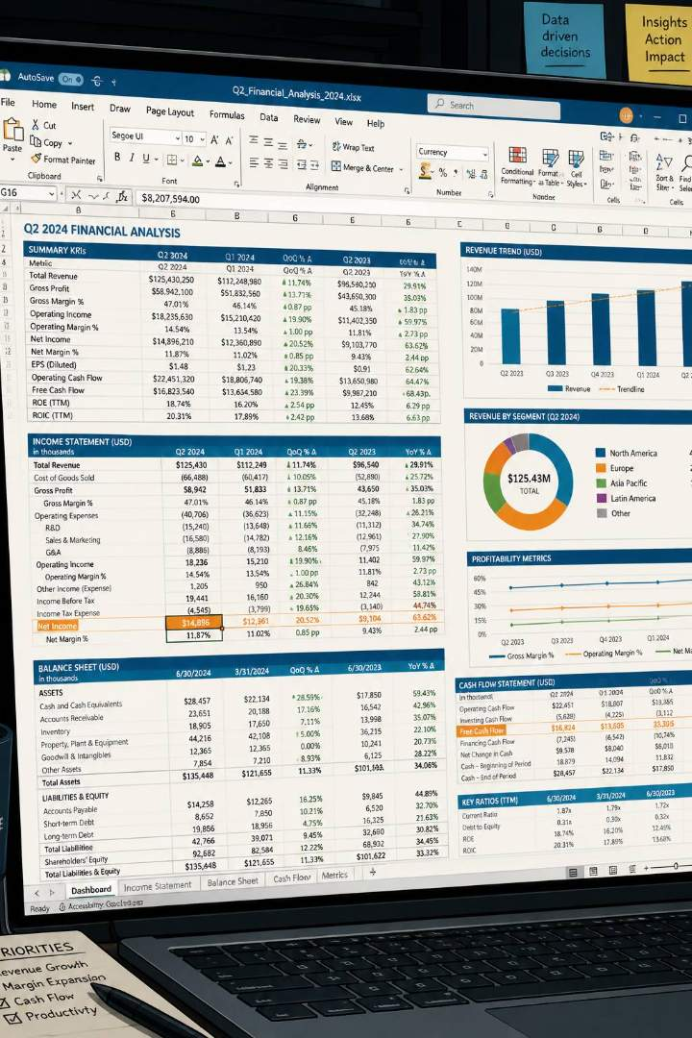
Dataset Snapshot
Rows / Columns
Key Features
3,900 rows · 18 columns
Demographics, purchase details, shopping behavior, subscription status
Missing Data
37 missing values in Review Rating

Slide 3

Data Preparation & Engineering
Cleaning Steps
Loaded data with pandas; inspected with df.info() and df.describe()
Imputed missing Review Rating using median per product category
Standardized column names to snake_case
Dropped redundant promo_code_used after consistency check
Feature Engineering
Created age_group bins and purchase_frequency_days for behavioral analysis.

Slide 4
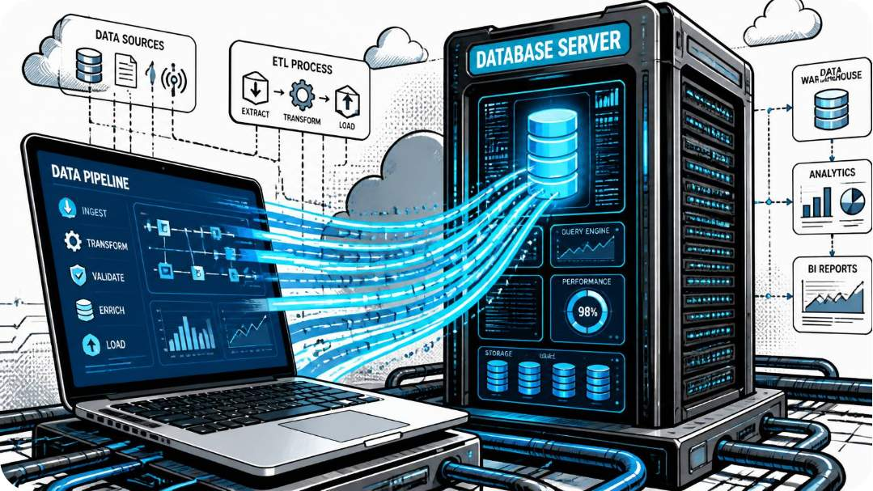
Database Integration & Workflow
Pipeline
Connected Python to Oracle SQL and loaded cleaned DataFrame for structured SQL analysis.
Enables repeatable queries
Supports dashboard-driven metrics

Slide 5

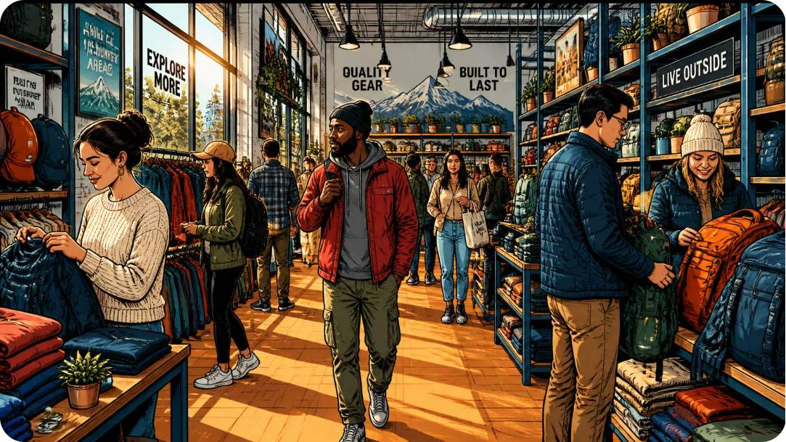
Revenue & Demographics
SQL analysis: Male customers generate nearly twice the revenue of female customers. Middle-aged and young adults contribute the largest share of revenue — key target segments.

Slide 6
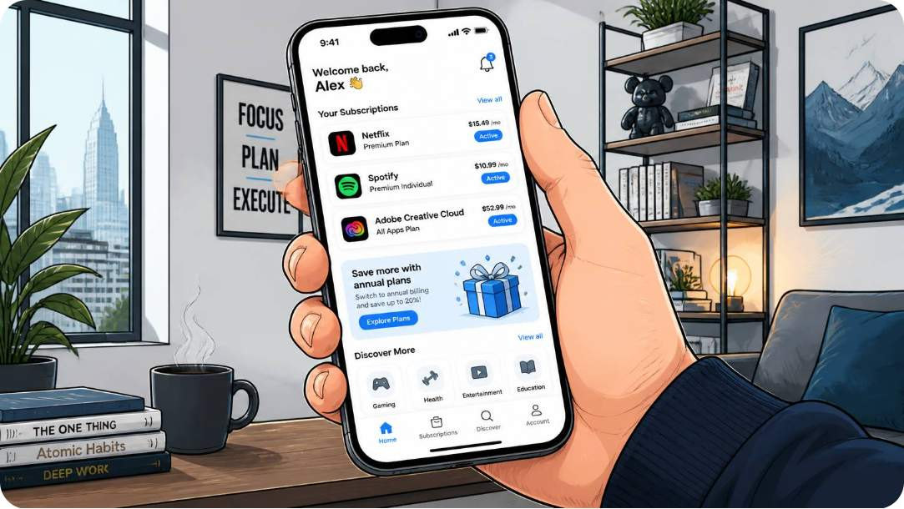
Subscription & Spending Patterns
Subscribers
Only 27% of customers are subscribers — clear growth opportunity for recurring revenue.
Discount Impact
Customers without discounts generate 57% of revenue — purchases not heavily promotion-dependent.
Shipping & Payment
Revenue similar across payment methods; Shipping comparison done (Standard vs Express).

Slide 7



Product & Category Insights
Clothing
Top Rated Products
Discount-Dependent Items
Drives the highest revenue — primary category focus.
Top 5 products identified by average rating (SQL-derived).
Five products have highest share of discounted purchases — candidates for margin review.

Slide 8




Customer Segmentation
New
Returning
Repeat buyers; nurture engagements
First-time buyers; onboarding focus
Returning
New
Loyal
Repeat purchase opportunities
First-time buyers; onboarding focus
High lifetime value; retention priority
Segments classified by purchase history to tailor marketing and retention strategies.
Loyal
High lifetime value; retention priority

Slide 9
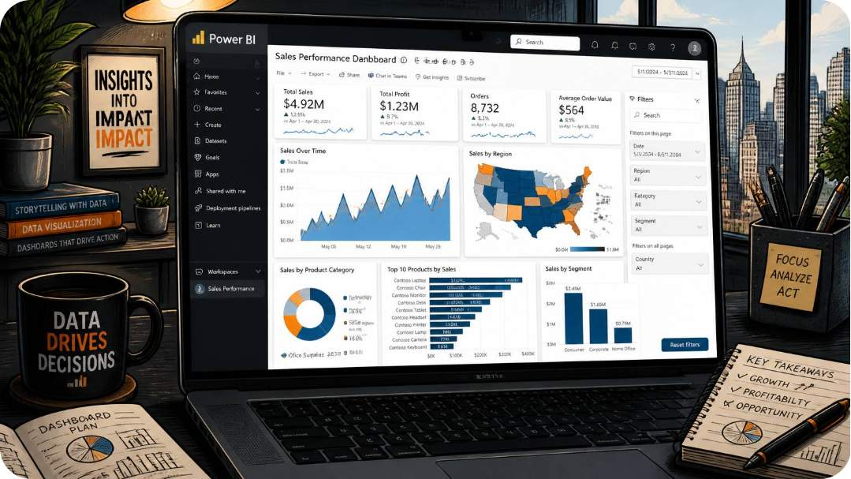

Analytics & Dashboard
Built an interactive Power BI dashboard to visualize SQL and Python results: revenue by gender, top products, seasonality, shipping comparison, and subscriber metrics — enabling exploratory analysis for stakeholders.
Dashboard centralizes findings and supports data-driven decisions.

Slide 10

Key Takeaways & Recommendations
Grow Subscriptions
27% penetration — prioritize acquisition and value messaging to increase recurring revenue.
Focus on Clothing
Highest revenue driver — allocate marketing and inventory to expand margins.
Optimize Promotions
57% revenue from non-discounted purchases — refine discount strategy to protect margins.
Target Key Segments
Young & middle-aged adults plus high-spend male segment—tailor campaigns and product mixes accordingly.

