Slide 1
Welcome to Selenium Training
By Sharath

Slide 2
Course Content
Introduction to JAVA
Installation of Eclipse IDE
Data types
Variables
Control Statements
Strings
Arrays
What are Functions?
Class
Object
Static and non-static variables
Static and non-static functions
Object Oriented Programming
Class
Object
Constructor
Inheritance
Polymorphism
Access Modifiers
Exception Handling
Collections
File Handling

Slide 3
Selenium Course Content
Introduction to Selenium WebDriver
First Program on selenium
Verify Page title in Selenium Webdriver
Navigation in selenium
Radio button and Checkbox in Selenium Webdriver
Handling Autosuggestion
Handling Dropdown List
Handling Drag and Drop in Selenium
Handling Mouse Hover ,Keyword Events using Action class
Synchronization using webdriver(Waits)
How to take screenshot using selenium
How to capture Error message using webdriver
Handling Multiple windows
Handling Alert Messages.
Handling IFrames.
Cross Browsing using selenium
Complete details of Dynamic XPath in Selenium
Complete details on CSS in selenium
How to download files in Selenium Webdriver.
Handling WebTable
How to use Logs File in selenium
How to use Properties File in selenium
Handling File upload using Saluki/Auto IT
TestNG
Apache POI

Slide 4
What is Java
Installing Java
Data types & Variables

Slide 5
What is Java
Java is a high-level programming language was originally developed by Sun Microsystems which was initiated by James Gosling and released in 1995.

Slide 6
Where java is used?
Java is basically used to develop the Software Applications. Below are types of applications
1) Standalone Application
It is also known as desktop application or window-based application. An application that we need to install on every machine such as media player, antivirus etc.
2) Web Application
An application that runs on the server side and creates dynamic page, is called web application. Currently, servlet, jsp, struts, jsf etc. technologies are used for creating web applications in java.

Slide 7
3) Enterprise Application
An application that is distributed in nature, such as banking applications etc. It has the advantage of high level security, load balancing and clustering. In java, EJB is used for creating enterprise applications.
4) Mobile Application
An application that is created for mobile devices. Currently Android and Java ME are used for creating mobile applications.

Slide 8
Java Installation
Steps to install the java:
Open the browser and navigate to URL: http://www.oracle.com/technetwork/java/javase/downloads/jre9-downloads-3848532.html
Click on Accept License Agreement
Select the Platform the and click on download.
Go to the file location and double-click on the saved file to start the installation process.
The installation process starts. Click the Install button to accept the license terms and to continue with the installation
You will get few window with Next button , click the Next button to continue the installation.
A few brief dialogs confirm the last steps of the installation process; click Close on the last dialog. This will complete Java installation process.

Slide 9
8. To verify the weather java is successfully installed, open cmd prompt and type below command
cd:\java –version [Enter]

Slide 10
First Java Program
public class FirstClass {
public static void main(String[] args){
System.out.println("Welcome to Java");
}
}

Slide 11
Data types & Varialbes
Variable:
Variable is name of reserved area allocated in memory. In other words, it is a name of memory location.
Eg : int age=20;
//age is variable
RAM
Reserved memory location
10

Slide 12
Types of Variable: There are three types of variables in java
1) Local Variable
A variable which is declared inside the method is called local variable.
2) Instance Variable
A variable which is declared inside the class but outside the method, is called instance variable . It is not declared as static.
3) Static variable
A variable that is declared as static is called static variable. It cannot be local.

Slide 13
class VariablesEg{
int age=20;//instance variable
static int marks=100;//static variable
void localVariable(){
int score=210;//local variable
}
}

Slide 14
Data Types in Java
Data types represent the different values to be stored in the variable. In java, there are two types of data types:
Primitive data types
Non-primitive data types

Slide 15
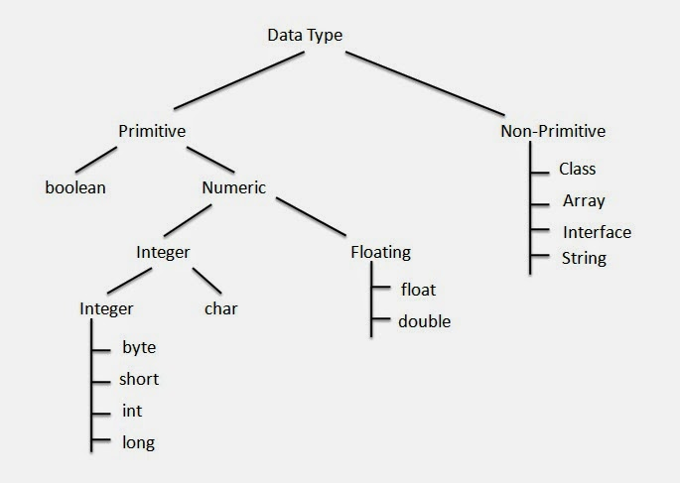

Slide 16
Data Type | Description | Range | Default Value | Default size
byte | Byte datatype is used to save space in large arrays, It is used in place of integer as it is four-time smaller than integer | +127 to -128 | 0 | 1 byte
short | Short data type is also used to save memory as byte datatype. The short data type is 2 times smaller than an int. | +32,767 to -32,768 | 0 | 2 byte
int | Int datatype is used as a default data type for integer values. | +2,147,483,647 to -2,147,483,648. (-2^31) | 0 | 4 byte
long | Long datatype is used when a wider range than int datatype is needed and Default value is OL. | +9,223,372,036,854,775,807 to -9,223,372,036,854,775,808 | 0L | 8 byte
float | Float datatype is used for saving memory in large arrays of floating point numbers. | 3.402,823,5 E+38 to 1.4 E-45 | 0.0f | 4 byte
double | Double datatype is used as a default data type for decimal values | 1.797,693,134,862,315,7 E+308 to 4.9 E-32 13.04, -145.5427, 0,0 | 0.0d | 8 byte
boolean | Boolean datatype is used for simple flags tracks true/false condition | true, false | FALSE | 1 bit
char | Char datatype is used for storing any character | All Unicode characters such as 'a', 's', '%', '9' | '\u0000' | 2 byte

Slide 17
Operators in java
Operator : Operator in java is a symbol that is used to perform operations. For example: +, -, *, / etc. There are many types of operators in java which are given below:
Unary Operator,
Arithmetic Operator,
shift Operator,
Relational Operator,
Bitwise Operator,
Logical Operator,
Ternary Operator and
Assignment Operator.

Slide 18
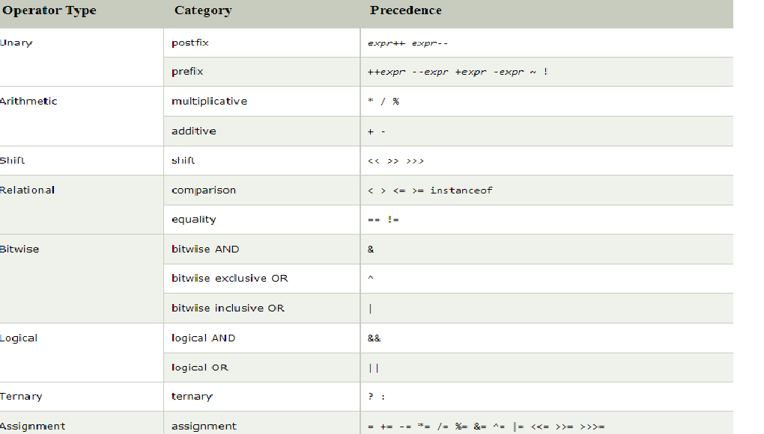

Slide 19
Example for Arithmetic Operator
class Arithmetic Example{
public static void main(String args[]){
int a=10;
int b=5;
System.out.println(a+b);//15
System.out.println(a-b);//5
System.out.println(a*b);//50
System.out.println(a/b);//2
System.out.println(a%b);//0
System.out.println(10*10/5+3-1*4/2);
}}

Slide 20
Example for Bitwise Operators
class Logical Example{
public static void main(String args[]){
boolean a = true;
boolean b = false;
if(a && b){
System.out.println("true");
}else{
System.out.println("False");
}}}

Slide 21
Example for Relational Operators
class Logical Example{
public static void main(String args[]){
int a=10, b=10;
boolean flag = a==10;
if(a==10){
System.out.println("equal");
}else{
System.out.println("not equal");
}}}

Slide 22
OR Operator Example: Logical || and Bitwise |
class LogicalBitwiseExample{
public static void main(String args[]){
int a=10;
int b=5;
int c=20;
System.out.println(a>b||a<c);//true || true = true
System.out.println(a>b|a<c);//true | true = true //|| vs |
System.out.println(a>b||a++<c);//true || true = true
System.out.println(a);//10 because second condition is not checked
System.out.println(a>b|a++<c);//true | true = true
System.out.println(a);//11 because second condition is checked
}}

Slide 23
Assignment Operator Example
class AssignmentExample{
public static void main(String args[]){
int a=10;
int b=20;
a+=4;//a=a+4 (a=10+4)
b-=4;//b=b-4 (b=20-4)
System.out.println(a);
System.out.println(b);
a+=3;//10+3
System.out.println(a);
a-=4;//13-4
System.out.println(a);
a*=2;//9*2
System.out.println(a);
a/=2;//18/2
System.out.println(a);
}
}

Slide 24
ShiftOperatorts
class BitwiseExample{
public static void main(String args[]){
// RightShift Operators
//For positive number, >> and >>> works same
System.out.println(10>>2);//10/2^2=10/4=2
System.out.println(20>>2);//20/2^2=20/4=5
System.out.println(20>>3);//20/2^3=20/8=2
System.out.println(20>>2);
System.out.println(20>>>2);
//For negative number, >>> changes parity bit (MSB) to 0
System.out.println(-20>>2);
System.out.println(-20>>>2);
// Left Shift Operators
System.out.println(10<<2);//10*2^2=10*4=40
System.out.println(10<<3);//10*2^3=10*8=80
System.out.println(20<<2);//20*2^2=20*4=80
System.out.println(15<<4);//15*2^4=15*16=240
}}

Slide 25
TernaryOperatorts
class TernaryExample{
public static void main(String args[]){
int a=2;
int b=5;
int min=(a<b)?a:b;
System.out.println(min);
}}

Slide 26
Conditional Statement

Slide 27
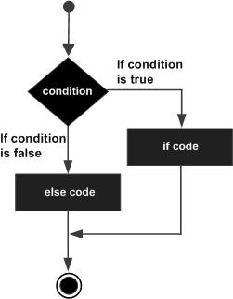
If Condition
public class Test {
public static void main(String args[]) {
int x = 30;
if( x < 20 )
{
System.out.print("This is if statement");
}
} }

Slide 28
if else condition
public class Test {
public static void main(String args[]) {
int x = 30;
if( x < 20 )
{
System.out.print("This is if statement");
}else{
System.out.print("This is else statement");
}
} }

Slide 29
if else condition
public class Test {
public static void main(String args[]) {
int x = 30;
if( x < 20 )
{
System.out.print("This is if statement");
}else{
System.out.print("This is else statement");
}
} }

Slide 30
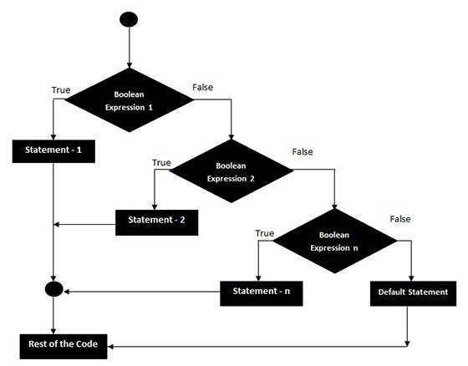
Nested if else condition

Slide 31
public class NestedIfElse {
public static void main(String[] args) {
int marks=65;
if(marks<35){
System.out.println("fail");
}
else if(marks>=35 && marks<50){
System.out.println("D grade");
}
else if(marks>=50 && marks<70){
System.out.println("C grade");
}
else if(marks>=70 && marks<80){
System.out.println("B grade");
}
else if(marks>=80 && marks<100){
System.out.println("A grade");
}else{
System.out.println("Invalid!");
}
}
}

Slide 32
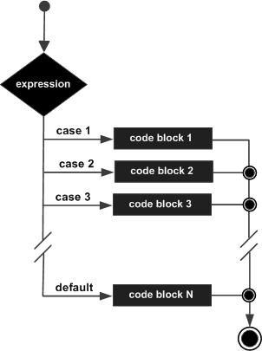
Switch Case
public class SwitchCaseExample {
public static void main(String[] args) {
String Case=Sunday;
switch(Case){
case ”Sunday”:
System.out.println(“Holiday");
break;
case ”Satuarday”:
System.out.println(“Holiday");
break;
default:
System.out.println(“WorkingDay");
}
}
}

Slide 33
LOOPS
loops in java is used to iterate any set of statements several times. The below are the different loops available in java.
For Loop
Normal for loop
Labeled for loop
For each loop
While Loop
Do While

Slide 34
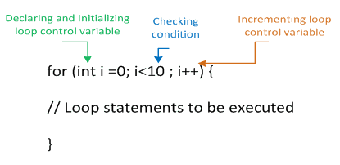
For Loop
If the number of iterations are fixed, it is recommended to use for loop.
There are three types of for loop in java.
For Loop
Labeled For Loop
For-each

Slide 35
Eg For Loop
for(int i=1; i<=10;i++){
System.out.println(i);
}
Break Keyword
for(int i=1; i<=10;i++){
if(i==5){
break;
}
System.out.println(i);
}
In Java break is a keyword used to exit from the loop or switch statement. It breaks the flow of the program. In case of nested loop, it breaks only inner loop.

Slide 36
Continue Keyword
for(int i=1; i<=10;i++){
if(i==5){
continue;
}
System.out.println(i);
}
In Java continue is a keyword used to skip from the step and continue the loop

Slide 37
Labeled For Loop
We can have name of each for loop. To do so, we use label before the for loop. It is useful if we have nested for loop so that we can break/continue specific for loop.
Normally, break and continue keywords breaks/continues the inner most for loop only.
FirstLoop:
for(int i=1;i<=3;i++){
SecondLoop:
for(int j=1;j<=3;j++){
if(i==2&&j==2){
break FirstLoop;
}
System.out.println(i+" "+j);
}
}

Slide 38
For Each Loop
The for-each loop is used to traverse array or collection in java. It is easier to use than simple for loop because we don't need to increment value and use subscript notation.
It works on elements basis not index. It returns element one by one in the defined variable.
int a[] = {1,2,4,5,6,7,8};
for(int i:a){
System.out.println(i);
}

Slide 39
Do While Loop
do-while loop is used to iterate a set of statements several times. If the you have to execute the loop at least once and want to continue the iteration till it satisfies some condition, it is recommended to use do-while loop. do-while loop is executed at least once because condition is checked after loop body
int i=1;
do{
System.out.println(i);
i++;
}while(i<=10);
}

Slide 40
While Loop
while loop is used to iterate a set of statements several times. If the number of iteration is not fixed, it is recommended to use while loop.
int i=1;
while(i<=10){
System.out.println(i);
i=i+1;
}

Slide 41
String
String is basically an object that represents sequence of char values. String class class provides a lot of methods to perform operations on string such as split(), length(), substring()..etc
String str = “JAVA”;
system.out.println(str.length()); OutPut:
JAVA

Slide 42
String Methods
Here are the list of the methods available in the Java String class. These methods are explained in the separate tutorials with the help of examples. Links to the tutorials are provided below:
int length(): It returns the length of a String.
String substring(int beginIndex): It returns the substring of the string. The substring starts with the character at the specified index.
String substring(int beginIndex, int endIndex): Returns the substring. The substring starts with character at beginIndex and ends with the character at endIndex.

Slide 43
Here are the list of the methods available in the Java String class. These methods are explained in the separate tutorials with the help of examples. Links to the tutorials are provided below:
int length(): It returns the length of a String.
String substring(int beginIndex): It returns the substring of the string. The substring starts with the character at the specified index.
String substring(int beginIndex, int endIndex): Returns the substring. The substring starts with character at beginIndex and ends with the character at endIndex.

