Slide 1

Introduction to Python Programming
Python was created by Guido van Rossum in 1991.
Python is a popular, versatile programming language, used for web development, data analysis, and machine learning.
Python's simple syntax and readability make it a great choice for beginners. This ease of learning allows you to focus on understanding the concepts and logic behind coding, rather than getting bogged down in complex syntax or rules.
Python's clear and concise structure encourages good coding practices from the start, paving the way for a strong foundation in programming.

Slide 2
Java vs Python
Just a example to show how simple python is to read and understand the code.
Java
Python
public class HelloWorld {
public static void main(String[] args) {
System.out.println("Hello, World");
}
}
print("Hello, World!")

Slide 3
What is Python?
Interpreted Language
High-Level Language
General-Purpose Language
Python is an interpreted language, which means it's executed line by line without needing to be compiled beforehand. This makes it easier to debug and iterate your code, as you can see the effects of changes immediately.
As a high-level language, Python focuses on readability and simplicity. Its syntax is designed to be clear and concise, making it easier to learn and use. This allows developers to express complex ideas with fewer lines of code.
Python is a general-purpose language, meaning it's suitable for a wide range of tasks, including web development, data science, machine learning, scripting, and more. Its versatility makes it a valuable tool for developers working in various fields.

Slide 4
Python Identifiers
1
1. Naming Rules
2
2. Keywords
3
3. Meaningful Naming
Identifiers, such as variable names, function names, and class names, must adhere to specific rules. They must begin with a letter (a-z, A-Z) or an underscore (_). Subsequent characters can include letters, digits (0-9), and underscores. Python is case-sensitive, meaning that `myVariable` and `myvariable` are treated as distinct identifiers.
Python has keywords, for its internal operations. These keywords have specific meanings and cannot be used as identifiers. Examples of common keywords include "if", "else", "for", "while", "def", "class", "import", and "return". Using these keywords as identifiers will lead to syntax errors and hinder code readability.
Choosing descriptive and meaningful names for identifiers significantly improves code readability. For instance, using "userName" instead of "u" for a variable that stores a user's name makes the code clearer and easier to understand.
Examples:
Good: `total_price`, `user_age`, `calculate_average`
Examples:
Examples:
Valid identifier: `my_list`
Bad: `x`, `y`, `z`
Valid identifiers: `my_variable`, `_age`, `name123`
Invalid identifier: `if` (because "if" is a reserved keyword)
Invalid identifiers: `123name`, `my-variable`

Slide 5
Python Statements
Defining Instructions
Statements are the basic building blocks of Python code, providing instructions the interpreter follows one by one. These instructions can range from simple assignments to complex function calls. For instance, an assignment statement like `variable = 10` assigns a value to a variable, while a function call statement like `print(variable)` executes a predefined function to perform a specific action.
Assignment Statement
Conditional Statement
Loop Statement
my_age = 25
if temperature > 30: print("It's hot!") else: print("It's not that hot.")
for i in range(3): print("Hello!")
Function Definition Statement
def add(a, b): return a + b

Slide 6
Python Expressions
Expressions in Python are a fundamental concept, used for various tasks ranging from simple calculations to complex data manipulations. An expression is formed by combining values, variables, operators, and function calls to produce a single value. Essentially, an expression is a piece of code that can be evaluated to produce a result.
Arithmetic Expressions
Comparison Expressions
Logical Expressions
Arithmetic expressions are used to perform mathematical calculations, such as addition (+), subtraction (-), multiplication (*), and division (/). These expressions operate on numeric values and yield a numerical result. For example, `10 + 5` evaluates to `15`, `20 - 12` evaluates to `8`, `3 * 7` evaluates to `21`, and `15 / 3` evaluates to `5`.
Comparison expressions use operators like "==" (equals), "!=" (not equals), "<" (less than), ">" (greater than), "<=" (less than or equals), and ">=" (greater than or equals) to compare operands. They evaluate to a Boolean value, either True or False, indicating whether a relationship between the operands is true or false. These expressions are essential for control flow in Python, allowing for decision-making based on comparisons. For example, `10 == 10` evaluates to `True`, `5 != 10` evaluates to `True`, `10 < 5` evaluates to `False`, `10 > 5` evaluates to `True`, `10 <= 10` evaluates to `True`, and `10 >= 5` evaluates to `True`.
Logical expressions combine Boolean values using "and," "or," and "not" operators. They are used to determine the truth or falsity of combined conditions, ultimately evaluating to a single Boolean value. These expressions are crucial for creating complex conditional statements and controlling program flow. For example, `True and True` evaluates to `True`, `True or False` evaluates to `True`, `False and False` evaluates to `False`, and `not True` evaluates to `False`.

Slide 7
Operators in Python
Arithmetic Operators
Comparison Operators
Perform mathematical calculations like addition (`+`), subtraction (`-`), multiplication (`*`), division (`/`), modulo (`%`), exponentiation (`**`), and floor division (`//`).
Compare values and return a Boolean result (True or False). These operators include:
Greater than (`>`)
>>> 5 + 3 8 >>> 10 - 4 6 >>> 2 * 6 12 >>> 10 / 2 5.0 >>> 10 % 3 1 >>> 2 ** 3 8 >>> 10 // 3 3
Less than (`<`)
Equal to (`==`)
Not equal to (`!=`)
Greater than or equal to (`>=`)
Less than or equal to (`<=`)
>>> 5 > 3 True >>> 2 < 5 True >>> 5 == 5 True >>> 5 != 6 True >>> 5 >= 5 True >>> 5 <= 6 True

Slide 8
Operators in Python
Logical Operators
Assignment Operators
Combine Boolean expressions using AND (`and`), OR (`or`), and NOT (`not`) to return a Boolean result. These operators are essential for constructing conditional statements and loops, allowing your program to make decisions based on logical conditions.
Assign values to variables. The most common is the equal sign (`=`). Python also provides compound operators like `+=`, `-=`, `*=`, and `/=`, which combine an arithmetic operation with assignment, offering a concise way to modify variable values.
>>> True and True True >>> True and False False >>> False and False False >>> True or True True >>> True or False True >>> False or False False >>> not True False >>> not False True
>>> a = 5 >>> a 5 >>> a += 3 >>> a 8 >>> a -= 2 >>> a 6 >>> a *= 2 >>> a 12 >>> a /= 3 >>> a 4.0

Slide 9
Operator Precedence
Operator Precedence
Operator precedence determines the order in which operations are performed in a Python expression. Operators with higher precedence are evaluated before those with lower precedence.
Here’s a brief overview of operator precedence from highest to lowest:
Parentheses: ()
Exponentiation: **
Unary + and -: +, -
Multiplication, Division, Floor Division, Modulus: *, /, //, %
Addition and Subtraction: +, -
Bitwise Shift Operators: <<, >>
Bitwise AND: &
Bitwise XOR: ^
Bitwise OR: |
Comparison Operators: ==, !=, <, >, <=, >=
Logical NOT: not
Logical AND: and
Logical OR: or
For example, multiplication and division have higher precedence than addition and subtraction.
This means in the expression `2 + 3 * 4`, the multiplication (`3 * 4`) is evaluated first, resulting in 12, and then the addition (`2 + 12`) is performed, giving us 14.
Some operators like exponentiation (`**`) have even higher precedence, so an expression like `2 + 3 ** 2` would be evaluated as `2 + 9`, which is 11.

Slide 10
Python Variables
Understanding Variables in the Context of Operator Precedence and Associativity
Variable Naming Rules for Efficient Coding
Variable names must start with a letter or underscore (_) and can consist of letters, numbers, and underscores.
Variables are crucial for storing data in Python expressions, allowing us to manipulate values in complex calculations. These rules ensure operations happen in the correct order based on operator precedence and associativity.
Python is case-sensitive.
Avoid using keywords like "if", "else", or "for" as variable names.
Remember, the assignment operator (`=`) is right-associative, enabling chained assignments. For example, `a = b = c = 10` assigns the value 10 to `c`, then to `b`, and finally to `a`.
Here are some valid variable names: `my_variable`, `name1`, `age`, `_temp`. Here are some invalid variable names: `123name`, `if`, `for`, `@name`. Using descriptive variable names enhances code readability and maintainability.

Slide 11

Dynamic Typing in Python
Python's dynamic typing allows you to declare variables without explicitly defining their data type. This simplifies coding, as you don't need to worry about type declarations, which can save time and effort. For example:
my_variable = 10 # No need to specify 'int' my_variable = "Hello" # Can now hold a string
While you don't need to specify types upfront, Python performs type checking during runtime. This means that the interpreter will verify whether the operations performed on variables are compatible with their data types. This helps catch type-related errors and ensures that the code runs smoothly. For example:
my_number = 10 my_string = "5" result = my_number + my_string # This would cause an error
Dynamic typing can sometimes lead to runtime errors. Python offers tools and techniques to help you handle these errors effectively. For example, you can use "try-except" blocks to catch and handle exceptions that might arise due to type mismatches. For example:
try: my_number = 10 my_string = "5" result = my_number + my_string except TypeError: print("Cannot add a number to a string.")

Slide 12
Python Data Types
Numeric Data Types
Boolean Data Type
Python offers integers, floats, and complex numbers to represent numerical values. Integers are whole numbers, floats are numbers with decimal points, and complex numbers have real and imaginary components. For example:
Booleans are fundamental for decision-making in Python. They represent truth values, either True or False, and are used in conditional statements to control program flow. For example:
True: 10 > 5
Integer: 10
False: 5 > 10
Float: 3.14
String Data Type
Strings are sequences of characters used to store text. Python offers a wide range of string methods for manipulation, such as searching, replacing, and formatting text. For example:
"Hello World!"
"Python is fun"

Slide 13
Numeric Data Types
Integers
Floating-Point Numbers
Integers are whole numbers, positive or negative, without any decimal points. Python integers can be arbitrarily large, meaning you don't need to worry about upper limits on their size. For example:
Floating-point numbers (floats) are used to represent real numbers with decimal points. Python uses the IEEE 754 standard for precision, ensuring accurate calculations even with very small or very large numbers. For example:
my_int = 10 # An integer
my_float = 3.14159 # A float with a decimal point
negative_int = -5 # A negative integer
small_float = 0.00001 # A very small float
large_int = 1234567890 # An arbitrarily large integer
large_float = 1.23456789e10 # A large float in scientific notation

Slide 14


Boolean Data Type
Truth Values
Logical Operations
A boolean is a fundamental data type in Python that can represent either "True" or "False." It is used to store truth values, which are essential for decision making and controlling program flow. For example, the following code snippet demonstrates the use of boolean variables to determine whether a number is even:
Booleans play a central role in logical operations, such as "AND," "OR," and "NOT," allowing for complex comparisons and decision making within programs. These operations rely on the truth values of boolean variables to determine the outcome of conditions and expressions. Here are some examples:
number = 10 is_even = number % 2 == 0 print(is_even) # Output: True
a = True b = False print(a and b) # Output: False print(a or b) # Output: True print(not a) # Output: False

Slide 15
String Data Type
A sequence of characters: Strings are ordered sequences of characters, where each character occupies a specific position or index. The index starts at 0 for the first character, 1 for the second, and so on.
Enclosed in quotes: Strings are defined in programming languages by enclosing them in either single or double quotes. This allows for the inclusion of quotes within the string itself, by using escape sequences or alternative quote types. For example, "This is a string with a single quote ' inside" or 'This is a string with a double quote " inside'.
Special characters: Strings can include special characters that represent non-printable characters or control codes. For example, the escape sequence '\n' represents a newline character, which is used to start a new line within a string. Consider this example: "This is the first line\nThis is the second line".

Slide 16
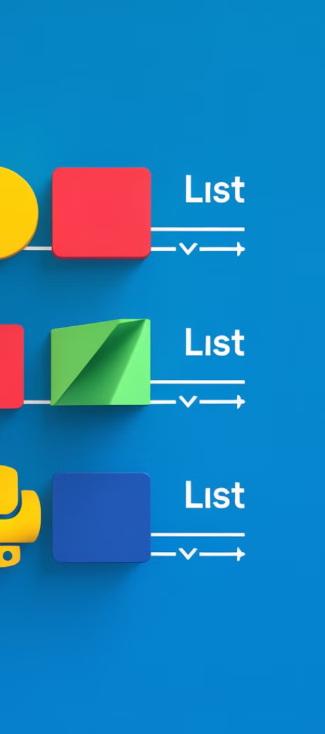
List Data Type
Lists in Python are versatile data structures that can store collections of items. They can be either ordered, preserving the order of elements, or unordered, where the order is not maintained.
Unlike strings, lists are mutable, meaning their elements can be changed. They are also dynamic, allowing you to add or remove elements while your program is running. For example, to change an element, you can use my_list[1] = "new_value". To add an element, try my_list.append("new_element"). And to remove an element, use my_list.remove("element_to_remove").
Lists also support indexing and slicing, which let you access specific elements or ranges of elements. To get the first element, use my_list[0]. To slice the list from the second element to the fourth element, try my_list[1:4].

