Slide 1

Introduction to Control Flow Statements
Control flow statements are an essential part of programming, allowing developers to control the order and execution of their code. These statements enable conditional logic, looping, and branching, which are fundamental to building complex and dynamic applications.
Simple Example
if x > 10:
print("x is greater than 10")
if-else statements: Execute different blocks of code based on a condition, for example, checking if a user is logged in or not.
for loops: Repeat a block of code a specific number of times, for example, printing a list of numbers.
while loops: Repeat a block of code as long as a condition is true, for example, waiting for user input.
Single-Line Example
Multiple Conditions Example
if y == 0: print("y is zero")
if a > 5 and b < 10:
print("a is greater than 5 and b is less than 10")

Slide 2
The if Decision Control Flow Statement
Conditional Execution
Decision-Making Logic
The if statement executes code based on a condition. If the condition is true, the code runs. Otherwise, it's skipped.
The if statement controls execution flow based on a true or false condition, allowing your program to react dynamically.
Syntax and Usage of if Statement
Simple Example
Single-Line Example
Multiple Conditions Example
if x > 10:
print("x is greater than 10")
if y == 0: print("y is zero")
if a > 5 and b < 10:
print("a is greater than 5 and b is less than 10")

Slide 3
Evaluating Conditions in if Statement
Comparison Operators
Logical Operators
Comparison operators like "==" (equals to), "!=" (not equals to), "<" (less than), ">" (greater than), "<=" (less than or equals to), and ">=" (greater than or equals to) compare values.
Logical operators combine multiple conditions: "AND" (&&), "OR" (||), and "NOT" (!).
if temperature > 30 and humidity < 50: # Execute code if temperature is above 30 and humidity is below 50
if age >= 18: # Execute code if age is 18 or older
The condition in an if statement is a boolean expression that evaluates to true or false.

Slide 4
The if...else Decision Control Flow Statement
1
1. Example: Voting Eligibility
2
2. Example: Even or Odd
3
3. Example: Temperature Check
```python age = 20 if age >= 18: print("You are eligible to vote.") else: print("You are not yet eligible to vote.") ```
```python number = 7 if number % 2 == 0: print("The number is even.") else: print("The number is odd.") ```
```python temperature = 25 if temperature > 20: print("It's warm outside.") else: print("It's cool outside.") ```
Single-Line if...else Statement
```number = 10 print("Even") if number % 2 == 0 else print("Odd")

Slide 5


The if...else Decision Control Flow Statement
Example 1: Age Verification
Example 2: Even or Odd
# Define the age variable
age = 18 # You can change this value to test different ages
# Check if the person is an adult
if age >= 18:
print("You are an adult.")
else:
print("You are not an adult yet.")
# Define the number
num = 10 # You can change this value to test different numbers
# Check if the number is even or odd
if num % 2 == 0:
print("The number is even.")
else:
print("The number is odd.")

Slide 6
The if...else Decision Control Flow Statement
1
Example 1
2
Example 2
3
Example 3
4
Example 4
# Define the age variable age = 18 # You can change this value to test different ages # Check if the person is an adult if age >= 18: print("You are an adult.") else: print("You are not an adult yet.")
# Define the number num = 10 # You can change this value to test different numbers # Check if the number is even or odd if num % 2 == 0: print("The number is even.") else: print("The number is odd.")
# Define the grade grade = 85 # You can change this value to test different grades # Check the grade if grade >= 90: print("A") elif grade >= 80: print("B") else: print("C or below")
# Define the day day = "Monday" # You can change this value to test different days # Check the day if day == "Saturday" or day == "Sunday": print("Weekend!") else: print("Weekday.")

Slide 7


The if...else if...else Decision Control Statement
Example 1: Student Grade
score = int(input("Enter the student's score: ")) if score >= 90: print("A") elif score >= 80: print("B") elif score >= 70: print("C") else: print("D")
Example 2: Discount Calculation
amount = float(input("Enter the purchase amount: ")) if amount >= 100: discount = 0.15 * amount elif amount >= 50: discount = 0.10 * amount else: discount = 0.05 * amount print("Discount:", discount)

Slide 8
Single-Line vs. Block if Statements
Single-Line if Statement
Block if Statement
A single-line if statement executes one statement if a condition is true. It's useful for simple logic.
A block if statement executes multiple statements if a condition is true. It's more versatile for complex logic.
if (age >= 18):
print("You are eligible to vote.")
# Example: Checking if a number is even
number = 10
print("Even") if number % 2 == 0 else print("Odd")
# Example: Setting a variable based on a condition
is_raining = True
weather_message = "Take an umbrella" if is_raining else "Enjoy the sunshine!"
print(weather_message)
if (score >= 90):
print("Excellent Job!");
awardBonusPoints();
# Example: Checking if a number is within a range
number = 50
if (number >= 10 and number <= 50):
print("Number is within the range.")
performCalculation(number);
# Example: Handling multiple conditions
grade = 85
if (grade >= 90):
print("A")
elif (grade >= 80):
print("B")
else:
print("C")

Slide 9
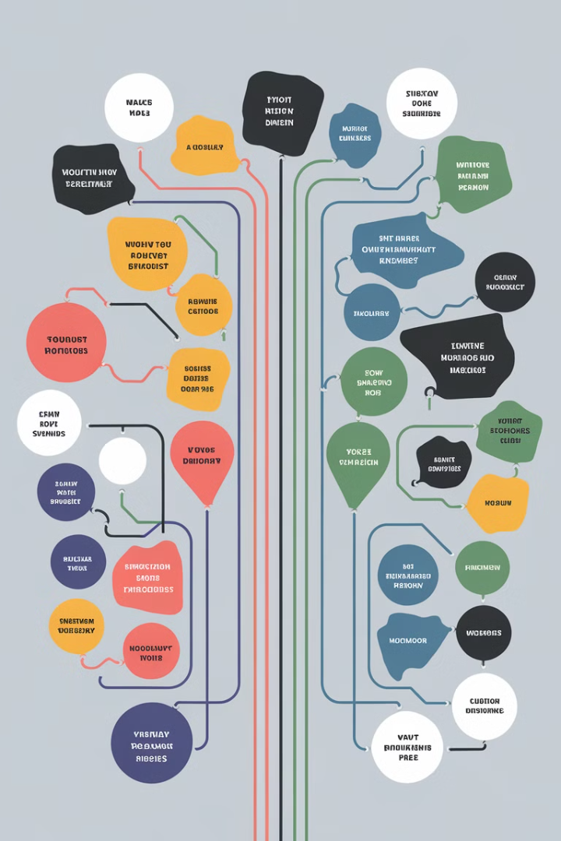
The if...else if...else Decision Control Statement
Example 1: Age-Based Messages
Example 2: Location-Based Shipping
Check a user's age and display appropriate messages: under 18 - warning, 18-21 - ID prompt, over 21 - welcome, else - error.
Calculate shipping costs based on location: same city - no fee, same state - flat fee, outside state - distance-based fee, else - invalid location.
age = int(input("Enter your age: ")) if age < 18: print("You are too young for this.") elif age >= 18 and age <= 21: print("Please provide your ID.") elif age > 21: print("Welcome!") else: print("Invalid age input.")
location = input("Enter your location: ") if location == "Bangalore": print("No shipping fee.") elif location == "Karnataka": print("Flat fee applied.") elif location == "outside state": print("Distance-based fee applied.") else: print("Invalid location.")
Example 3: Purchase Amount Discounts
Determine discounts based on purchase amounts: less than $100 - no discount, $100-$200 - 5% discount, over $200 - 10% discount, else - error.
amount = float(input("Enter purchase amount: ")) if amount < 100: print("No discount.") elif amount >= 100 and amount <= 200: print("5% discount applied.") elif amount > 200: print("10% discount applied.") else: print("Invalid purchase amount.")

Slide 10


Nested if Statements
Checking Eligibility for a Discount
Validating User Input
Nested ifs create decision trees, branching based on conditions.
Nested ifs enable sequential decisions, evaluating inner conditions only if the outer one is true.
if customer_type == "Gold":
if purchase_amount >= 100:
print("Apply 20% discount")
else:
print("Apply 10% discount")
else:
print("No discount available")
if len(password) >= 8:
if "!" in password:
print("Strong password!")
else:
print("Password should include a special character.")
else:
print("Password should be at least 8 characters long.")

Slide 11



The while Loop
Printing Numbers
User Input Validation
Calculating Factorial
This example prints numbers from 1 to 5:
This example asks the user for a positive number until a valid input is provided:
This example calculates the factorial of a number using a while loop:
i = 1
while i <= 5:
print(i)
i += 1
number = 0
while number <= 0:
number = int(input("Enter a positive number: "))
if number <= 0:
print("Invalid input. Please enter a positive number.")
print("You entered: ", number)
num = 5
factorial = 1
i = 1
while i <= num:
factorial *= i
i += 1
print("Factorial of", num, "is:", factorial)

Slide 12



The while Loop
Example 1: Counting to 10
Example 2: User Input Validation
Example 3: Looping Through a List
counter = 1 while counter <= 10: print(counter) counter += 1
age = 0 while age < 0: age = int(input("Enter your age: ")) print("You are", age, "years old.")
names = ["Alice", "Bob", "Charlie"] i = 0 while i < len(names): print(names[i]) i += 1
The while loop lets you repeat instructions until a condition is false.

Slide 13
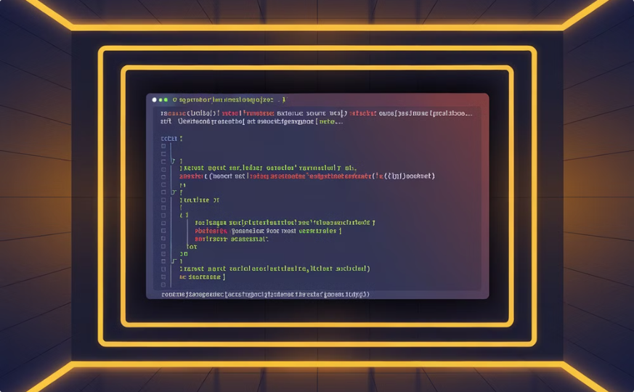
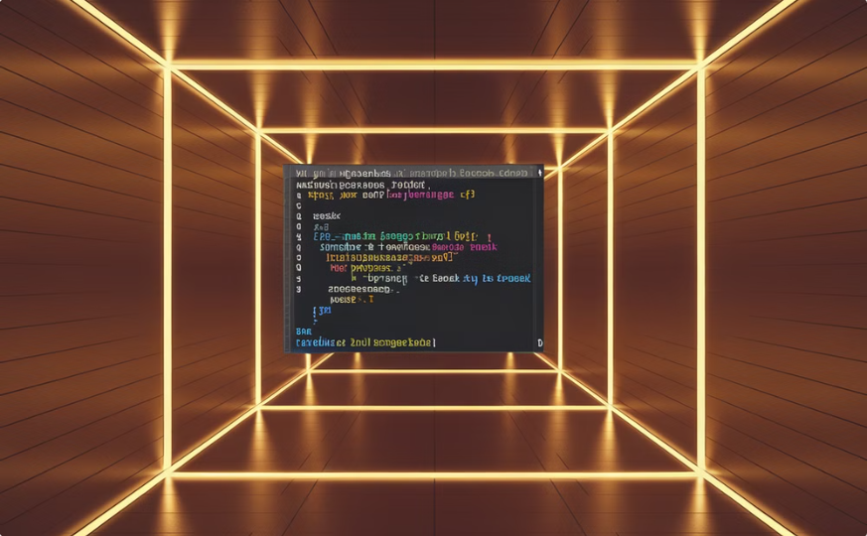
The continue and break Statements
Skipping Iterations
Terminating Loops
Imagine you're going through a list of numbers and want to skip any even numbers. The continue statement lets you do just that! Here's how it works:
Sometimes you might want to stop a loop altogether before it reaches its natural end. That's where break comes in. Let's say you want to find the first even number in a list and stop the loop as soon as you find it:
# Loop through numbers from 1 to 10
for i in range(1, 11):
if i % 2 == 0:
continue # Skip even numbers
print(i) # Print only odd numbers
# Loop through numbers from 1 to 10 for i in range(1, 11): if i % 2 == 0: print(f"Found the first even number: {i}") break # Stop the loop

Slide 14
The continue Statement
Introduction to continue
Example
The continue statement skips the current iteration of a loop, allowing you to move to the next iteration without processing the current one.
Imagine you are iterating through a list of numbers and want to skip any even numbers:
# Loop through numbers from 1 to 10 for i in range(1, 11): if i % 2 == 0: continue # Skip even numbers print(i) # Print only odd numbers

Slide 15
The continue and break Statements
1
2
3
continue
break
Control
For example, you can use continue to skip even numbers in a loop:
For example, you can use break to stop a loop when a specific condition is met:
Both statements control loop execution.
for i in range(10):
if i % 2 == 0:
continue
print(i)
for i in range(10):
if i == 5:
break
print(i)

Slide 16
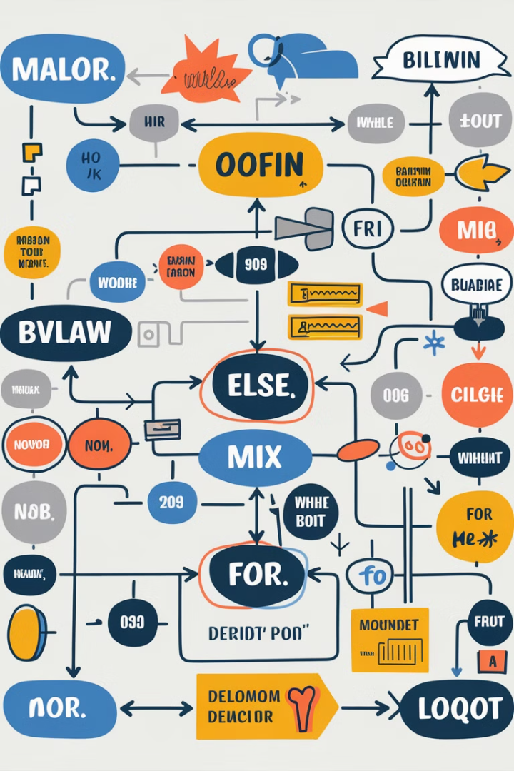


Conclusion and Key Takeaways
Understanding Control Flow
Key Takeaways
Master control flow statements to create dynamic and efficient programs.
Control flow statements are essential for building complex and efficient code.

