Slide 1
Encapsulation in Python
Encapsulation is a core concept in object-oriented programming (OOP) and plays a crucial role in Python. It bundles data (attributes) and methods (functions) that operate on that data within a single unit called a class. This bundling enforces data hiding and protects data integrity.
Encapsulation acts as a protective barrier around an object's data. By using encapsulation, we ensure that data is only accessed and modified through well-defined methods. This controlled access helps maintain data consistency and prevents accidental changes or corruption.
Consider a bank account class in Python. It's a good example to understand encapsulation. The class will have attributes like balance, account number, etc. and methods for depositing, withdrawing, and checking the balance. Encapsulation ensures these methods are the only way to interact with the balance attribute. This protects the integrity of the data by preventing direct modification of the balance from outside the class.
In Python, encapsulation is achieved using the `__` (double underscore) naming convention. Attributes and methods prefixed with `__` are considered private and are not directly accessible outside the class. This restricts access to the internal data and methods of the class, promoting data protection.
Encapsulation, along with other OOP principles like inheritance and polymorphism, contributes to creating robust, modular, and maintainable code in Python. By using encapsulation effectively, we can design cleaner and more organized programs that are easier to understand, modify, and extend.

Slide 2
Key Concepts of Encapsulation in Python
Example 1: Bank Account Class
class BankAccount: def __init__(self, balance): self.__balance = balance def deposit(self, amount): self.__balance += amount def withdraw(self, amount): if self.__balance >= amount: self.__balance -= amount else: print("Insufficient funds.") def get_balance(self): return self.__balance account = BankAccount(1000) account.deposit(500) account.withdraw(200) print("Current balance:", account.get_balance())

Slide 3
Example 2: Car Class
class Car: def __init__(self, speed, fuel_level): self.__speed = speed self.__fuel_level = fuel_level def accelerate(self, amount): self.__speed += amount def brake(self, amount): self.__speed -= amount def refuel(self, amount): self.__fuel_level += amount def get_speed(self): return self.__speed def get_fuel_level(self): return self.__fuel_level my_car = Car(0, 50) my_car.accelerate(20) my_car.brake(10) my_car.refuel(10) print("Current speed:", my_car.get_speed()) print("Current fuel level:", my_car.get_fuel_level())

Slide 4
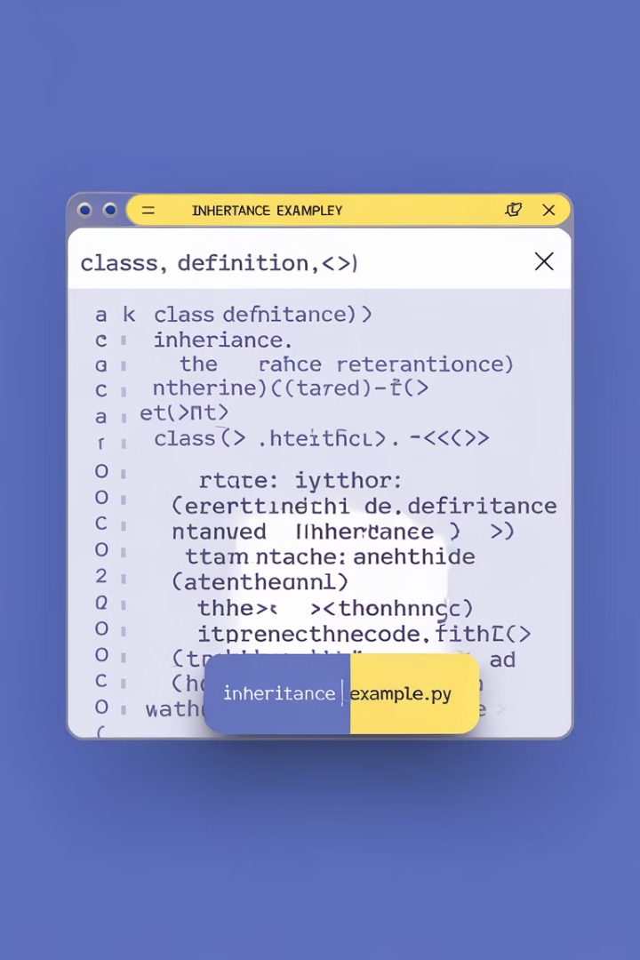
Inheritance in Python
Inheritance is a fundamental concept in object-oriented programming (OOP). It allows programmers to create new classes that inherit properties and behaviors from existing classes. This is achieved through the use of the "class" keyword and the "super()" function in Python.
The concept of inheritance is commonly referred to as the "is-a" relationship. For example, a "Dog" class could inherit from a "Mammal" class. This means a Dog *is a* Mammal, and it will inherit all the properties and behaviors of the Mammal class.
This "parent-child" relationship fosters code reusability and promotes modularity in software development. Inheritance establishes a hierarchical structure where child classes, called subclasses, inherit characteristics from their parent classes, known as superclasses. This allows for efficient code reuse and reduces redundancy.

Slide 5
Inheritance in Python
Example 1
class Animal:
# Constructor for the Animal class
def __init__(self, name):
# Assigns the given name to the animal
self.name = name
# Method to simulate the animal's sound
def speak(self):
# Prints a generic animal sound
print("Generic animal sound")
class Dog(Animal):
# Overrides the speak method from the Animal class
def speak(self):
# Prints a specific sound for a dog
print("Woof!")
# Creates a Dog object named 'Buddy'
my_dog = Dog("Buddy")
# Calls the speak method on the Dog object
my_dog.speak()

Slide 6
Example 2
class Vehicle:
# Constructor for the Vehicle class
def __init__(self, brand):
# Assigns the given brand to the vehicle
self.brand = brand
# Method to simulate driving the vehicle
def drive(self):
# Prints a message indicating the vehicle is driving
print("Driving the vehicle")
class Car(Vehicle):
# Constructor for the Car class
def __init__(self, brand, model):
# Calls the parent class's constructor to initialize brand
super().__init__(brand)
# Assigns the given model to the car
self.model = model
# Creates a Car object with brand 'Toyota' and model 'Corolla'
my_car = Car("Toyota", "Corolla")
# Calls the drive method on the Car object
my_car.drive()
# Prints the brand of the car
print(my_car.brand)
# Prints the model of the car
print(my_car.model)

Slide 7

Polymorphism in Python
Polymorphism is a core concept in object-oriented programming (OOP) that enables code to be flexible and adaptable. In Python, polymorphism is achieved through the use of inheritance and method overriding. It allows you to write code that works seamlessly with objects of different classes through a common interface.
The term "polymorphism" translates to "many forms". In OOP, polymorphism refers to the ability of a single method to handle different data types or objects. This simplifies code and promotes reusability by allowing you to perform the same action on various object types without needing to write separate code for each.

Slide 8
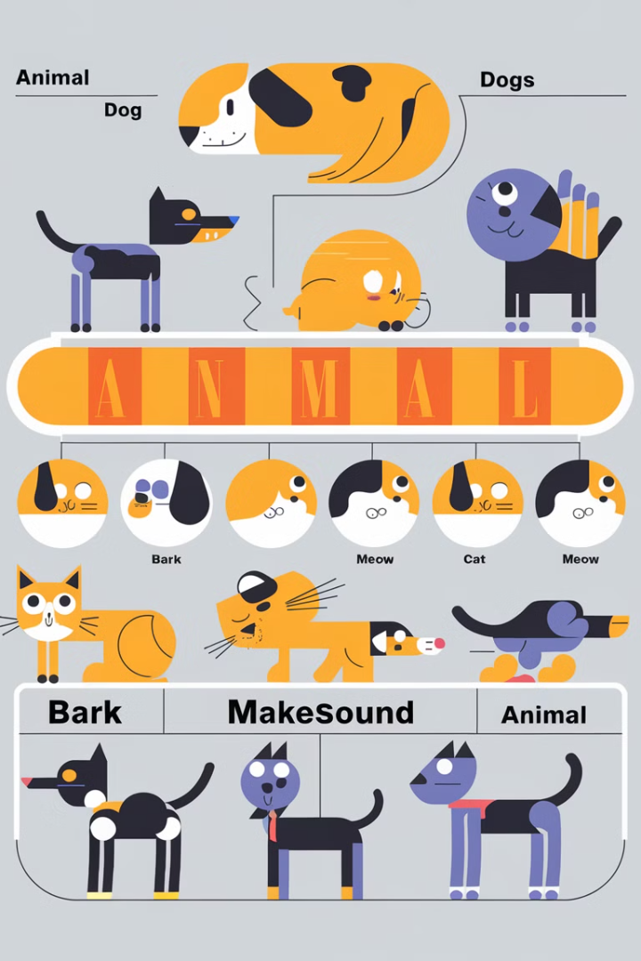
Polymorphism in Python
Polymorphism is a core principle of OOP that allows objects of different classes to be treated as instances of a common base class. This flexibility enables code reuse and makes programs more adaptable and maintainable.
Consider the example below, where a base class "Animal" is defined with a `make_sound` method. Derived classes "Dog" and "Cat" inherit from "Animal" and override the `make_sound` method with their specific sounds. Even though we access the `make_sound` method through a list of "Animal" objects, the output reflects the specific behavior of each class. This demonstrates the power of polymorphism.
class Animal:
def make_sound(self):
print("Generic animal sound")
class Dog(Animal):
def make_sound(self):
print("Woof!")
class Cat(Animal):
def make_sound(self):
print("Meow!")
animals = [Dog(), Cat(), Animal()]
for animal in animals:
animal.make_sound()

Slide 9
Examples
1. Classes and Objects
Python allows you to define classes, blueprints for creating objects, which encapsulate data and methods. Objects are instances of a class, representing specific data and behavior. For example:
class Dog:
def __init__(self, name, breed):
self.name = name
self.breed = breed
def bark(self):
print("Woof!")
my_dog = Dog("Buddy", "Golden Retriever")
my_dog.bark()

Slide 10
Inheritance
Inheritance allows you to create new classes (child classes) that inherit properties and methods from existing classes (parent classes). This promotes code reusability and allows for specialized functionality. For example:
class Animal:
def __init__(self, name):
self.name = name
def make_sound(self):
print("Generic animal sound")
class Dog(Animal):
def make_sound(self):
print("Woof!")
my_dog = Dog("Buddy")
my_dog.make_sound()

Slide 11
Encapsulation
Encapsulation hides data within a class, controlling access through methods. This promotes data security and makes your code more robust. For example:
class BankAccount:
def __init__(self, balance):
self.__balance = balance # Private attribute
def deposit(self, amount):
self.__balance += amount
def withdraw(self, amount):
if self.__balance >= amount:
self.__balance -= amount
print("Withdrawal successful")
else:
print("Insufficient funds")
def get_balance(self):
return self.__balance
my_account = BankAccount(1000)
my_account.deposit(500)
my_account.withdraw(200)
print(my_account.get_balance())

Slide 12
Polymorphism
Polymorphism allows objects of different classes to respond to the same method call in different ways. For example:
class Cat:
def make_sound(self):
print("Meow!")
class Dog:
def make_sound(self):
print("Woof!")
animals = [Cat(), Dog()]
for animal in animals:
animal.make_sound()

