Slide 1
Decorator Design Pattern
Submitted By:
Arvind Sheri
Sharath Koppu
V Bhanu Sudheer
Aditya Soman

Slide 2
Introduction
A design pattern is usually used to extend the behavior of an object at runtime.
Part of Object Oriented Programming.
Allows a behavior to be added to individual object, either statically or dynamically.
Allows functionality to be divided between class with unique areas of concern.
All the classes handle the request.

Slide 3
Story
We are going to consider the making of ice cream as an example.
We usually will make the basic ice cream layer first, and then add the toppings as needed.
The next few slides will deal with the UML diagram and codes for the above mentioned example.

Slide 4
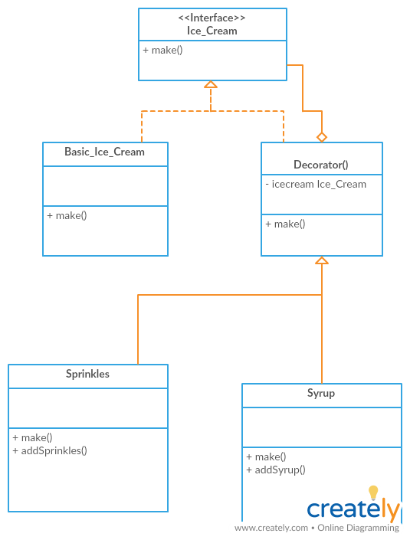
UML Design

Slide 5
Code – Interface
//Interface Creation: Basic Ice Cream
package com.umkc.addy.designpattern;
public interface Ice_Cream {
public String make();
}

Slide 6
Code – Basic Layer of Ice Cream
package com.umkc.addy.designpattern;
public class Basic_Ice_Cream implements Ice_Cream {
@Override
public String make() {
return "Basic Icecream";
}
}

Slide 7
Code – Decorator Class
package com.umkc.addy.designpattern;
abstract class Decorator implements Ice_Cream {
protected Ice_Cream specialIcecream;
public Decorator (Ice_Cream specialIcecream)
{
this.specialIcecream = specialIcecream;
}
public String make()
{
return specialIcecream.make();
}
}

Slide 8
Code – Sprinkles Decorator
package com.umkc.addy.designpattern;
public class Sprinkles extends Decorator{
public Sprinkles(Ice_Cream specialIcecream)
{
super(specialIcecream);
}
public String make()
{
return specialIcecream.make() + addSprinkles(); //adding sprinkles
}
private String addSprinkles()
{
return " + Sprinkles";
}
}

Slide 9
Code – Syrup Decorator
package com.umkc.addy.designpattern;
public class Syrup extends Decorator{
public Syrup(Ice_Cream specialIcecream)
{
super(specialIcecream);
}
public String make()
{
return specialIcecream.make() + addSyrup(); //adding syrup
}
private String addSyrup()
{
return " + Syrup";
}
}

Slide 10
Code: Main Function
package com.umkc.addy.designpattern;
public class IceCreamMaking {
public static void main(String args[])
{
Ice_Cream icecream = new Syrup(new Sprinkles(new Basic_Ice_Cream()));
System.out.println(icecream.make());
}
}

Slide 11
Code – Java Files
Interface File
Basic Ice Cream Creation
Decorator Syrup Class
Decorator Class
Decorator Sprinkles Class
Main Function

Slide 12
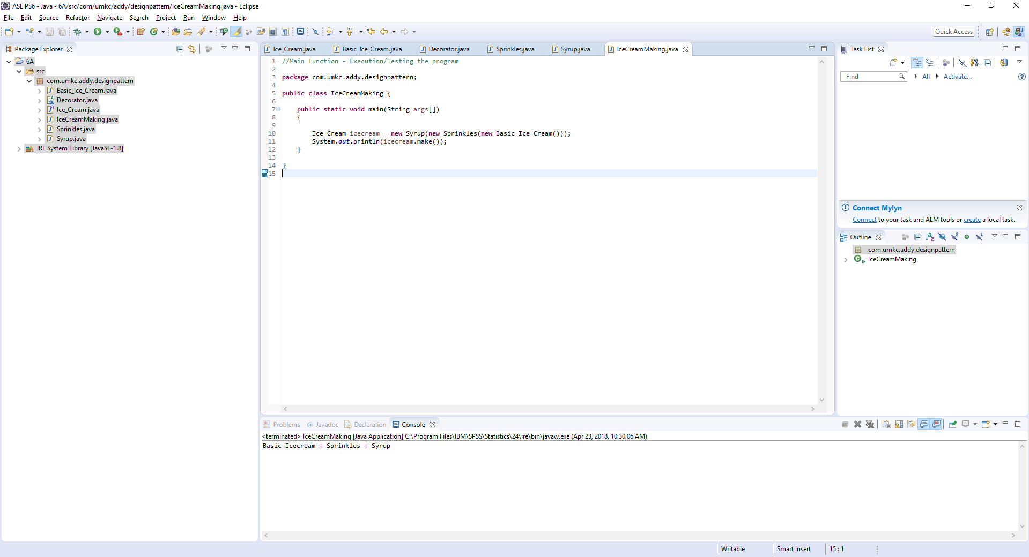
Program Output

Slide 13
Quiz
What is a decorator design pattern?
Decorator Design Pattern allows the user to add new functionality to an existing object without altering its structure. (True/False)
List at least one disadvantage of decorator design pattern.

Slide 14
References
https://en.wikipedia.org/wiki/Decorator_pattern
https://javapapers.com/design-patterns/decorator-pattern/
https://creately.com/app/#
https://www.geeksforgeeks.org/the-decorator-pattern-set-2-introduction-and-design/

