Slide 1


UE20CS302 – Machine Intelligence Mini Project
Credit Card Fraud Detection
Team No: 1
Project Team with SRNs :
Satish – PES2UG20CS550 Sharath – PES2UG20CS552
Shreepathi – PES2UG20CS553

Slide 2
Problem statement
With the growth of e-commerce websites, people and financial companies rely on online services to carry out their transactions that have led to an exponential increase in the credit card frauds.
Fraudulent credit card transactions lead to a loss of huge amount of money. The design of an effective fraud detection system is necessary in order to reduce the losses incurred by the customers and financial companies.
Research has been done on many models and methods to prevent and detect credit card frauds. Some credit card fraud transaction datasets contain the problem of imbalance in datasets.
A good fraud detection system should be able to identify the fraud transaction accurately and should make the detection possible in real-time transactions.

Slide 3
Application and Uses
Banking Sector
It helps banks track fraudulent transactions and create new security while fixing existing flaws. It will be very helpful in shopping malls and other places where transactions take place.

Slide 4
High level Architecture
Data Acquisition
Data Pre-processing
Building the model
Analysing results
Testing and validating the model
Training the model

Slide 5

Literature Survey
Title of the paper | Year of Publication | Journal/Conference Name | Advantages | Limitations
Credit Card Fraud Detection Using Machine Learning | 2020 | ICICCS | A better approach to handle large data sets with higher dimensionality. | It's main drawbacks include the poor performance on imbalanced data .
Credit card fraud detection using artificial neural network | 2021 | GTP | Explained taxonomy of fraud detection techniques | The method followed is not appropriate for huge dataset and accuracy was low as well.
Detection of Fraudulent Transactions in Credit Card using Machine Learning Algorithms | 2019 | Conference on I-SMAC | robust to outliers and handling missing values better .Good at Handling classification | When the size of dataset increases, raise complexity and leads to overfitting as Trees were used

Slide 6
Literature Survey
Title of the paper | Year of Publication | Journal/Conference Name | Advantages | Limitations
Machine Learning Approaches to Predict Default of Credit Card Clients. | 2018 | Scientific research (An academia publisher) | The paper has an excellent comparative analysis of traditional methods and ANN (with dropout). And also produces positive results. | There is no focus on imbalanced data sets in this research.
Deep Learning Detecting Fraud in Credit Card Transactions. | 2018 | IEEE | The research has good results and outcome from deep neural network. | The paper does not look into the aspect of overfitting of the model.
A Survey on Credit Card Fraud Detection using Machine Learning | 2017 | IEEE ICOEI | The paper gives a good understanding of the problem statement and different approaches | The paper do not focus on results of the model.

Slide 7
Literature Survey
Title of the paper | Year of Publication | Journal/Conference Name | Advantages | Limitations
An Experimental Study With Imbalanced Classification Approaches for Credit Card Fraud Detection | 2019 | IEEE SPECIAL SECTION ON ADVANCED SOFTWARE AND DATA ENGINEERING FOR SECURE SOCIETIES | It gives clarity about most of the well-performing working MI models with their performance and explains the importance of handling imbalance data. | Didn't provide much information about the internal workings of any Models with stats or any changes to the routine execution of MI models.
Comparison on machine learning and neural network models on fraud detection | 2021 | IEEE ICAICA | The paper discusses DNN implementation and its effects on TensorFlow and PyTorch when the dataset is imbalanced. | They did not provide executed statistics or a detailed explanation of how DNNs used for balanced datasets. The use of sampling techniques is missing.
Effects of Hidden Layers on the Efficiency of Neural networks | 2020 | IEEE INMIC | Explains how more than one hidden layer improves accuracy with time complexity constraints and helps in choosing the number of hidden layers. | It did not pay much attention to the activation functions in the hidden layers or to any other effects on the model after modifying the activation function.

Slide 8

Proposed Approach
We proposed Artificial neural networks with different number hidden layer using keras making it more deeper for training model to train it .
In the first MLP, we have the neural network with single hidden layer without drop and with drop.
We have a neural network with two hidden layers with dropout in the second MLP

Slide 9
Proposed Approach
In the first MLP, there are three layers in the network: an input layer, a hidden layer, and an output layer.
The input layer has 29 neurons, the hidden layer has 65 neurons, and the output layer has one neuron.
A defined custom activation function was utilised, one without dropout and the sigmoid function was used in the output layer
It was subsequently determined that our model was overfitting the data set and that dropout was necessary.

Slide 10
Proposed Approach
In the second model, there are four layers in the network: an input layer, two hidden layer, and an output layer.
The input layer has 29 neurons, the two hidden layer has 65 neurons each, and the output layer has one neuron.
For one of the hidden layers, a special activation function(custom ) was used, while ReLU was used for the other.
The sigmoid function was used in the output layer.
However we had already determined that our model would overfit the data set without the use of dropout, So we continued using dropout.

Slide 11
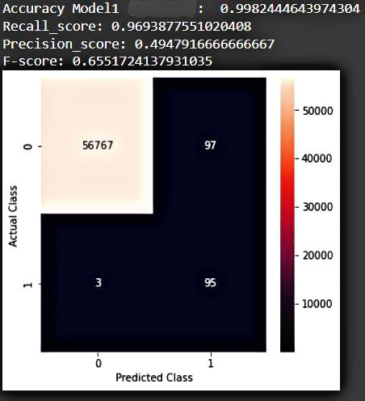
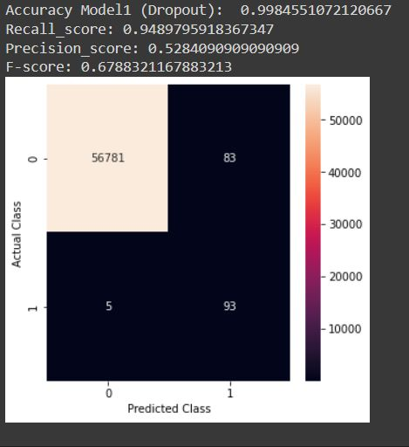
Results
MLP with 1 hidden layer

Slide 12
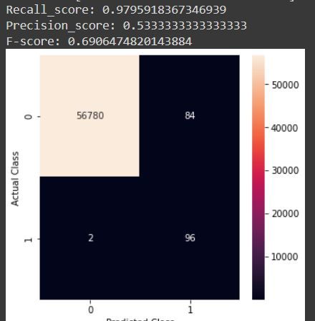
Results
MLP with 2 hidden layers

Slide 13
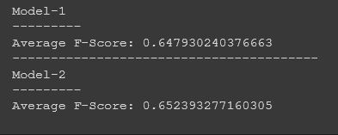
Results
Comparing the mean performance of the
F-score for both the models

Slide 14
THANK YOU !

