Slide 1
Kelp
Project Aurora
Investment Brief
kelpglobal.com
Strictly Private & Confidential – Prepared by Kelp M&A Team

Slide 2
Network & Infrastructure
Kelp
Business Overview:
At a Glance
The Company is a premier logistics and supply chain management provider in India, offering customized solutions across diverse sectors such as e-commerce and automotive. With over three decades of experience, it utilizes advanced technology for efficient operations and real-time tracking, underscoring its commitment to sustainability and operational excellence.
At a Glance
Founded: 1995
Employees: 5
Facilities: 6 state-of-the-art facilities
Global Presence: India
Product Portfolio
• Express Distribution
• Supply Chain
• Warehousing
• Technology
Industries Served
• Chemical
• Automotive
• E-commerce
Certifications:
Strictly Private & Confidential – Prepared by Kelp M&A Team

Slide 3
Operational Metrics & Financials
Kelp
-2.5%
Revenue CAGR
4.3%
EBITDA Margin
0.6%
RoCE
-3.4%
ROE
Despite facing a challenging revenue trend over the past five years, the company has shown resilience with steady EBITDA performance, reflecting operational efficiency improvements.
Key Achievements
• Achieved EBITDA growth of 88% from FY21 to FY23, indicating improved operational leverage.
• Maintained a consistent EBITDA margin amidst fluctuating revenues, demonstrating effective cost management.
• Expanded service offerings, enhancing value proposition in the logistics sector.
Strictly Private & Confidential – Prepared by Kelp M&A Team

Slide 4
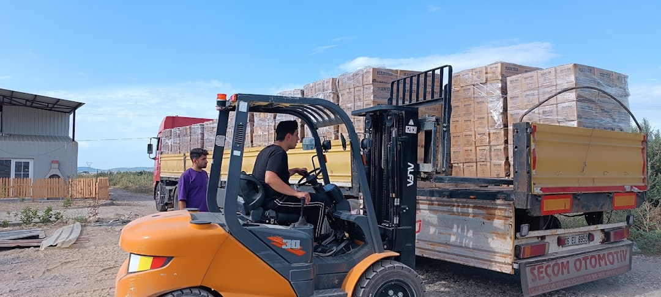
Investment Highlights
Kelp
Robust Financial Growth
Achieved a remarkable FY25 net profit of Rs 10 crore, showcasing a 150% increase from the previous year.
Strong Revenue Momentum
Q4 2025 revenue surged by 9% to Rs 385 crore, reflecting an upward trajectory in market demand.
Expanding Market Opportunities
The express logistics sector is poised for a 14% CAGR from FY23 to FY28, presenting significant growth avenues.
Strategic Expansion Plans
Aiming to open eight new hubs this financial year, enhancing service capacity and market penetration.
Focused on Tier 2 and Tier 3 Markets
Strategically targeting expansion into Tier 2 and Tier 3 markets to broaden client reach and optimize logistics.
Seize the opportunity to invest in a rapidly growing logistics leader with a clear path to market dominance.
Strictly Private & Confidential – Prepared by Kelp M&A Team

Slide 5
Kelp
Important Notice & Disclaimer
Strictly Private & Confidential. This presentation is prepared by Kelp Global exclusively for the intended recipient and may not be reproduced or distributed without prior written consent. This document is for informational purposes only and does not constitute an offer to sell or a solicitation of an offer to buy any securities. While all information is obtained from sources believed to be reliable, Kelp Global makes no representation or warranty regarding its accuracy or completeness and accepts no liability for any loss arising from its use. This presentation contains forward-looking statements and financial projections based on current assumptions; actual results may vary materially.
Strictly Private & Confidential – Prepared by Kelp M&A Team

