Slide 1
Kelp
Project Falcon
Investment Brief
kelpglobal.com
Strictly Private & Confidential – Prepared by Kelp M&A Team

Slide 2
Technology & Product Portfolio
Kelp
Business Overview:
At a Glance
The Company is a leading diversified electronics provider specializing in high-technology solutions for the defense, aerospace, and space sectors. With a focus on customized product design and manufacturing, it delivers innovative, mission-critical electronics and passenger information systems globally, enabling flexible engagement models for diverse customer needs.
At a Glance
Founded: 1993
Employees: 2
Facilities: 2 state-of-the-art facilities
Global Presence: India, France, North America, Europe, Asia
Product Portfolio
• Flexible Engagement Models
• Passenger Information Systems
• Strategic Electronics
• Electronics Manufacturing Solutions
Industries Served
• Aerospace
• Defence
• Space
• Medical
• Automotive
Certifications: ISO/IEC 27001:2013 | ISO-9001:2015 | ISO 13485: 2003 Medical
Strictly Private & Confidential – Prepared by Kelp M&A Team

Slide 3
Manufacturing Excellence & Financials
Kelp
5.5%
Revenue CAGR
8.4%
EBITDA Margin
4.4%
RoCE
3.0%
ROE
The company has demonstrated robust revenue growth, achieving a CAGR of 5.5% over the past five years, reflecting strong market demand in the electronics sector. With a consistent improvement in EBITDA, the financial performance is on an upward trajectory.
Key Achievements
• Achieved record revenue of 11,554.2 million in FY25
• Increased EBITDA from 895.3 million in FY21 to 967.1 million in FY25
• Improved profitability with a PAT margin of 1.1%
Strictly Private & Confidential – Prepared by Kelp M&A Team

Slide 4
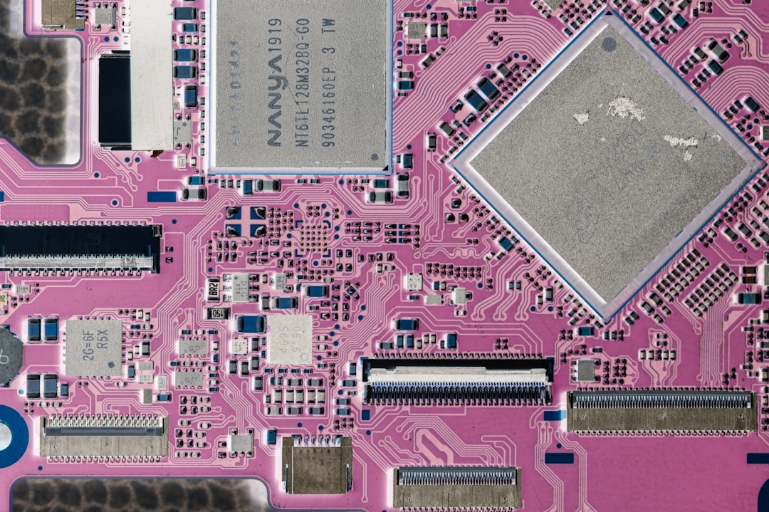
Investment Highlights
Kelp
Proven Market Leader in Electronics
With nearly three decades of experience, the company has established a strong reputation and reliability, supported by successful joint ventures with multinational firms.
Robust Order Book Ensures Revenue Stability
A substantial order book of ₹1303 crore as of September 30, 2024, provides significant revenue visibility and positions the company for sustained profitability.
Strategic Partnerships with Key Clients
Collaboration with prestigious clients like ISRO and DRDO enhances credibility and market position, having contributed to major space missions.
Significant Expansion and Growth Plans
Plans to raise ₹250 crore for expansion and increased working capital will enhance operational capacity and market reach to meet rising demand.
Capitalizing on Growing Electronics Demand
The company is poised to benefit from a projected growth in India's ER&D export market, expected to surge from $44-45 billion in 2023 to $130-170 billion by 2030.
This opportunity represents a compelling investment in a resilient and growth-oriented electronics leader.
Strictly Private & Confidential – Prepared by Kelp M&A Team

Slide 5
Kelp
Important Notice & Disclaimer
Strictly Private & Confidential. This presentation is prepared by Kelp Global exclusively for the intended recipient and may not be reproduced or distributed without prior written consent. This document is for informational purposes only and does not constitute an offer to sell or a solicitation of an offer to buy any securities. While all information is obtained from sources believed to be reliable, Kelp Global makes no representation or warranty regarding its accuracy or completeness and accepts no liability for any loss arising from its use. This presentation contains forward-looking statements and financial projections based on current assumptions; actual results may vary materially.
Strictly Private & Confidential – Prepared by Kelp M&A Team

