Slide 1
Kelp
Project Genesis
Investment Brief
kelpglobal.com
Strictly Private & Confidential – Prepared by Kelp M&A Team

Slide 2
Product Portfolio & Therapeutic Areas
Kelp
Business Overview:
At a Glance
The Company is a prominent player in the pharmaceutical sector, specializing in the development and manufacture of a diverse portfolio of pharmaceutical products, including APIs and herbal formulations. With a strong commitment to quality and safety, evidenced by numerous certifications, The Company has successfully established a significant presence in both domestic and international markets, exporting to 45 countries worldwide.
At a Glance
Founded: 1986
Employees: 955
Facilities: 3 state-of-the-art facilities
Global Presence: 45 countries
Product Portfolio
• Noble Division
• Nova Division
• Ethical Division
• Generic Division
Industries Served
• Pharmaceuticals
• Healthcare
• Biotechnology
Certifications: ISO 9001-2008 | WHO-GMP | IDMA Quality Excellence Certified
Strictly Private & Confidential – Prepared by Kelp M&A Team

Slide 3
Manufacturing & Regulatory Compliance
Kelp
6.3%
Revenue CAGR
9.7%
EBITDA Margin
0.7%
RoCE
5.4%
ROE
The company has demonstrated a robust revenue growth trajectory with a CAGR of 6.3% over the past five years, reflecting strong market demand in the pharmaceutical sector.
Key Achievements
• Achieved revenue of 5022.5 million in FY24, marking a significant increase from previous years.
• Successfully improved EBITDA from negative figures to a solid 485.1 million in FY24.
• Maintained a positive PAT margin of 2.5%, indicating effective cost management and profitability.
Strictly Private & Confidential – Prepared by Kelp M&A Team

Slide 4
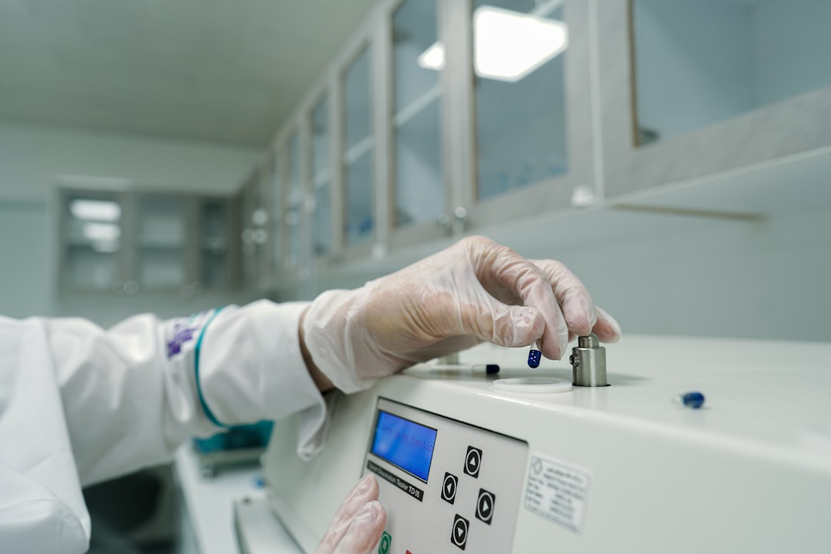
Investment Highlights
Kelp
Impressive Profit Growth
Net profit surged by 832.98% to ₹8.77 crore in the June 2025 quarter, showcasing remarkable financial strength.
Explosive Sales Increase
Sales skyrocketed by 360.45% to ₹152.73 crore in the same quarter, reflecting robust market demand.
Significant FII Interest
Foreign institutional investor shareholding soared by 2179.75% over the past year, highlighting increased confidence in the company.
Strategic Expansion Plans
Plans to invest ₹100 crore in new units across Punjab, Himachal Pradesh, and Jammu & Kashmir aim for a three-fold capacity increase, driving future growth.
Thriving Market Opportunities
The Indian pharma market is projected to double from USD 25 billion in 2024 to USD 50 billion by 2030, creating vast growth potential.
This investment represents a unique opportunity to capitalize on strong growth trends and solid financial performance in a dynamic market.
Strictly Private & Confidential – Prepared by Kelp M&A Team

Slide 5
Kelp
Important Notice & Disclaimer
Strictly Private & Confidential. This presentation is prepared by Kelp Global exclusively for the intended recipient and may not be reproduced or distributed without prior written consent. This document is for informational purposes only and does not constitute an offer to sell or a solicitation of an offer to buy any securities. While all information is obtained from sources believed to be reliable, Kelp Global makes no representation or warranty regarding its accuracy or completeness and accepts no liability for any loss arising from its use. This presentation contains forward-looking statements and financial projections based on current assumptions; actual results may vary materially.
Strictly Private & Confidential – Prepared by Kelp M&A Team

