Slide 1
Donor data study
Sharath Malladi
msharath@live.com

Slide 2
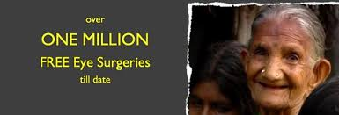
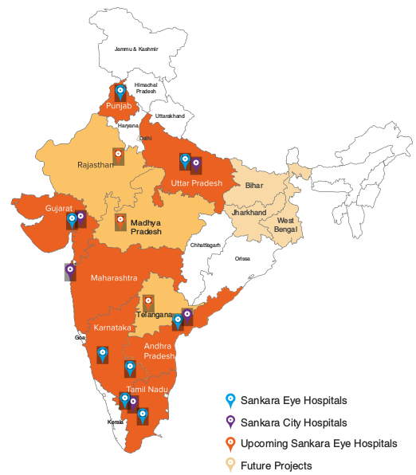
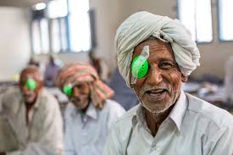
Sankara Eye Foundation (SEF)
Vision:
Eradicate curable blindness by 2020

Slide 3
Objectives
Collect donor attributes
Are we on track to achieve our goal?

Slide 4


$$$
Where?
When?
How much?
How much?
Retention rate?

Slide 5
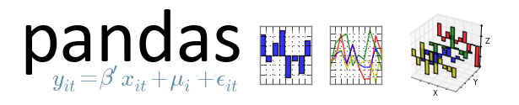




Feature Engineering
Visualizations
Overall growth
New vs Repeat Donors
Forecasting donations

Slide 6
Visualizations

Slide 7
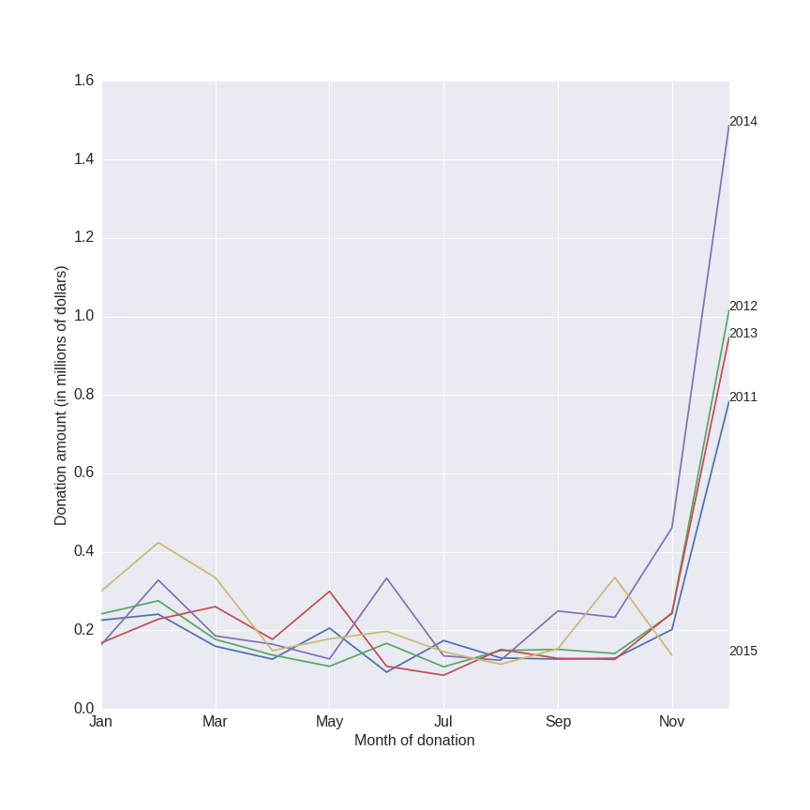
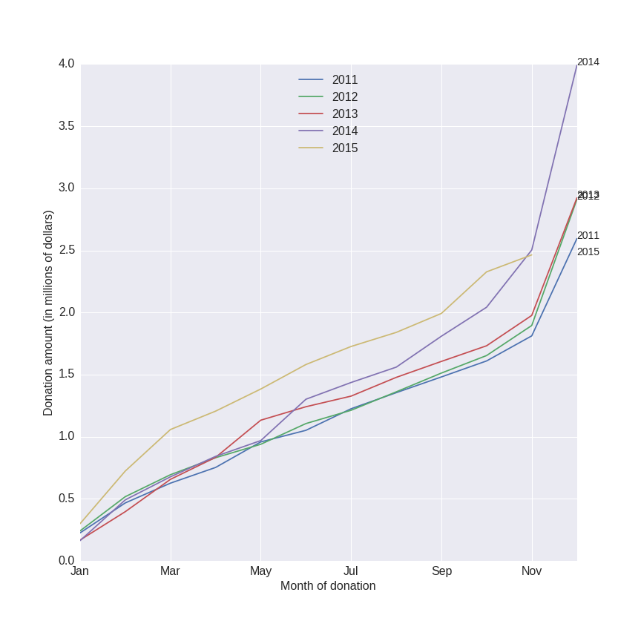
Growth rate of donations is 16.7% annually
Donations
(Monthly)
Donations
(Cumulative)

Slide 8
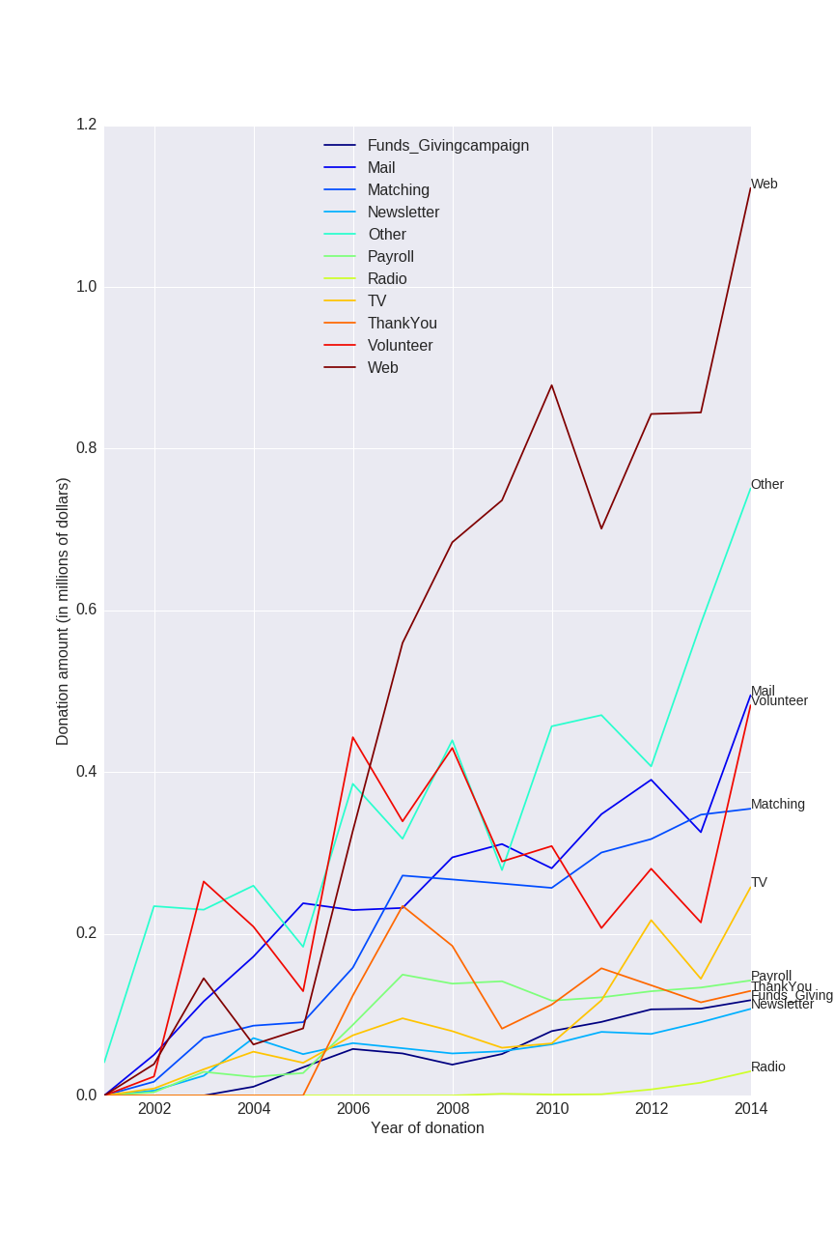
Donations via the Web are rising at 13% per year

Slide 9
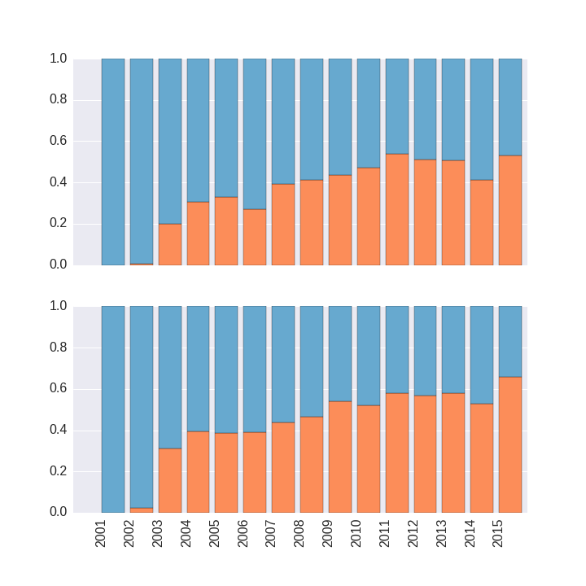

Repeat Donors
Account for over 50% of the donor population
Proportions of number of Donors
Account for over 60% of the donation amount
Proportions of amount donated

Slide 10
Predicting future donations

Slide 11
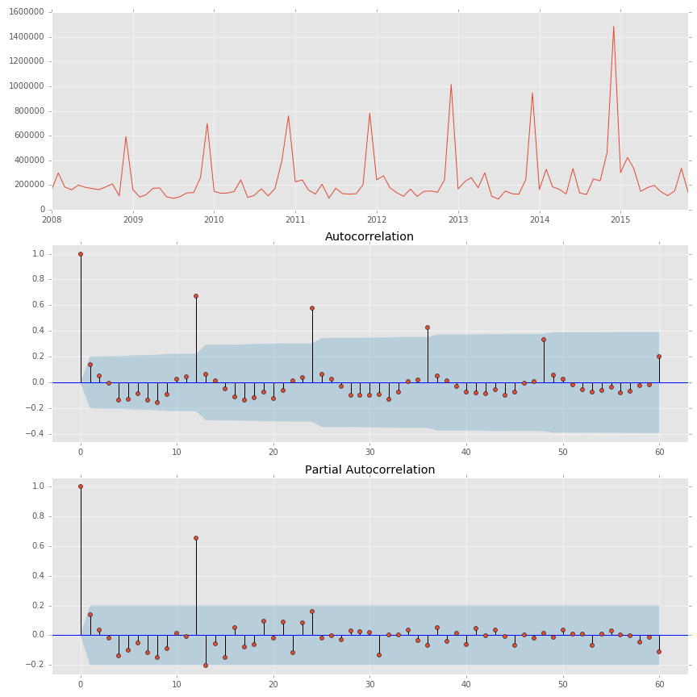
"Eradicate curable blindness by the year 2020"
Vision
of the
organization:

Slide 12
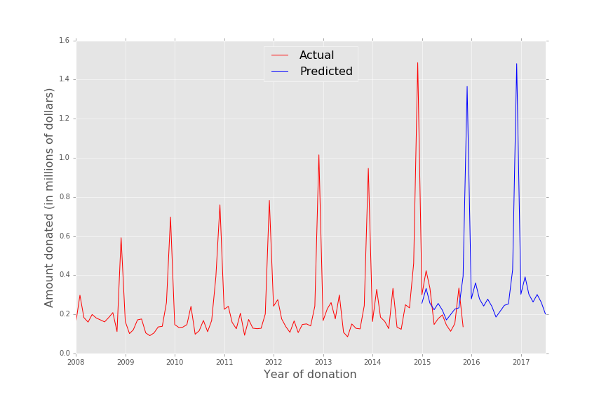
Seasonal ARIMA
Order=(0,1,1)
Seasonal Order=(0,1,1,12)
Predictor variable = Log(Amount)
AIC of 80

Slide 13
Conclusion
Donations increasing 16.7% annually
Donations via Web are rising 13% annually
Repeat donors account for 50% of the population and 60% of the total amount donated
Repeat donors donate more money annually

Slide 14
Next steps
Web application with interactive visualizations (in progress)
Measure campaign effectiveness

Slide 15
Thank you!
Sharath Malladi
https://github.com/smalladi78/SEF

Slide 17
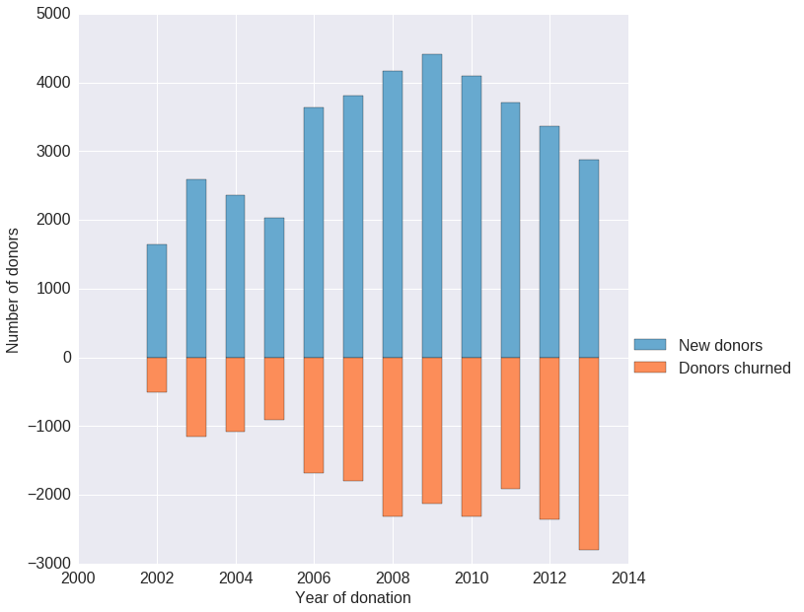
Churn vs new donors over the years

Slide 19
SEF Donor base
SEF is a non-profit organization
Charitable contributions go towards constructing new hospitals and eye surgeries in India
2014: 4.3 million dollars donated
Donations are tax deductible
Donors are primarily Indians living in the USA
2014: 9000 unique donors

Slide 20
Ask from the SEF board members
"Determine how fund-raising campaigns are impacting donations"
"Easily understand the activity in different regions"
"Study impact of various marketing strategies (newsletters, TV advertising, emails, facebook) on donations"
"Know where to organize the next fund-raising campaign"
"Know if we are can reach our goal - to eradicate curable blindness in India by 2020"

