Slide 1


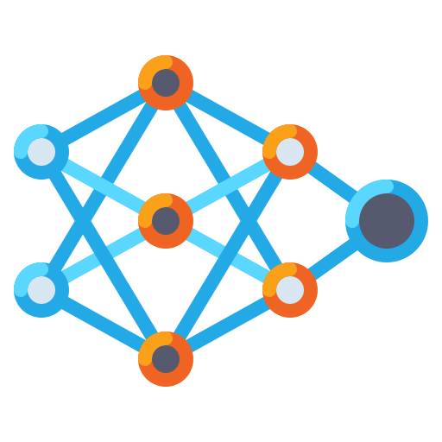
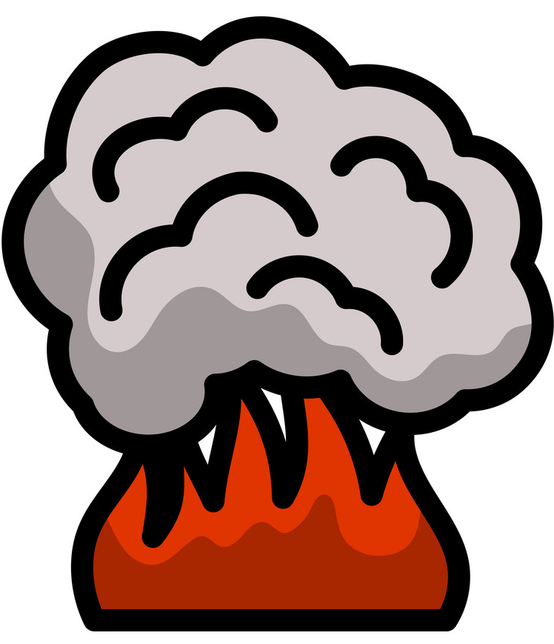

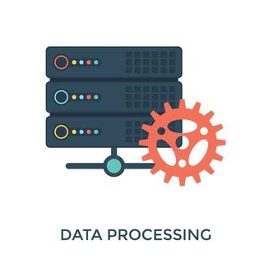

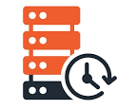
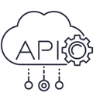

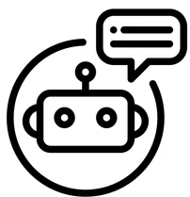
Docker
Real Time Camera
Data Pre-Processing
Flask WEB App
Neural Net (Transfer Learning)
Fire and Smoke patterns
Real Time Data Base
Telegram BOT
BOT Notifications 🔔

