Slide 1
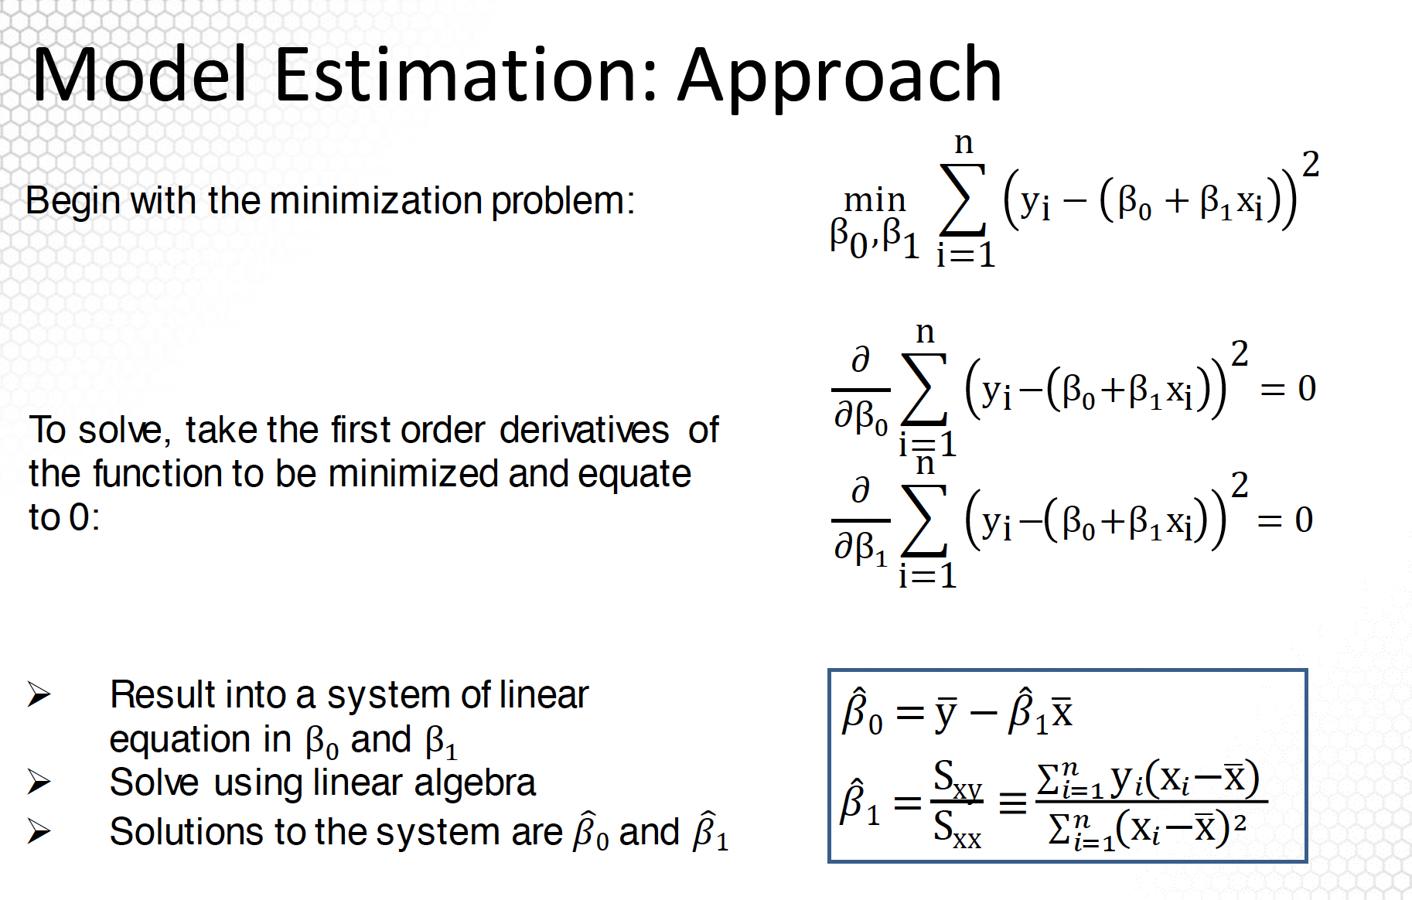
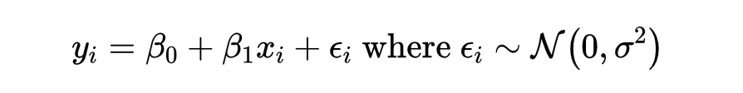




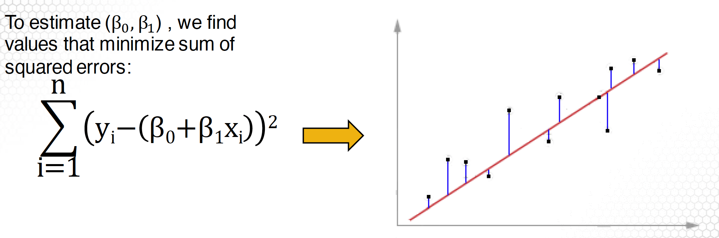
Linear Regression
Formula
Goal
To find the line that best describes the relationship. i.e. to the find the best
Model Estimation

Slide 2
Linear Regression
Formula

Slide 3
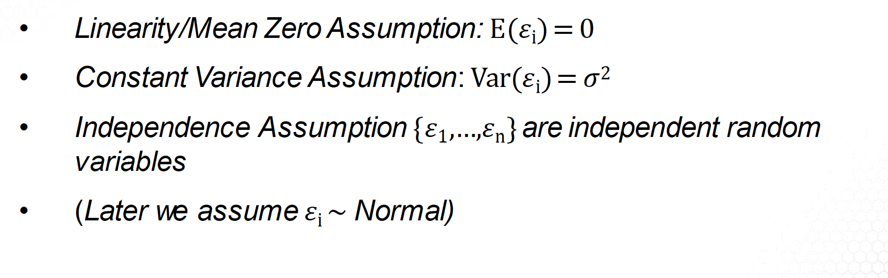
Assumptions
Linear Regression
Formula
Assumptions
Derivation

Slide 4
Assumptions
Derivation

