Slide 1
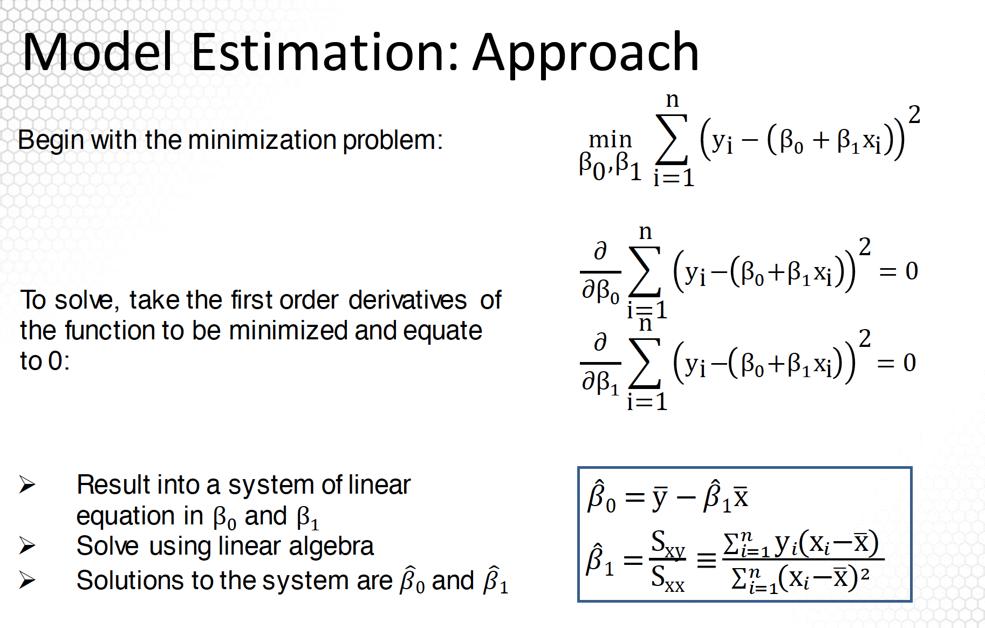
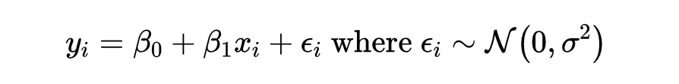




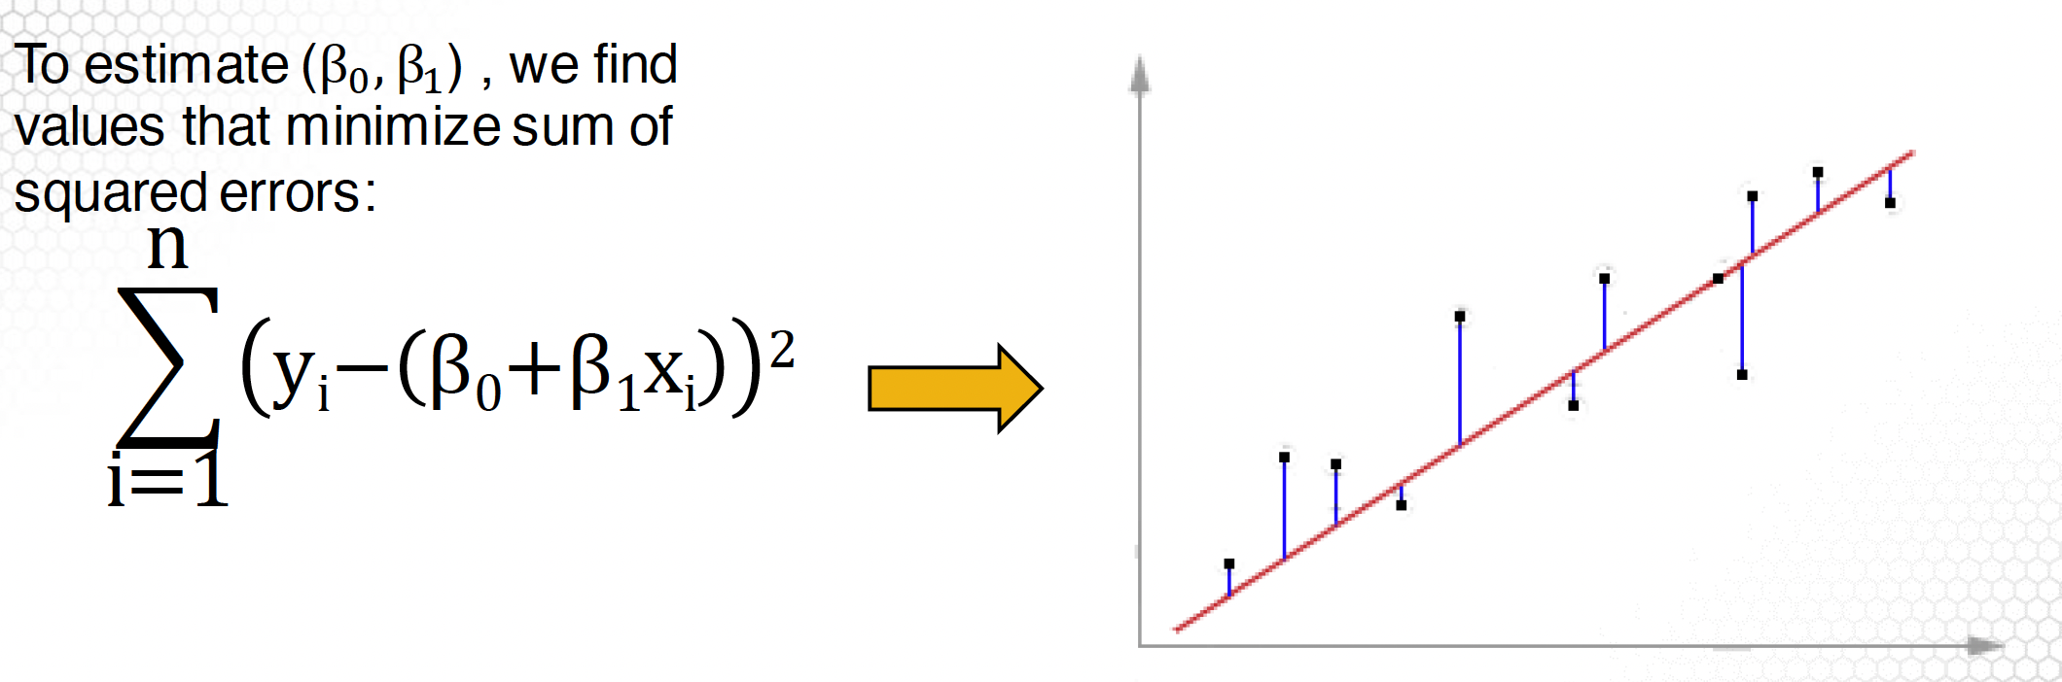
Linear Regression
Formula
Goal
To find the line that best describes the relationship. i.e. to the find the best
Model Estimation

Slide 2
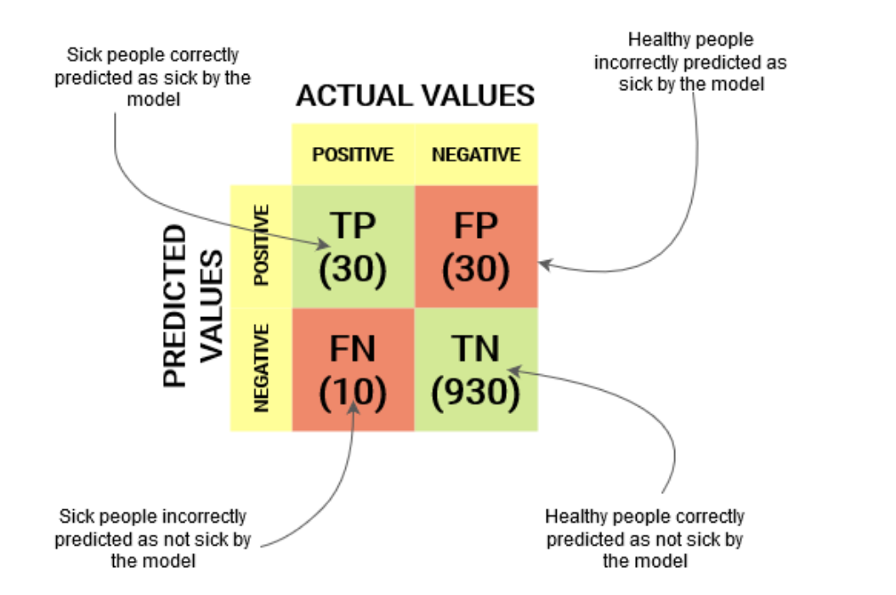
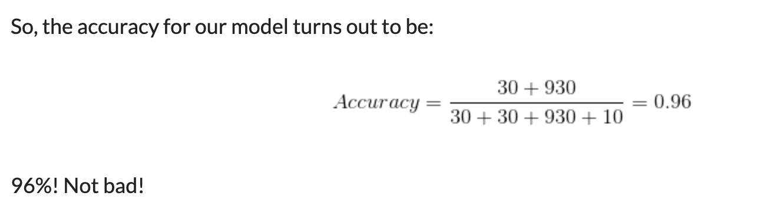
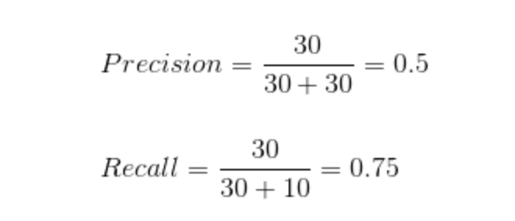
Confusion Matrix
Precision tells us how many of the correctly predicted cases actually turned out to be positive.
Recall tells us how many of the actual positive cases we were able to predict correctly with our model.
Recall is important in medical cases where it doesn’t matter whether we raise a false alarm but the actual positive cases should not go undetected!

Slide 3
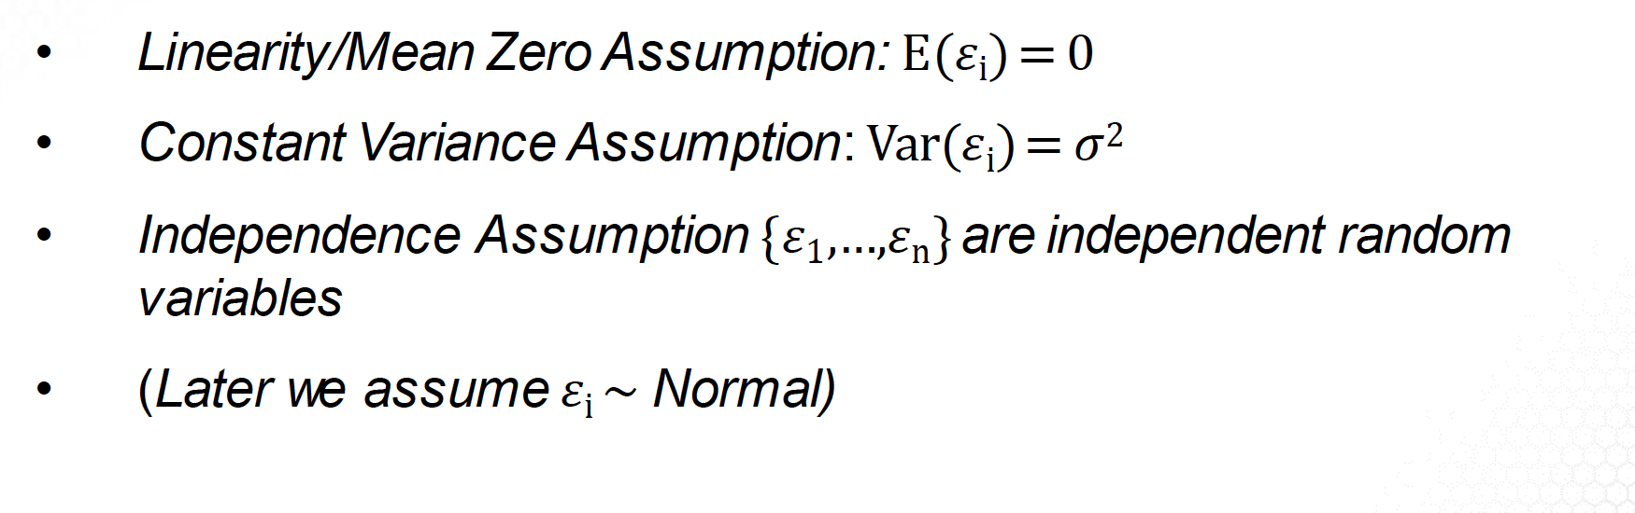
Assumptions
Linear Regression
Formula
Assumptions
Derivation

Slide 4
Assumptions
Derivation

