Slide 1

CREDIT CARD FRAUD DETECTION Using random forest and cart algorithm

Slide 2
ABSTRACT
The credit card fraud is mostly come in financial services. The credit card fraud is generated huge number of problems in every year. Lack of research on this credit card problem and submits the real-world credit card fraud analyzes, that is issues. In this paper is introduced best data mining algorithm called “machine learning algorithm”, which is utilized to recognize the credit card fraud, so initially use this algorithm and it is one of the standard model. Then, secondly apply the hybrid methods namely, “AdaBoost and majority vote method”. Use this model efficacy, which is evaluated, and then use the credit card data set it is publicly available one. The financial institution included true world data set, so it is taking and analyzed. In this robustness algorithm additionally evaluate the noise added data samples. This concept is used in experiment and then produce the result positively indicate the hybrid method, that is majority voting, it provides good accuracy rates in credit card fraud detection

Slide 3
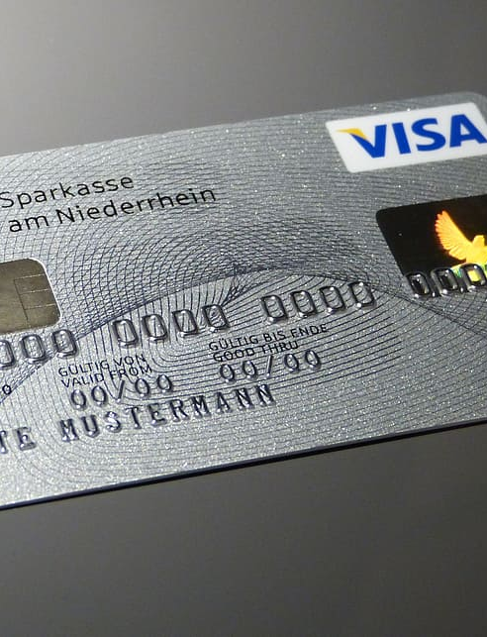
AIM
Aim is introduced best data mining algorithm called “machine learning algorithm”, which is utilized to
recognize the credit card fraud, so initially use this algorithm and it is one of the standard model.

Slide 4
OBJECTIVE
Apply the hybrid methods namely, “AdaBoost and majority vote method”. Use this model efficacy, which is evaluated, and then use the credit card data set it is publicly available one. The financial institution included true world data set, so it is taking and analyzed.

Slide 5
EXISTING SYSTEM
In existing System, a research about a case study involving credit card fraud detection, where data normalization is applied before Cluster Analysis and with results obtained from the use of Cluster Analysis and Artificial Neural Networks on fraud detection has shown that by clustering attributes neuronal inputs can be minimized. And promising results can be obtained by using normalized data and data should be MLP trained. This research was based on unsupervised learning.
Significance of this paper was to find new methods for fraud detection and to increase the accuracy of results. The data setfor this paper is based on real life transactional data by a large European company and personal details in data is kept confidential.
Accuracy of an algorithm is around 50%. Significance of this paper was to find an algorithm and to reduce the cost measure. The result obtained was by 23% and the algorithm they find was Bayes minimum risk.

Slide 6
DISADVANTAGES OF EXISTING SYSTEM
1. In this paper a new collative comparison measure that reasonably represents the gains and losses due to fraud detection is proposed.
2. A cost sensitive method which is based on Bayes minimum risk is presented using the proposed cost measure.

Slide 7
PROPOSED SYSTEM
In proposed System, we are applying random forest algorithm for classification of the credit card dataset. Random Forest is an algorithm for classification and regression. Summarily, it is a collection of decision tree classifiers. Random forest has advantage over decision tree as it corrects the habit of over fitting to their training set. A subset of the training set is sampled randomly so that to train each individual tree and then a decision tree is built, each node then splits on a feature selected from a random subset of the full feature set. Even for large data sets with many features and data instances training is extremely fast in random forest and because each tree is trained independently of the others. The Random Forest algorithm has been found to provide a good estimate of the generalization error and to be resistant to over fitting.

Slide 8
ADVANTAGES OF PROPOSED SYSTEM
Random forest ranks the importance of variables in a regression or classification problem in a natural way can be done by Random Forest.
The transaction amount. Feature 'class' is the target class for the binary classification and it takes value 1 for positive case (fraud) and 0 for negative case (not fraud).

Slide 9
SYSTEM MODEL
Using Random forest and cart algorithm

Slide 10
REQUIREMENT ANALYSIS
The project involved analyzing the design of few applications so as to make the application more users friendly. To do so, it was really important to keep the navigations from one screen to the other well ordered and at the same time reducing the amount of typing the user needs to do. In order to make the application more accessible, the browser version had to be chosen so that it is compatible with most of the Browsers.

Slide 11
REQUIREMENT SPECIFICATION
Functional Requirements
Graphical User interface with the User
Software Requirements
For developing the application the following are the Software Requirements:
Python
Operating Systems supported
Windows
Technologies and Languages used to Develop
Python

Slide 12
REQUIREMENT SPECIFICATION
Hardware Requirements
For developing the application the following are the Hardware Requirements:
Processor: Pentium IV or higher
RAM: 256 MB
Space on Hard Disk: minimum 512MB

Slide 13


CONCLUSION
The Random forest algorithm will perform better with a larger number of training data, but speed during testing and application will suffer. Application of more pre-processing techniques would also help. The SVM algorithm still suffers from the imbalanced dataset problem and requires more preprocessing to give better results at the results shown by SVM is great but it could have been better if more preprocessing have been done on the data.

Slide 14

BANK
THANK YOU
1856
5893
1287
8934
CARD HOLDER NAME
09/22

