Slide 1
BLEND360
DATA & ANALYTICS PRACTICE
LIVE PERFORMANCE
Insights generated from your Tableau dashboards using AI analysis of both the visual content and underlying data. Each slide includes: • Cropped dashboard view • Applied filters • Data source details • AI-generated findings
DASHBOARD INSIGHTS
Automated Tableau Analytics Report
From snapshot to insight — powered by AI
1
✓ INCLUDED
Apr 19, 2026
DASHBOARDS
AI INSIGHTS
GENERATED
Confidential | Blend360 | Data & Analytics Practice

Slide 2
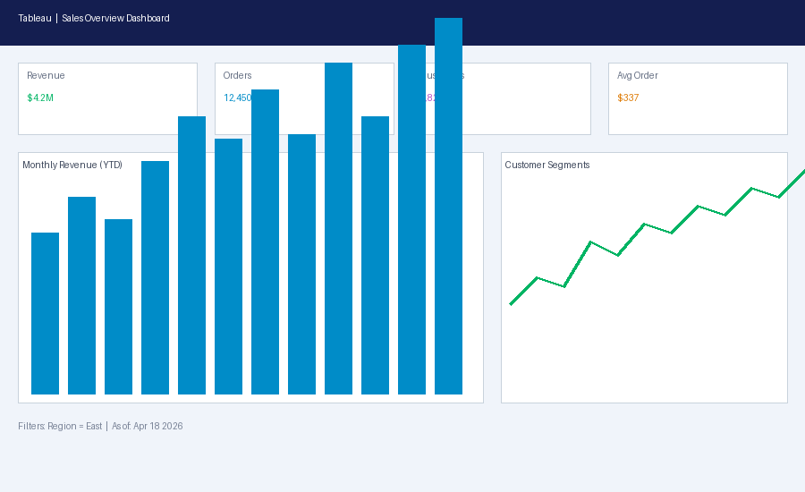
BLEND360
DATA & ANALYTICS PRACTICE
RETAIL | DATA & ANALYTICS — SALES OVERVIEW
AI INSIGHTS
Filters: Region: East, Quarter: Q1 2026
Source: Extract — As of Apr 18, 2026 02:30 PM
AI insights generation failed
› Error: name 'PILImage' is not defined › Please check your Gemini API key and quota.
Confidential | Blend360 | Data & Analytics Practice

