Slide 1
BLEND360
Data & Analytics · Snowflake Modernization Demo
TABLEAU TO STREAMLIT-IN-SNOWFLAKE
Modernizing BI
on Snowflake
SIMPLIFY
TRUST
EVOLVE
Unified BI operating model
Automated migration validation
AI-assisted applications
OBJECTIVE — Modernize suitable Tableau workloads into governed, AI-ready Streamlit applications in Snowflake while reducing platform duplication and preserving trusted business outcomes.
Sharath Kumar | Snowflake modernization demo
Notes:
Timing: 1 minute. Open with modernization, not tool replacement. The goal is to move suitable BI workloads onto a governed, extensible Snowflake application foundation.

Slide 2
BI MODERNIZATION · 02
BLEND360
The data platform modernized, but BI still operates separately
Snowflake is the governed system of record; Tableau remains a second platform, control plane and cost base.
CURRENT OPERATING MODEL
THE RESULT
Snowflake
Tableau
$
Separate cost
+
Tableau licenses, infrastructure or cloud subscription
Data + governance
BI consumption
⚙
Duplicated operations
Administration, access, monitoring and deployment
Two platforms to license, secure, administer, monitor and release.
⇄
Data movement
Extract creation, refresh schedules and failure handling
∑
Logic duplication
Business calculations repeated across ELT and dashboards
This is the situation the modernization program is designed to change.
⊕
Limited extensibility
Additional applications needed beyond dashboard interaction
02 / 12
Notes:
Timing: 3 minutes. Explain the situation before mentioning the accelerator. Do not attack Tableau; describe the operational duplication created when the data platform and BI platform evolve separately. Replace generic cost language with client figures when available.

Slide 3
BI MODERNIZATION · 03
BLEND360
Why Streamlit in Snowflake — not a standalone Streamlit app
Same open-source framework. The platform underneath it is what changes the answer.
⛨
⚿
⚙
✦
No egress, no copies
Governance inherited
Zero infrastructure
Cortex is a local call
Compute runs next to the data. A standalone app pulls governed data out of the boundary on every query.
Runs as a Snowflake role. RBAC, row-access, masking and audit apply automatically — nothing rebuilt in a second environment.
Serverless inside Snowflake. No VM, container, patching or scaling for anyone to own.
COMPLETE, Analyst and semantic views execute in-account. Outside Snowflake, using Cortex means calling back into the platform you just left.
THE HONEST BOUNDARY
If the data weren't already in Snowflake, and there were no governance or AI requirement, a standalone Streamlit app would be the simpler choice. The case rests on data-in-Snowflake + governance + Cortex — exactly this situation.
03 / 12
Notes:
Timing: 2 minutes. This slide exists to pre-empt the question every technical Snowflake audience asks: why not just Streamlit on its own? Lead with the honest boundary — it builds credibility precisely because it isn't a universal claim. The case is data-in-Snowflake + governance + Cortex, not 'Streamlit is better in Snowflake' as a blanket statement.

Slide 4
BI MODERNIZATION · 04
BLEND360
Modernization creates value beyond visualization
The opportunity is larger than replacing a visualization tool.
⇳
⚡
⚖
✦
Platform economics
Delivery speed
Governance
AI-ready experiences
LOWER DUPLICATE COST
SHORTER CHANGE CYCLES
FEWER CONTROL GAPS
NEW CLIENT EXPERIENCES
Potentially reduce Tableau licenses and duplicated platform support for migrated users.
Build on governed Snowflake data using reusable Python and Streamlit components.
Reuse Snowflake RBAC, masking policies, semantic assets and controlled deployment.
Extend migrated apps with CoCo and add natural-language analytics through Cortex Analyst.
Measure the business case — baseline licenses, platform support, extract operations and dashboard change lead time before the pilot.
04 / 12
Notes:
Timing: 3 minutes. Leadership should hear business outcomes; Snowflake should hear platform consolidation; BI developers should hear faster iteration and extensibility. License savings are potential until client-specific TCO is calculated.

Slide 5
AI-ASSISTED BI LIFECYCLE · 05
BLEND360
VISION · SNOWFLAKE COCO
The migrated application becomes an AI-assisted product, not a static replica
Natural-language enhancement changes the economics of maintaining and extending BI applications.
1
2
3
4
5
Migrate
Validate
Deploy
Enhance
Revalidate
Tableau to
Streamlit
Visual, data,
formulas
Governed
SiS app
CoCo
instructions
Controlled
release
COCO / CORTEX CODE
CORTEX ANALYST
Generates reviewable application changes from natural-language requirements.
Adds governed natural-language questions over semantic views.
“Add a region filter to every chart, preserve existing calculations, and create a customer-detail view on selection.”
Every AI-assisted change returns through regression and validation before release — CoCo lowers dependence on specialized coding skills, but production changes are never unreviewed.
05 / 12
Notes:
Timing: 3 minutes. This is a primary modernization advantage, but say clearly this is where the roadmap is headed next, not a capability wired into the accelerator's current five stages. Say that CoCo lowers dependence on specialized coding skills; do not promise that production applications can be changed without engineering review. Every AI-assisted change returns through regression and validation.

Slide 6
ACCELERATOR DEMO · 06
BLEND360
One workbook moves through five controlled stages
Each stage leaves an inspectable artifact before the next stage proceeds.
01
02
03
04
05
Discovery
Parsing
Data model
App creation
Validation
Sources, extracts
and tables
→
Workbook to
migration IR
→
Relations and optional
semantic view
→
Generated Streamlit
application
→
Visual, data and
formula evidence
⛓ Human deployment gate
The application is deployed only after findings and validation are visible.
06 / 12
Notes:
Timing: 3 minutes. This slide replaces the conflicting three-stage and seven-stage descriptions in earlier material. During the live demo, narrate the same five labels shown here.

Slide 7
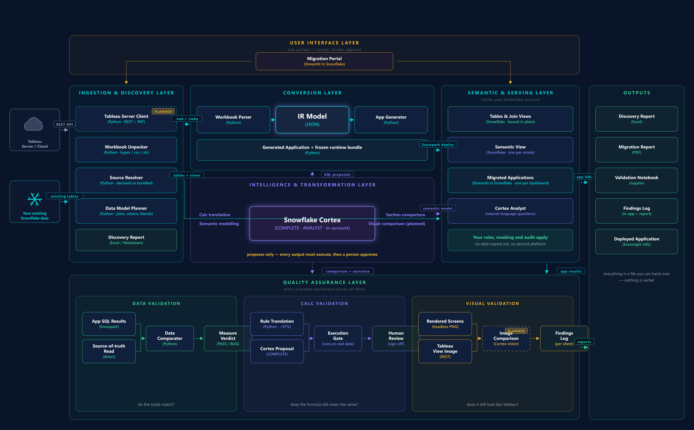
ACCELERATOR DEMO · 07
BLEND360
Platform architecture
One engine runs once per workbook across the estate; Cortex sits inside the account; three independent validations before anything is approved.
07 / 12
Notes:
Timing: 2 minutes. Walk left to right: ingestion/discovery, conversion into an IR, Cortex called from inside the account (proposes only, never final say), semantic and serving layer, then the three-lane QA gate (data / calc / visual) before anything ships. This is the detailed technical backing for the five-stage story just shown.

Slide 8
ACCELERATOR DEMO · 08
BLEND360
Visual parity is reviewed at dashboard level
The first check is immediate: does the migrated tab preserve the same analytical composition?
TABLEAU
STREAMLIT IN SNOWFLAKE
[ Insert dashboard screenshot ]
=
[ Insert dashboard screenshot ]
layout hierarchy
KPI presence
chart type
filters
labels
visible grain
Review evidence — visual similarity alone is not a pass; it is the first evidence layer.
08 / 12
Notes:
Timing: 2 minutes. Visual similarity alone is not a pass. It is the first evidence layer. Point out that the chart colors can differ while data, hierarchy and interaction behavior still require independent checks. Replace the placeholder panes with the real Tableau vs Streamlit comparison screenshot before presenting.

Slide 9
ACCELERATOR DEMO · 09
BLEND360
A PASS is earned with chart-grain numbers and formulas
The displayed visual grain determines the evidence: product rows for a ranked product table, not a dashboard total.
DATA PROOF
FORMULA PROOF
Product | Tableau | Streamlit | Backend | Diff | Result
Canon imageCLASS 2200 | $61,600.00 | $61,599.82 | $61,599.82 | $0.18 | PASS
Fellowes PB500 | $27,454.00 | $27,453.78 | $27,453.78 | $0.22 | PASS
Cisco TelePresence | $22,638.00 | $22,638.28 | $22,638.28 | $0.28 | PASS
Profit Ratio
TABLEAU
SUM([Profit]) / SUM([Sales])
SNOWFLAKE SQL
SUM(PROFIT) / NULLIF(SUM(SALES), 0)
The three displayed rows are representative slide evidence; the downloadable report retains the complete result set and every mismatch.
Semantically equivalent + null-safe
Absolute and relative tolerance are recorded in the downloadable report. Currency tolerance is expressed in currency, not points.
09 / 12
Notes:
Timing: 4 minutes. The three displayed rows are representative slide evidence; the downloadable report retains the complete result set and every mismatch. Explain absolute and relative tolerance in the report and that currency tolerance must be expressed in currency, not points.

Slide 10
NEXT STEPS · 10 · CORE PRESENTATION ENDS HERE
BLEND360
Let's find the right proof point together
A proposed path from this demo to a joint customer win on Snowflake.
01
02
03
Identify a workload
→
Run it live
→
Review together
A Snowflake account team nominates one Tableau-on-Snowflake workload as the proof point.
The migration executes inside that account, stage by stage, with the account team watching.
Visual, data and formula evidence reviewed jointly before anyone calls it a win.
WHAT WE'RE ASKING OF SNOWFLAKE
Help us identify one workload and one account team ready to run this live.
10 / 12
Notes:
Timing: 2 minutes. Close on a concrete ask to the Snowflake partner audience, not a generic next-step list. This is a co-sell motion: we need Snowflake to nominate the account and workload.

Slide 11
APPENDIX
BLEND360
Appendix: Cortex assists only where its output can be governed
DETERMINISTIC CORE
OPTIONAL CORTEX ASSISTANCE
1
Workbook parser
✦
Semantic view generation
2
Intermediate representation
✦
Guarded calculation proposal
+
3
Calculation rules
✦
Narrative validation summary
4
Code generation
Execution-gated
5
Numeric validation
Human-reviewed
No model decision is needed for the standard path.
Cortex cannot convert a deterministic mismatch into a PASS.
11 / 12
Notes:
Use when Snowflake asks where Cortex adds value. The concise answer: Cortex enriches the governed semantic experience and can propose translations for unsupported calculations, but deterministic checks retain authority.

Slide 12
APPENDIX
BLEND360
Appendix: every dashboard tab receives the same evidence contract
1
Summary
2
Visual
3
Chart data
Dashboard and sheet verdicts with reasons
Tableau and Streamlit tab comparison when source capture is available
Every displayed key compared across Tableau, Streamlit and backend
4
Formulas
5
Interactions
6
Artifacts
Tableau calculation mapped to generated Snowflake SQL
Filters, parameters, sorting and tooltip behavior checked
Full rows, mismatches, queries and notebook retained for audit
The HTML report is the readable entry point; the notebook and row-level artifacts provide the complete proof set.
12 / 12
Notes:
Use when the audience asks what is inside the generated report. Stress that the HTML is the readable entry point while the notebook and row-level artifacts provide the complete proof set.

