Slide 1
Pre Setup
Once you've gained access to your terminal it might be wise to spend ~1 minute to setup your environment. Set these:
alias k=kubectl
Complete –F - - start_kubectl k
​
export do="--dry-run=client -o yaml" # like short for dry output. use whatever you like
vim
To make vim use 2 spaces for a tab edit ~/.vimrc to contain:
set tabstop=2
set expandtab
set shiftwidth=2

Slide 2
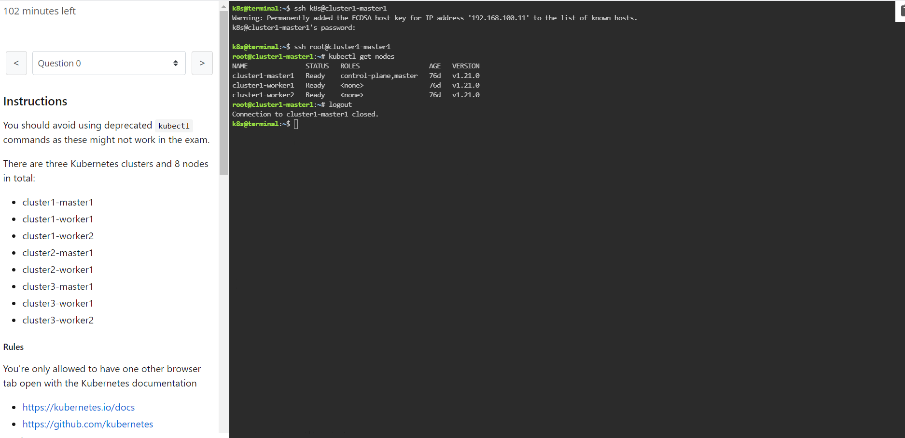

Slide 3
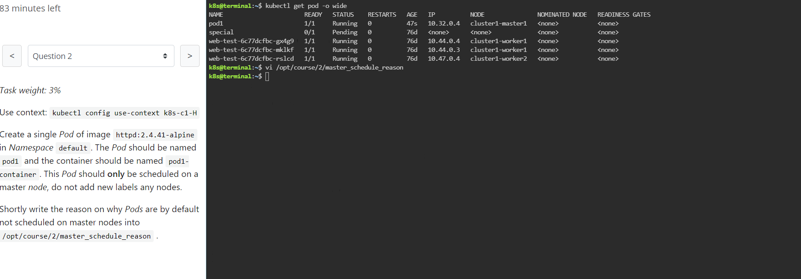

Slide 4
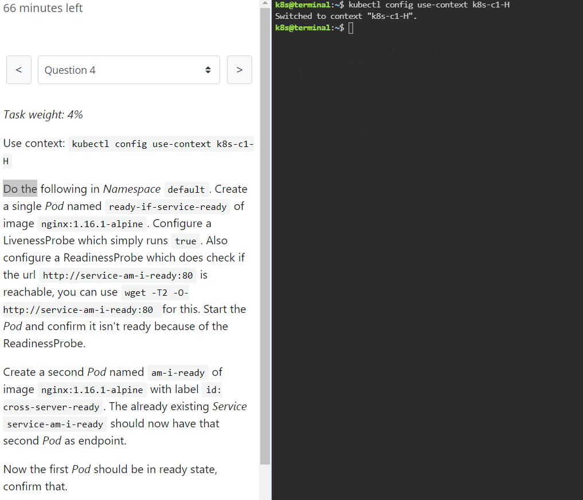

Slide 5
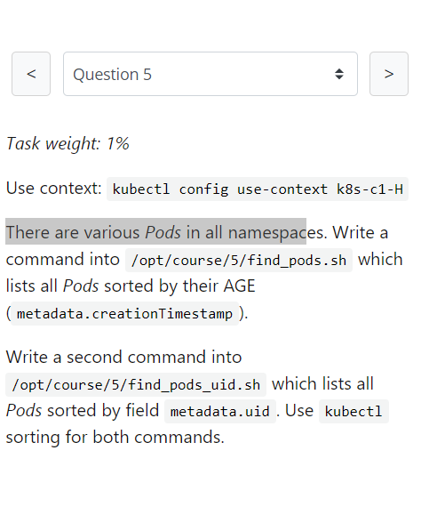

Slide 6
Task weight: 8%
Use context: kubectl config use-context k8s-c1-H
Create a new PersistentVolume named safari-pv. It should have a capacity of 2Gi, accessMode ReadWriteOnce, hostPath /Volumes/Data and no storageClassName defined.
Next create a new PersistentVolumeClaim in Namespace project-tiger named safari-pvc . It should request 2Gi storage, accessMode ReadWriteOnce and should not define a storageClassName. The PVC should bound to the PV correctly.
Finally create a new Deployment safari in Namespace project-tiger which mounts that volume at /tmp/safari-data. The Pods of that Deployment should be of image httpd:2.4.41-alpine.

Slide 7
Task weight: 1%
Use context: kubectl config use-context k8s-c1-H
The metrics-server hasn't been installed yet in the cluster, but it's something that should be done soon. Your college would already like to know the kubectl commands to:
show node resource usage
show Pod and their containers resource usage
Please write the commands into /opt/course/7/node.sh and /opt/course/7/pod.sh

Slide 8
Task weight: 2%
Use context: kubectl config use-context k8s-c1-H
Ssh into the master node with ssh cluster1-master1. Check how the master components kubelet, kube-apiserver, kube-scheduler, kube-controller-manager and etcd are started/installed on the master node. Also find out the name of the DNS application and how it's started/installed on the master node.
Write your findings into file /opt/course/8/master-components.txt. The file should be structured like:
# /opt/course/8/master-components.txt
kubelet: [TYPE]
kube-apiserver: [TYPE]
kube-scheduler: [TYPE]
kube-controller-manager: [TYPE]
etcd: [TYPE]
dns: [TYPE] [NAME]
Choices of [TYPE] are: not-installed, process, static-pod, pod

Slide 9
Task weight: 5%
Use context: kubectl config use-context k8s-c2-AC
Ssh into the master node with ssh cluster2-master1. Temporarily stop the kube-scheduler, this means in a way that you can start it again afterwards.
Create a single Pod named manual-schedule of image httpd:2.4-alpine, confirm its started but not scheduled on any node.
Now you're the scheduler and have all its power, manually schedule that Pod on node cluster2-master1. Make sure it's running.
Start the kube-scheduler again and confirm its running correctly by creating a second Pod named manual-schedule2 of image httpd:2.4-alpine and check if it's running on cluster2-worker1.

Slide 10
Task weight: 6%
Use context: kubectl config use-context k8s-c1-H
Create a new ServiceAccount processor in Namespace project-hamster. Create a Role and RoleBinding, both named processor as well. These should allow the new SA to only create Secrets and ConfigMaps in that Namespace.

Slide 11
Task weight: 4%
Use context: kubectl config use-context k8s-c1-H
Use Namespace project-tiger for the following. Create a DaemonSet named ds-important with image httpd:2.4-alpine and labels id=ds-important and uuid=18426a0b-5f59-4e10-923f-c0e078e82462. The Pods it creates should request 10 millicore cpu and 10 megabytes memory. The Pods of that DaemonSet should run on all nodes.

Slide 12
Task weight: 6%
Use context: kubectl config use-context k8s-c1-H
Use Namespace project-tiger for the following. Create a Deployment named deploy-important with label id=very-important (the pods should also have this label) and 3 replicas. It should contain two containers, the first named container1 with image nginx:1.17.6-alpine and the second one named container2 with image kubernetes/pause.
There should be only ever one Pod of that Deployment running on one worker node. We have two worker nodes: cluster1-worker1 and cluster1-worker2. Because the Deployment has three replicas the result should be that on both nodes one Pod is running. The third Pod won't be scheduled, unless a new worker node will be added.
In a way we kind of simulate the behaviour of a DaemonSet here, but using a Deployment and a fixed number of replicas.

Slide 13
Task weight: 4%
Use context: kubectl config use-context k8s-c1-H
Create a Pod named multi-container-playground in Namespace default with three containers, named c1, c2 and c3. There should be a volume attached to that Pod and mounted into every container, but the volume shouldn't be persisted or shared with other Pods.
Container c1 should be of image nginx:1.17.6-alpine and have the name of the node where its Pod is running on value available as environment variable MY_NODE_NAME.
Container c2 should be of image busybox:1.31.1 and write the output of the date command every second in the shared volume into file date.log. You can use while true; do date >> /your/vol/path/date.log; sleep 1; done for this.
Container c3 should be of image busybox:1.31.1 and constantly write the content of file date.log from the shared volume to stdout. You can use tail -f /your/vol/path/date.log for this.
Check the logs of container c3 to confirm correct setup.

Slide 14
Task weight: 2%
Use context: kubectl config use-context k8s-c1-H
You're ask to find out following information about the cluster k8s-c1-H :
How many master nodes are available?
How many worker nodes are available?
What is the Pod CIDR of cluster1-worker1?
What is the Service CIDR?
Which Networking (or CNI Plugin) is configured and where is its config file?
Which suffix will static pods have that run on cluster1-worker1?
Write your answers into file /opt/course/14/cluster-info, structured like this:
# /opt/course/14/cluster-info
1: [ANSWER]
2: [ANSWER]
3: [ANSWER]
4: [ANSWER]
5: [ANSWER]
6: [ANSWER]

Slide 15
Task weight: 3%
Use context: kubectl config use-context k8s-c2-AC
Write a command into /opt/course/15/cluster_events.sh which shows the latest events in the whole cluster, ordered by time. Use kubectl for it.
Now kill the kube-proxy Pod running on node cluster2-worker1 and write the events this caused into /opt/course/15/pod_kill.log.
Finally kill the main docker container of the kube-proxy Pod on node cluster2-worker1 and write the events into /opt/course/15/container_kill.log.
Do you notice differences in the events both actions caused?

Slide 16
Task weight: 2%
Use context: kubectl config use-context k8s-c1-H
Create a new Namespace called cka-master.
Write the names of all namespaced Kubernetes resources (like Pod, Secret, ConfigMap...) into /opt/course/16/resources.txt.
Find the project-* Namespace with the highest number of Roles defined in it and write its name and amount of Roles into /opt/course/16/crowded-namespace.txt.

Slide 17
Task weight: 3%
Use context: kubectl config use-context k8s-c1-H
In Namespace project-tiger create a Pod named tigers-reunite of image httpd:2.4.41-alpine with labels pod=container and container=pod. Find out on which node the Pod is scheduled. Ssh into that node and find the docker container(s) belonging to that Pod.
Write the docker IDs of the container(s) and the process/command these are running into /opt/course/17/pod-container.txt.
Finally write the logs of the main docker container (from the one you specified in your yaml) into /opt/course/17/pod-container.log using the docker command.

Slide 18
Task weight: 8%
Use context: kubectl config use-context k8s-c3-CCC
There seems to be an issue with the kubelet not running on cluster3-worker1. Fix it and confirm that cluster3 has node cluster3-worker1 available in Ready state afterwards. Schedule a Pod on cluster3-worker1.
Write the reason of the is issue into /opt/course/18/reason.txt.

Slide 19
Task weight: 3%
this task can only be solved if questions 18 or 20 have been successfully implemented and the k8s-c3-CCC cluster has a functioning worker node
Use context: kubectl config use-context k8s-c3-CCC
Do the following in a new Namespace secret. Create a Pod named secret-pod of image busybox:1.31.1 which should keep running for some time, it should be able to run on master nodes as well.
There is an existing Secret located at /opt/course/19/secret1.yaml, create it in the secret Namespace and mount it readonly into the Pod at /tmp/secret1.
Create a new Secret in Namespace secret called secret2 which should contain user=user1 and pass=1234. These entries should be available inside the Pod's container as environment variables APP_USER and APP_PASS.
Confirm everything is working.

Slide 20
Task weight: 10%
Use context: kubectl config use-context k8s-c3-CCC
Your coworker said node cluster3-worker2 is running an older Kubernetes version and is not even part of the cluster. Update kubectl and kubeadm to the version that's running on cluster3-master1. Then add this node to the cluster, you can use kubeadm for this.

Slide 21
Task weight: 2%
Use context: kubectl config use-context k8s-c3-CCC
Create a Static Pod named my-static-pod in Namespace default on cluster3-master1. It should be of image nginx:1.16-alpine and have resource requests for 10m CPU and 20Mi memory.
Then create a NodePort Service named static-pod-service which exposes that static Pod on port 80 and check if it has Endpoints and if its reachable through the cluster3-master1 internal IP address. You can connect to the internal node IPs from your main terminal.

Slide 22
Task weight: 2%
Use context: kubectl config use-context k8s-c2-AC
Check how long the kube-apiserver server certificate is valid on cluster2-master1. Do this with openssl or cfssl. Write the exipiration date into /opt/course/22/expiration.
Also run the correct kubeadm command to list the expiration dates and confirm both methods show the same date.
Write the correct kubeadm command that would renew the apiserver server certificate into /opt/course/22/kubeadm-renew-certs.sh.

Slide 23
Task weight: 2%
Use context: kubectl config use-context k8s-c2-AC
Node cluster2-worker1 has been added to the cluster using kubeadm and TLS bootstrapping.
Find the "Issuer" and "Extended Key Usage" values of the cluster2-worker1:
kubelet client certificate, the one used for outgoing connections to the kube-apiserver.
kubelet server certificate, the one used for incoming connections from the kube-apiserver.
Write the information into file /opt/course/23/certificate-info.txt.
Compare the "Issuer" and "Extended Key Usage" fields of both certificates and make sense of these.

Slide 24
sk weight: 9%
Use context: kubectl config use-context k8s-c1-H
There was a security incident where an intruder was able to access the whole cluster from a single hacked backend Pod.
To prevent this create a NetworkPolicy called np-backend in Namespace project-snake. It should allow the backend-* Pods only to:
connect to db1-* Pods on port 1111
connect to db2-* Pods on port 2222
Use the app label of Pods in your policy.
After implementation, connections from backend-* Pods to vault-* Pods on port 3333 should for example no longer work.

Slide 25
Task weight: 8%
Use context: kubectl config use-context k8s-c3-CCC
Make a backup of etcd running on cluster3-master1 and save it on the master node at /tmp/etcd-backup.db.
Then create a Pod of your kind in the cluster.
Finally restore the backup, confirm the cluster is still working and that the created Pod is no longer with us.

