Slide 1

IST-652: Final Project Presentation
Security analytics and recommendations in distributed systems
SHARAT SRIPADA

Slide 2
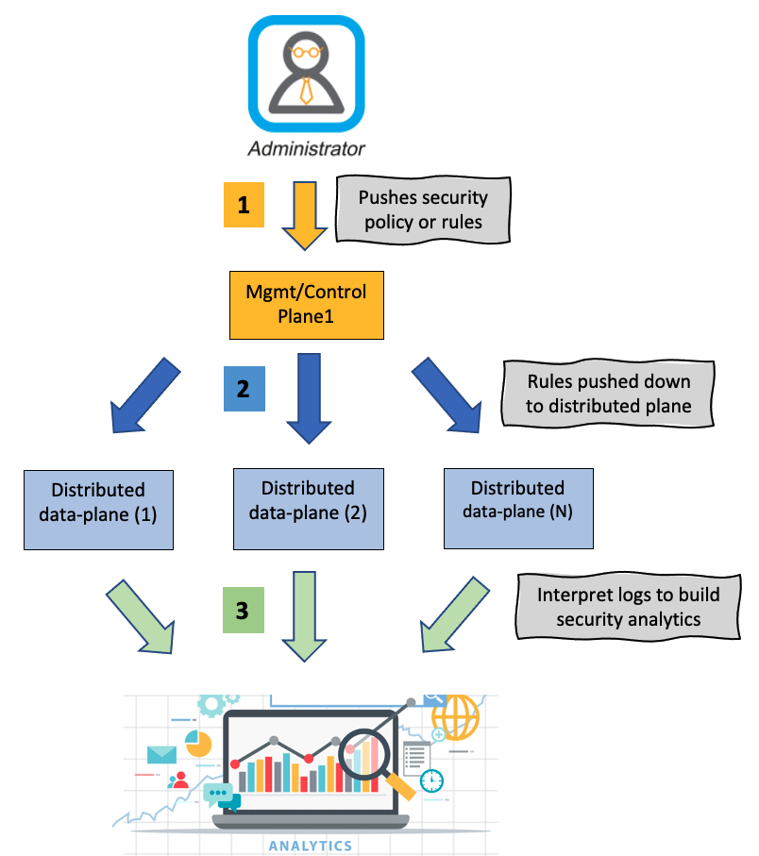
Introduction
Securing enterprise/cloud data can be realized via what is commonly known as network firewall policies or rules
In traditional network architecture, perimeter firewalls can achieve this but with the advent of software defined networks (SDN), firewalls are de-centralized and distributed
GOAL:
Collect logs (un-structured data) across the distributed plane and build an analytics/recommendation system based on machine-learning
De-centralized/distributed Firewall

Slide 3
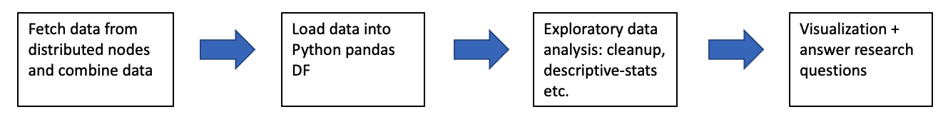
RESEARCH QUESTIONs
Traffic patterns or flows across the datacenter
Analyze and visualize traffic patterns – get counts of flows across TCP, UDP and ICMP protocols
Provide rule metrics across all network policies
Plot time-series graphs:
For high hitting flows (allow/deny) identify spikes, saw-tooth behavior or sustained/repeated patterns etc.
Finally, based on traffic patterns make recommendations to add/remove/update network policies or rules. Explore machine-learning algorithms to achieve this.
Workflow

Slide 4
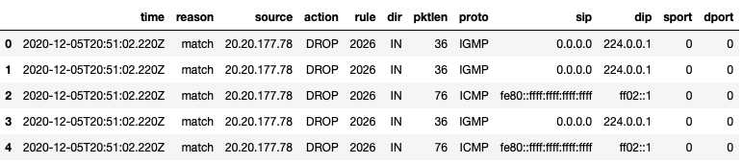
SOURCE OF DATA
The source of data will largely be logs written by software components enforcing network policies or rules. It captures traffic flows/tuples hitting an action (allow/deny).
A traffic flow or tuple would comprise the following fields:
src ip-address
dst ip-address
src port
dst port
TCP/IP Protocol
Action – Deny/Permit
2017-10-19T22:38:05.586Z 58734 INET match PASS domain-c8/1006 OUT 84 ICMP 172.18.8.121->172.18.8.119 RULE_TAG
2017-10-19T22:38:08.723Z 58734 INET match PASS domain-c8/1006 OUT 60 TCP 172.18.8.121/36485->172.18.8.119/22 S RULE_TAG
2017-10-19T22:38:18.785Z 58734 INET TERM domain-c8/1006 OUT ICMP 8 0 172.18.8.121->172.18.8.119 2/2 168/168 RULE_TAG
2017-10-19T22:38:20.789Z 58734 INET TERM domain-c8/1006 OUT TCP FIN 172.18.8.121/36484->172.18.8.119/22 44/33 4965/5009 RULE_TAG
Log excerpt on distributed-plane (raw un-structured data)
Data loaded from Mongo-DB into data-frame

Slide 5
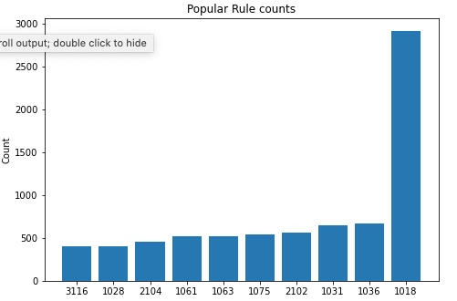
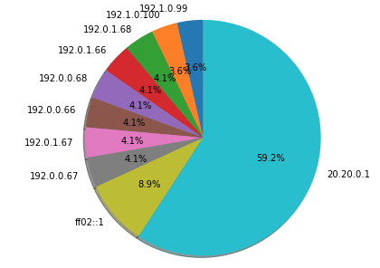
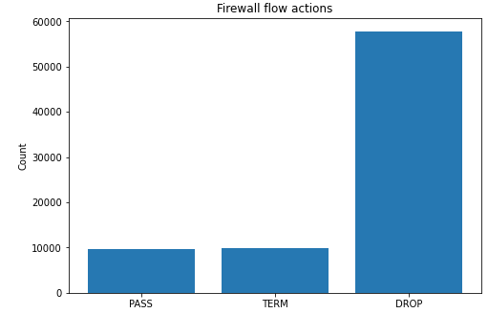
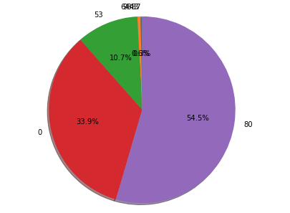
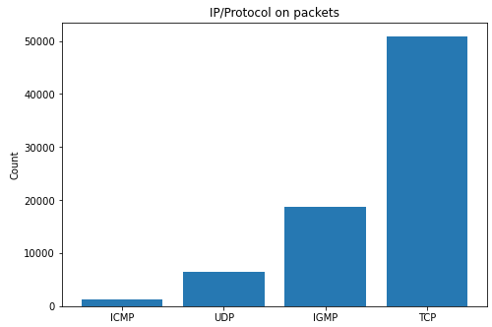
Analytics-DASHBOARD
Drop flows categorized by source
Zoom in on DROP flows
Drop flows categorized by L4 ports

Slide 6
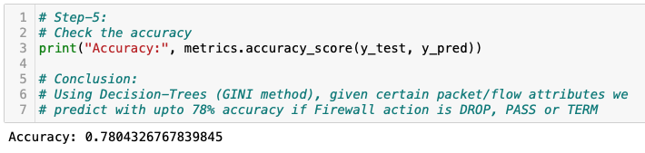
RECOMMENDATIONS and conclusion
Decision-Tree (used sklearn libraries) to train, test and predict outcomes given a flow tuple:
Data-split: 80% train, 20% test
Result: Accuracy of 78%
CONCLUSION AND FUTURE-WORK:
Improve accuracy of prediction with usage of Random Forests (ensemble methods) or other kernel SVM techniques
Explore application of deep-learning methods
Research if database signatures of commonly known threat/attack vectors can be maintained in an MNIST-like datastore
Build a simple utility – given a packet tuple (s.ip, d.ip, ports, protocol) predict Firewall action based on flows extracted
Fig. Result of prediction using Decision-Trees

