Slide 1
NLP Application IST-664
Using Amazon’s Textract and Comprehend to build an NLP powered search index
Sharat Sripada
MS – Applied Data-science program

Slide 2
Introduction
Text extraction from a scanned document when it contains formats such as tables, forms, paragraphs, and check boxes can be difficult
Combine that with having to create a search index that could efficiently sift through millions of documents based on:
key-phrases, language, sentiments or other common elements
Amazon Textract and Comprehend solve this problem!
Leveraging Machine-Learning and NLP
Extracting and analyzing text from images or PDFs is a classic machine learning (ML) and natural language processing (NLP) problem.
When extracting the content from a document we want to:
maintain the overall context
store the information in a readable and searchable format

Slide 3
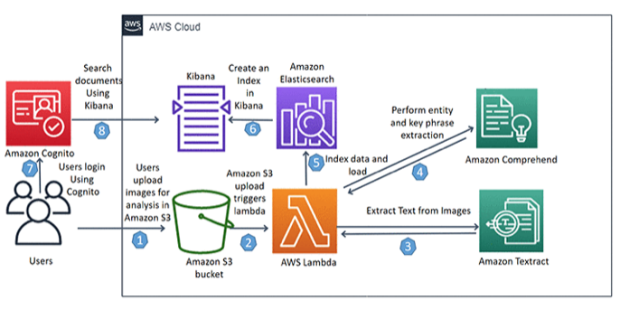
Architecture (process pipeline)
The architecture comprises several pieces in Amazon’s pipeline:
Textract - machine-learning/deep-learning to extract content from documents & NLP to preserve overall structure
Comprehend – enables an index-based search to extract useful information from documents using NLP
Elastic search/Kibana
Cognito
S3
Lambda

Slide 4
Comprehend
Uses NLP to scan or parse the content of documents and extract insights
ENTITIES
Provides a list of entities like people, places and locations identified from the document
LANGUAGE
Identifies the dominant language in a document
PII
Capable of extracting personally identifiable information like an individual’s address, phone number or bank account
SENTIMENT
Determines the sentiment of a document – Positive, Negative, Neutral or mixed
SYNTAX
Parses each word in the document and determines POS for the word
KEY-PHRASES
Extracts key phrases that appear in a document.
For example, a document about a soccer game might return the names of the teams, the name of the venue, and the final score

Slide 5
Applications and Benefits
Use-Case1: Find documents about a subject (Topic modeling)
Scan a set of documents to determine the topics discussed and to find the documents associated with each topic. Comprehend allows to specify one or more topics and returns corresponding documents
Use-Case2: Find out how customers feel about your products
Comprehend offers a service called DetectSentiment where you can send customer feedback and it will tell you whether customers feel positive, negative, neutral or mixed
Use-Case3: Discover what matters to customers
Using Comprehend’s topic modeling discover what customers are talking on forums, message boards and then use Entity detection to determine people, places and finally apply sentiment analysis to determine how customers feel about the product
Benefits
Integrate powerful natural language processing into application – Removes complexity of having to build NLP ability in apps and offers service over a simple API
Deep learning based natural language processing to accurately analyze text
Scalable natural language processing – Works with millions of documents to discover insights

Slide 6
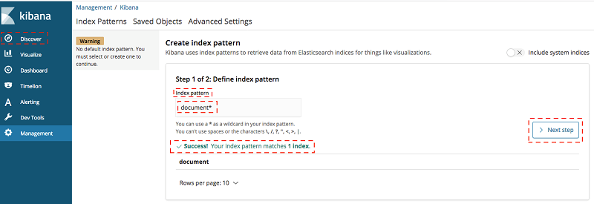
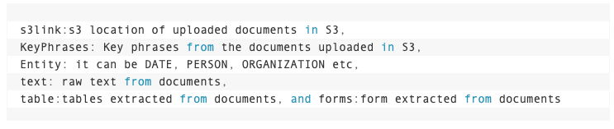
Demo – Comprehend in motion
High-level workflow when you upload a document to Amazon S3 - It triggers a Lambda S3 event that do the following:
1. Extracts text from images using Amazon Textract
2. Performs key phrase extraction using Amazon Comprehend
3. Searches text using Amazon ES
Fig: Search index – Kibana/ES
Fetching based on the following document attributes

Slide 7
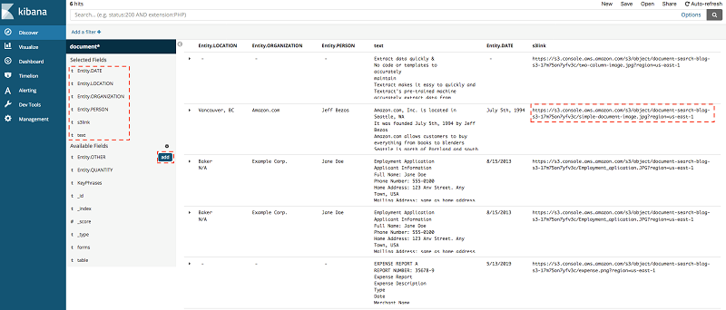
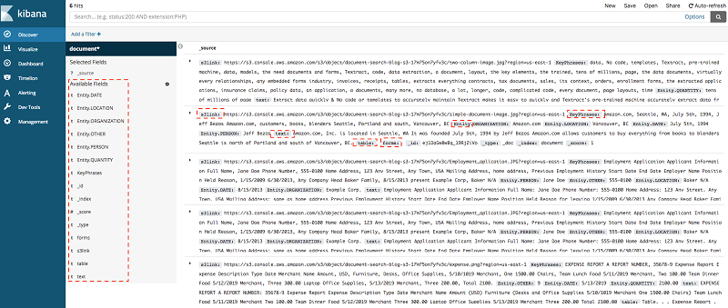
Demo - Results
Search results based on Entities like location, Org, Date etc.
Search results of relevant documents and their attributes

Slide 8
References
Amazon’s NLP powered search index project:
https://aws.amazon.com/blogs/machine-learning/building-an-nlp-powered-search-index-with-amazon-textract-and-amazon-comprehend/
Introduction to Comprehend:
https://docs.aws.amazon.com/comprehend/latest/dg/what-is.html
Introduction to Textract:
https://aws.amazon.com/textract/

