Slide 1
HW5 Support Material

Slide 2
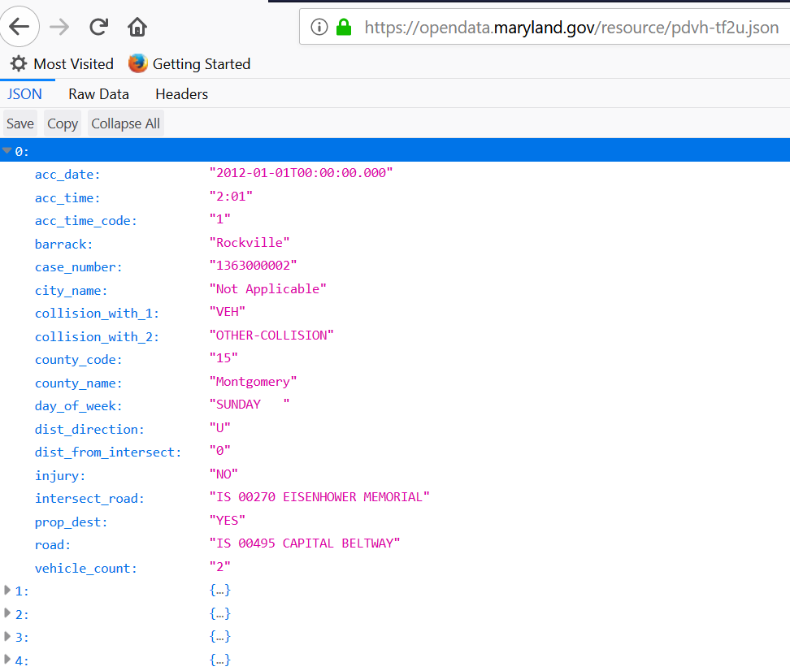

Slide 3
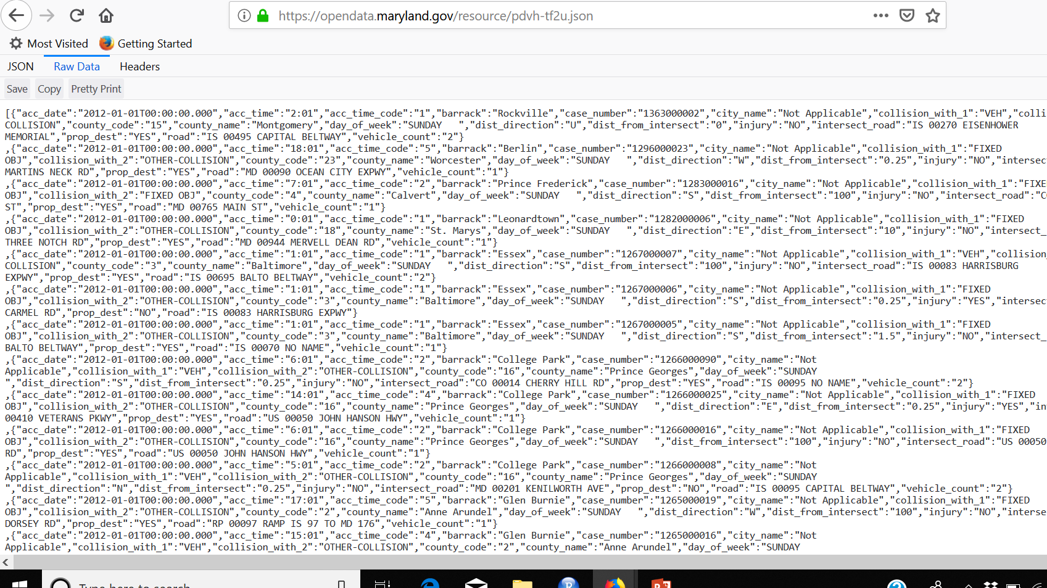

Slide 4
Your code
library(RCurl)
library(sqldf)
library(jsonlite)
link<-'https://opendata.maryland.gov/resource/pdvh-tf2u.json'
document<-fromJSON(txt=link)
str(document)
Start your cleansing activities

Slide 5
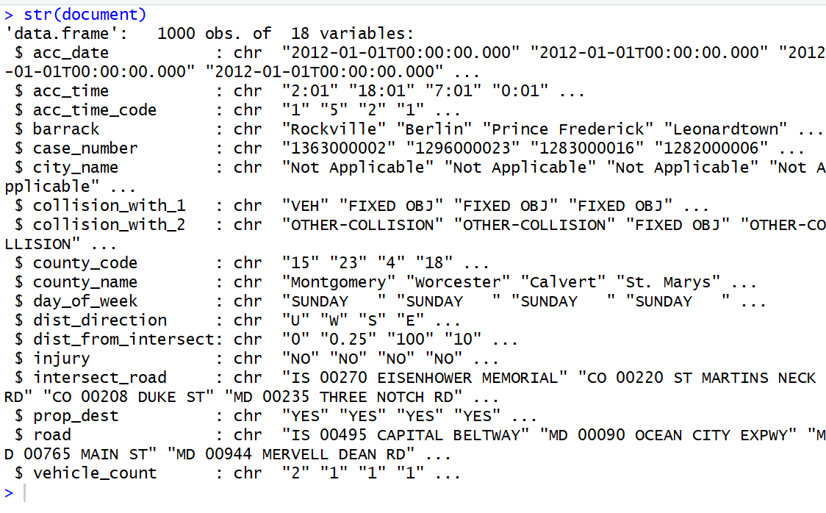

Slide 6
Other
Are there any NA’s, how do you check
sqldf
tapply
Spaces in fields (ie “white space”) , how will you manage

Slide 7
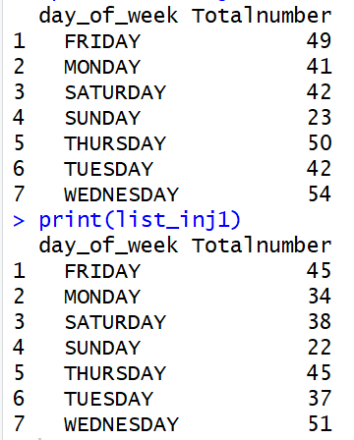
Using sqldf & tapply – sample solutions
How many accidents happen on SUNDAY
List the injuries by day
95
86 (removed NA’s)
How many accidents had injuries
301
272(removed NA’s)

Slide 8

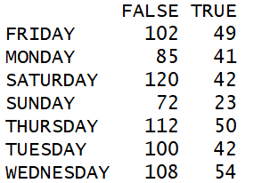

Using sqldf & tapply – sample solutions
How many accidents happen on SUNDAY
List the injuries by day
How many accidents had injuries

