Slide 1
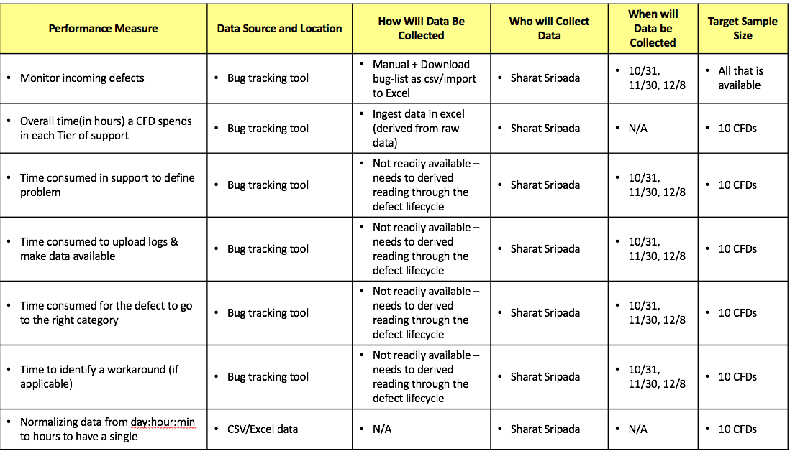
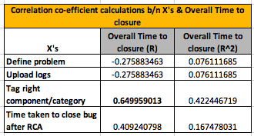
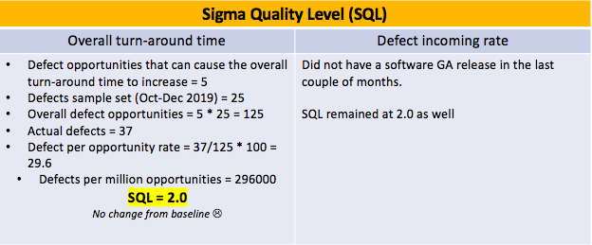
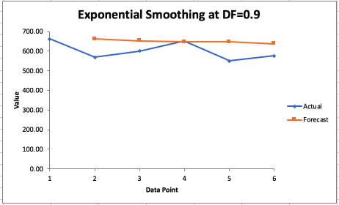
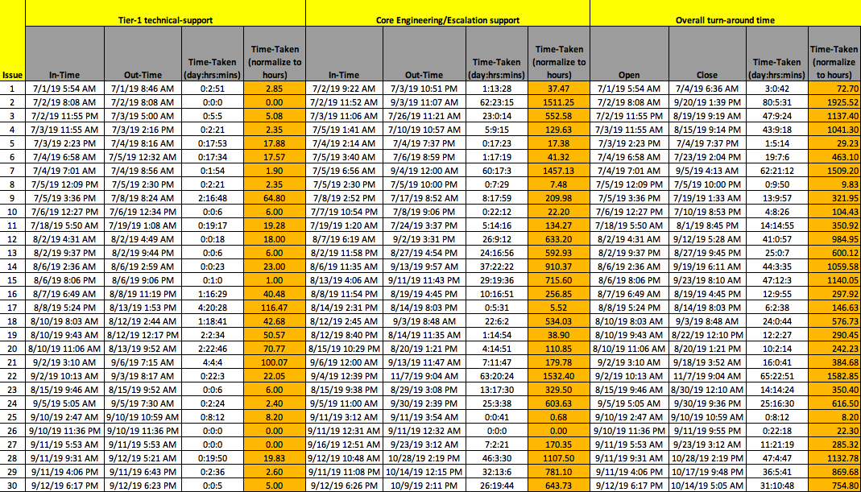
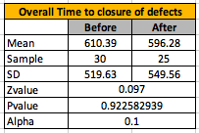
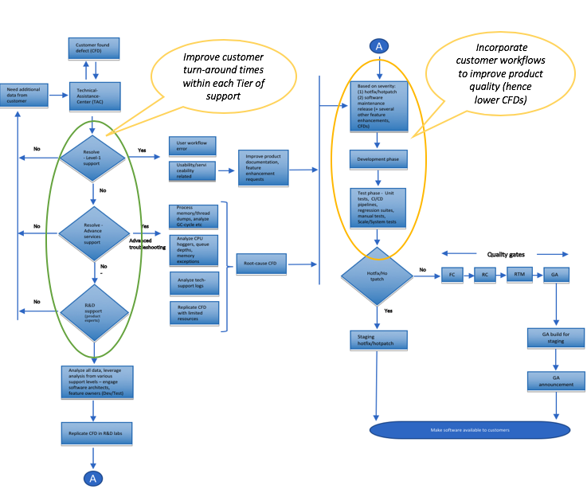
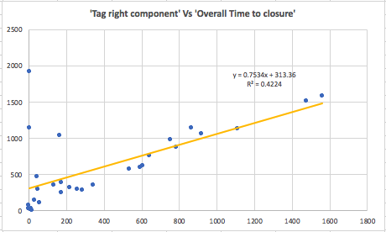
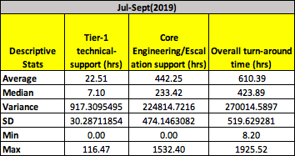
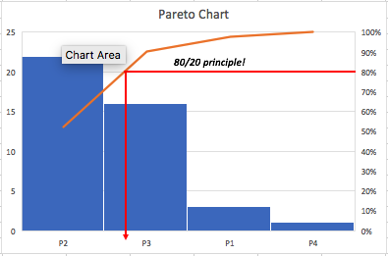
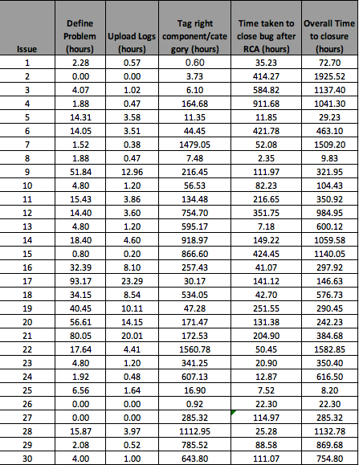

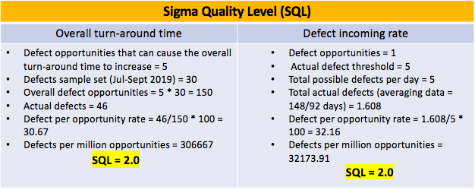
Process Improvement Project – Improve turn-around time & time-to-resolution for customer found defects Process Owner: Sharat Sripada
Define – 9/25 | Measure – 10/10 | Analyze – 11/1 | Improve – 12/1 | Control (ongoing)
Problem Statement: Improve support, Engineering turn-around time for customer found defects(CFDs) + improve overall quality of the product to lower incoming rate of defects Goals: ~10% reduction in turn-around time/mean time to defect resolution (in terms of hours) ~5% lower incoming CFD rate – bracing some customer practices into our existing Phased approach |  | High correlation co-efficient between ‘Tag right component/category’ and ‘Overall Time to closure of defects’ among all known inputs/Xs. Scatter plot below shows the correlation between the variables the corresponding equation from linear regression is shown: | SQL remained at 2.0 after the process change which proves no significant benefits were gained | Pilot for Phase-1 of the project (lowering overall CFD turn-around time) shows lower forecast for Jan-2020 which is encouraging. In pipeline for Q1 FY 2020, pilot for Phase-2 which also aims to reduce the overall count of CFDs.
SQL2.0
Data collection
Marginal gain in Mean
Process-chart explaining a typical flow for a CFD
Unable to accept the null-hypotheses since p >> alpha!
SQL2.0

Slide 2
Define – Problem Statement, Impact & Goals
Improve turn-around time & time-to-resolution for customer found defects (CFDs).
Impact
Impact to Customers (Consumers) – Critical services and applications can be impacted depending on the severity of a CFD. Severity is categorized P1-P4 (P1 being most severe) and correspondingly have a spiraling effects on their growth and revenue.
Impact to R&D (Producers) - Engaging multi-tier support/R&D escalation groups, development and test teams investigating, root-causing and fixing CFDs impacts productivity & delivery of critical milestones.
Goals
~10% reduction in turn-around time/mean time to defect resolution (in terms of hours)
~5% lower incoming CFD rate – bracing some customer practices into our existing
Team
Vice-President - Quality Engineering, Customer Advocacy Specialist & Sharat Sripada
NOTE – Cannot callout a dollar value in Impact/Savings/Goals since it is protected by NDA.

Slide 3
Define – Operational Definitions
Defects
Based on the goals, we were able to identify the following indices and determine some pilot values for each of the categories:
Turn-around time top contributors:
Define problem > 24 hours
Upload logs > 8 hours
Tag the right category/component > 120 hours
To close defect after RCA > 400 hours
Overall time to closure > 600 hours
CFD incoming rate > 5 per day
Definitions
Define problem: Time a support Engineer takes to understand and define/create a defect in the Bug Tracking Tool (also explains steps he did to triage or remediate a problem)
Upload logs: Time a support Engineer takes to collect diagnostic information/logs from customer production & upload it to the defect in the Bug Tracking Tool
Tag the right category/component: Time a defect is un-attended to since it landed in a wrong component
To close defect after RCA: Time a defect is left open after an RCA for completion of other book-keeping processes

Slide 4
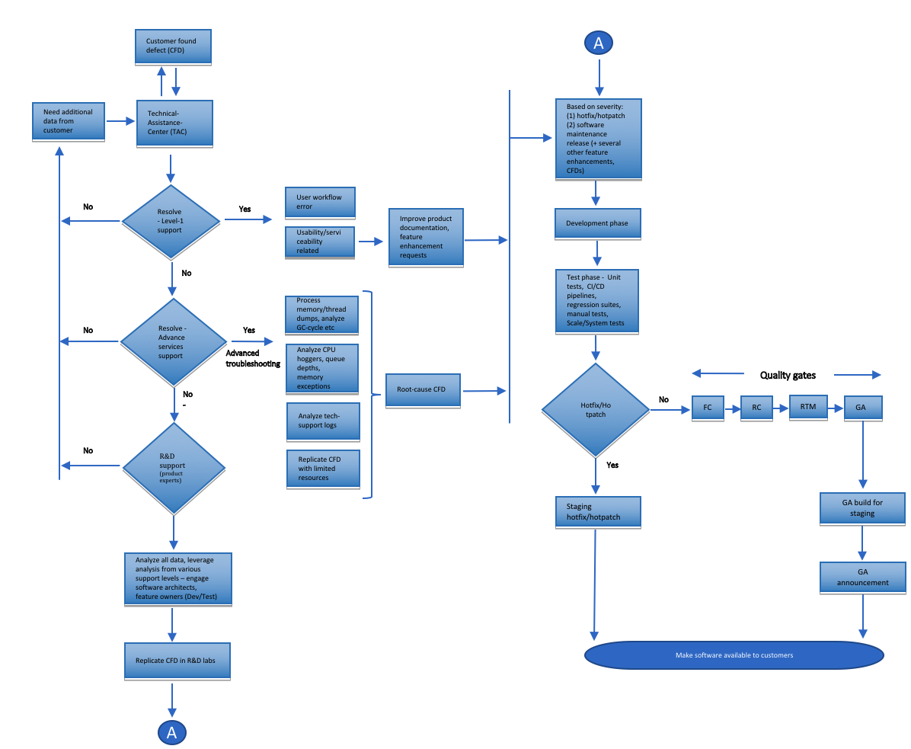
Define Phase – Process Map
Improve customer turn-around times within each Tier of support
Incorporate customer workflows to improve product quality (hence lower CFDs)
Identified broadly two areas of process improvement:
1. Improve turn-around times within various Tiers of support
2. Enhance certain R&D practices to improve overall product quality (reviews, incorporating customer workflows, automation etc).
NOTE – Pilot for (2) of the process improvement is planned in Phase-2, Q1 FY-2020. We will merely, plot/use some meaningful data but do not strive to prove any benefits.

Slide 5

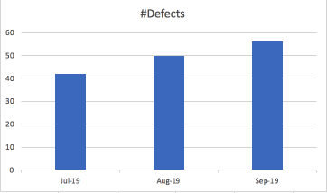
Measure Phase – Data collection
In an attempt to study trends we sampled data of incoming defects during the period of Jul-Sept 19 and plotted a baseline (10x defects from each month)
We broadly measured time-taken for defects across Tier-1 technical-support, Core Engineering/Escalation support & the Overall turn-around times* for defects (which includes an RCA & release)
Since all measurements are in terms of ‘hours’ this data will be classified as CONTINUOS
* Overall turn-around time is not additive of the time defects spend in Tier-1/Escalation support (it involves additional R&D practices).

Slide 6
Measure Phase – Data collection (cont.)
In this table are presented some top contributors which have been defined earlier under Define Phase – ‘Operational Definitions’
The data is specific to the time-line Jul-Sept 2019 & will collect a similar data for Oct-Dec 2019 where we will drive some process improvements.

Slide 7
Measure phase – Pareto Chart
To further examine the nature of the defects we classified them based on their severity: P1, P2, P3, P4 (P1 being most severe)
From the Pareto Chart: Applying the 80/20 principle – 80% of the problems are due to P3 category (20%) of bugs in the system
This is an important data-point we are trying to mine, to understand if there are any patterns to certain components of the software falling in this category.

Slide 8
Measure Phase – Data collection
Performance Measure | Data Source and Location | How Will Data Be Collected | Who will Collect Data | When will Data be Collected | Target Sample Size
Monitor incoming defects | Bug tracking tool | Manual + Download bug-list as csv/import to Excel | Sharat Sripada | 10/31, 11/30, 12/8 | All that is available
Overall time(in hours) a CFD spends in each Tier of support | Bug tracking tool | Ingest data in excel (derived from raw data) | Sharat Sripada | N/A | 10 CFDs
Time consumed in support to define problem | Bug tracking tool | Not readily available – needs to derived reading through the defect lifecycle | Sharat Sripada | 10/31, 11/30, 12/8 | 10 CFDs
Time consumed to upload logs & make data available | Bug tracking tool | Not readily available – needs to derived reading through the defect lifecycle | Sharat Sripada | 10/31, 11/30, 12/8 | 10 CFDs
Time consumed for the defect to go to the right category | Bug tracking tool | Not readily available – needs to derived reading through the defect lifecycle | Sharat Sripada | 10/31, 11/30, 12/8 | 10 CFDs
Time to identify a workaround (if applicable) | Bug tracking tool | Not readily available – needs to derived reading through the defect lifecycle | Sharat Sripada | 10/31, 11/30, 12/8 | 10 CFDs
Normalizing data from day:hour:min to hours to have a single | CSV/Excel data | N/A | Sharat Sripada | N/A | 10 CFDs

Slide 9
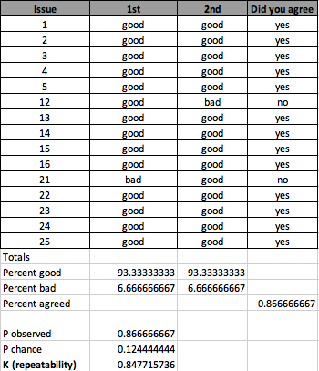
Measure phase – SQL & Measurement Error
Sigma Quality Level (SQL)
Overall turn-around time | Defect incoming rate
Defect opportunities that can cause the overall turn-around time to increase = 5 Defects sample set (Jul-Sept 2019) = 30 Overall defect opportunities = 5 * 30 = 150 Actual defects = 46 Defect per opportunity rate = 46/150 * 100 = 30.67 Defects per million opportunities = 306667 SQL = 2.0 | Defect opportunities = 1 Actual defect threshold = 5 Total possible defects per day = 5 Total actual defects (averaging data = 148/92 days) = 1.608 Defect per opportunity rate = 1.608/5 * 100 = 32.16 Defects per million opportunities = 32173.91 SQL = 2.0
Measurement Error: There are potential measurement errors since this involves reading through several updates on defects & using discretion (based on certain deterministic criteria) to tabulate data.
I randomly picked some defects between two separate dates & calculated the Kappa index for repeatability as 0.8477 -> 0.85 (which meets the criteria for measurement of >= 0.85)
NOTE – The sample set was 50% of the original set (this is a manual laborious process & hence the smaller comparison set)

Slide 10
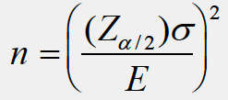
Measure Phase – Estimate sample size
Using the formula:
Referencing data from the Measure phase:
Z(alpha/2) at 95% confidence level = 1.96
SD for data (overall turn-around time) = 519.62 hours (not accounting for weekends/holidays which we will use in the Error estimate)
Acceptable error = 40 hours
n = (1.96 * 519.62) / 40 = 25.46

Slide 11
Analyze phase – Scatter-plots and Correlation
When gathering data & tabulating top contributors adding delay to the overall resolution of a defect, I wanted to understand their correlation.
Plotting the correlation co-efficient:
1. The data beside indicates the r-value highest for ‘Tag right component/category’ (vs ‘Overall Time to closure’)
2. Hence we plot the corresponding scatter plot & derive the equation from Linear Regression:
y = 0.7534x + 313.3
3. Also of significance was ‘Time taken to close bug after RCA’
NOTE - Extreme corner table from Slide-6/Define Phase – Data collection

Slide 12
Improve phase – What we did!
Based on the data that came out of the Analyze Phase, we did the following:
For ‘Tag the right component/category’:
Support Engineers were informed during TOIs, trainings or New-Product-Intro sessions about what components they should tag to defects
Trainings also captured specific diagnostics to collect when the component was selected in the Bug tracking tool (it also pointed them in the direction to dive deeper with triaging defects so it could to go to the right component)
For ‘Time taken to close the bug after an RCA’:
We went after the Teams responsible to book-keeping giving them some guide-lines
NOTE – These are loaded process changes & it possibly takes several releases to see these items become lesser contributors before we get our next bunch of parameters.
I repeated the data collection process post these changes during the week of 12/2 – 12/8

Slide 13
Improve phase - SQL & Hypothesis Test
Sigma Quality Level (SQL)
Overall turn-around time | Defect incoming rate
Defect opportunities that can cause the overall turn-around time to increase = 5 Defects sample set (Oct-Dec 2019) = 25 Overall defect opportunities = 5 * 25 = 125 Actual defects = 37 Defect per opportunity rate = 37/125 * 100 = 29.6 Defects per million opportunities = 296000 SQL = 2.0 No change from baseline ☹ | Did not have a software GA release in the last couple of months. SQL remained at 2.0 as well
Hypothesis Test: Since there was marginal improvement in the mean across data-sets before & after the process improvement, I ran the following test:
Continuous -> Two-Sample -> Upper/Right-tail test
Since p-value >> alpha at 0.1, 0.05 or 0.01 we fail to Reject the Null hypothesis & therefore state the new mean is not statistically different from the previous!

Slide 14
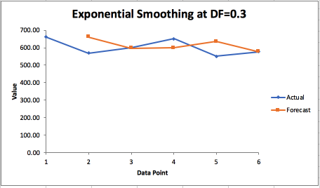
Control phase – Time series, Next-steps & conclusion
Time series analysis:
As a final step, we predict the mean time for CFD resolution in Jan-2020 using an exponential smoothing time series method shown alongside.
The forecast itself is encouraging, showing the mean time to resolution of a CFD:
DF=0.3 -> 576
DF=0.9 -> 637
Initial Goal of 10% reduction in time to resolution of defects is met!
Next steps & conclusion
This is a pilot but just the sheer volume of data & all the variables associated with a complex eco-system are overwhelming – hence we would spend some effort in automating the data-collection process itself
Continue driving process improvements & make necessary changes to get meaningful results
Goal - Streaming an efficient pipeline for flow of defects with the aim itself being to bring the rate of defects down.

