Slide 1

IST-719 Advanced Topic Presentation (Week-8)
Topic: Using D3.js to visualize the wine sales dataset
Sharat Sripada (vssripad@syr.edu)
Sharat Sripada (vssripad@syr.edu)

Slide 2
D3 - Introduction
D3 stands for Data-Driven Documents. It is an open-source JavaScript library developed to create custom interactive data visualizations in web-browser
Features
Uses web standards
Dynamic properties
Custom visualizations
Interaction
+
animation
Transitions

Slide 3
D3 - Advantages
Attribute
D3 is a javascript (JS) library
D3 focuses on data
D3 is open-source
It works with web standards
D3 works with web standards like HTML, CSS and SVG
D3 does not provide any specific feature
D3 is lightweight, and works directly with web standards
Description
It can be used with any JS framework
It is the most appropriate and specialized tool for data visualizations
Add your own features
You don't need any other technology or plugin other than a browser to make use of D3
No new learning or debugging tool required
Gives you complete control over your visualization to customize it the way you want. This gives it an edge over other popular tools like Tableau or QlikView.
Extremely fast and works well with large datasets.

Slide 4
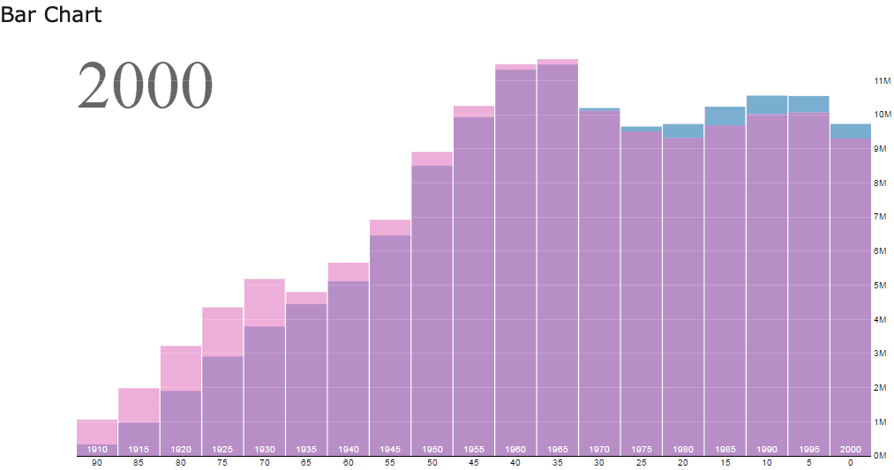
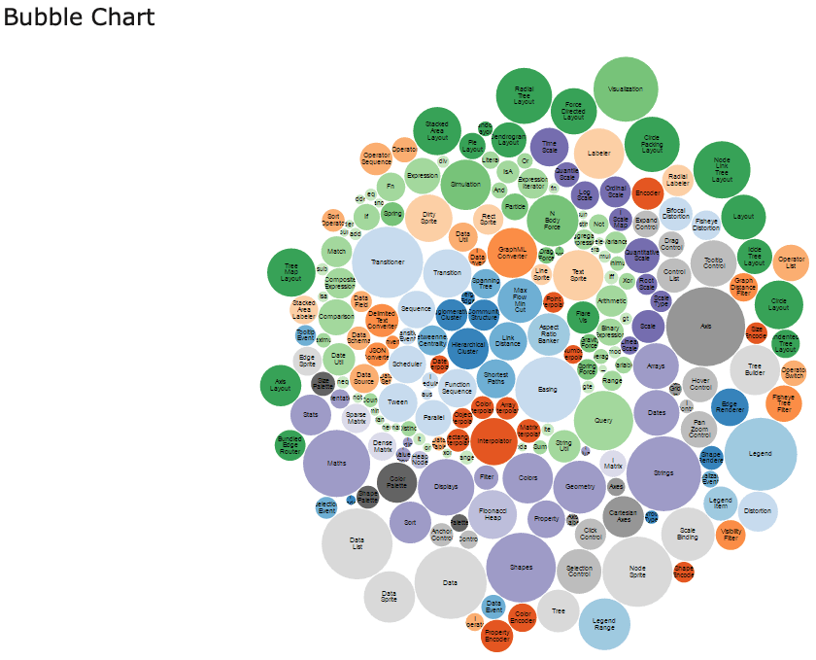
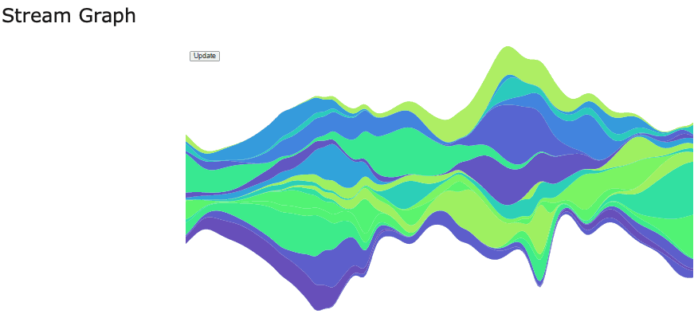
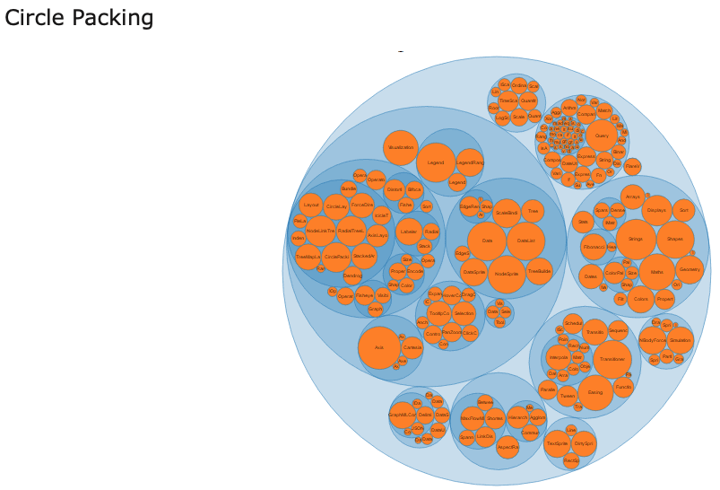
D3 - Visualization examples

Slide 5
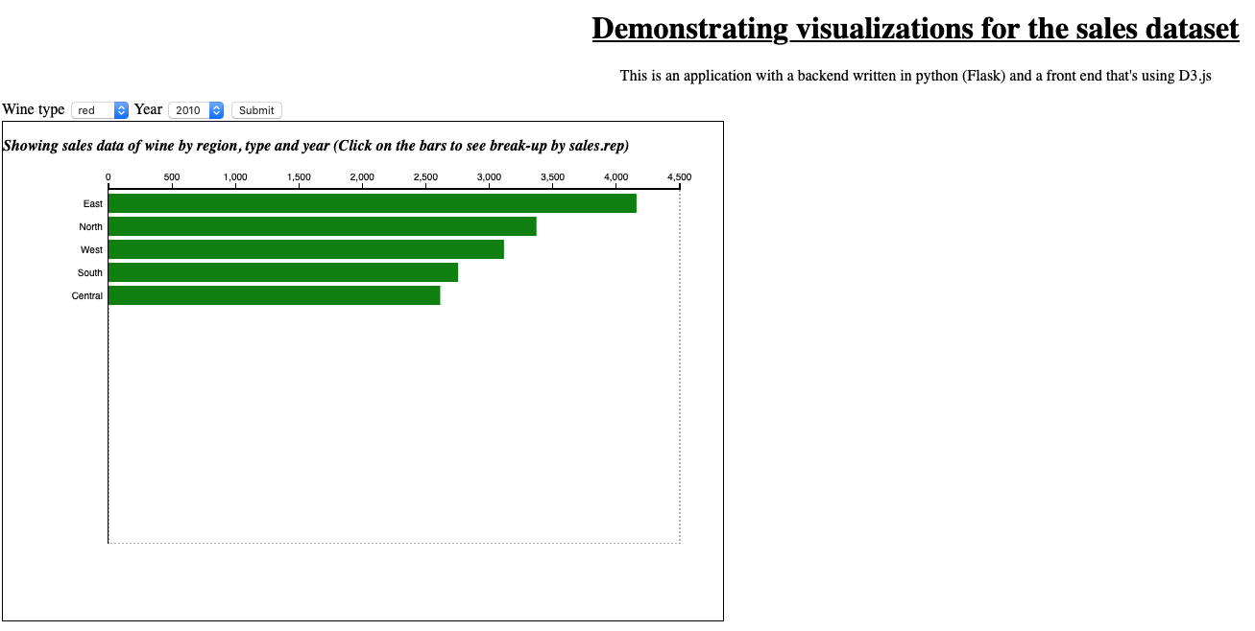

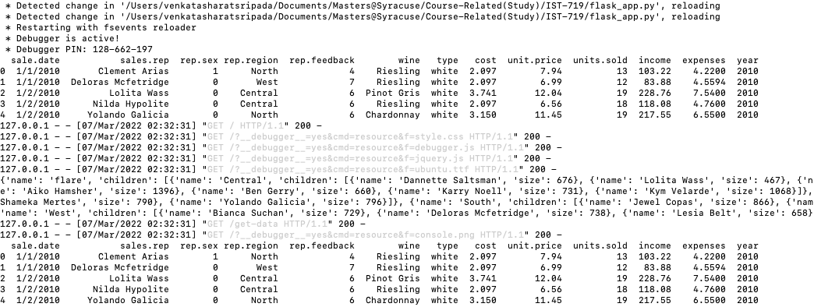
Building a simple dashboard with Python and D3.js
Fig: index.html showing d3.js invocation
HTML page with charts, user interface and javascript (index.html)
Request received from frontend via action form
Data sent to front end through the flask and jinja module
Fig: Front-end GUI with d3.js charts
Application in Python/Flask framework
sales.csv
Fig: High-level architecture
Fig: Python Flask app in action

Slide 6
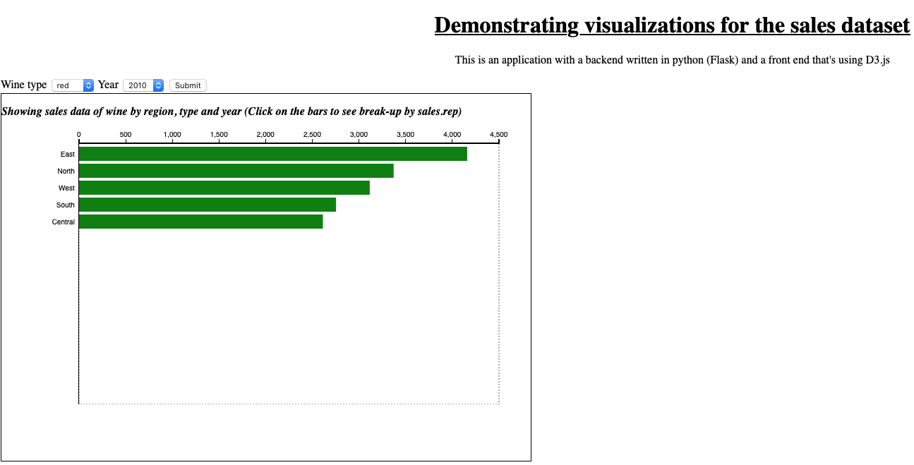
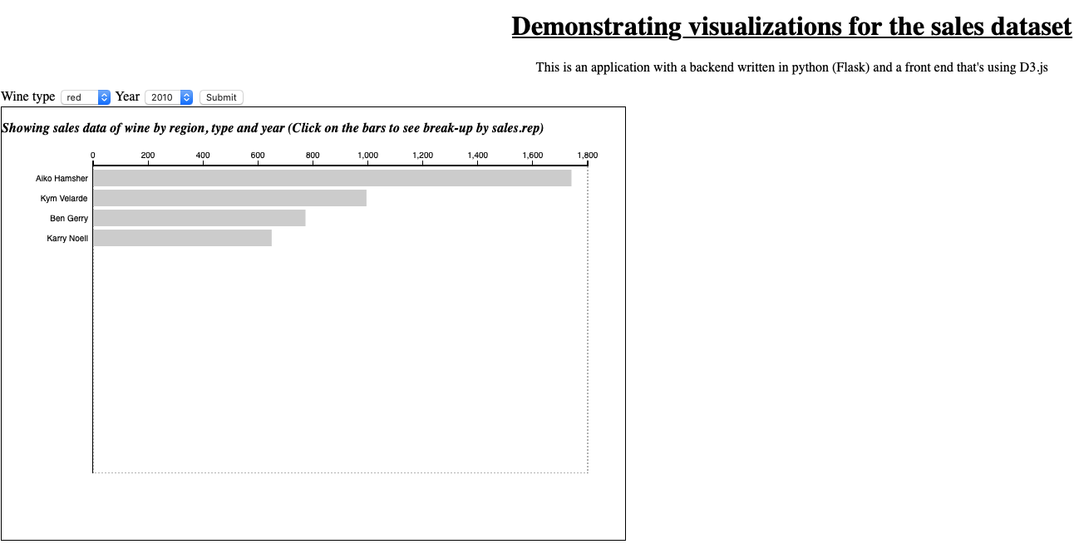
Demo
Choose wine type
Choose year
Each bar is drillable. Click!
Sales rep in region East
Grouped by Region
Fig: Home page (front-end)
Fig: Children under parent
Interact with bar-plot to navigate between parent/child objects

Slide 7
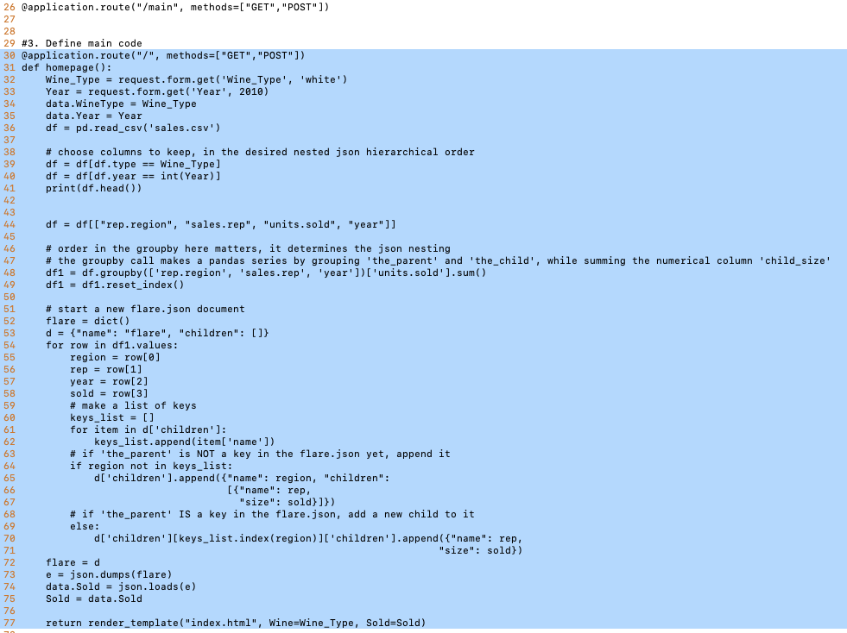
Demo
Fig: Python code to convert data to json for D3

Slide 8
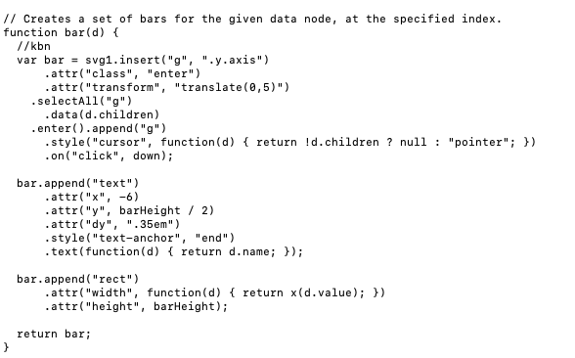
Demo
Fig: Code in D3 to make an interactive bar-plot

Slide 9
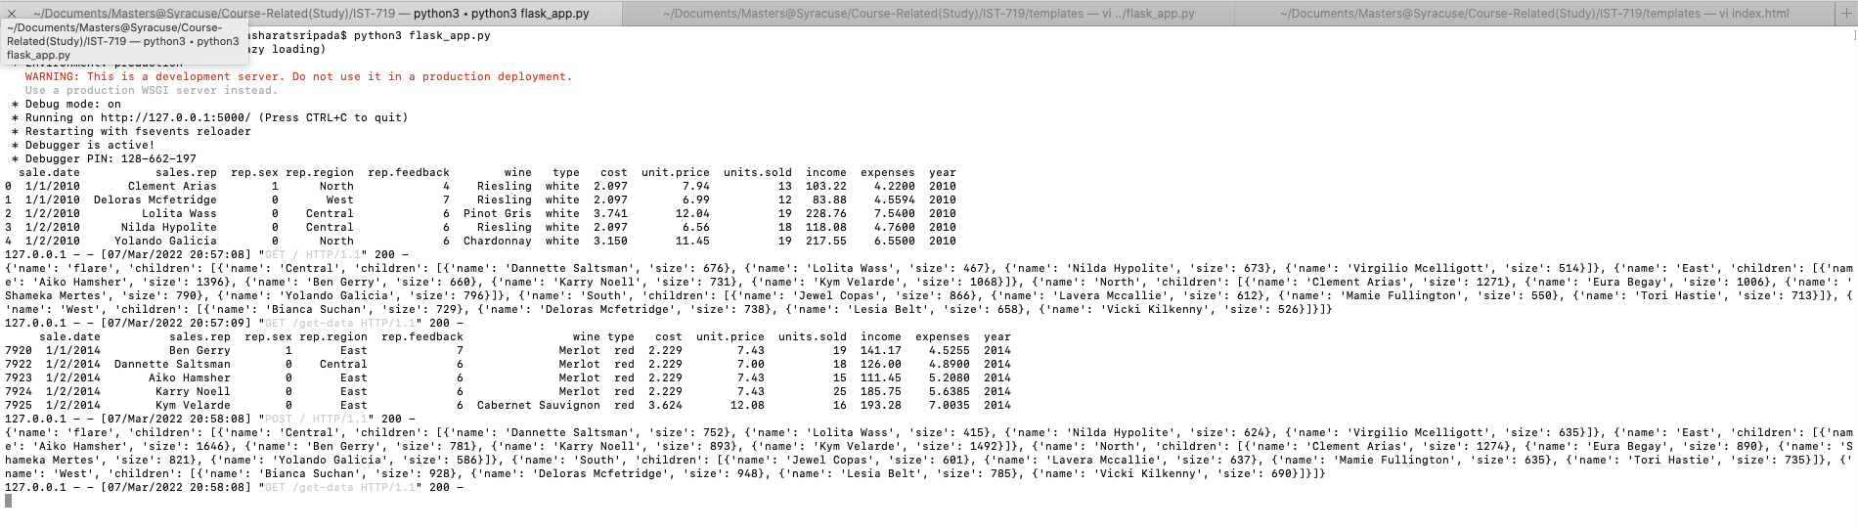
Demo
Fig: Application (back-end) in action

Slide 10
Thank you!
Sharat Sripada (vssripad@syr.edu)

