Slide 1
EXPLORATION OF FIFA PLAYER ATTRIBUTES
Group number : 11
Members: Sharath, Harish, Yiran, minhong

Slide 2
Motivation and Objective
To simplify the complex representation of FIFA attributes and identify key features
To derive simplistic and useful insights through visualization
To simplify the rating system of players based on their key attributes
To build a model based on skills, attributes and position of the players

Slide 3
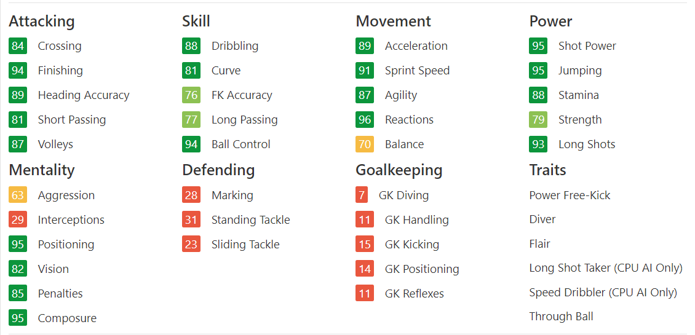
SOFIFA Player Attributes

Slide 4
Pre Processing
Data Source: SOFIFA
Scrapping Tool: Beautiful Soap
Identified correct tags to extract features
Data Cleaning
Stored the processed data in Pandas Dataframe

Slide 5
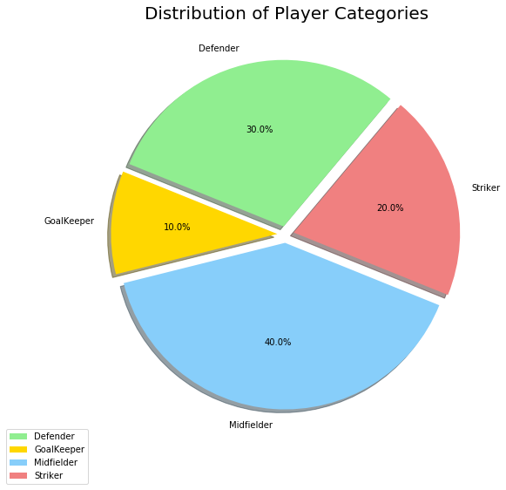
Methodology-Analysis
Divided the dataset (10k players) into
Strikers, Midfielders, Defenders and Goalkeepers
The Analysis has 2 parts:
Exploratory
ML based

Slide 6
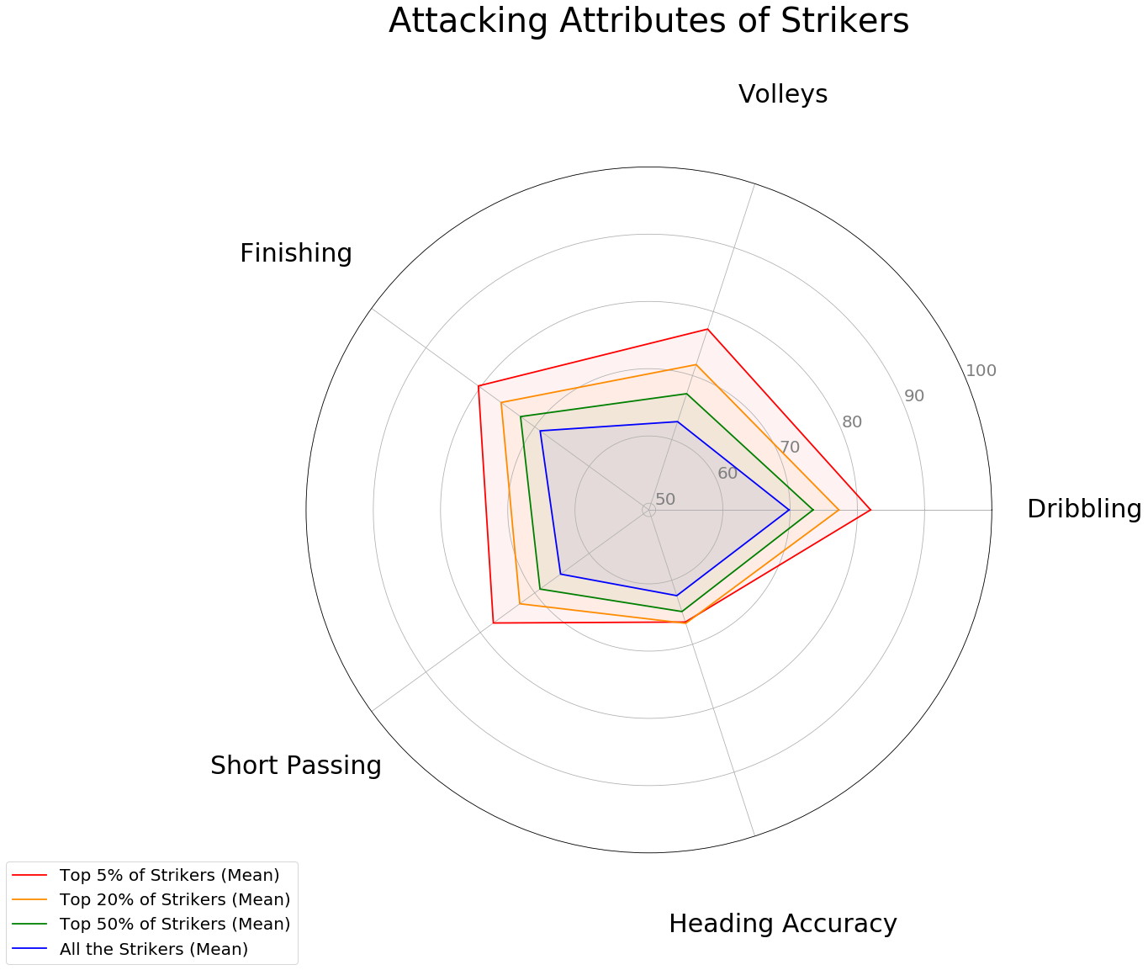
Exploratory Analysis
Inference: Significant difference in all the skills except Heading accuracy

Slide 7
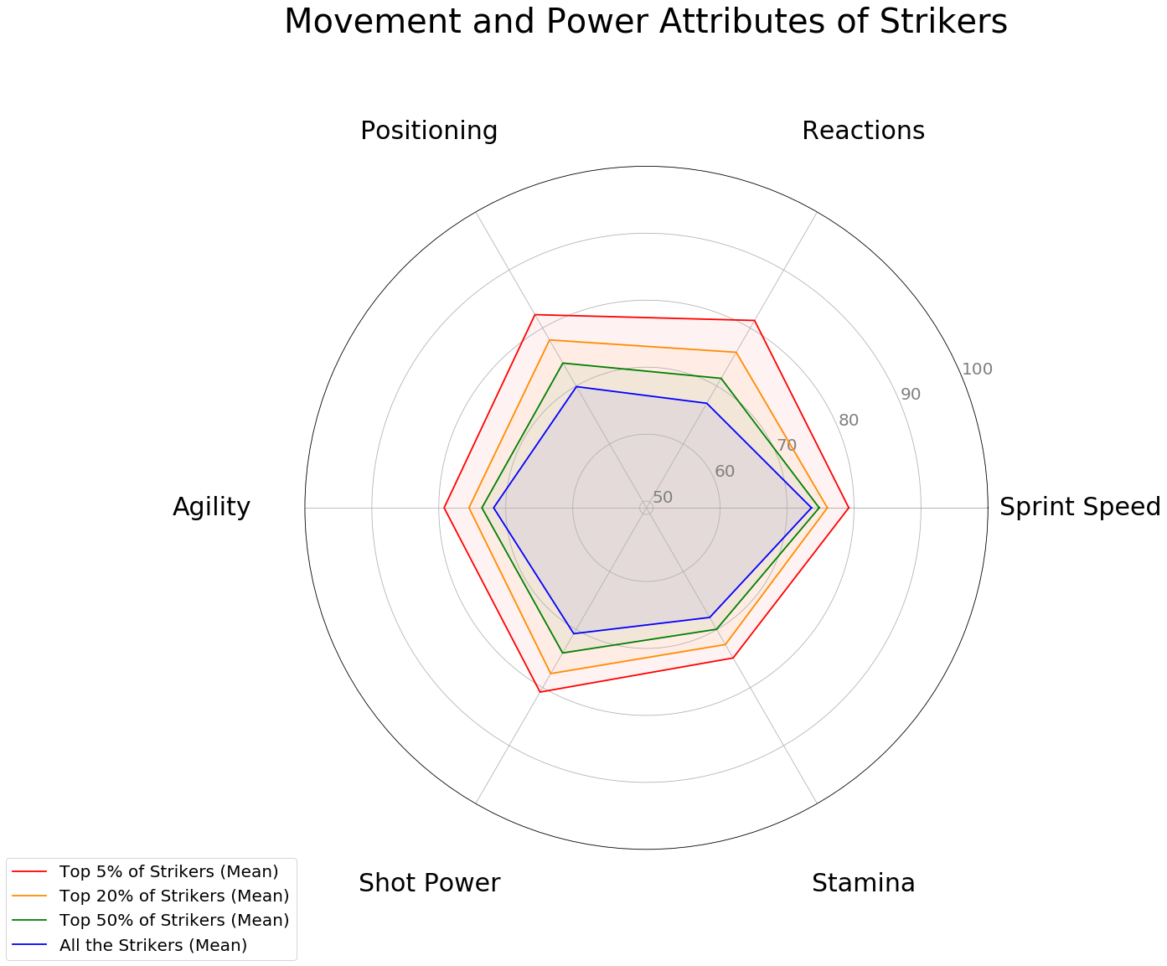
Exploratory Analysis
Inference: Movement a key factor to be in top ranks

Slide 8
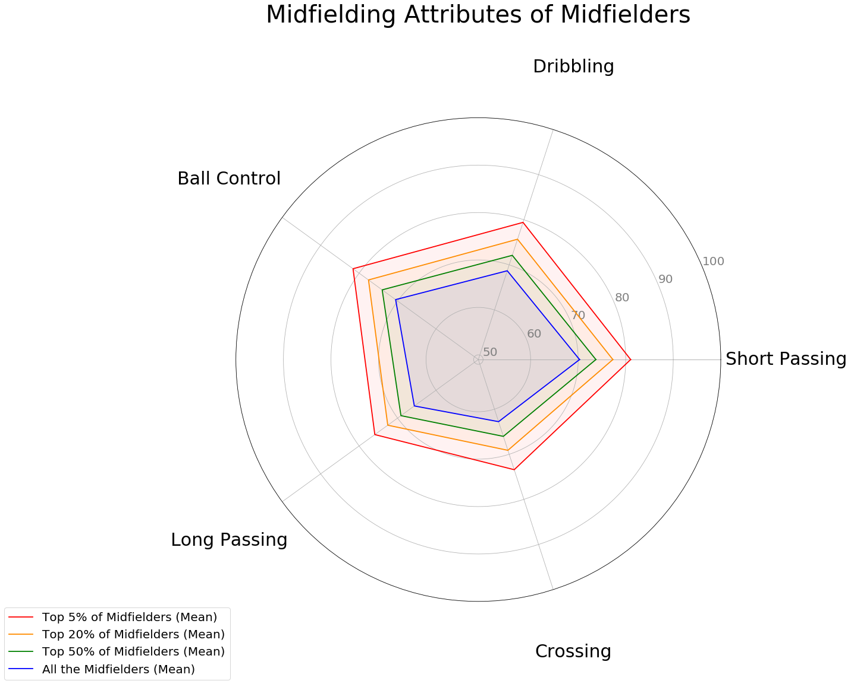
Exploratory Analysis
Inference: Skills are evenly spaced out

Slide 9
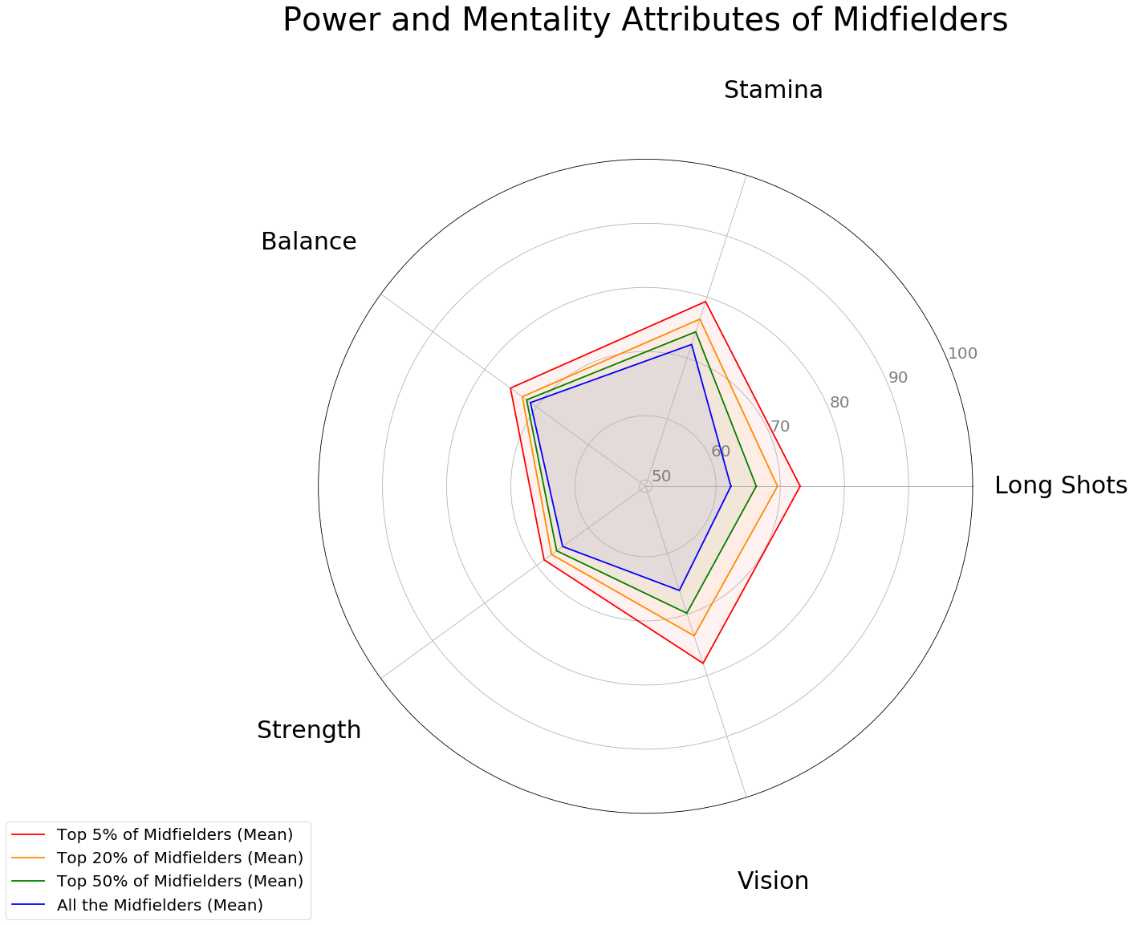
Exploratory Analysis
Inference: Vision and Long Shots accuracy are the differentiators

Slide 10
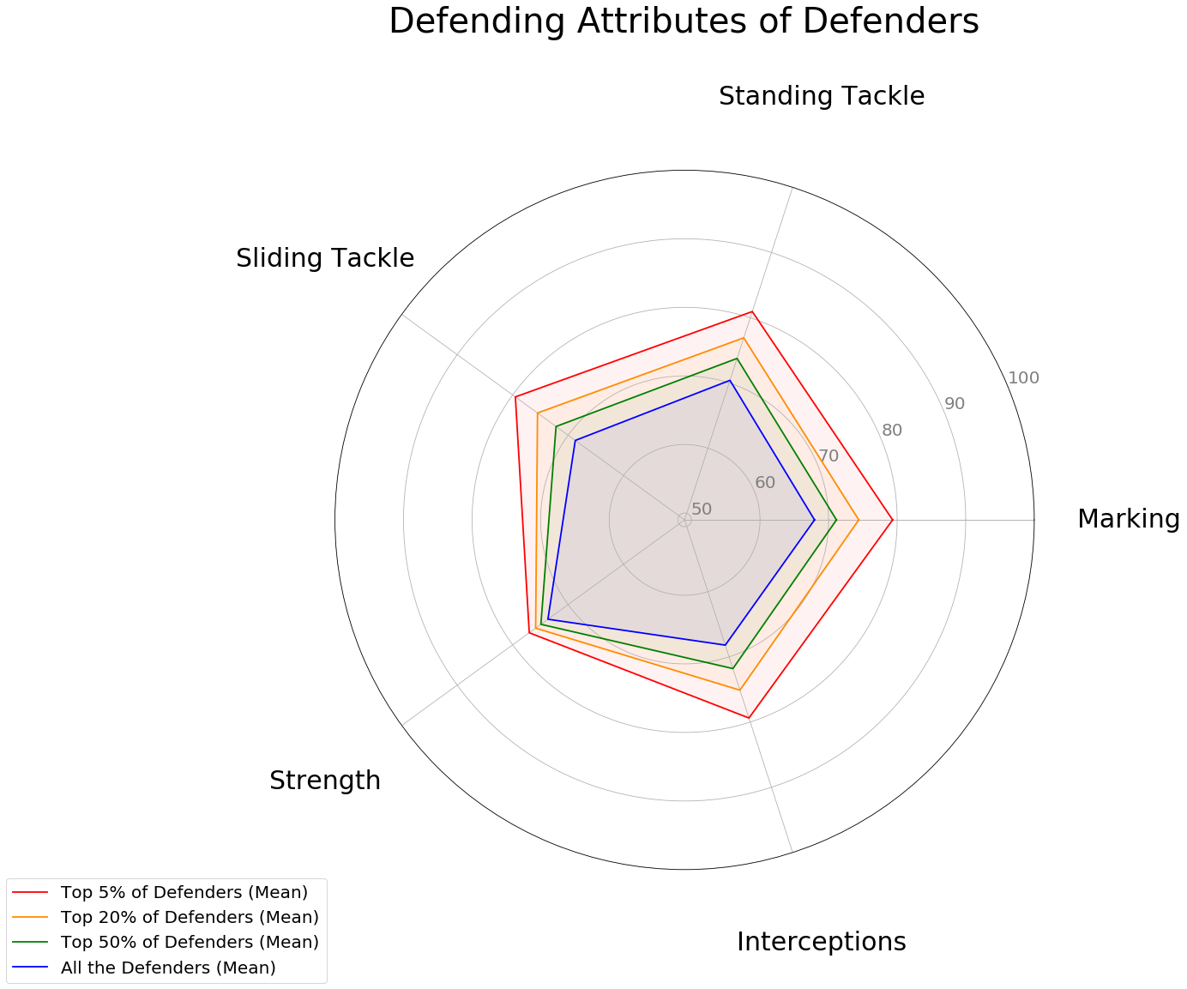
Exploratory Analysis
Inference: Marking and Tackling make the difference, while Strength doesn’t

Slide 11
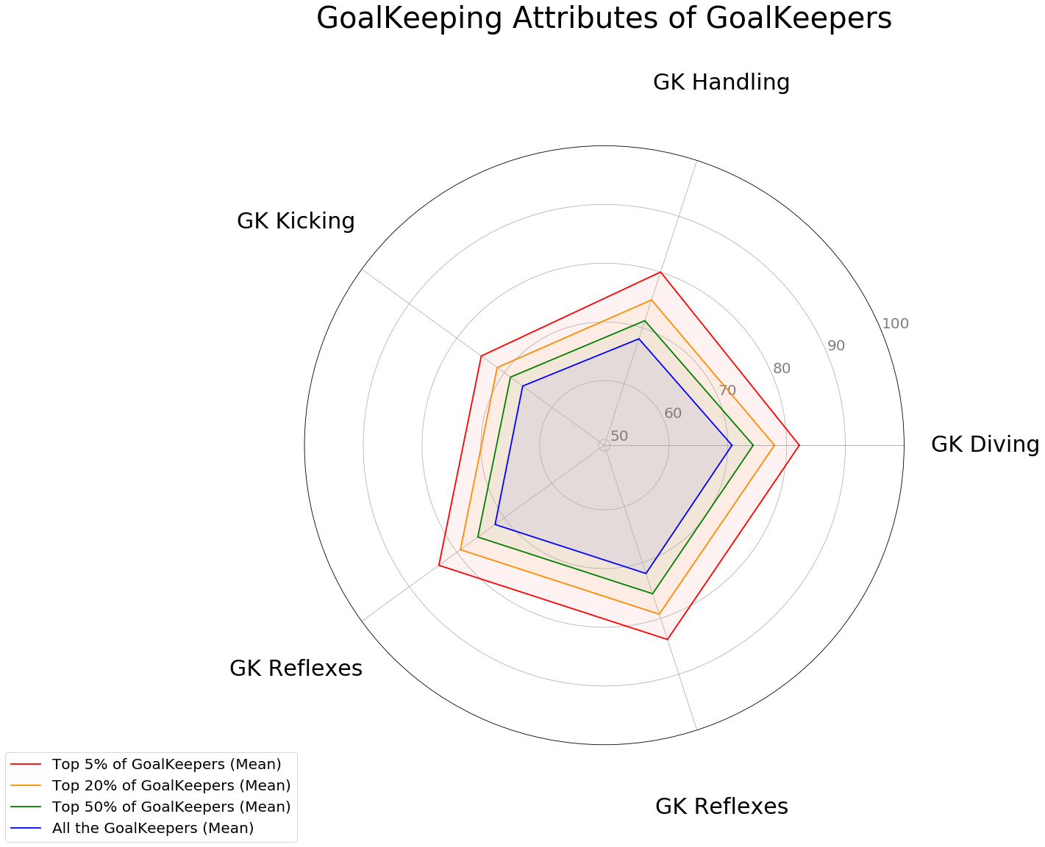
Exploratory Analysis
Inference: Significant differences in
all the attributes

Slide 12
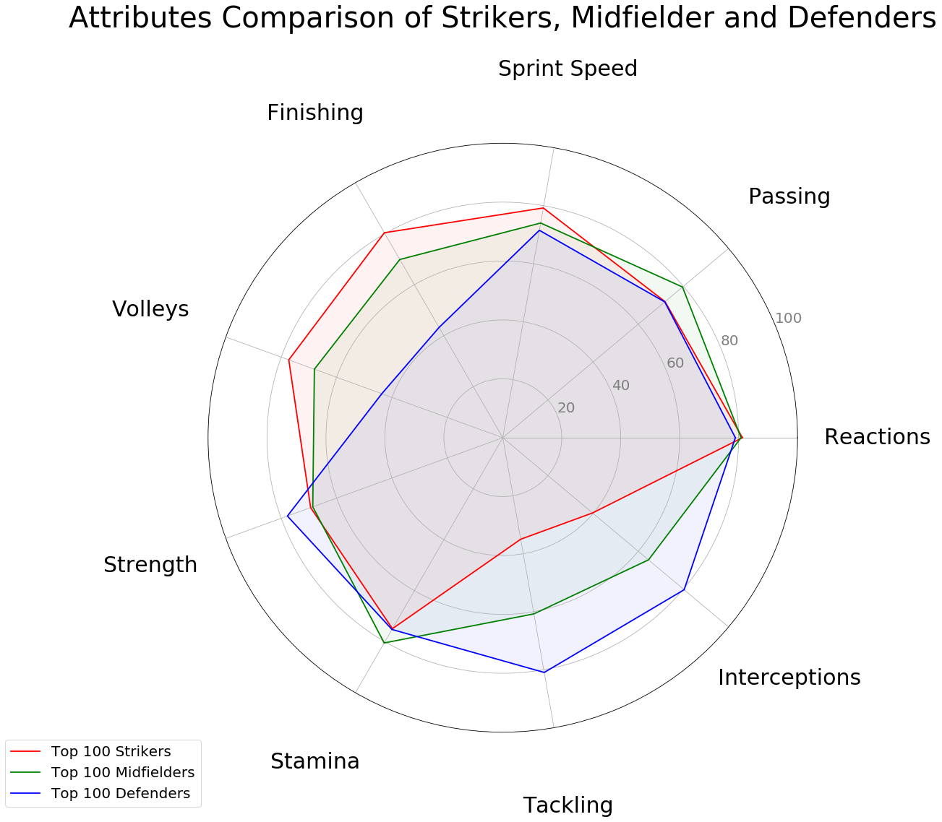
Exploratory Analysis
Inference: Each position has few
unique differentiators and few

Slide 13
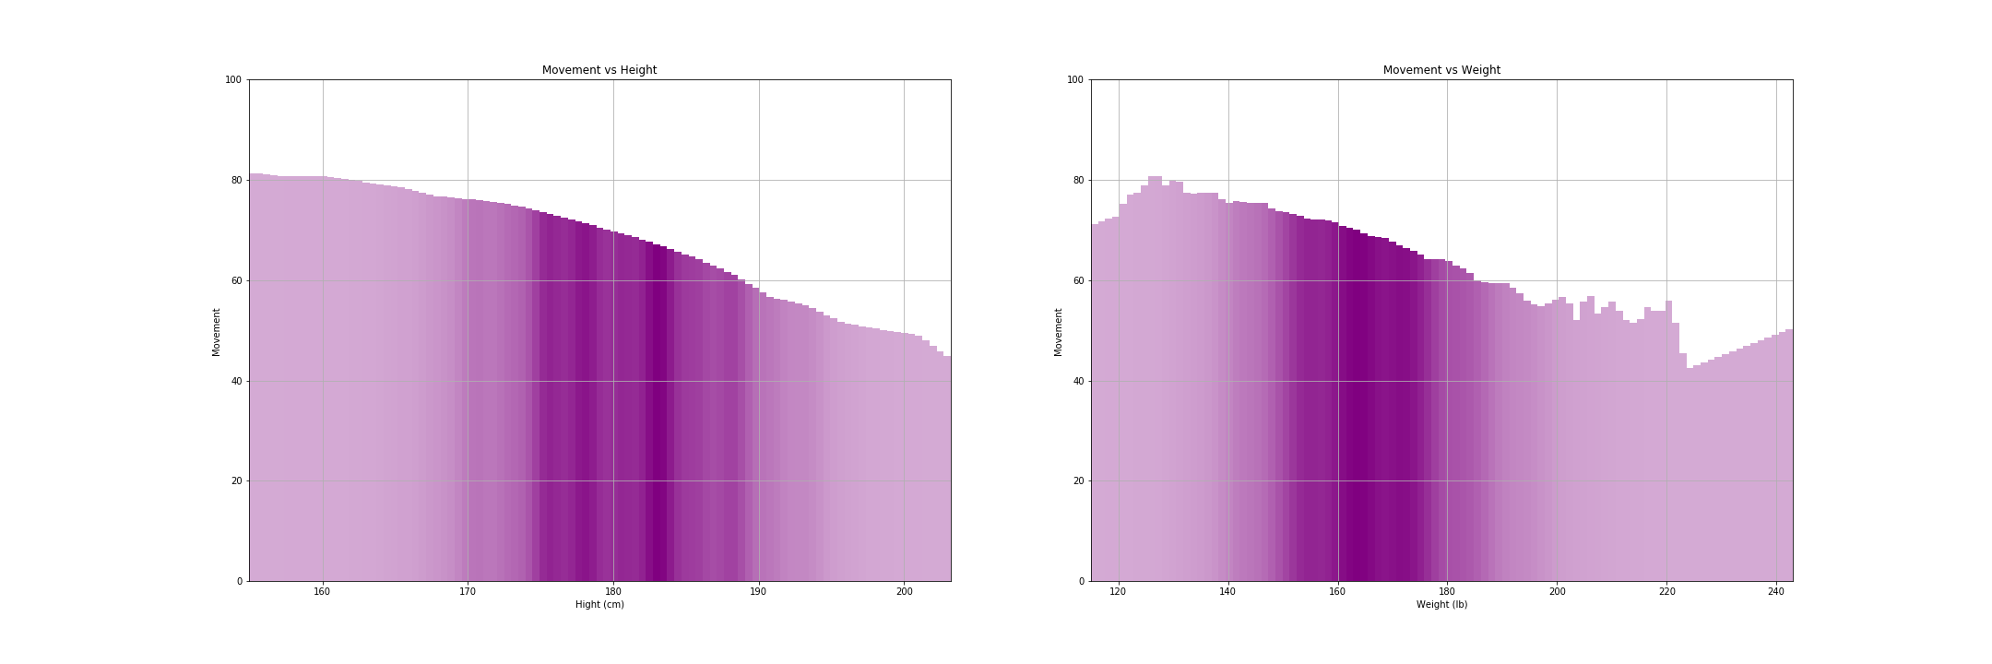
Exploratory Analysis
Inference: Heavier and Taller the players are less agile

Slide 14
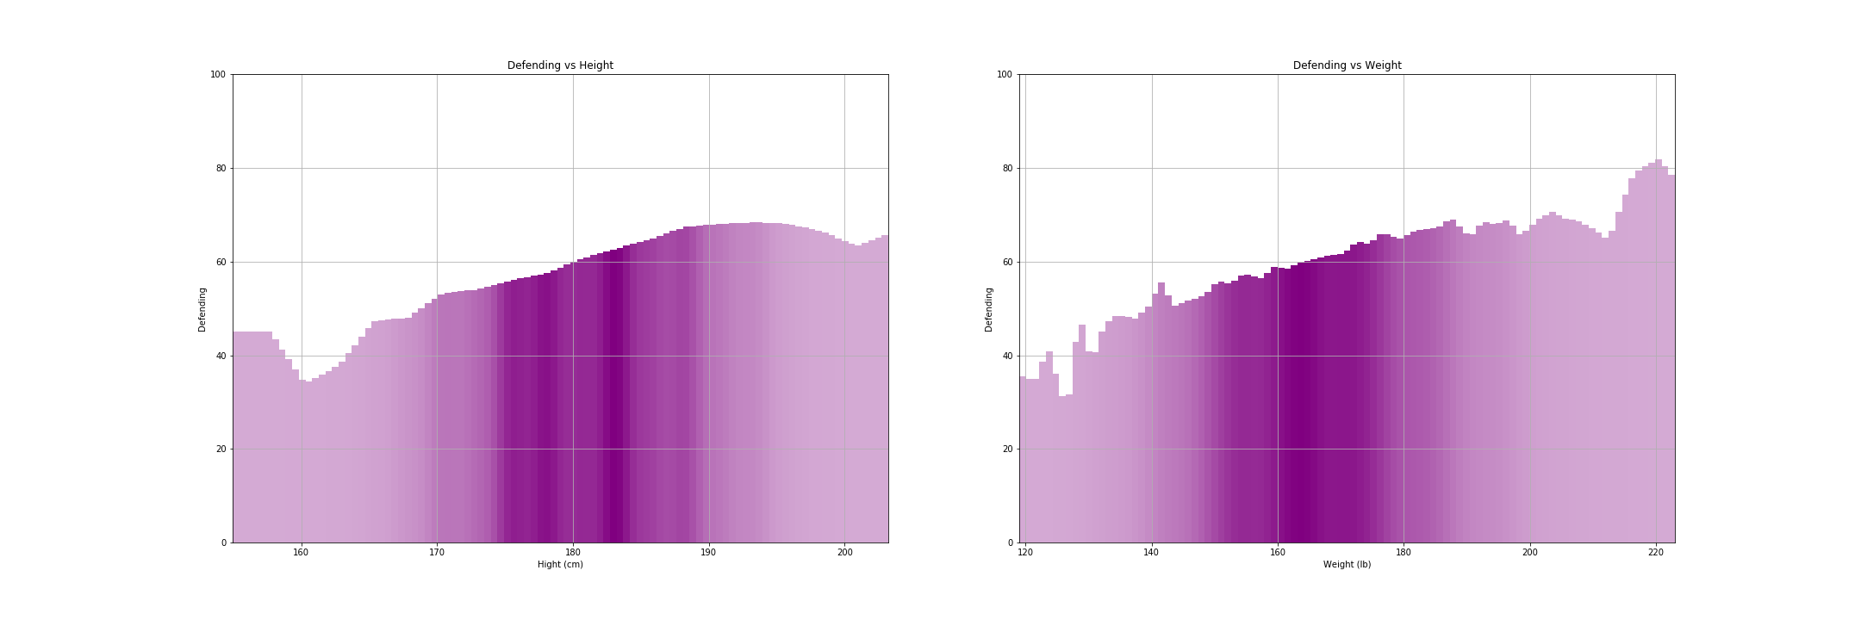
Exploratory Analysis
Inference: Defending abilities proportional to height and weight

Slide 15
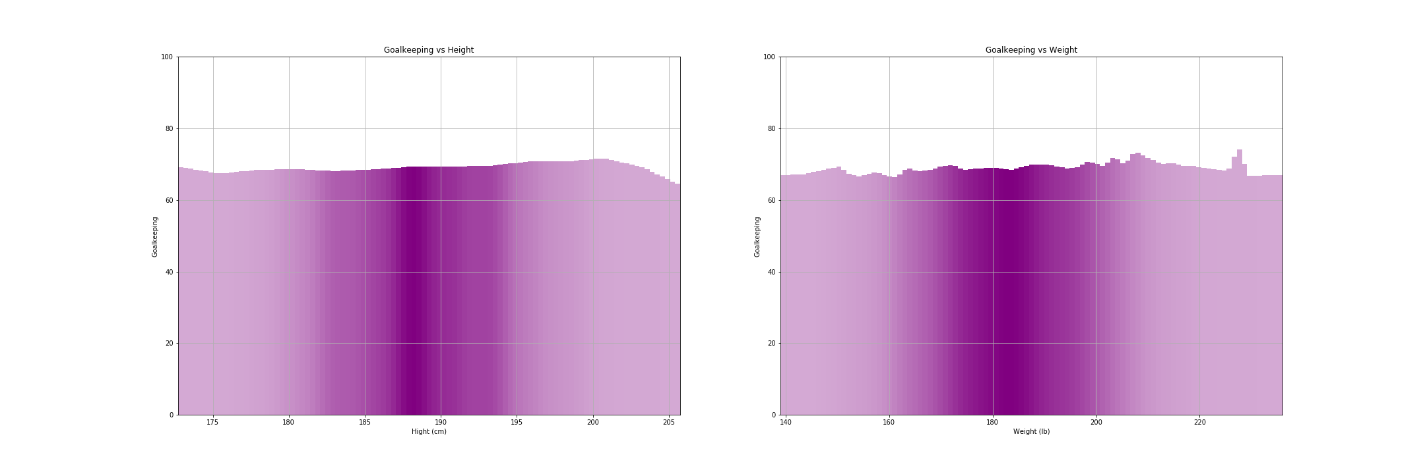
Exploratory Analysis
Inference: Goalkeeping abilities are independent of the Physical Attributes

Slide 16
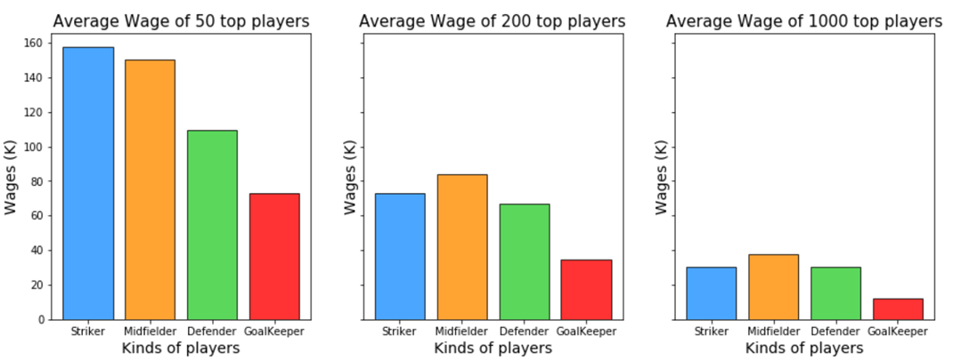
Exploratory Analysis
Inference: Are Strikers paid more? Or ranking matters?

Slide 17
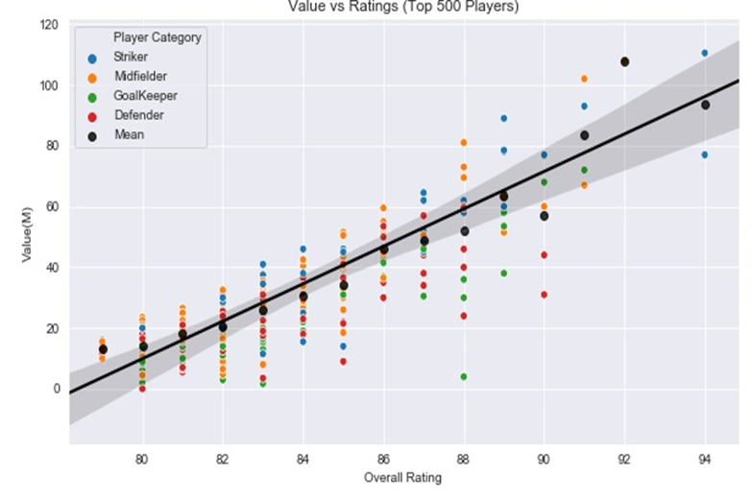
Exploratory Analysis
Inference: Are strikers more valuable?

Slide 18
ML-Analysis
Used regression models to predict the ratings based on the important features
Index | Model | Train Error | Test Error
1. | Baseline 1 - Median | 21.39 | 22.5
2. | Baseline 2 – Mean (Adjusted features) | 20.2 | 21.1
3. | Linear Regression (Adjusted Features) | 4.9 | 6.2
4. | XGB Regressor | 1.21 | 1.47

Slide 19
ML-Analysis
Prediction of Player category and corresponding ratings:
Player Ratings | Predicted Category | Actual ratings | Predicted ratings
Lionel Messi | Striker | 94 | 92
Neymar Jr | Midfielder | 92 | 91

Slide 20
Conclusion
Through visualization of the graphs, we were able to infer how the ratings of the various attributes change for the players and what attributes are important for a player category.
Designing a ML based model, we were able to predict the player category and the player’s value, given the ratings of the attributes of the player.

