Slide 1
EXPLORATION OF FIFA PLAYER ATTRIBUTES ECE 143
Group 11
Sharath Harish
Minhong Yiran

Slide 2

Motivation and Objective
Problems:
1. Too much statistics describing a football player
2. Same parameters for all kinds of players
Aim:
1. Graphical analysis on player attributes:
physical attributes, skills, position
2. Gather useful inferences and attain some insights
3. Build a ML model based on those insights
Notes:
Problem:
with these much data describing, it is hard to predict and define who is a good player
but we know that certain parameters are only applicable to certain positions.

Slide 3

Methodology- Pre Processing
Data source: SOFIFA website as the main source for data analyzation
https://sofifa.com/players
Data scrapping: Beautiful soup
Methods:
1. extract data from HTML tags stored in soup’s data structures
2. store and clean data in padas data frame
3. apply pandas as a main source in further analysis

Slide 4
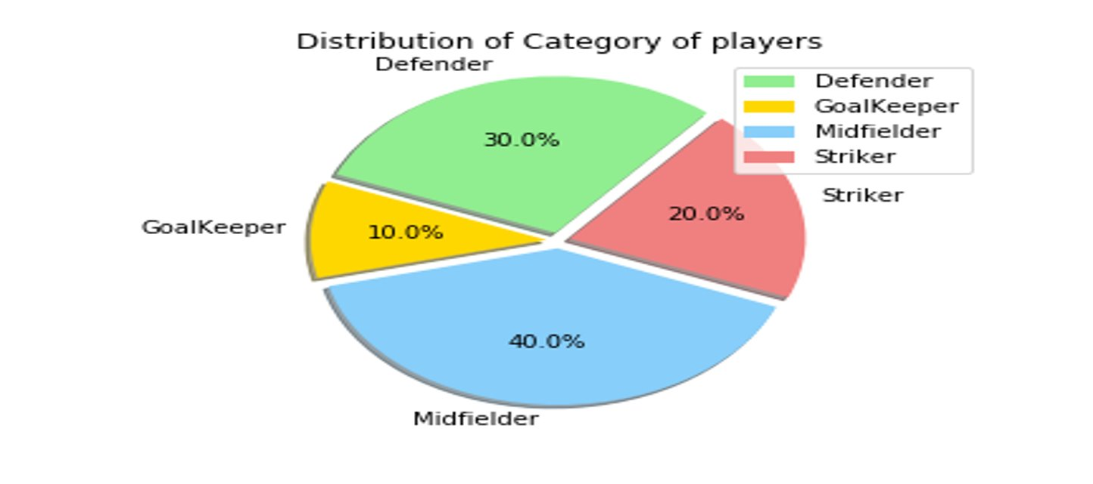
Methodology-Analysis
Divided the dataset(10k)into strikers, midfielders, Defenders and Goalkeepers
Further classified each of them into top 50, top 200, top 1000 respectively
The Graphical Analysis has 3 parts:
Exploratory (Radar Plots)
Comparison
ML based

Slide 5
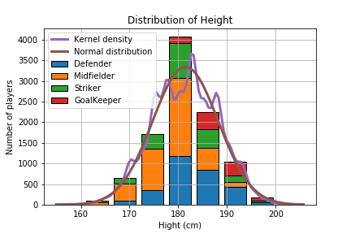
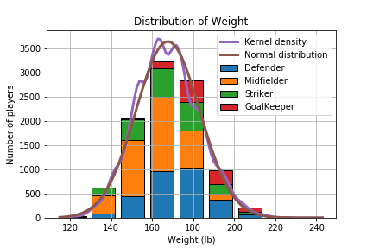
Physical Attributes- Explored
Inference: Heavier/taller the person

Slide 6
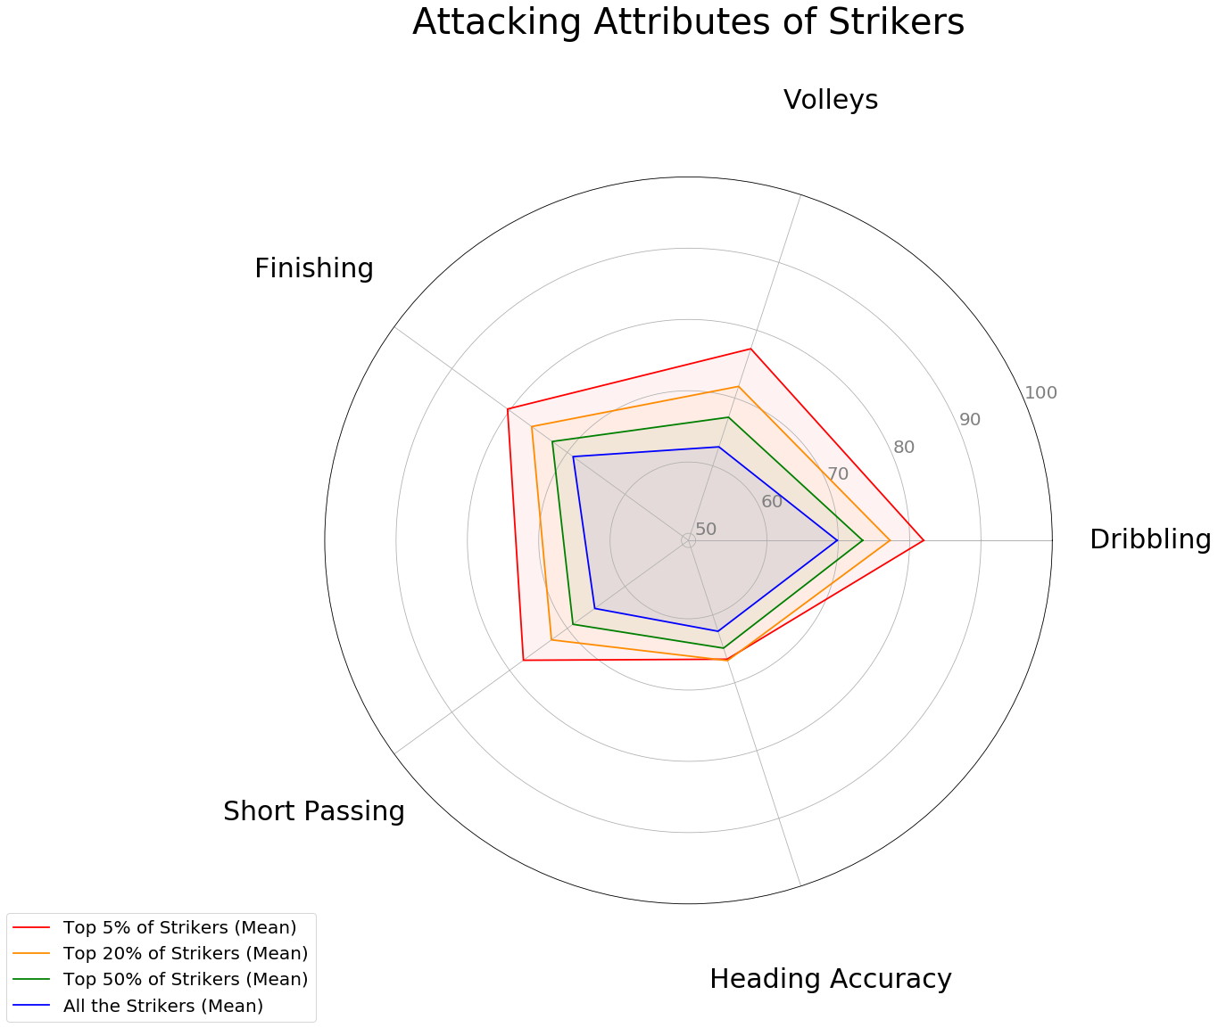
Exploratory Analysis
Inference: Significant Difference Heading accuracy unimportant.

Slide 7
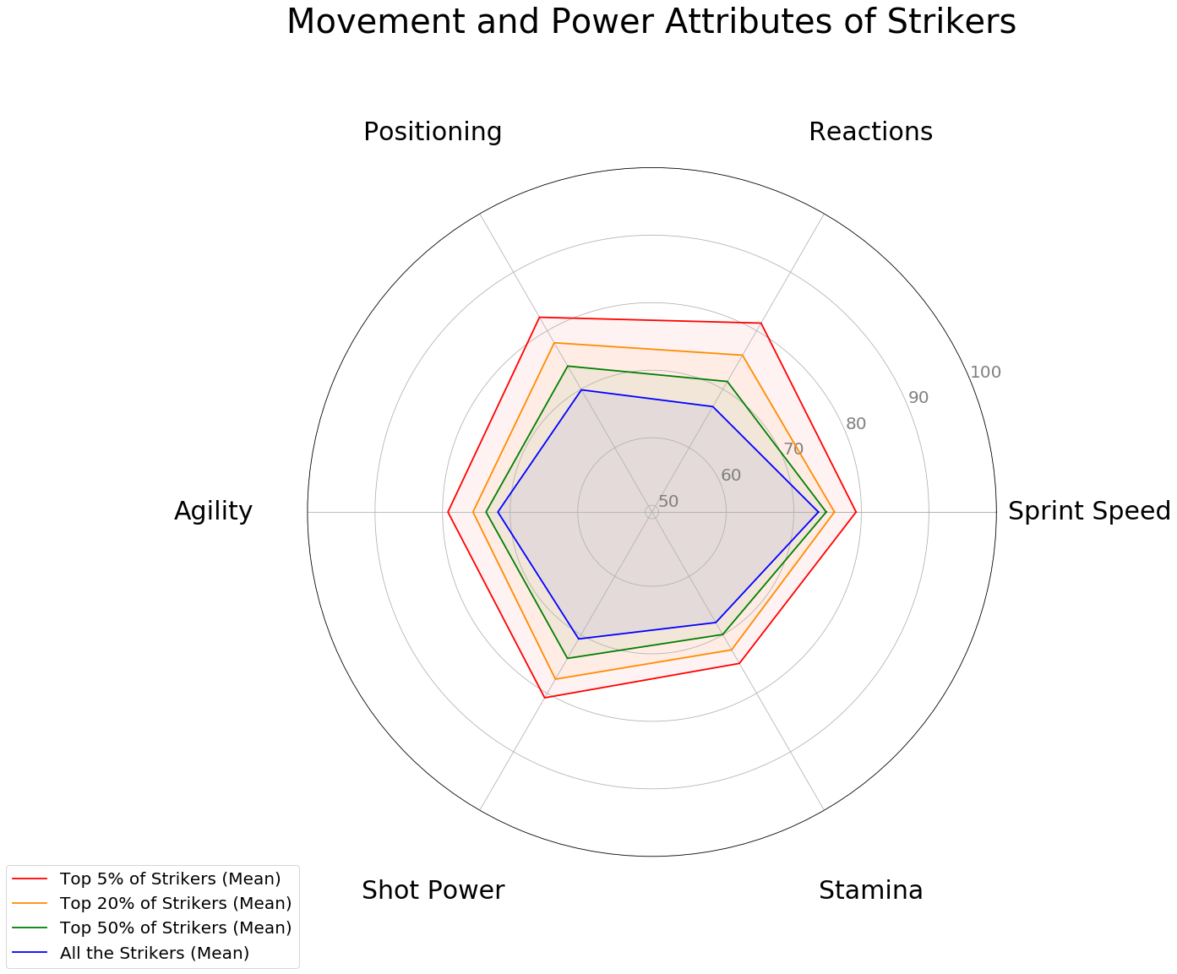
Exploratory Analysis
Inference: Movement a key factor to be in TOP ranks

Slide 8
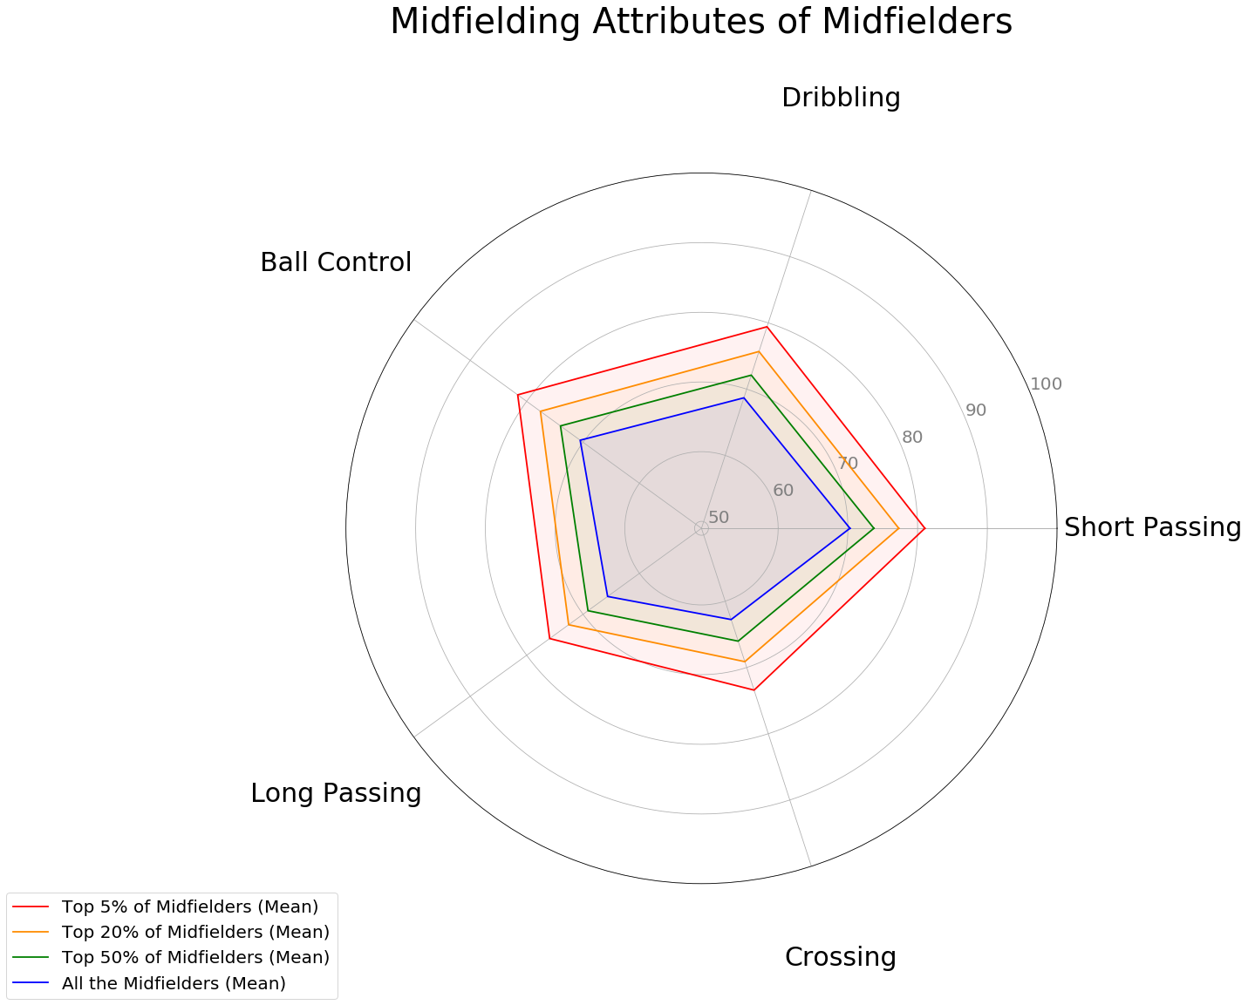
Exploratory Analysis
Inference: Evenly spaced out

Slide 9
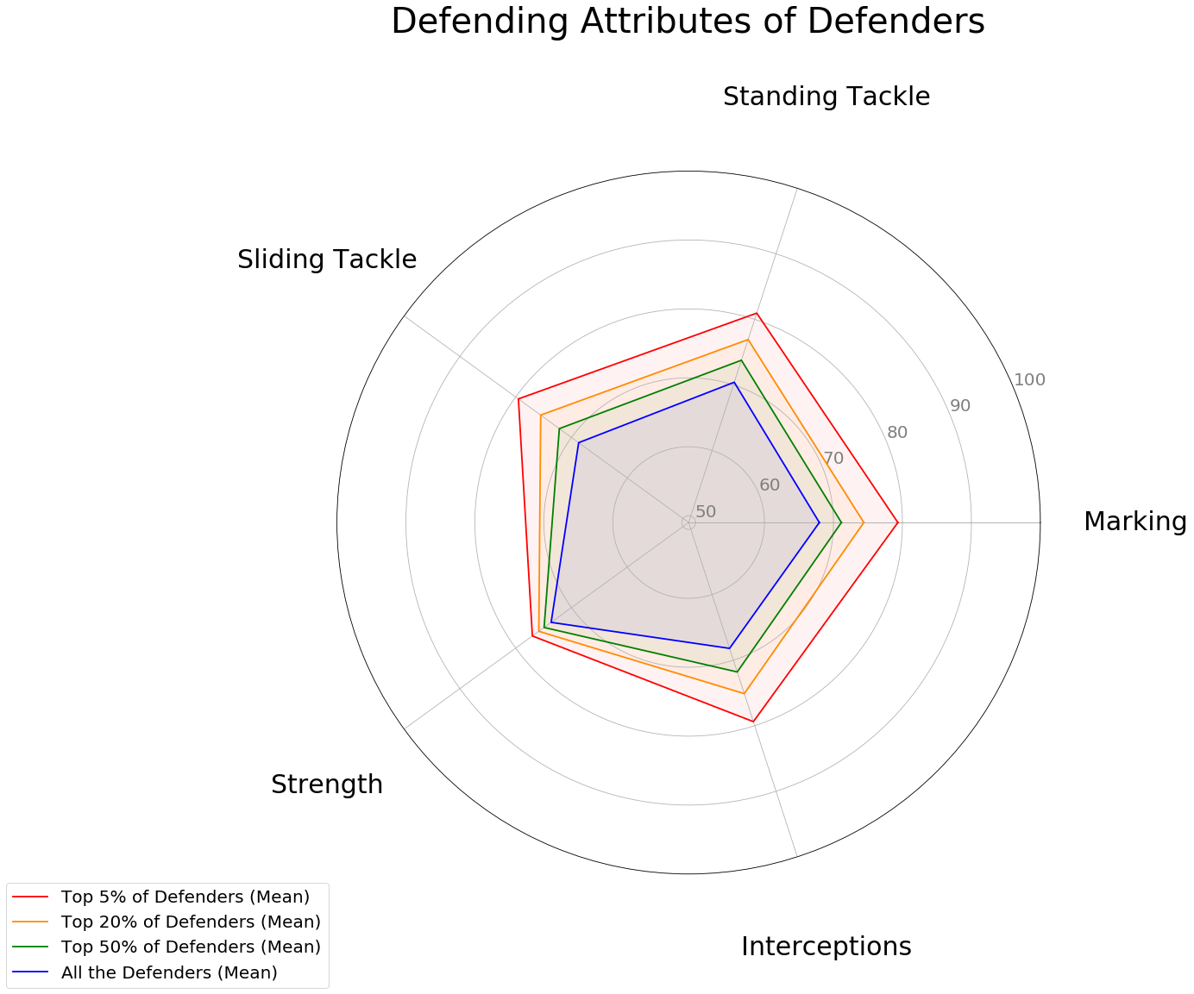
Exploratory Analysis
Inference: Marking Important, Strength not important

Slide 10
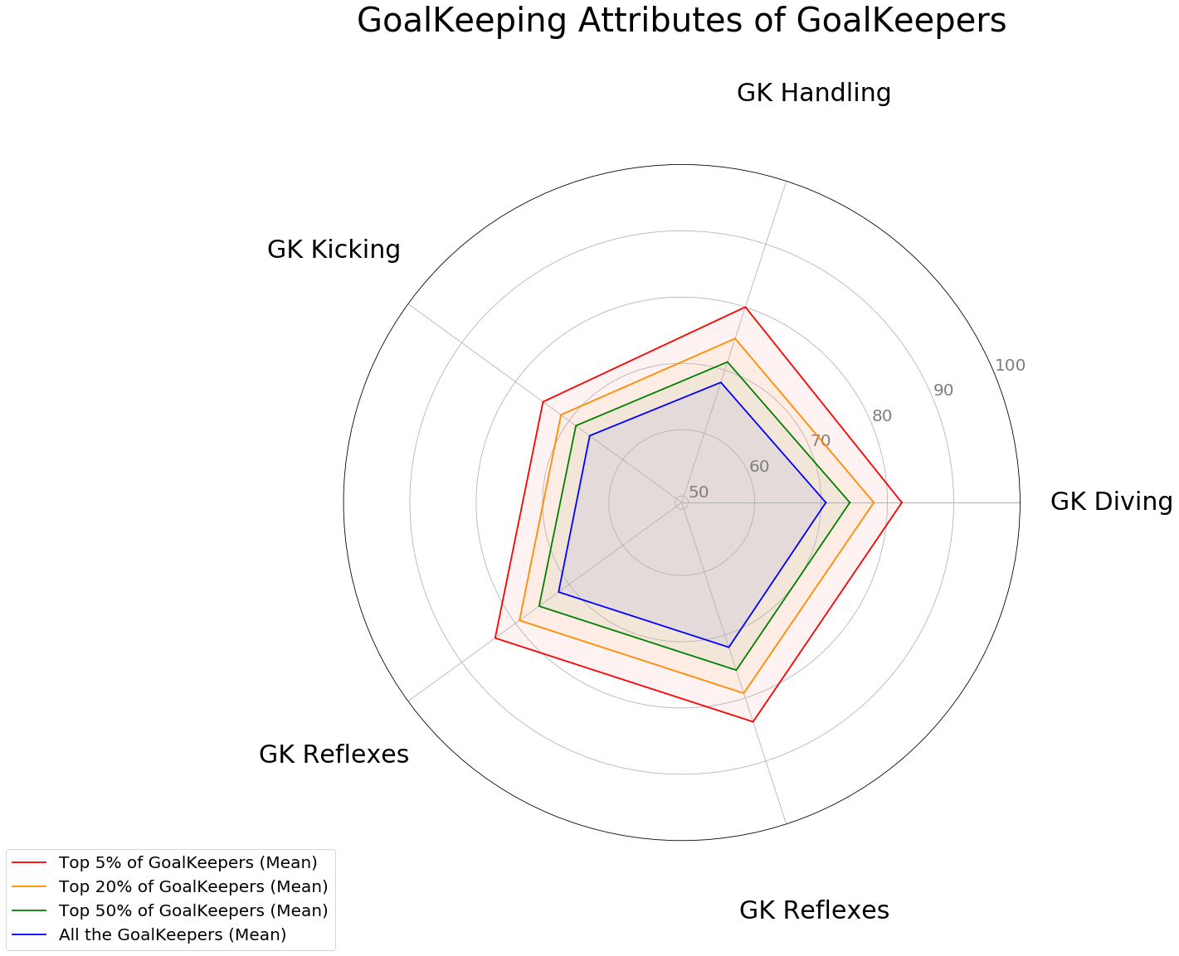
Exploratory Analysis
Inference: Significant Difference

Slide 11
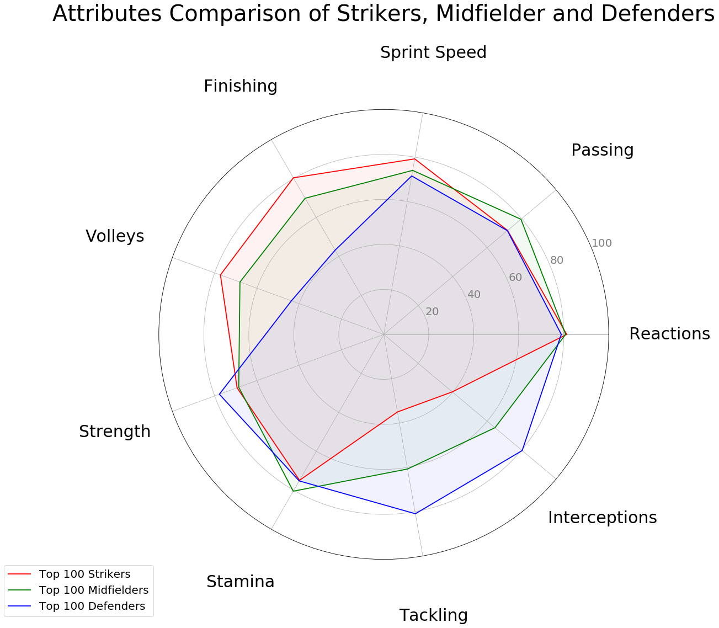
Exploratory Analysis
Inference: Each position have few unique differentiators

Slide 12
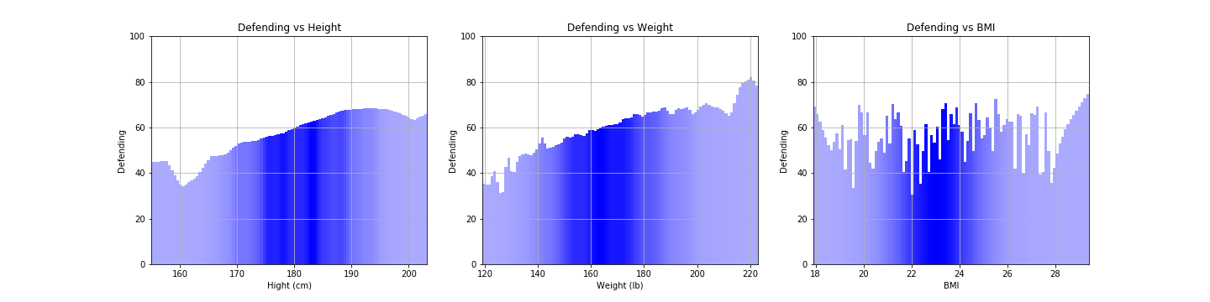
Comparisions Plots
Inference: Heavier/taller the person – Better at Defending?

Slide 13
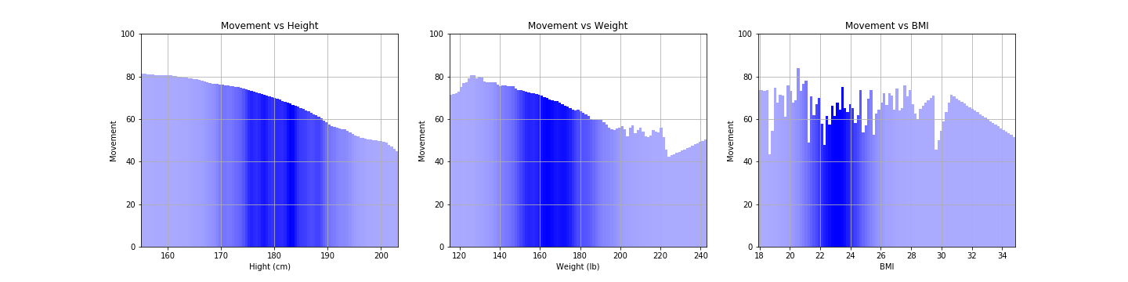
Comparisions Plots
Inference: Movement drops rapidly

Slide 14
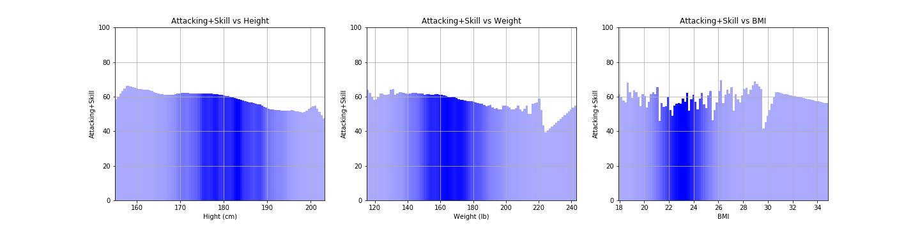
Comparisions Plots
Inference: Attacking abilities relatively constant

Slide 15
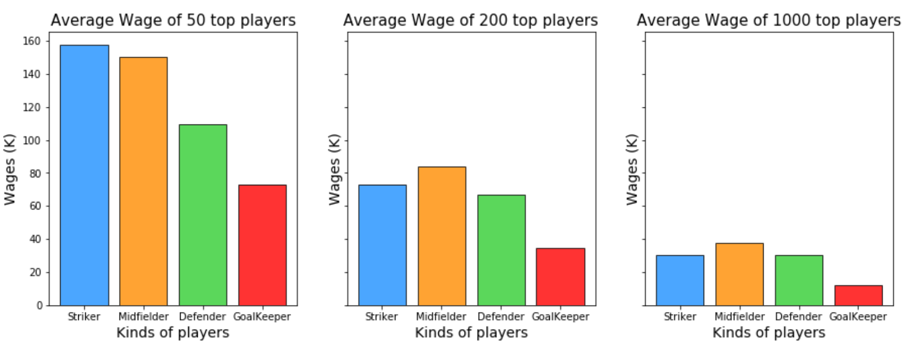
Comparisions Plots
Inference: Are Strikers paid more? Or ranking matters?

Slide 16
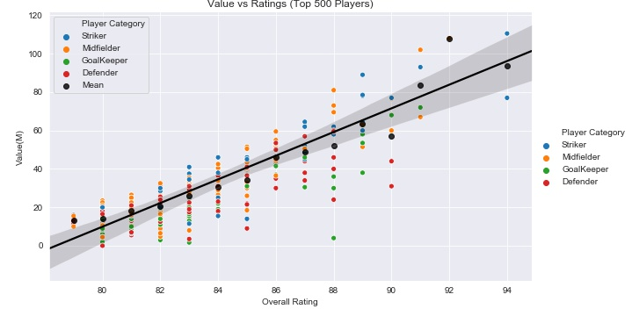
Comparisions Plots
Inference: Are strikers more valuable?

Slide 17
ML-Analysis
Index | Model | Train Error | Test Error
1. | Baseline 1 - Median | 21.39 | 22.5
2. | Baseline 2 – Mean (Adjusted features) | 20.2 | 21.1
3. | Linear Regression (Adjusted Features) | 4.9 | 6.2
4. | XGB Regressor | 1.21 | 1.47
Used Features from the data set to come up with a classifier to predict the ratings and the classification and more importantly to have an idea about the feature importance in general.
Used regression models to predict the ratings based on the important adjusted features

Slide 18

Thanks for watching

