Slide 1
EXPLORATION OF FIFA PLAYER ATTRIBUTES
Group number : 11
Members: Sharath, Harish, Yiran, minhong

Slide 2
Motivation and Objective
In general we find a lot of statistics defining a football player, but they present too much information and it's difficult to derive inferences from them
We saw that several players have been rated on a constant scale of all parameters, but we know that certain parameters are only applicable to certain positions.
Our analysis considers a player's physical attributes, skills and the position he plays at and tries to derive useful insights.
This analysis aims to tackle:
Graphical Analysis on player attributes
Gather useful inferences and attain some insights
Build a ML model based on those insights

Slide 3
Methodology- Pre Processing
Used SOFIFA website as the main source for data analysis
The data was scraped using Beautiful soup framework
Each of HTML tags are stored in soup's data structures.
Using those tags the required information was extracted, cleaned and stored in a pandas dataframe.
This pandas dataframe is now the main source for all further analysis

Slide 4
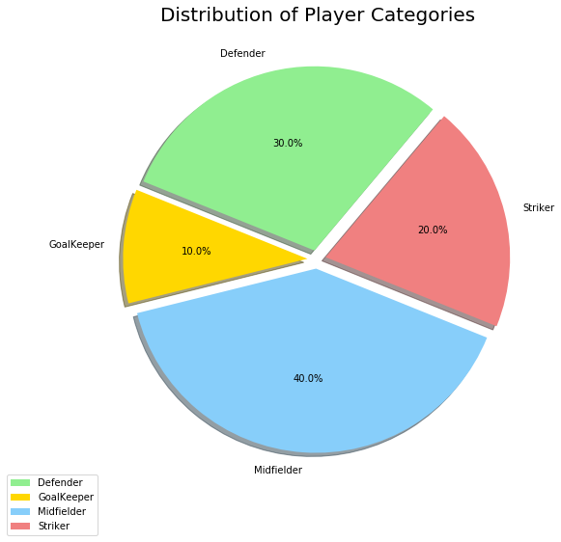
Methodology-Analysis
Divided the dataset (10k players) into
Strikers, Midfielders, Defenders and Goalkeepers
Further classified each of them into
top 50, top 200, top 1000 respectively
The Graphical Analysis has 3 parts:
Exploratory (Radar Plots)
Comparison
ML based

Slide 5
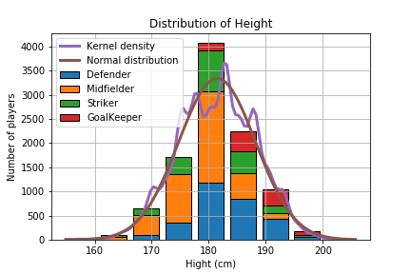
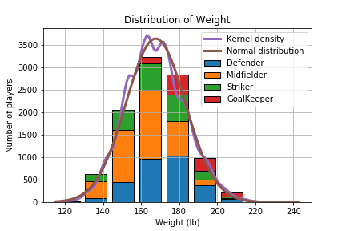
Physical Attributes- Explored

Slide 6
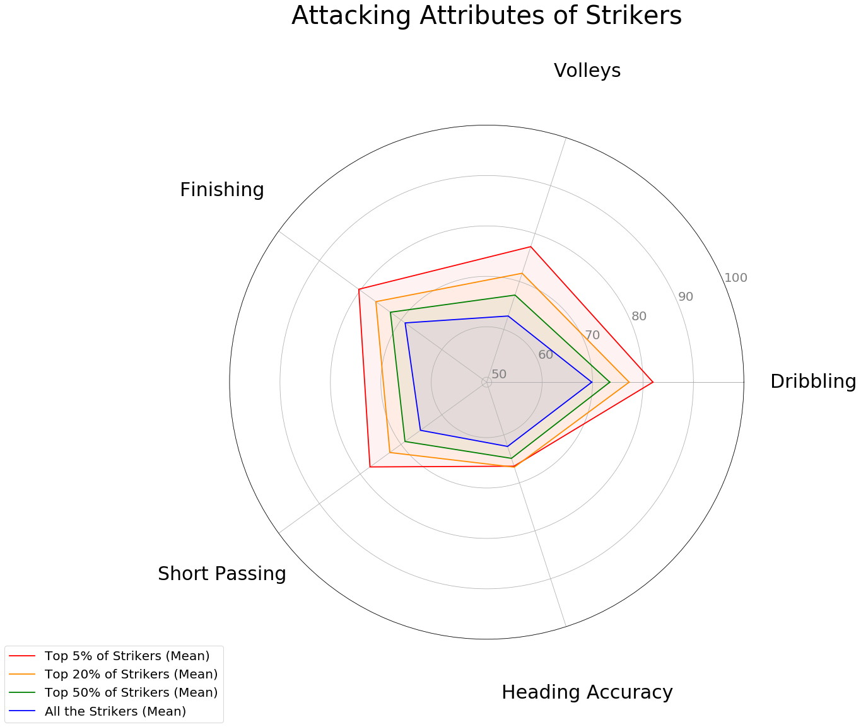
Exploratory Analysis
Inference: Significant difference in all the skills except Heading accuracy

Slide 7
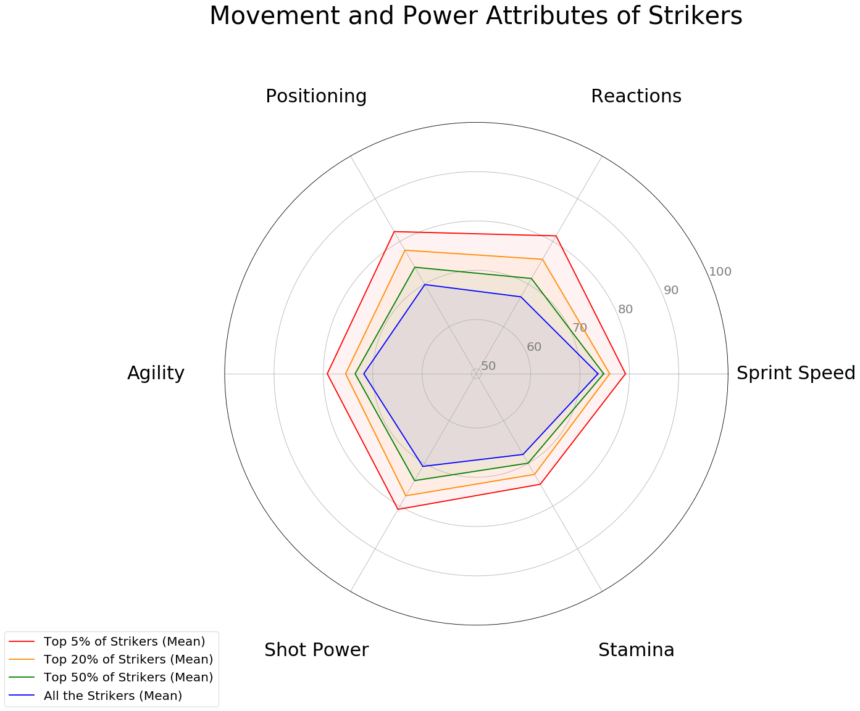
Exploratory Analysis
Inference: Movement a key factor to be in TOP ranks

Slide 8
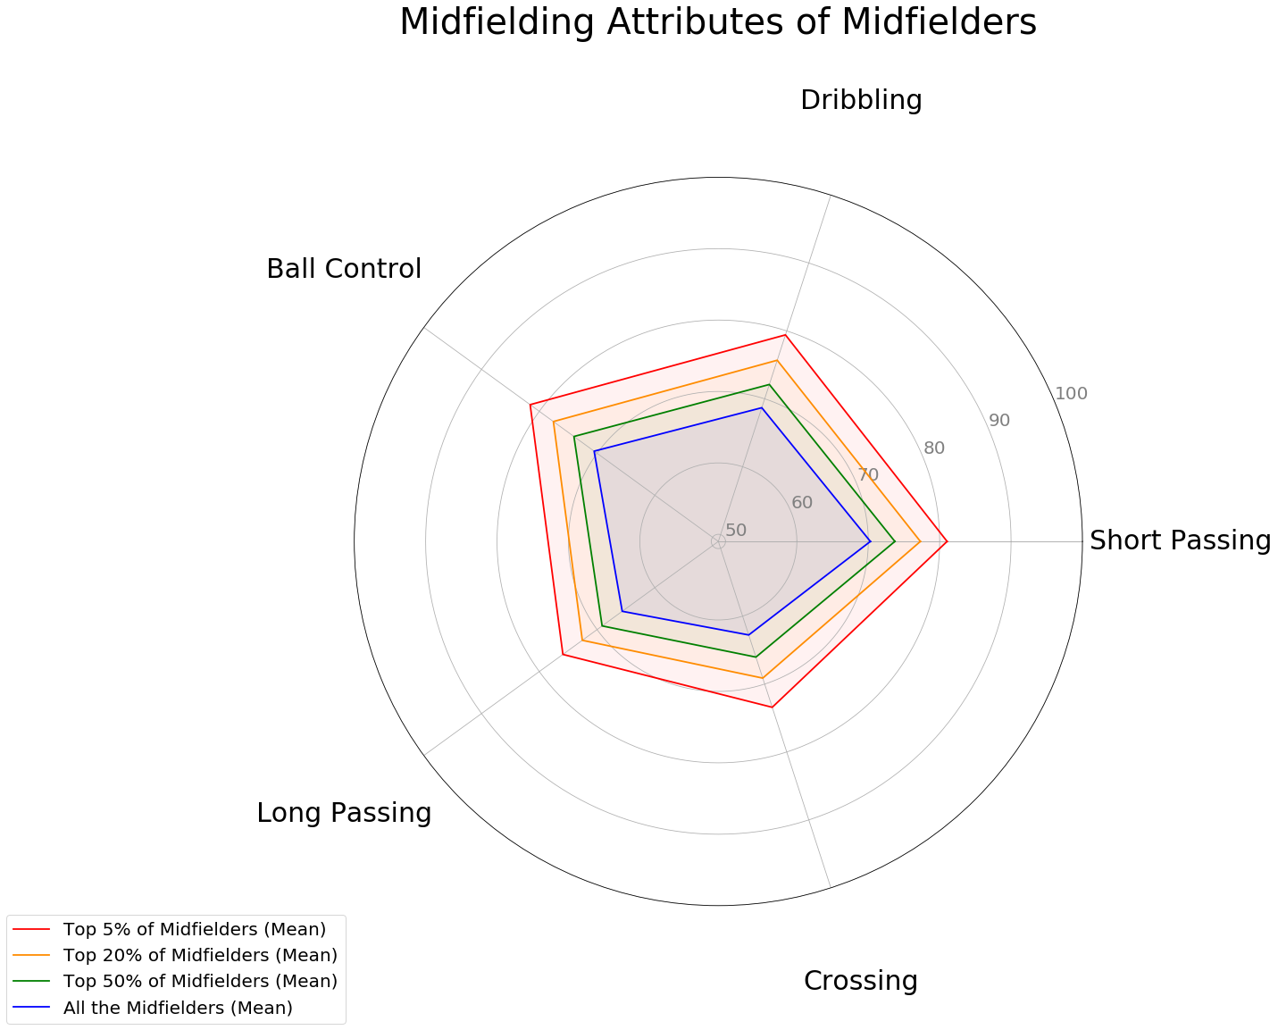
Exploratory Analysis
Inference: Skills are evenly spaced out

Slide 9
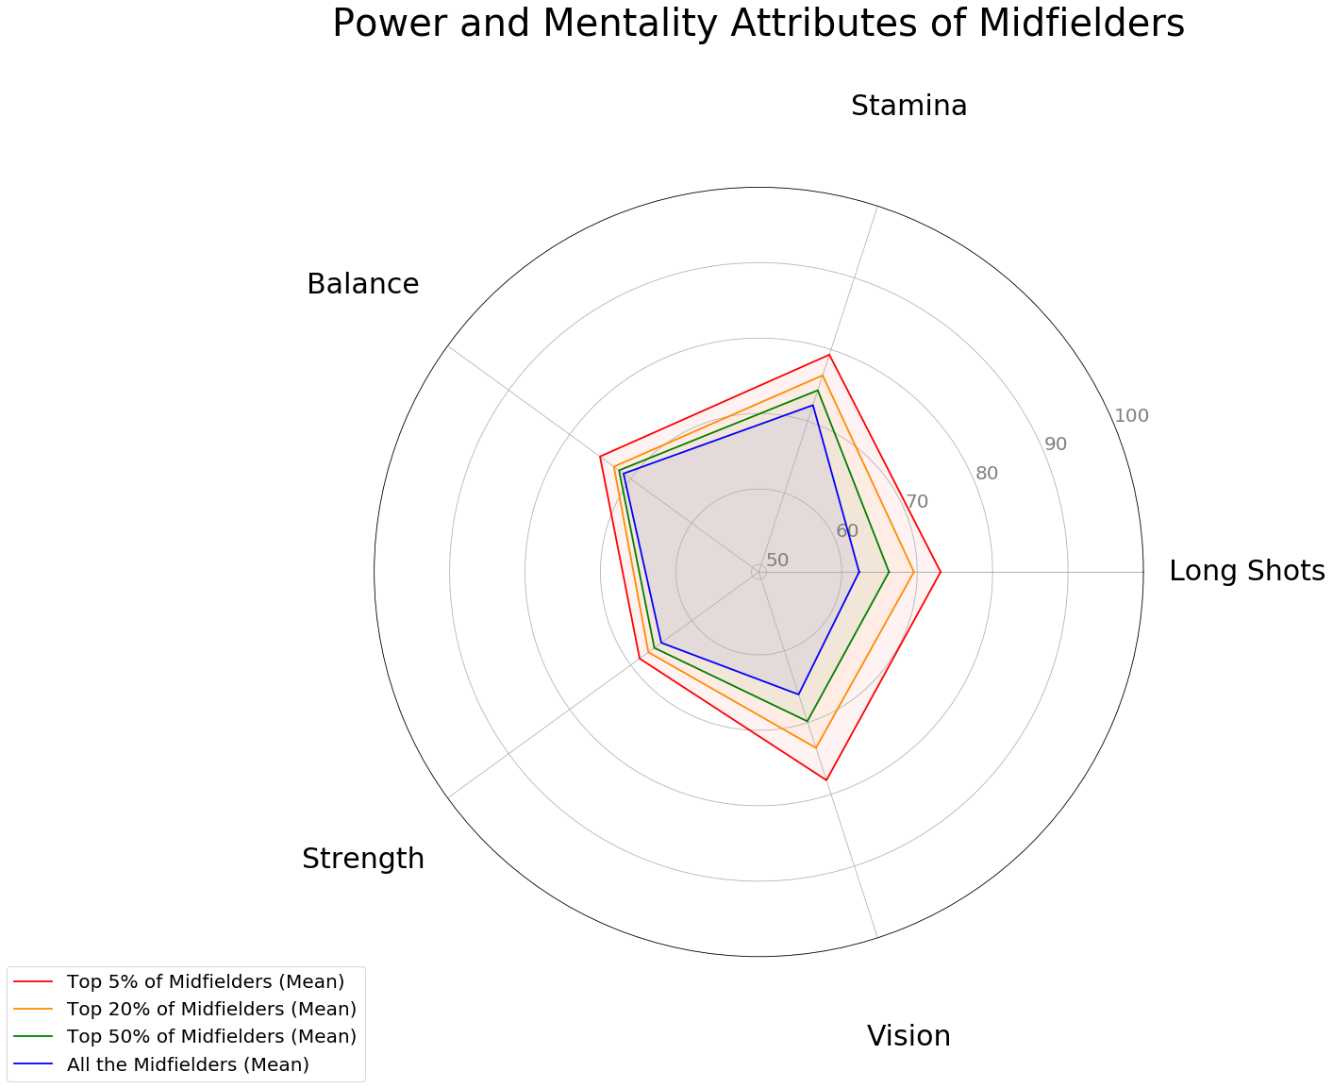
Exploratory Analysis
Inference: Vision and Long Shots accuracy are the differentiators

Slide 10
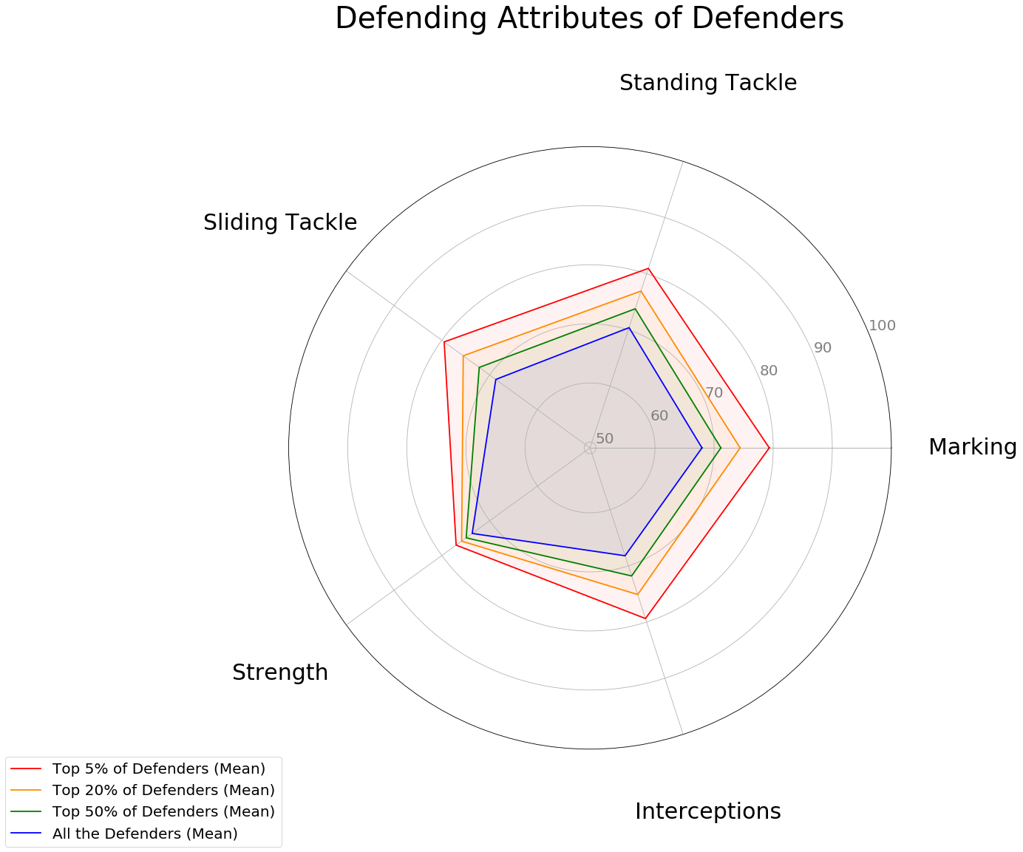
Exploratory Analysis
Inference: Marking and Tackling make the difference, while Strength doesn’t

Slide 11
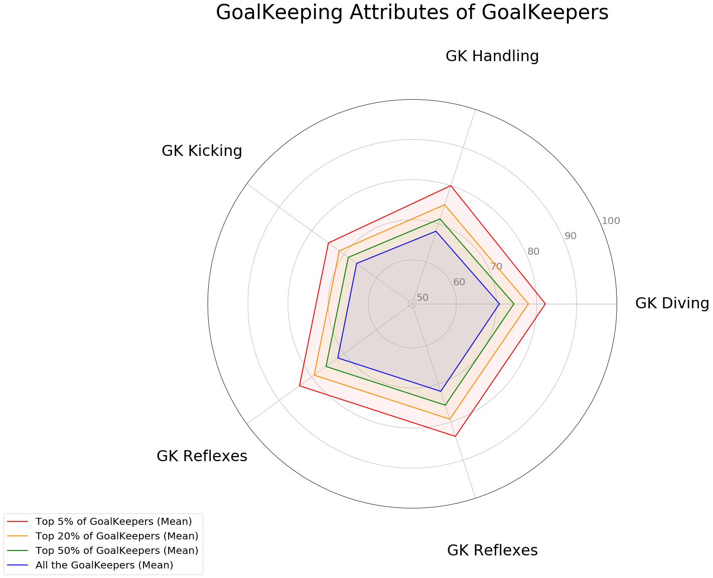
Exploratory Analysis
Inference: Significant differences in
all the attributes

Slide 12
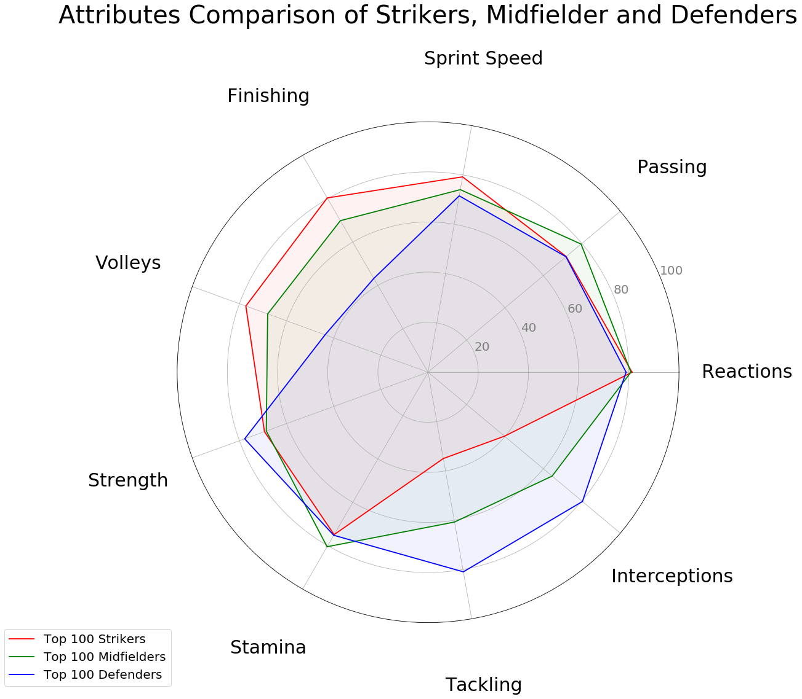
Exploratory Analysis
Inference: Each position has few
unique differentiators and few

Slide 13
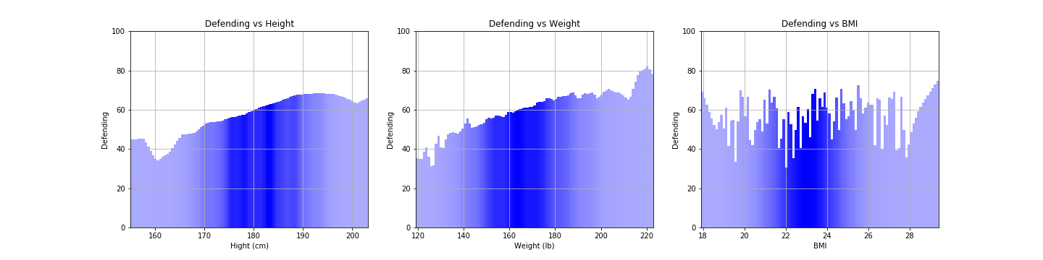
Comparisions Plots
Inference: Heavier/taller the person – Better at Defending?

Slide 14
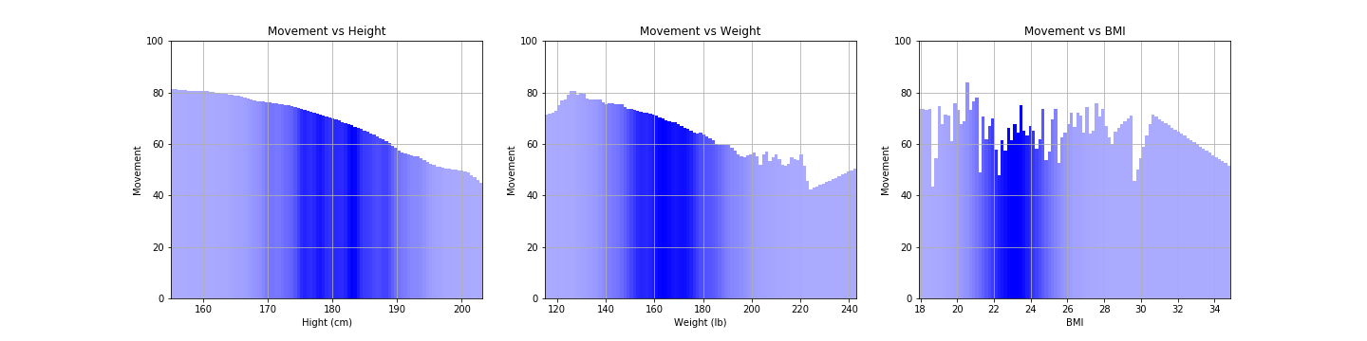
Comparisions Plots
Inference: Movement drops rapidly

Slide 15
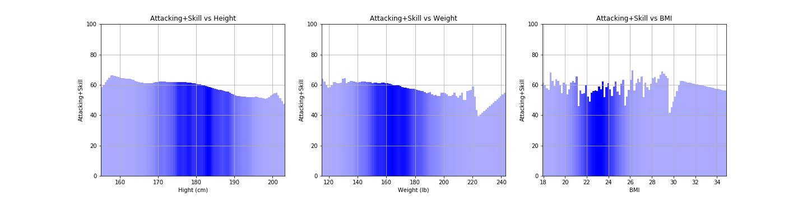
Comparisions Plots
Inference: Attacking abilities relatively constant

Slide 16
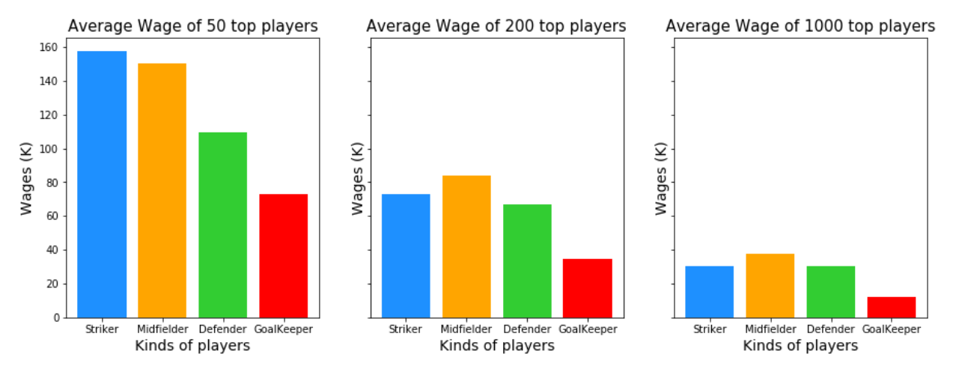
Comparisions Plots
Inference: Are Strikers paid more? Or ranking matters?

Slide 17
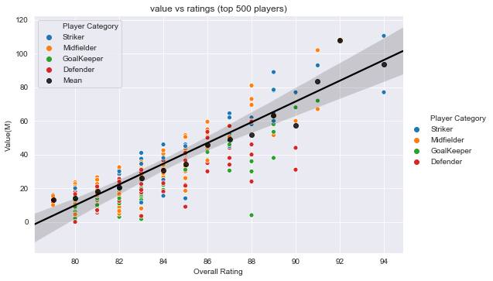
Comparisions Plots
Inference: Are strikers more valuable?

Slide 18
ML-Analysis
Used Features from the data set to comeup with a classifier to predict the ratings and the classification and more importantly to have an idea about the feature importances in general.
Used regression models to predict the ratings based on the important adjusted features
Index | Model | Train Error | Test Error
1. | Baseline 1 - Median | 21.39 | 22.5
2. | Baseline 2 – Mean (Adjusted features) | 20.2 | 21.1
3. | Linear Regression (Adjusted Features) | 4.9 | 6.2
4. | XGB Regressor | 1.21 | 1.47

