Slide 1
RECIPE ORGANIZER
Android application for Open source software development (CS510) summer 2011 class project.
By: Sharayu Jadhav

Slide 2
RECIPE ORGANIZER
Android application which helps you save and organize recipes on your android phone
Project Details
Intended Users
Implemented Features
Project Snapshots/ demo
Improvements

Slide 3
Recipe Organizer- Project Details
Android Platform: Android device with version (2.1)
Languages: Java and Xml
Database: SQLite
IDE: Eclipse
License: GNU General Public License
Project hosted on: Github

Slide 4
Recipe Organizer - Users
This application is for people who love to try new recipes but have a tough time remembering all the ingredients or the procedure
Your android phone provides a anytime accessible and portable place for saving the recipes you love.
The application generates a grocery list for any recipe that you saved on the phone. This means you can shop for ingredients on the go, without having to jot down a list of items in advance.

Slide 5
Recipe Organizer - Features
Saves your recipes in your own personalized database without having to look into a list of unwanted recipes
Generates Grocery list when you want to shop for the ingredients. Since the android phone goes with you everywhere, it eliminates the need to write down and carry the list with you.

Slide 6
Recipe Organizer - Features
Gives an option to make changes to the recipes saved according to your experiences when actually cooking
An option to delete unnecessary recipes

Slide 7
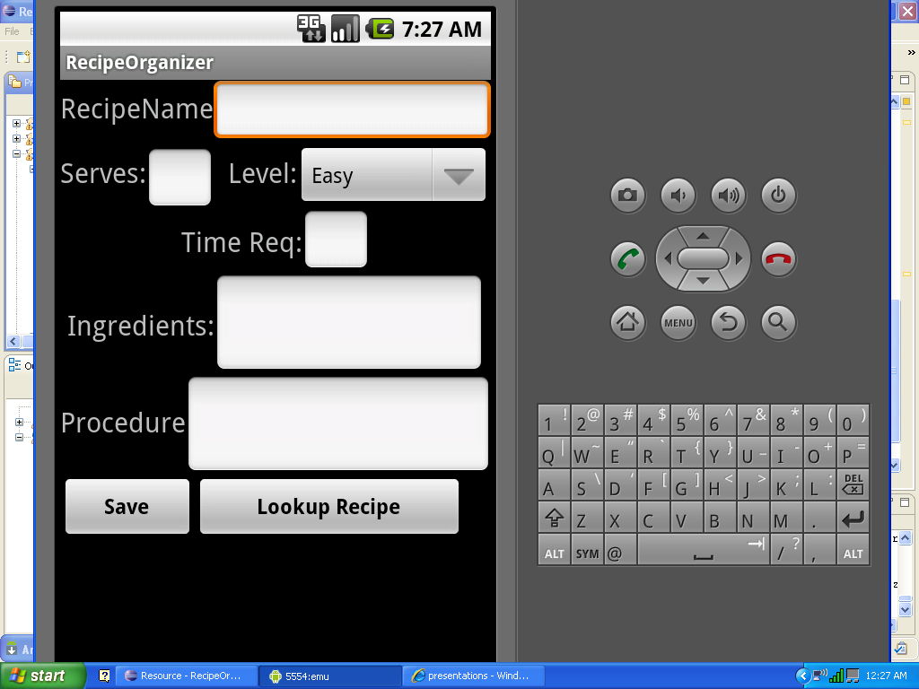
Recipe Organizer – Add Recipe

Slide 8
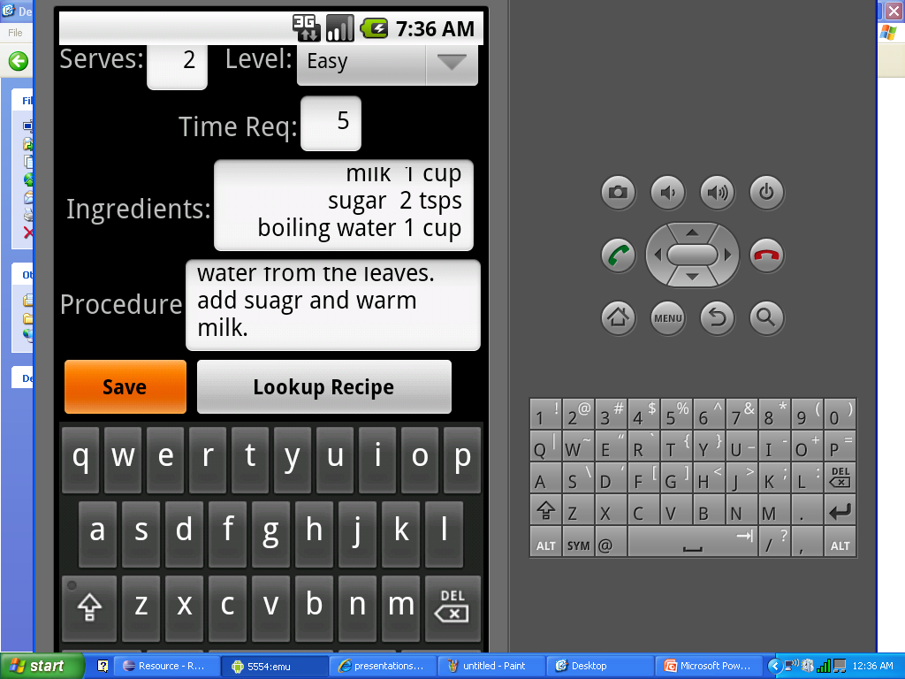

Slide 9
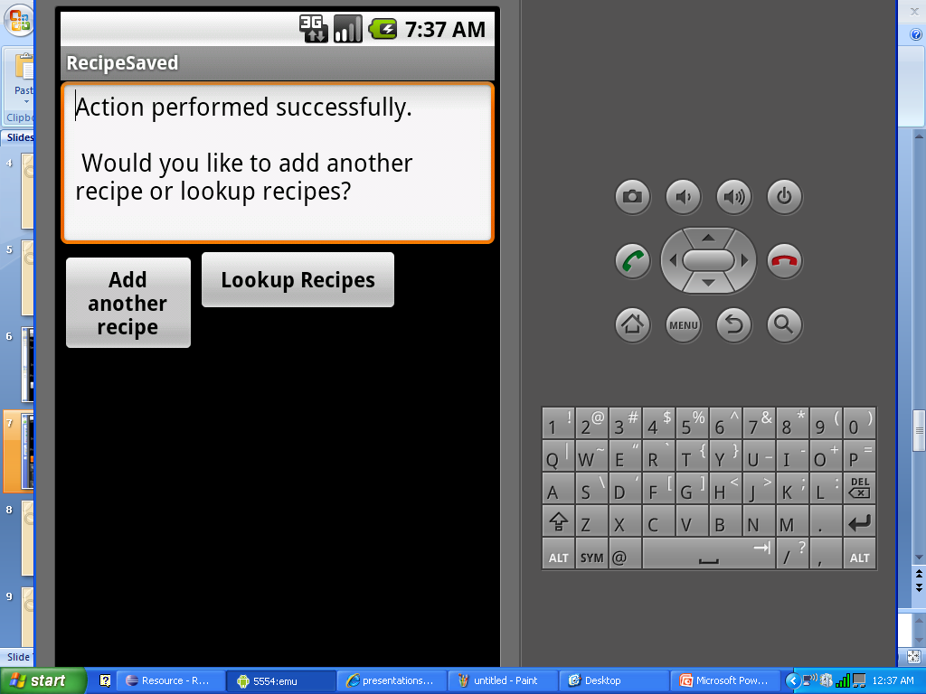

Slide 10
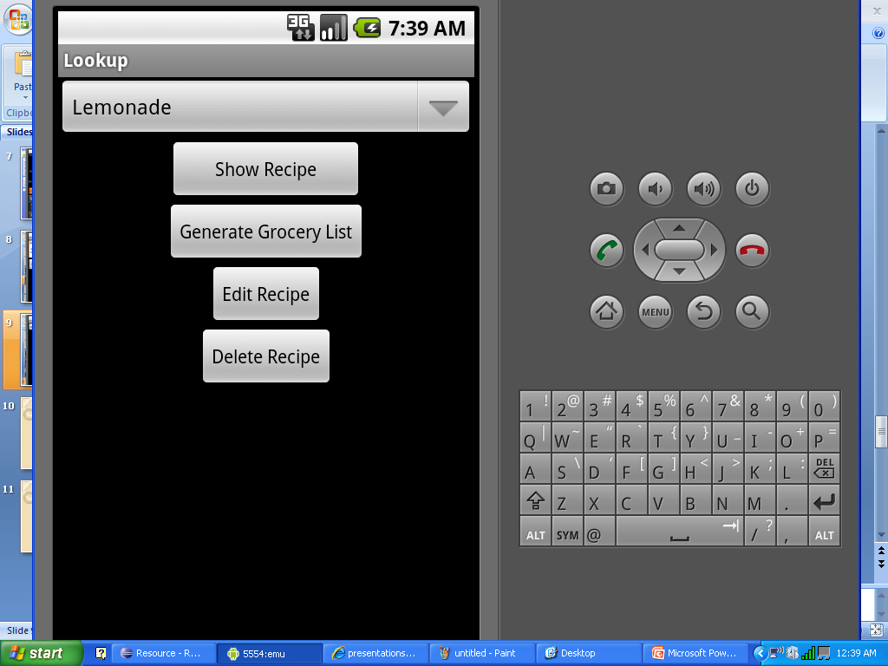

Slide 11
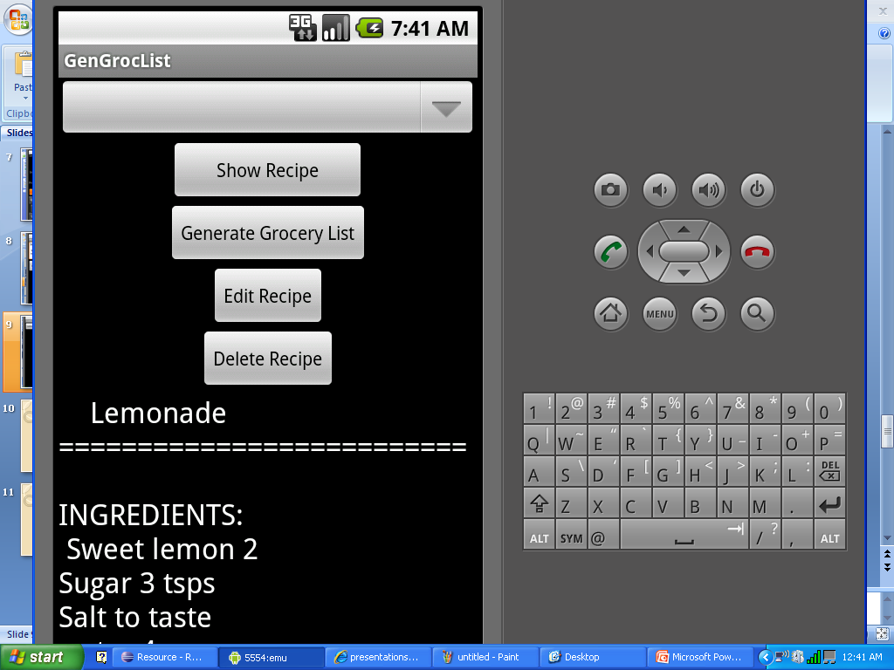

Slide 12
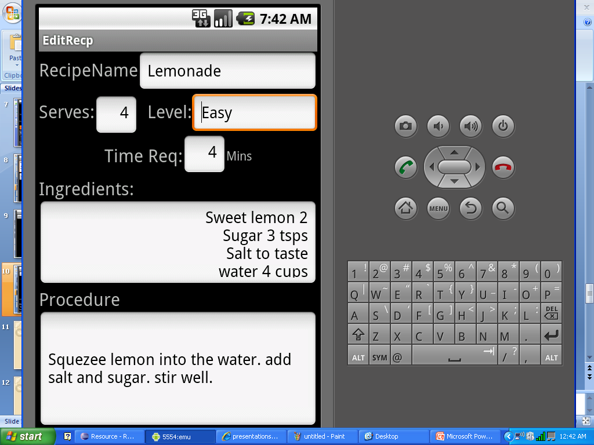

Slide 13
Recipe Organizer - Improvements
Share recipes with friends through email.
Ability to generate the grocery list with suitable quantities of ingredients depending on the number of people to be served.
Generic search feature.

