Slide 1
Packages:
Com.examination.models-users,marks,questions
Com.examination.controller -crud operation,authentication
com.examination.databse-dbconnection
Com.examination.servlets-servlet files
Com.examination.customtags-jsp classes for questions,marks

Slide 2
Jsp :
Index.jsp-login,registration
Teacher.jsp-add update questions
Student.jsp-display exam page,update profile
Exam.jsp-start exam page

Slide 3
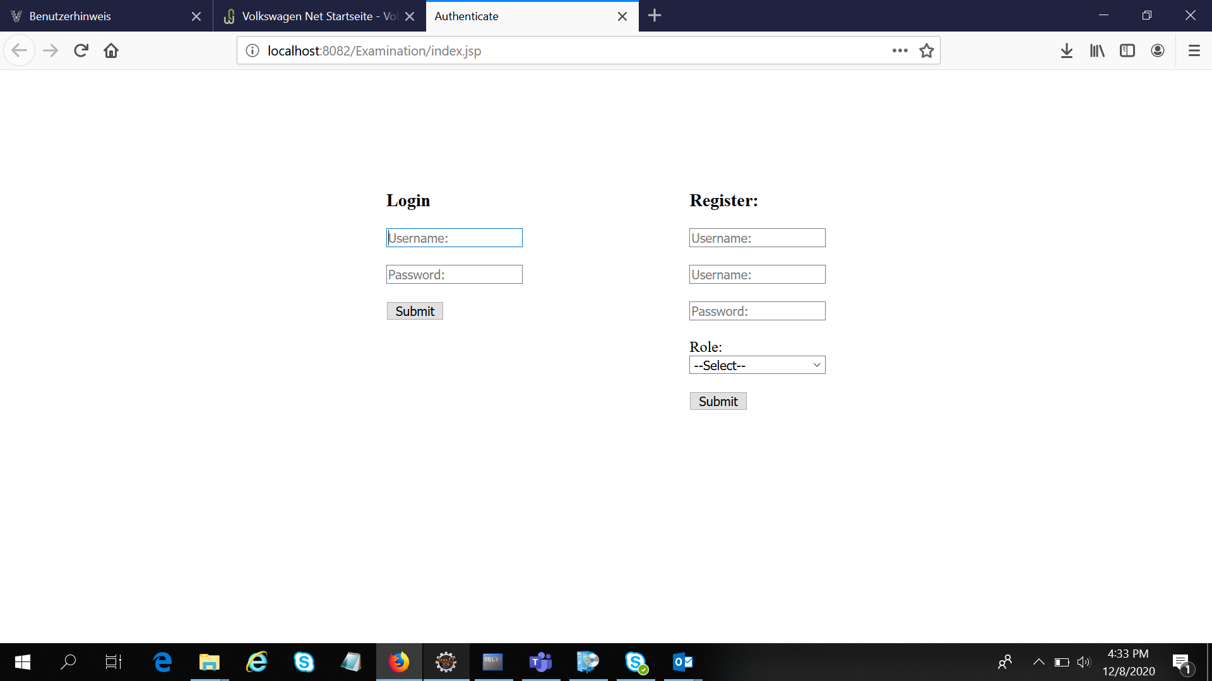

Slide 4
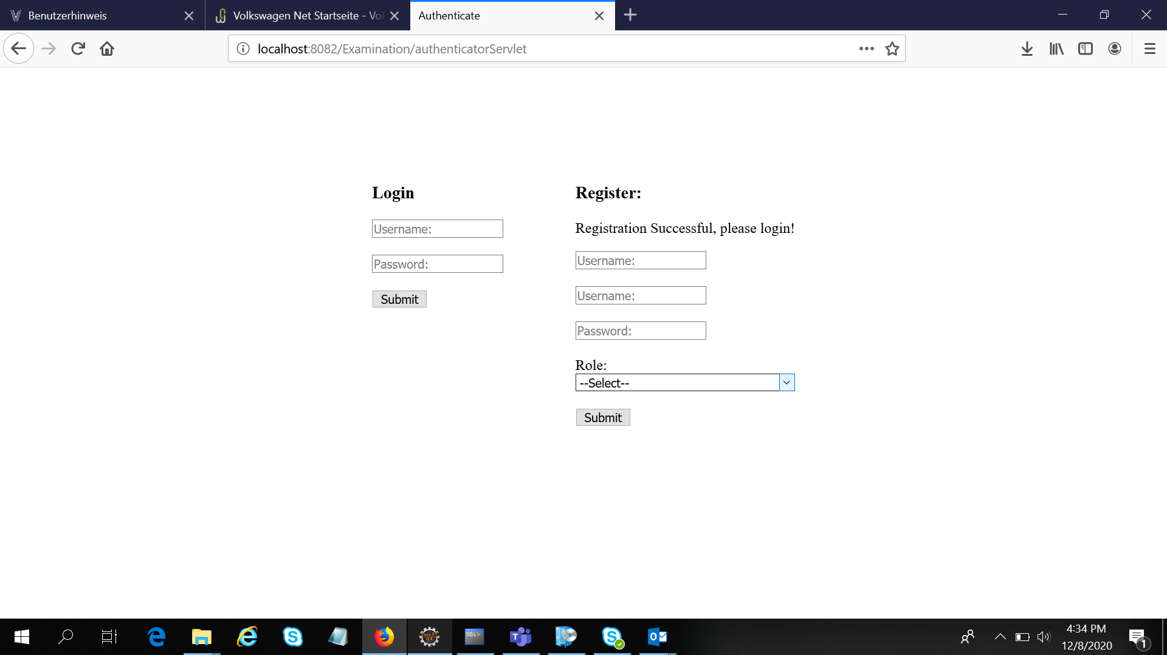

Slide 5
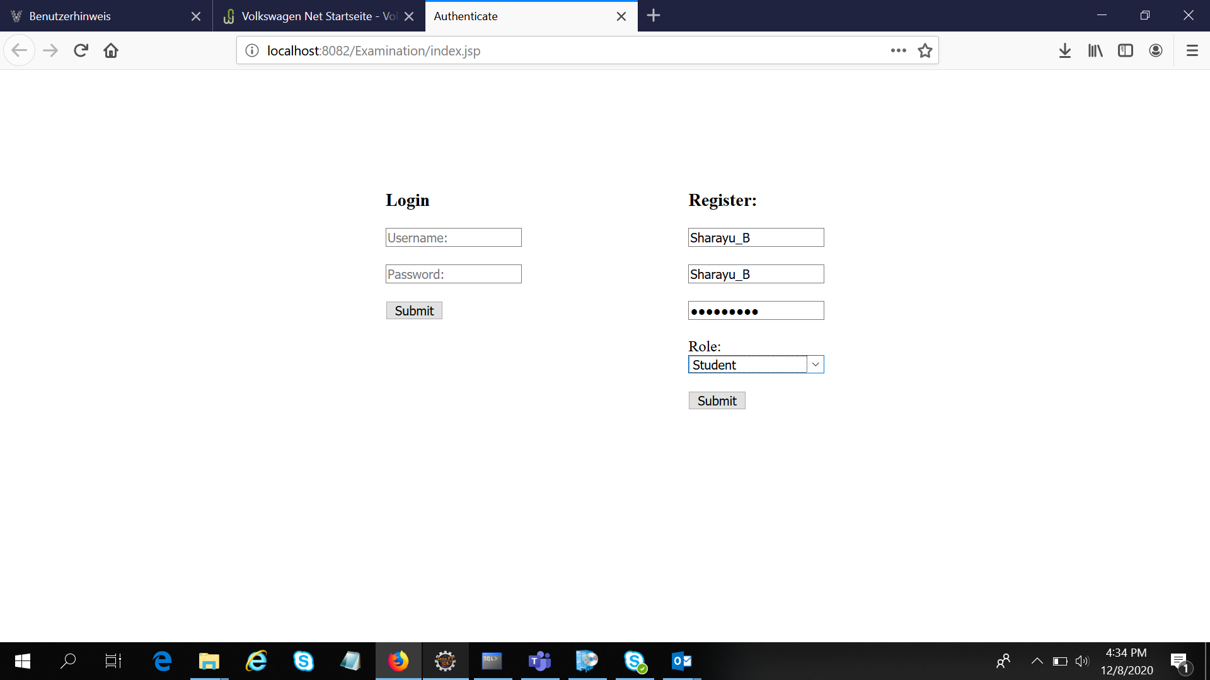

Slide 6
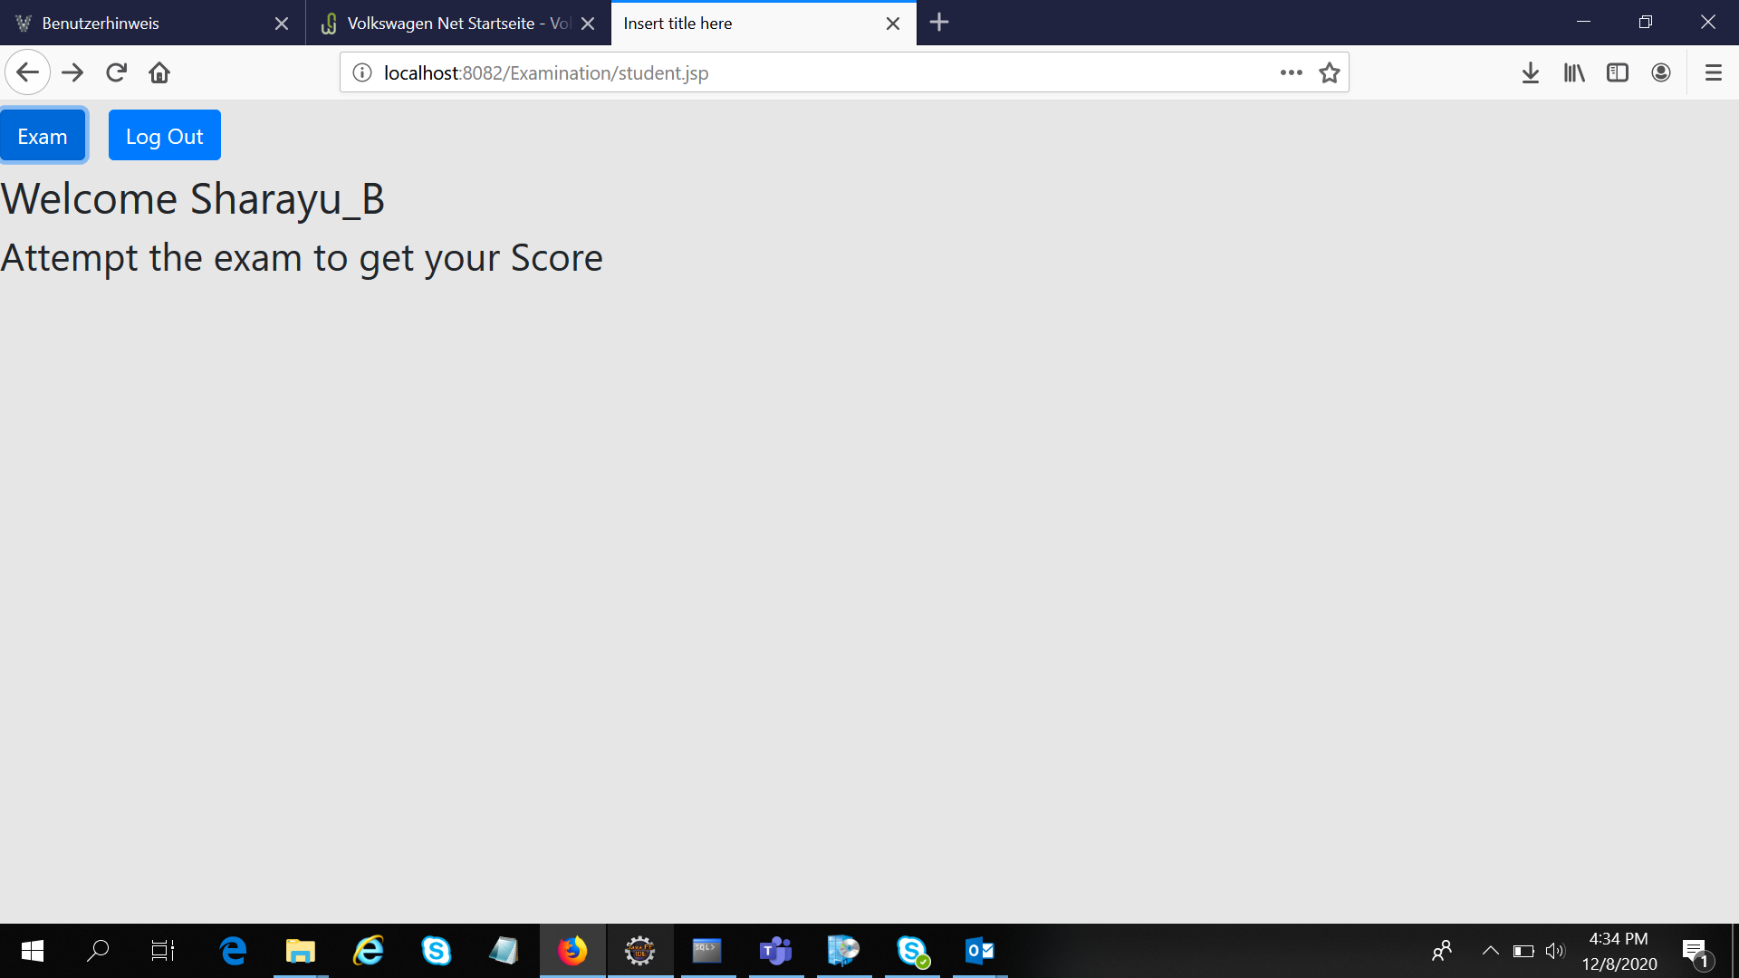

Slide 7
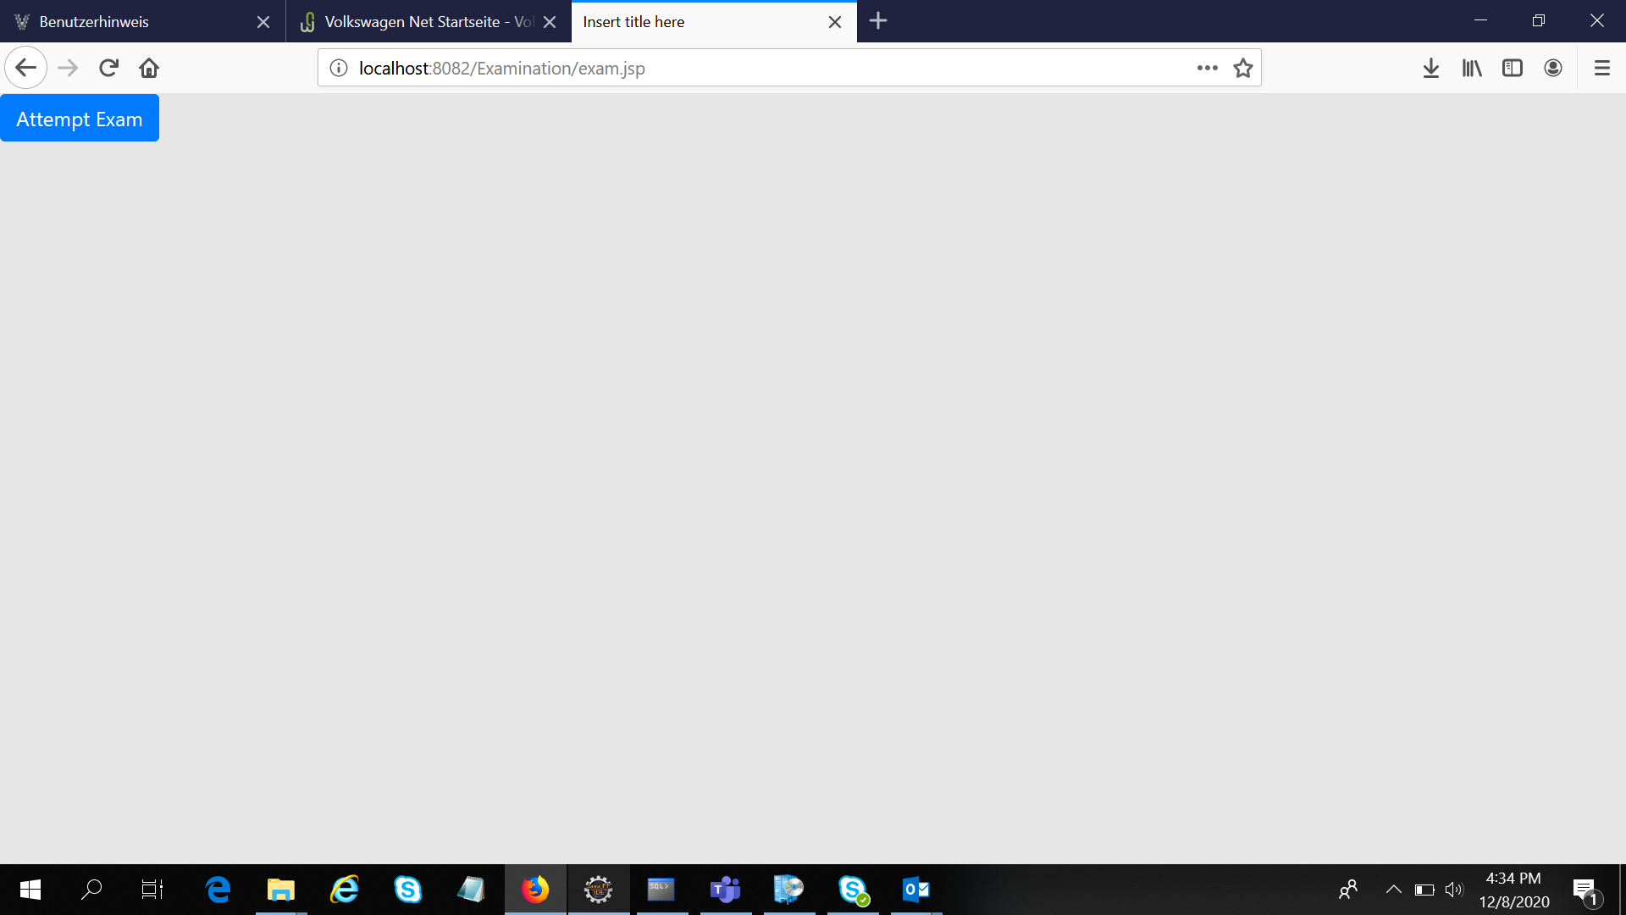

Slide 8
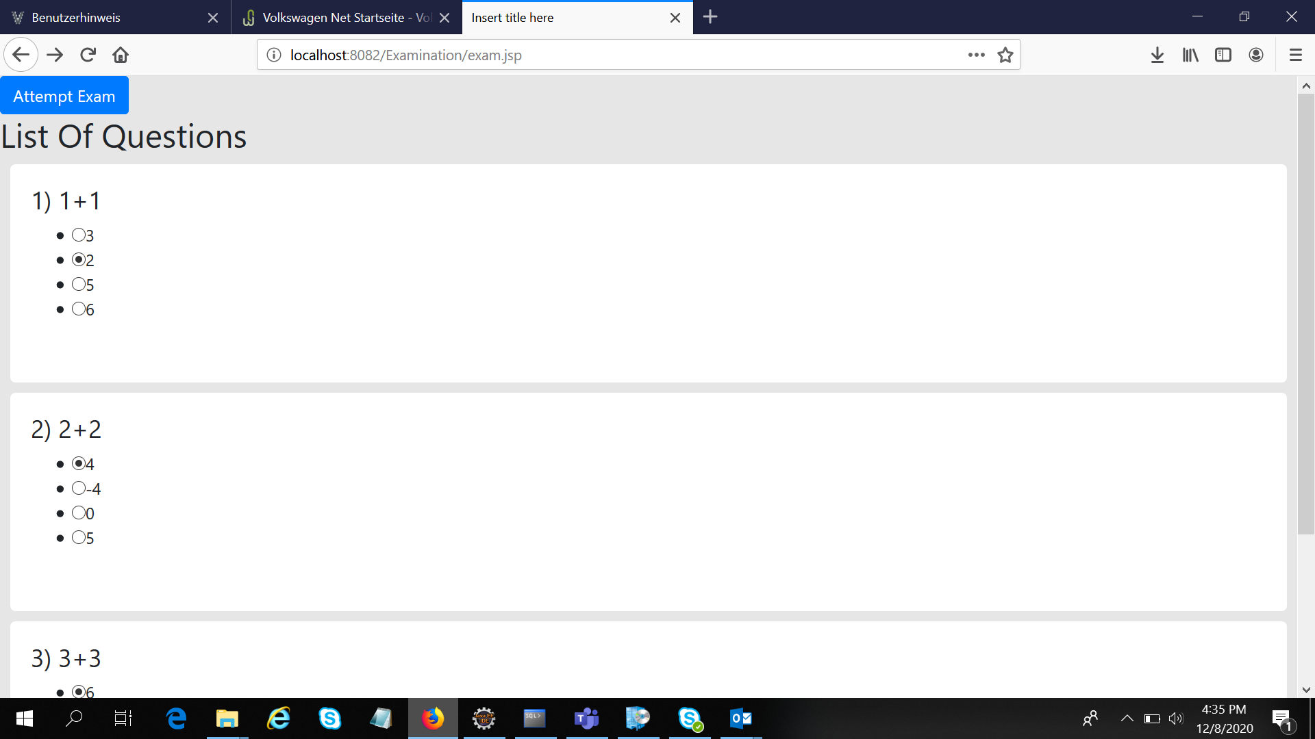

Slide 9


Slide 10


Slide 11
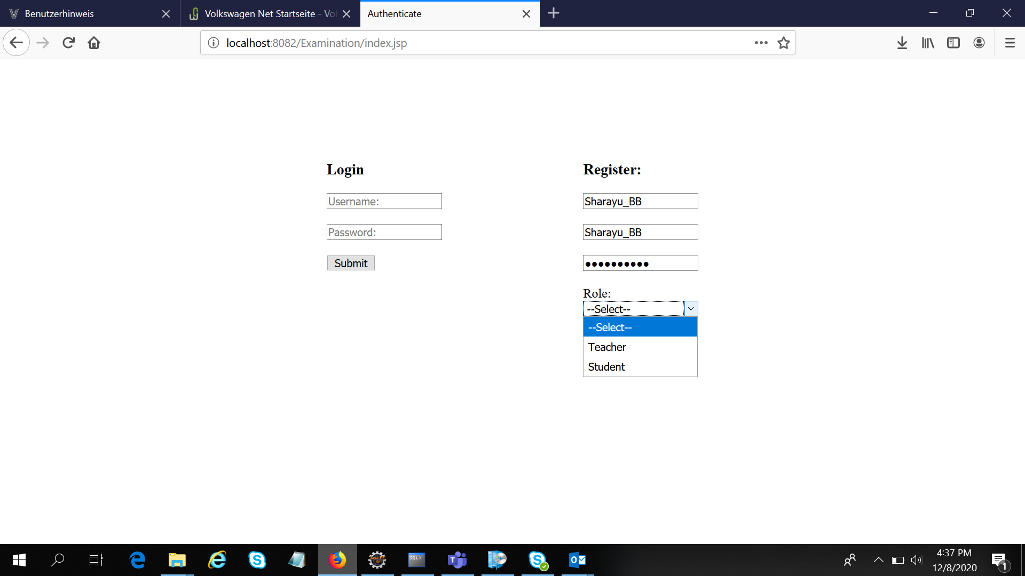

Slide 12
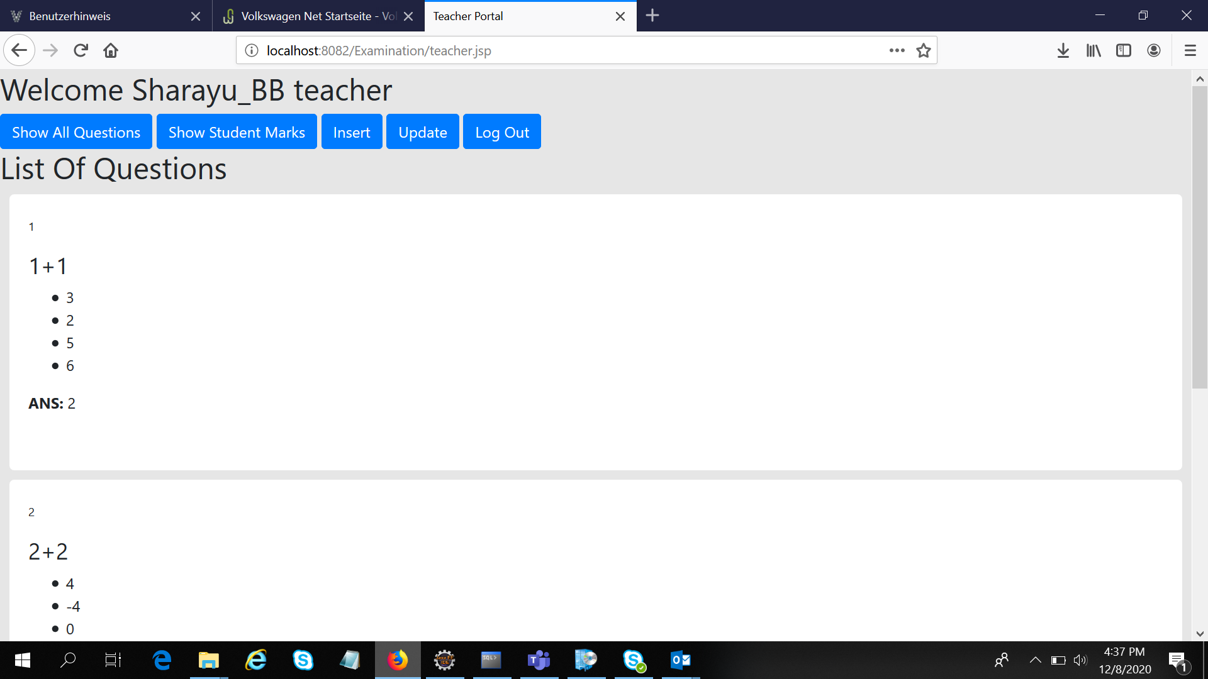

Slide 13
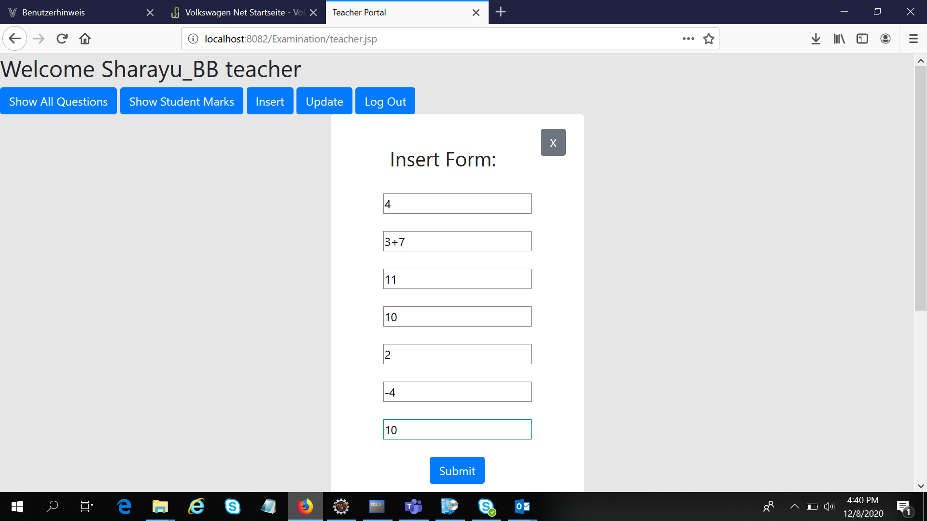

Slide 14
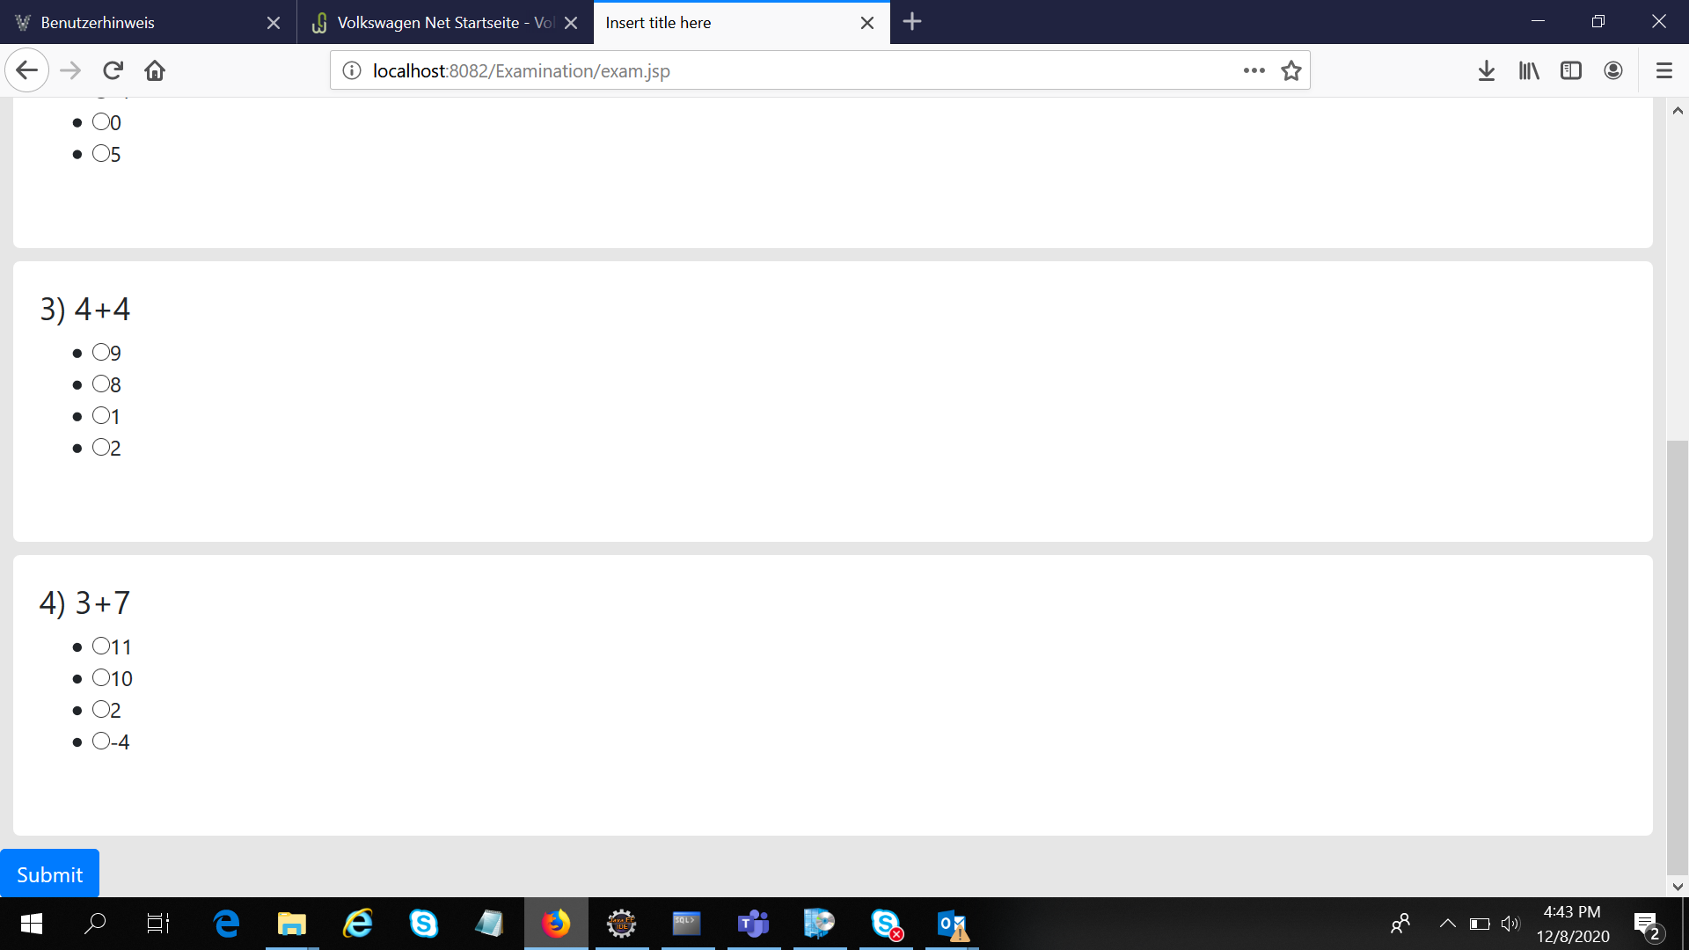

Slide 15


Slide 16
