Slide 1
DataBase Tutorial!
Sep. 27, 2021
Morteza Alipour

Slide 2
Outline
•
ER Schema Mapping
•
Aggregation Function
•
Group by/Having/Joins/Views
•
Questions

Slide 3
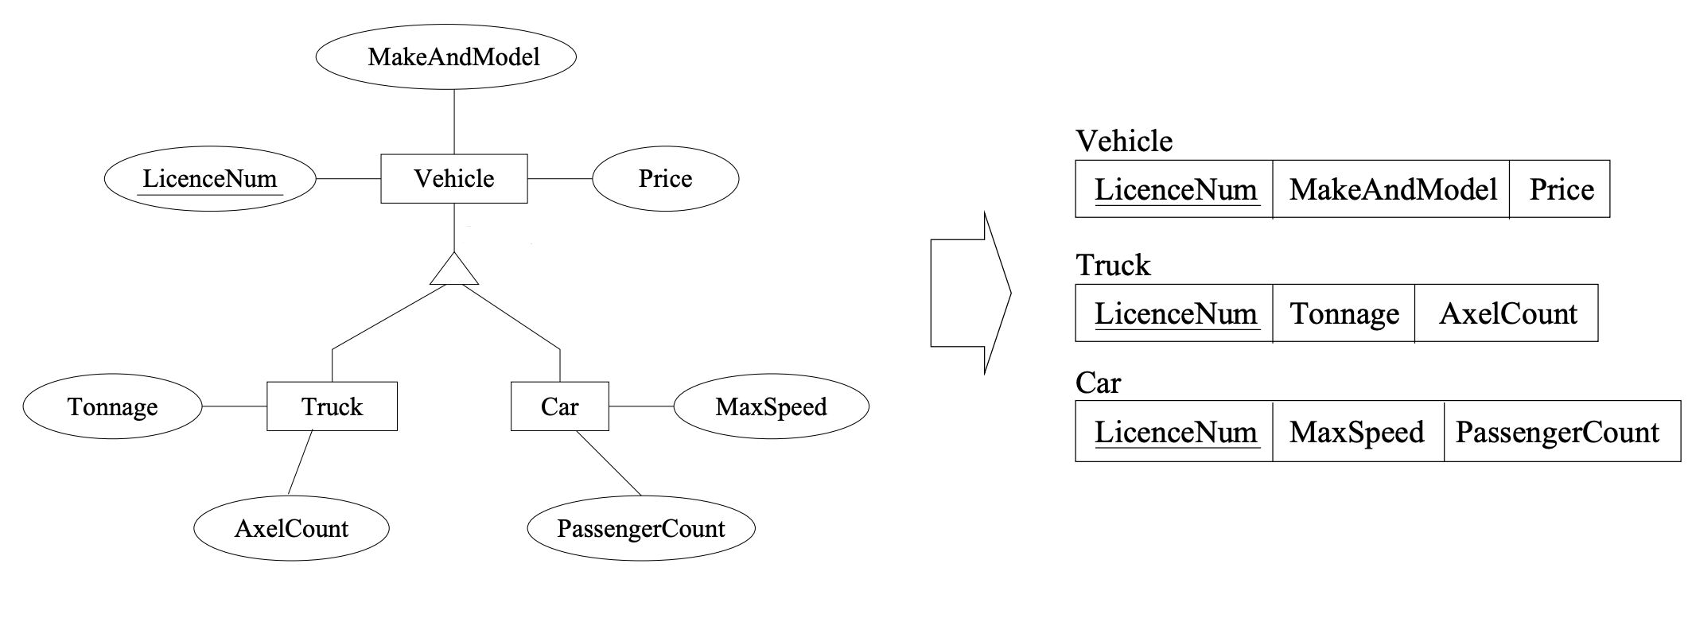
IS-A
Source: https://cs.uwaterloo.ca/~gweddell/cs348/errelational-present.pdf

Slide 4
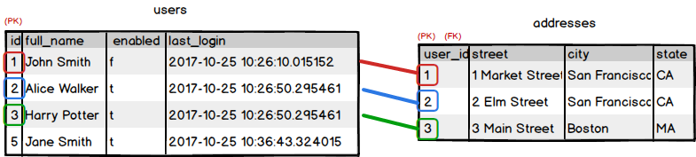
One-to-One Relation
A one-to-one relationship between two entities exists when a particular entity instance exists in one table, and it can have only one associated entity instance in another table.
Example: A user can have only one address, and an address belongs to only one user.

Slide 5
One-to-One Relationship
E1: (a, x, b), E2: (b, y, z)
Or E1: (a, x), E2: (b, y, z, a)
a
R
b
E1
E2
x
z
y

Slide 6
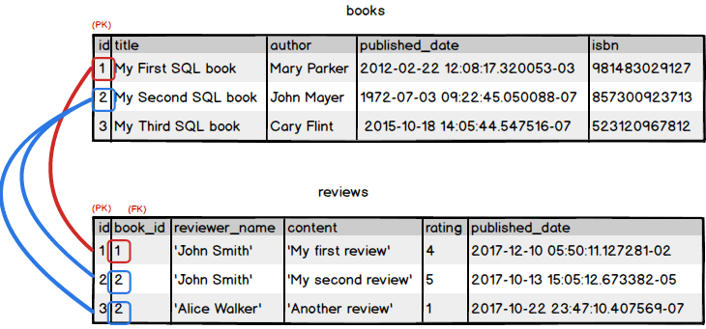
Many-to-One Relation
A many-to-one relationship exists between two entities if an entity instance in one of the tables can be associated with multiple records (entity instances) in the other table. The opposite relationship does not exist.
Example: A review belongs to only one book. A book has many reviews.

Slide 7
Many-to-One Relationship
E1: (a, x), E2: (b, y, z, a)
Note: the primary key of E1 is the foreign key of E2
a
R
b
E1
E2
x
z
y

Slide 8
Many-to-Many Relationship
E1: (a, x), E2: (b, y, z), R: (a, b)
a
R
b
E1
E2
x
z
y

Slide 9
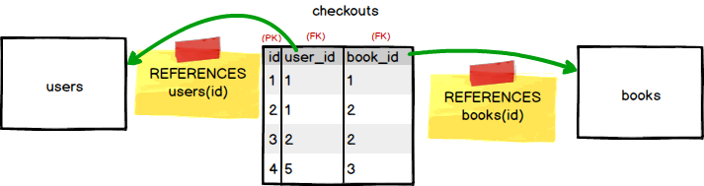
Many-to-Many Relation
A many-to-many relationship exists between two entities if for one entity instance there may be multiple records in the other table, and vice versa.
Example: A user can check out many books. A book can be checked out by many users (over time).

Slide 10
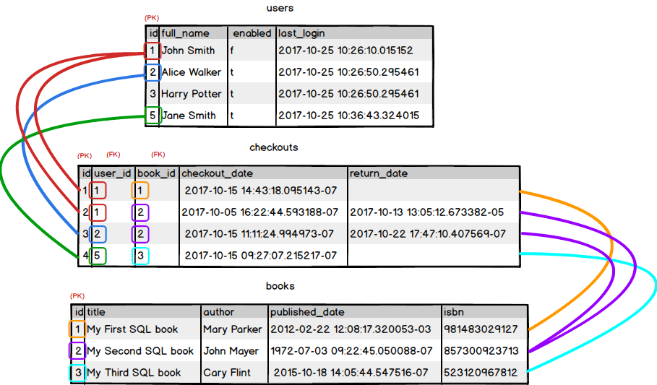
Many-to-Many Relation

Slide 11
Aggregation Functions
•
Aggregate function is a function where the values of multiple rows are grouped together as input on certain criteria to form a single output value.
•
Max, Min, Sum, Count, Avg
•
Aggregate functions often need an added GROUP BY statement.

Slide 12

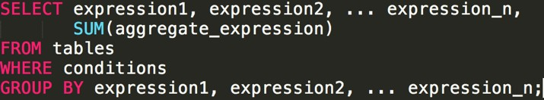
Example
•
If you only want to return the SUM:
•
If you want to return the several attributes and SUM:

Slide 13


Find out salary of all employees whose salary is above $25,000 / year. (Only return SUM)
•
•
Return the name of the department and the total sales (in the associated department).

Slide 14
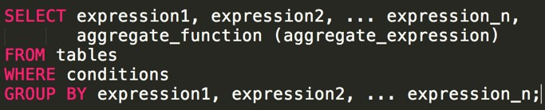
Group by
•
The SQL GROUP BY clause can be used in a SELECT statement to collect data across multiple records and group the results by one or more columns.
•
It is often used with Aggregation Functions

Slide 15
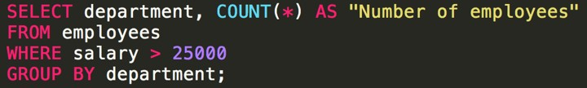

Example: group by and Aggregation Functions
•
Uses the COUNT function to return the department and the number of employees (in the department) that make over $25,000 / year.
•
uses the MIN function to return the name of each department and the minimum salary in the department.

Slide 16
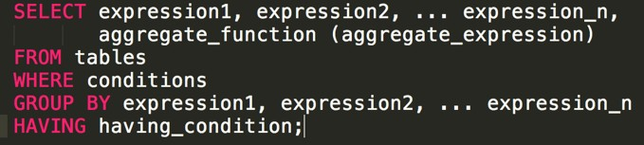
Having
•
The SQL HAVING Clause is used in combination with the GROUP BY Clause to restrict the groups of returned rows to only those whose the condition is TRUE.

Slide 17
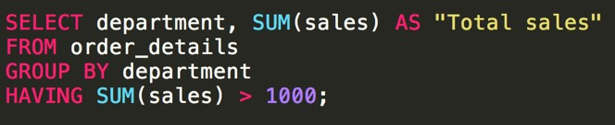
Example
•
use the SQL SUM function to return the name of the department and the total sales (in the associated department). The SQL HAVING clause will filter the results so that only departments with sales greater than $1000 will be returned.

Slide 18
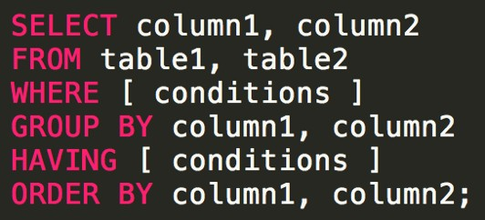
Statement Order

Slide 19
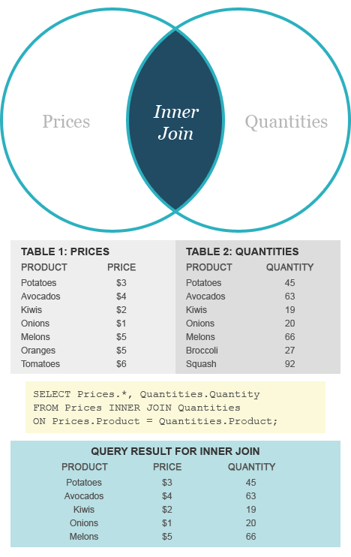
Inner Join

Slide 20
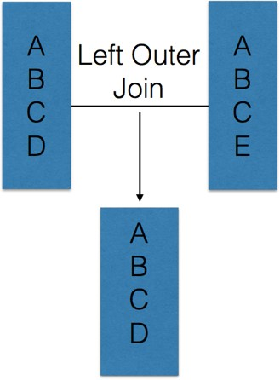
Left Outer Joins

Slide 21
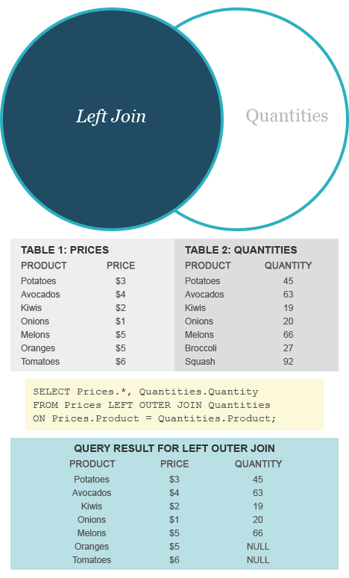
Left Outer Join

Slide 22
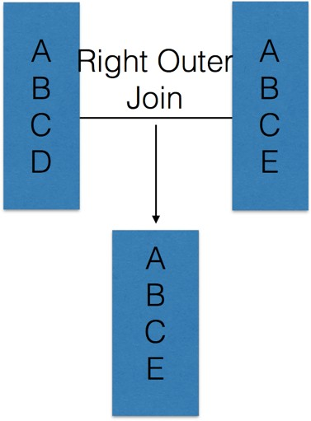
Right Outer Joins

Slide 23
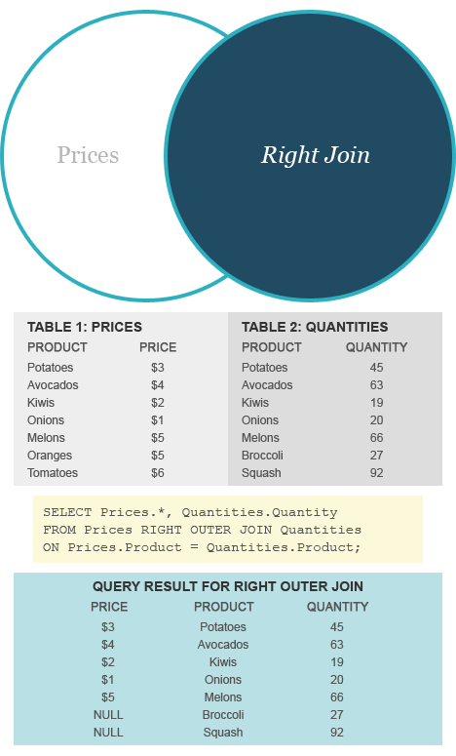
Right Outer Join

Slide 24
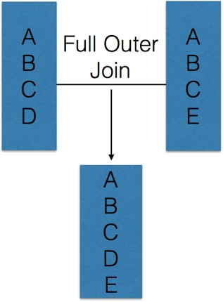
Full Outer Joins

Slide 25
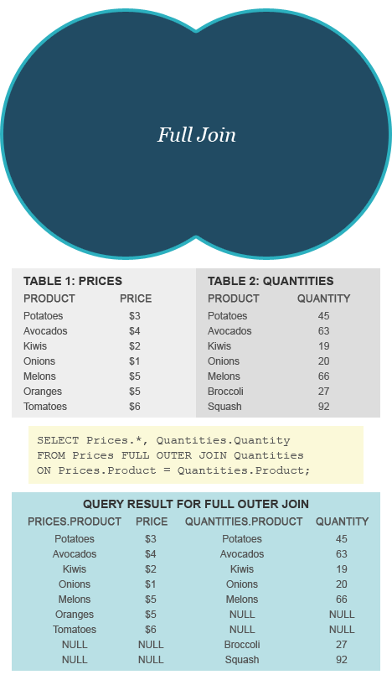
Full Outer Join

Slide 26
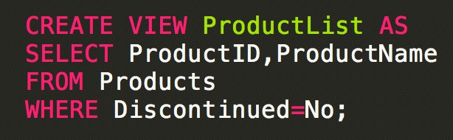

Examples
Query a view as if it were a base table.

Slide 27

Index
•
An index can be created in a table to find data more quickly and efficiently.
•
Clustered vs. Unclustered: If order of index data entries is the same as order of data records, then called clustered index.
•
B+ tree index type: insert value and delete value

