Slide 1
SE3DB3 TUTORIAL
Lucia Cristiano
Sept 20-22, 2021

Slide 2
Introduction
Expectations:
I will repeat the questions that students in the room ask before I answer
I will pause occasionally to look at the chat, please unmute yourself or ask questions at these points

Slide 3
Outline
Review of Keys
Referential Integrity
ER Terms
ER Diagram Notations
Relationship Types
Relationship Degree
Participation Constraints
ER Design Example
Assignment 1 Tips
Contact

Slide 4
Review of Keys
Employee Relation
List candidates key(s), super key(s) and designate a primary key:
Employee ID | Name | DOB | Department No
123 | John Smith | 02/25/1978 | 5
456 | Alice Doe | 04/06/1984 | 3
789 | John Smith | 09/17/1990 | 3

Slide 5
Referential Integrity
Referential integrity is used to guarantee that attributes in one relation refer to existing tuples in another relation referenced in a relationship
Employee ID | Name | DOB | Department No
123 | John Smith | 02/25/1978 | 5
456 | Alice Doe | 04/06/1984 | 3
789 | John Smith | 09/17/1990 | 3
Is there a foreign key or referential integrity violation between these relations?
Department No | Name | Manager | # employees
5 | Finance | Jane Mae | 10
2 | Sales | Bob Brown | 15
4 | Development | Sally Roe | 30

Slide 6
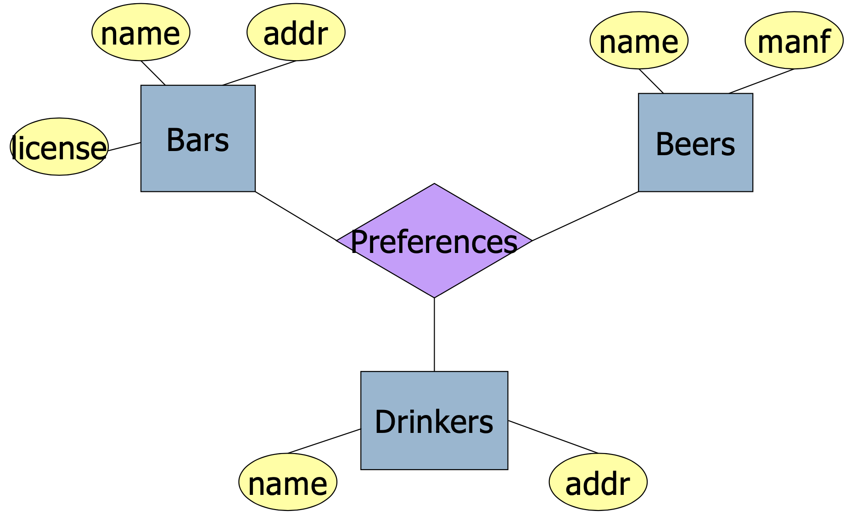
ER Terms
Entity: Is a “thing” or object
Attribute: Is a property of an entity set. Usually, a simple value
Has a domain: a list of values under the that attribute
Relationship: Association between entity sets
List entities, attributes and
relationships:

Slide 7
ER Diagram Notations
Entity
Weak Entity
Relationship
Identifying Relationship
Attribute
Key Attribute
Composite Attribute

Slide 8
One-to-One Relationship
Each entity of either entity set is related to at most one entity of the other set.
E.g., an manufacturer has exactly one best-seller beer.
Best-seller
Manufacturers
Beers

Slide 9
Many-to-Many Relationship
An entity of either set can be connected to many entities of the other set.
E.g., a bar sells many beers, and a beer is sold by many bars.
sells
Bars
Beers

Slide 10
Many-to-One Relationship
Each entity of the first set is connected to at most one entity of the second set. But an entity of the second set can be connected to zero, one, or many entities of the first set.
E.g., a drinker has only one most favorite beer, and a beer can be the most favorite of many drinkers.
Favorite
Drinkers
Beers

Slide 11
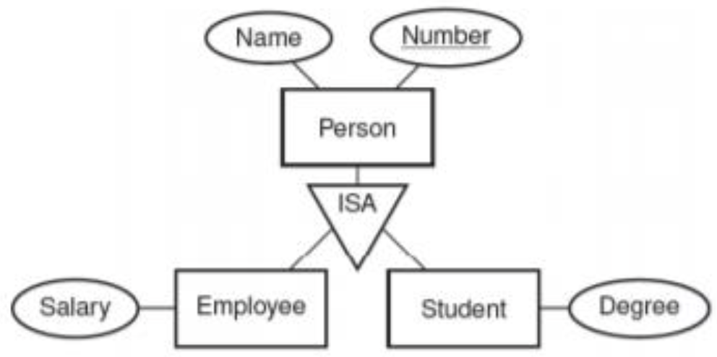
Subclasses/ISA Relationship
Subclass are a special type of entity set that inherit properties from a parent entity
The subclass must have all attributes of the parent as well as having additional properties

Slide 12
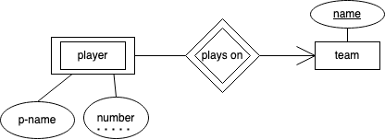
Weak Entity Sets
Weak entities do not have enough information to have its own primary key
The weak entity relies on the supporting entity for its identification
The key of the weak entity is a composite key made of the primary key of the supporting entity and the partial key of the weak entity

Slide 13
Relationship Degree(1)
Sex
Zero
Binary
ID
People
name
sells
Bars
Beers

Slide 14
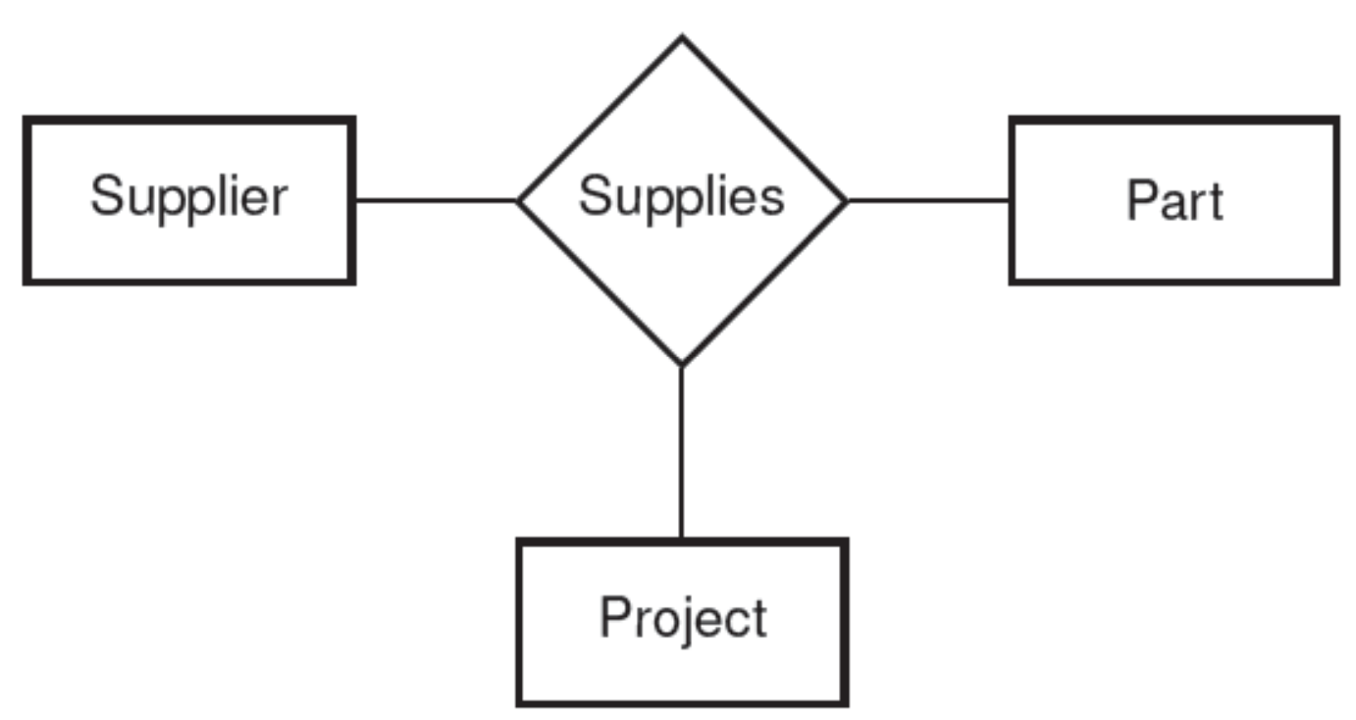
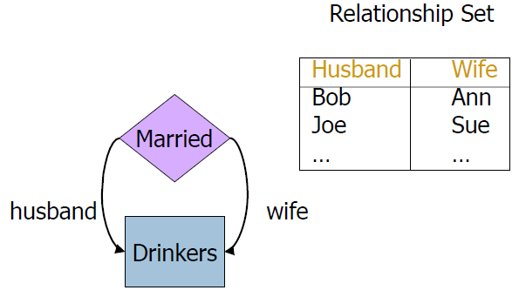
Relationship Degree(2)
Ternary
Roles(Cyclical or recursive relationship)

Slide 15
Participation
Totally participation: At least one or more entities are in the relationship. Mandatory
Partially participation: zero or more entities are in the relationship. Optional
Works in
Employee
Department
Works in
Employee
Department

Slide 16
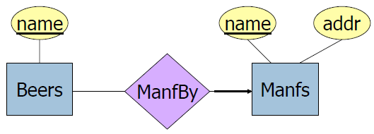
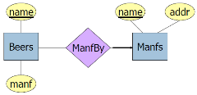
ER Schema Mapping(4)
Design Techniques
Avoid redundancy
Good Bad
Limit the use of weak entity sets
Do not use an entity set when an attribute will do

Slide 17
An Example
Suppose you are given the following requirements for a simple database for the National Hockey League (NHL):
the NHL has many teams,
each team has a name, a city, a coach, a captain, and a set of players,
each player belongs to only one team,
each player has a name, a position (such as left wing or goalie), a skill level, and a set of injury records,
a team captain is also a player,
a game is played between two teams (referred to as host_team and guest_team) and has a date (such as May 11th, 1999) and a score (such as 4 to 2).
Note: name is the primary key for team and player

Slide 18
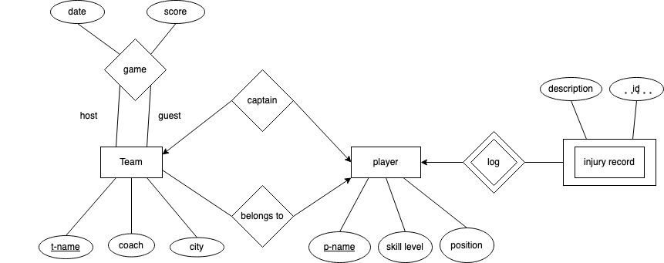
Solution

Slide 19
Assignment 1 Tips
Suggested drawing software: (some are paid with free trials)
Lucid Chart
diagrams.net
Visual Paradigm
ERD Plus
Pay attention to the description, look for words that indicate relationships, constraints, special cases etc.

Slide 20
Contact
If you have any questions or feedback, please email me or attend my office hours:
Lucia Cristiano
Email: cristial@mcmaster.ca​
Office hours: Tue 3:00pm – 4:00pm on MS Teams​

