Slide 1
Lab 3
Akshati Vaishnav

Slide 2
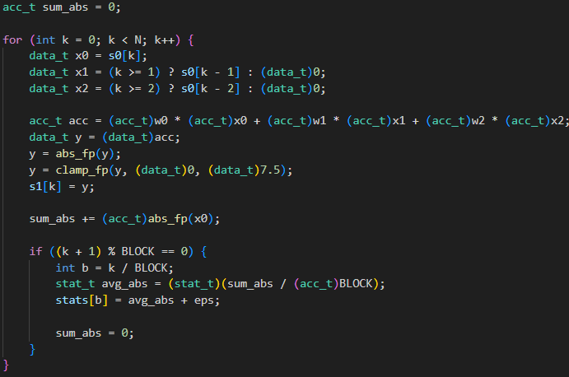
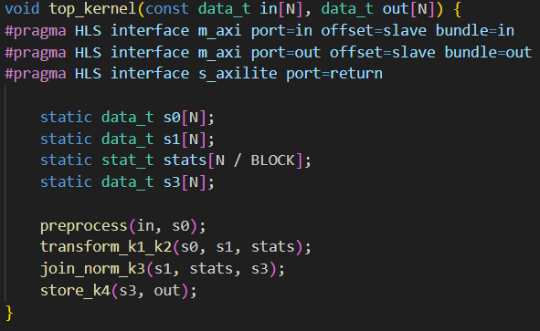
Reformatting the Baseline
Converting baseline into functions
Combined k1 and k2 loops because they used the same set of arrays
1.13x speedup from baseline

Slide 3
Unrolls, pipelining, streaming, and dataflow
Processing 16 elements at once
4218 cycles
7.918 ns
Utilization (%): 72| 17| 10| 52| 0|
Speedup = 275x
FIFO usage was blowing up:
Choosing stream sizes carefully
Aggregate pragma: groups all elements of stream into a single-wide vector with bit-alignment so that members can be read and written to simultaneously
Caused some utilization changes, but it didn’t change the speedup

Slide 4
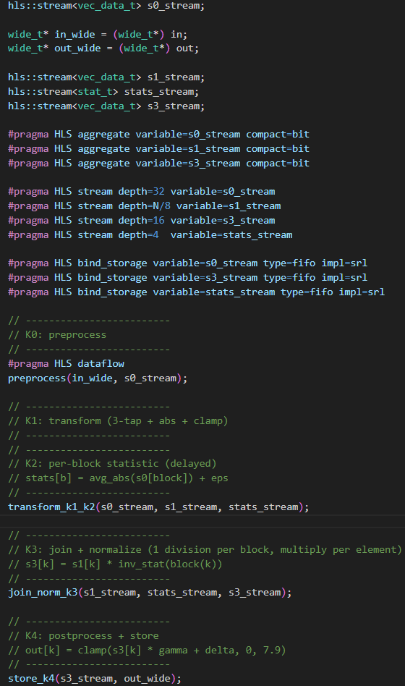
Unrolls, pipelining, streaming, and dataflow

Slide 5
Increasing elements in vector
Maximum elements we can process through bus is 1024
Processing 32 elements at once
2165 cycles
8.834 ns
Speedup = 481x
Have reached the limit of using a wide bus

Slide 6
Changing Clock Period in Tcl Script
Changed it to 2.5ns
2201 cycles
2.484 ns
|Utilization (%) | 52| 35| 38| 85| 0|
Speedup: 1683x

Slide 7
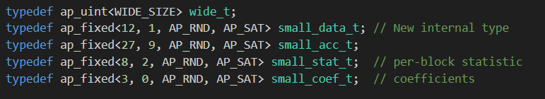
Decreasing Data Type Sizing
Trial and error
Script clock period: 2ns
2188 cycles
1.982 ns
Speedup: 2122x

Slide 8
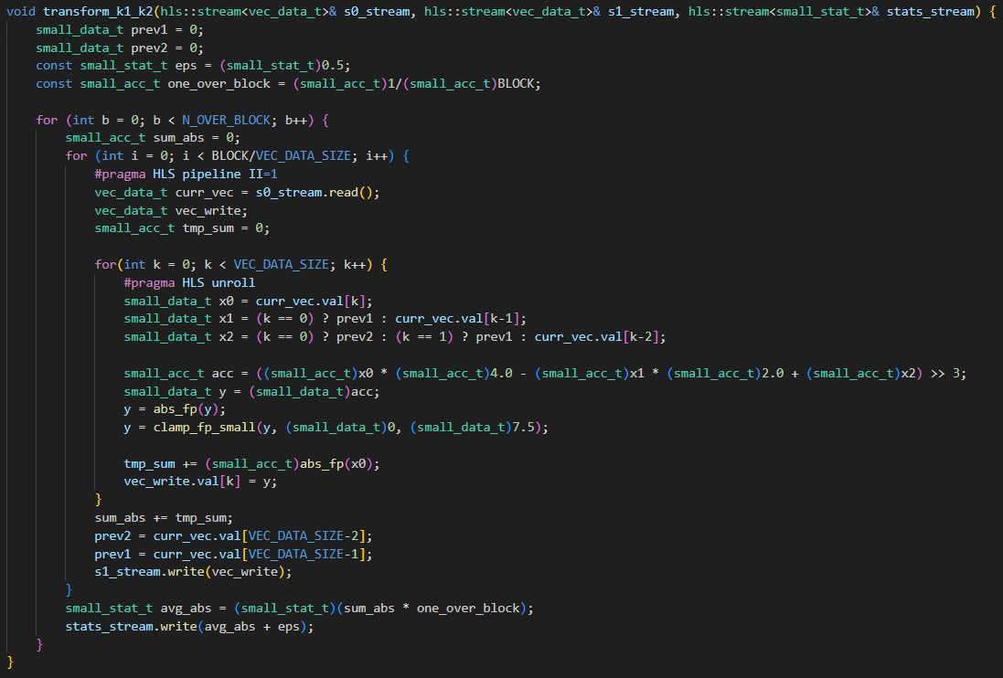
Adder tree
Addition in the k1_k2 function was slowest
Converted tmp_sum to be a separate loop with four levels of adders

Slide 9
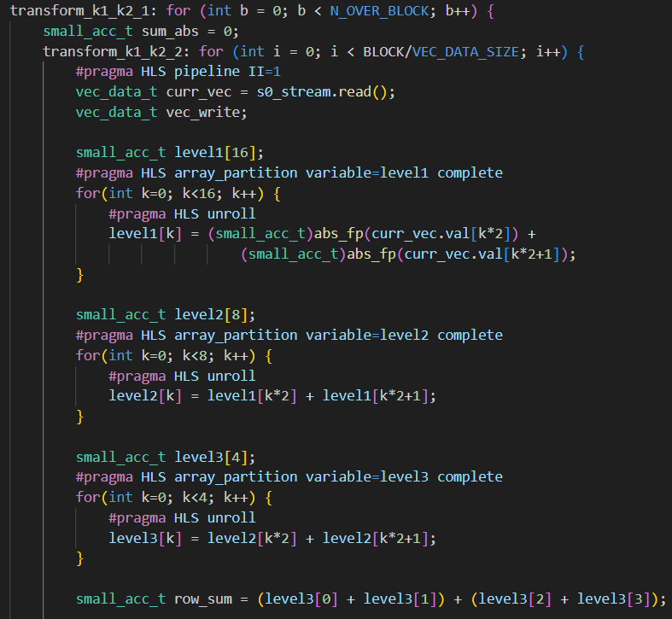
Adder tree
Addition in the k1_k2 function was slowest
Converted tmp_sum to be a separate loop
Used complete array partitioning
Utilization was low

Slide 10
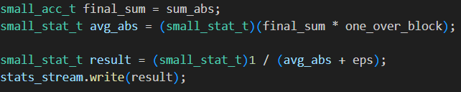
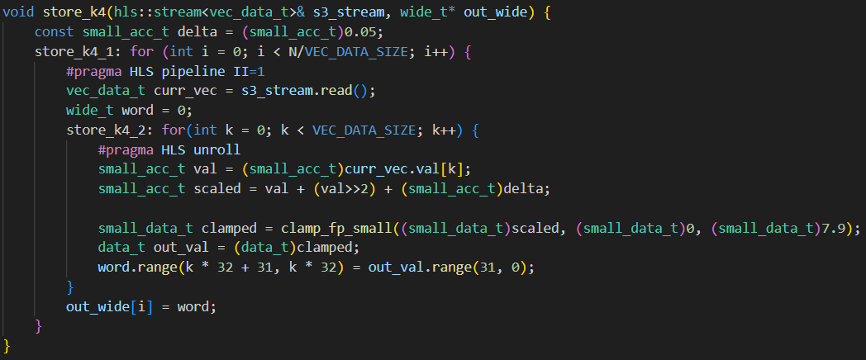
Minor Updates
Changing divisions to constants/multiplication/bit shifts when possible
Moving division to be at FIFO insertion time

Slide 11
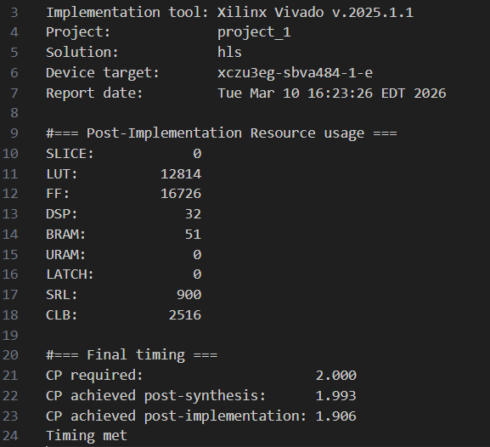
Final Numbers
Script clock period: 2ns
2138 cycles
1.906ns clock period
2259x period

Slide 12
LLM Usage
Adder tree coding

Slide 13
Code

