Slide 1
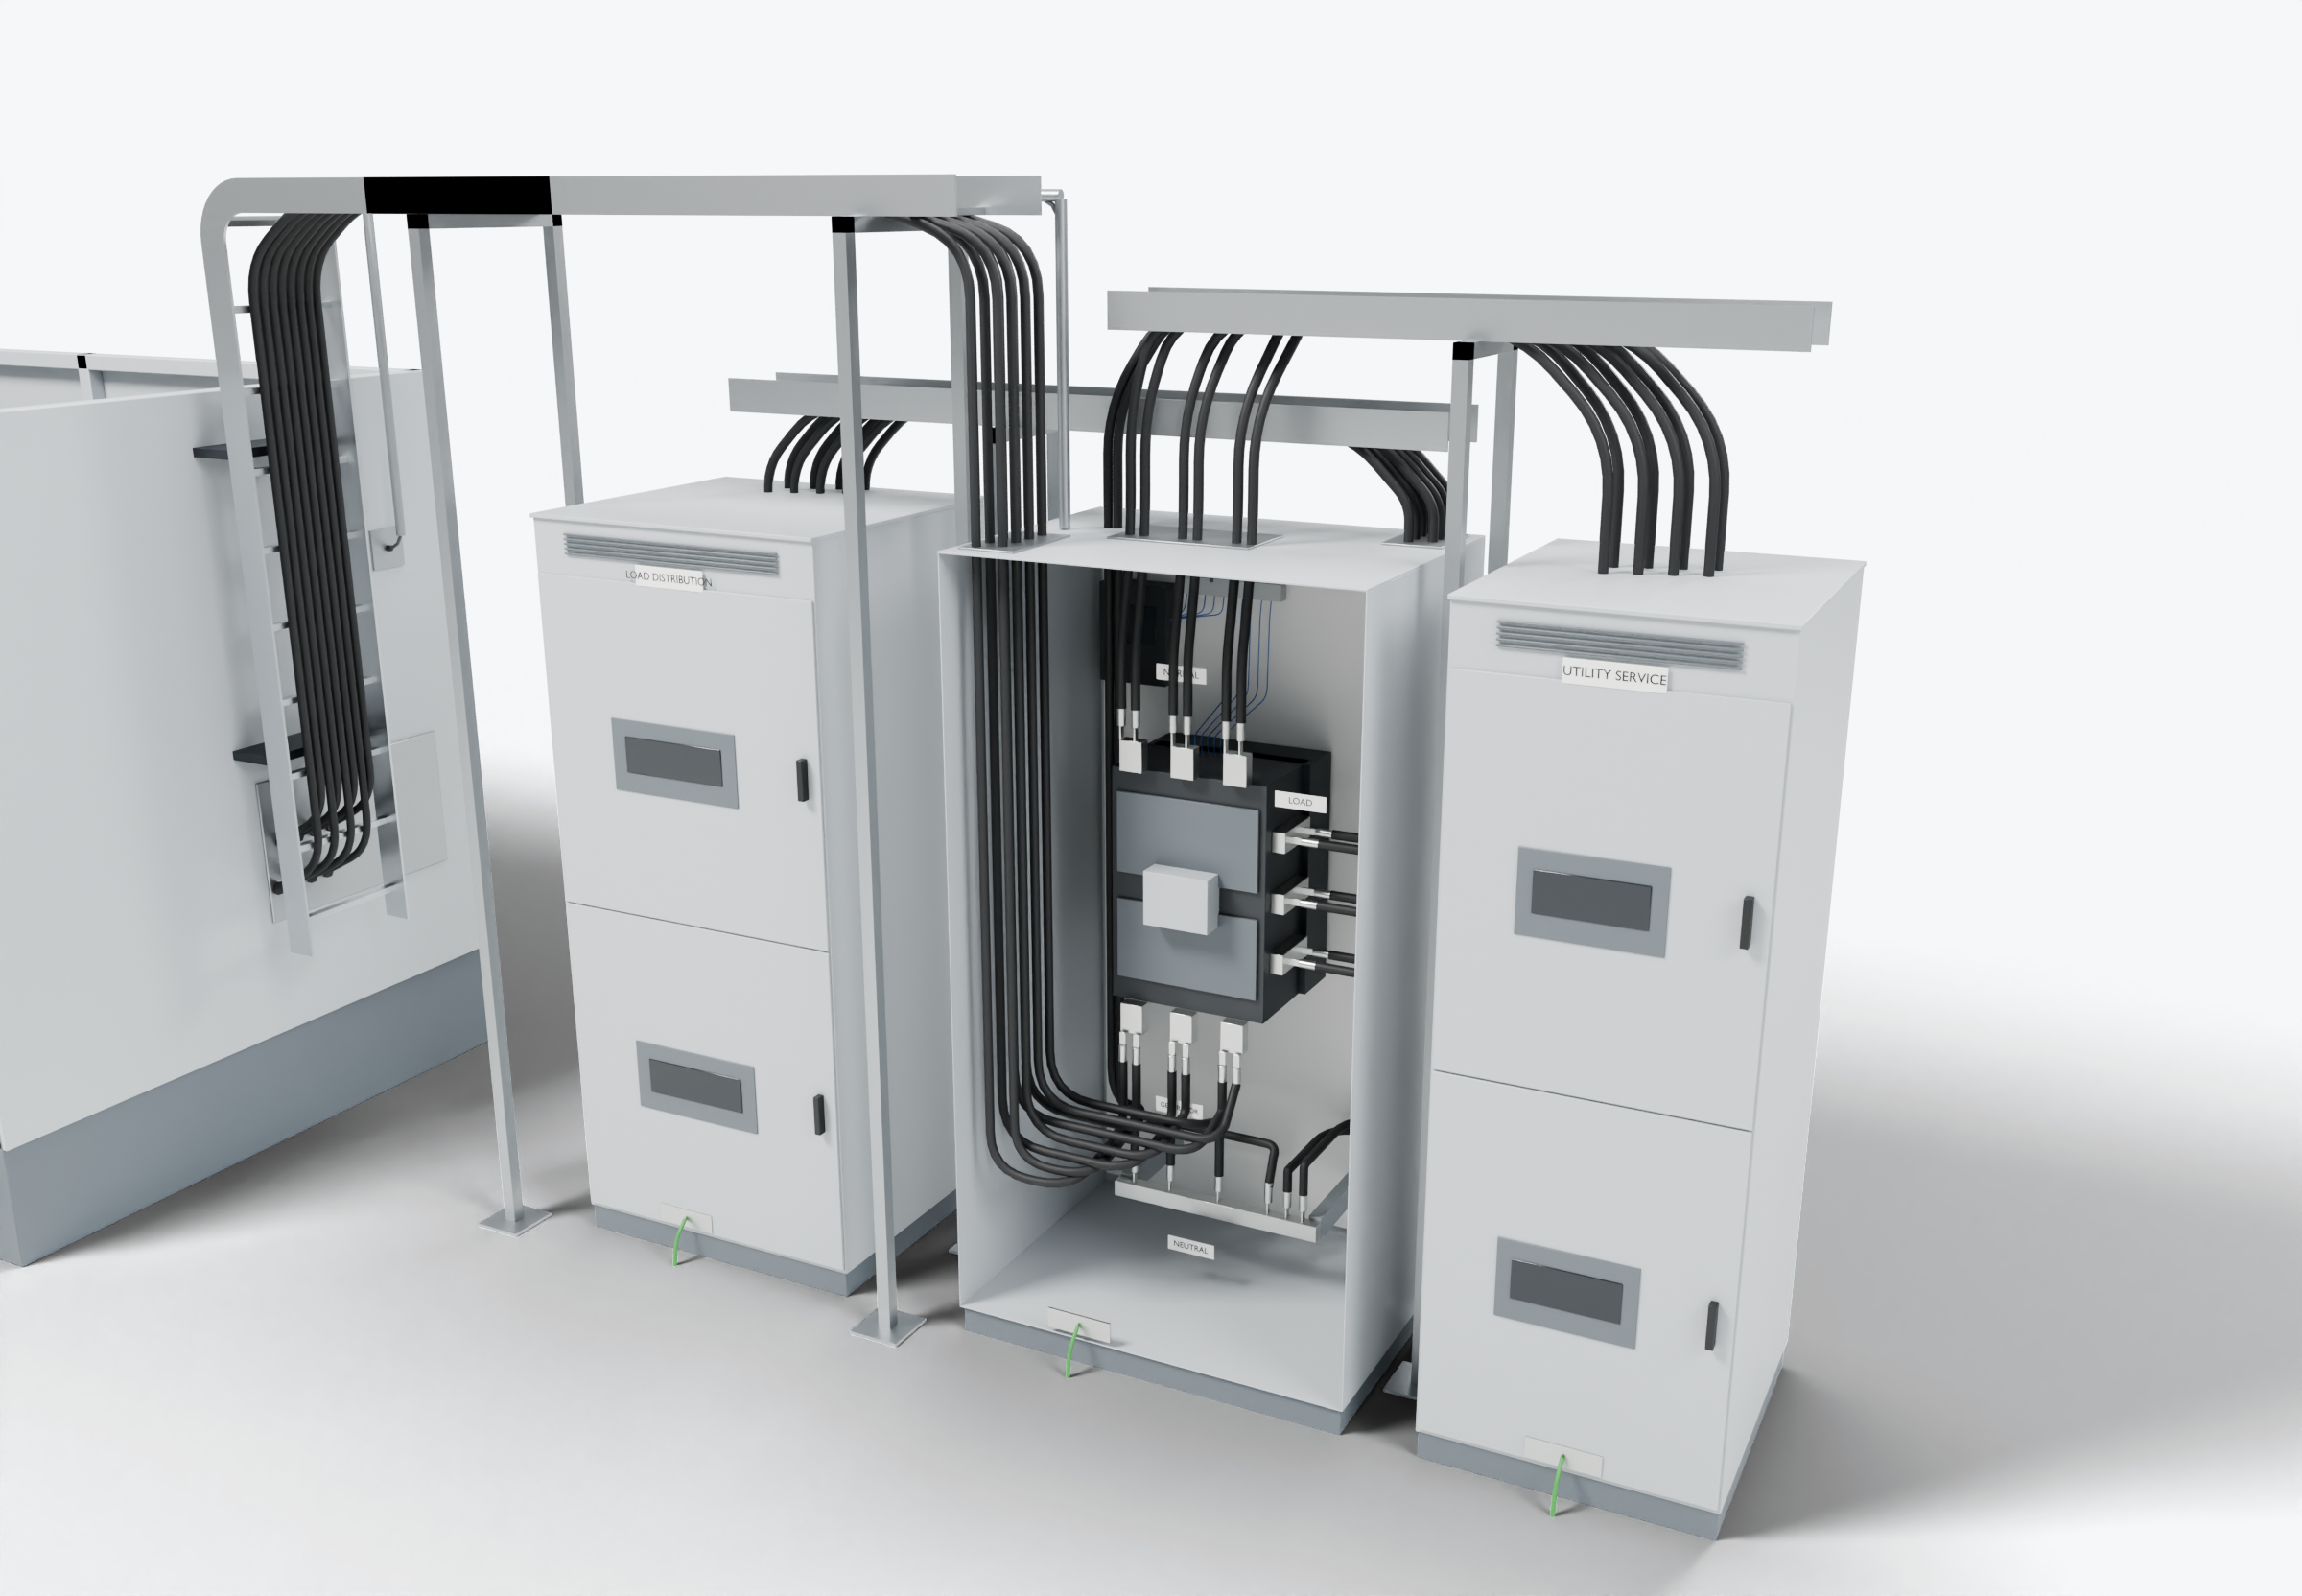
SOUTHWIRE LOGO
placeholder - insert approved artwork
POWER GENERATION SOLUTIONS
Discussion with Schneider Electric / ASCO
Defining scope at transfer-equipment interfaces
Clarify factory-supplied and installer-supplied connections at the normal-source, generator-source and load terminals. Open-transition switch shown; sources are not paralleled.
1
Normal-source connection
Load connection
3
2
Generator-source connection
Control wiring (presentation blue)
Power conductors
Grounding / bonding
Highlight colors are for presentation only and do not indicate conductor identification.
APPLICATIONS TO EVALUATE
1
Normal-source connection
2
Generator-source connection
3
Load connection
Document lug, conductor and entry details so installer-supplied cable can be specified and prepared consistently.
Evaluate prepared generator feeders and a separately routed engine-start control cable as one defined package.
Confirm which load and neutral terminations are factory-supplied and which are completed by the installer.
Established: Southwire wire and cable manufacturing and supply.
For evaluation: the prepared kits, cable packages and assemblies shown are application concepts, not qualified Southwire products.
Illustrative model. Ratings, cable sizes, clearances and termination selections are subject to application engineering. No code compliance, engineering approval or certification is implied.
PROPOSED NEXT STEP
Stephan Hardt
Establish factory-supplied versus installer-supplied scope for one transfer-switch configuration and identify where a cable package could help.
Director, Power Generation Solutions, Southwire
[Phone] [Email]
Notes:
View: ASCO_TransferInterface (master .blend). Discussion concept for Schneider Electric / ASCO; no agreement, pilot or purchase is implied. Replace the logo placeholder and the [Phone]/[Email] placeholders before use.

