Slide 1
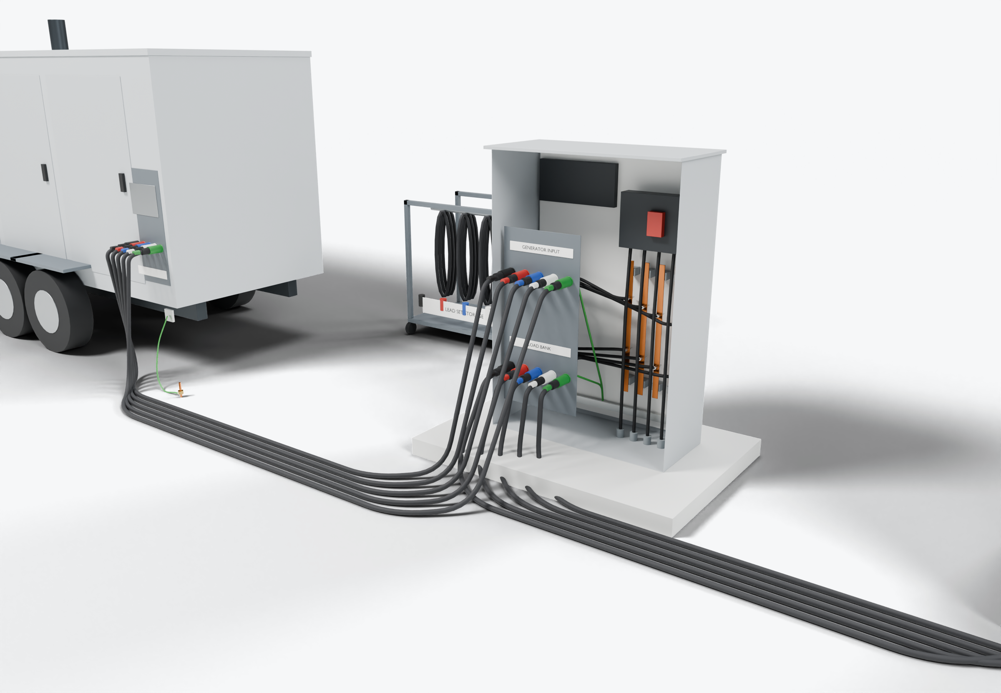
SOUTHWIRE LOGO
placeholder - insert approved artwork
POWER GENERATION SOLUTIONS
Discussion with InPower
Generator docking and connection sets
Review portable lead sets and internal docking-station wiring as coordinated, identified connection packages.
3
Generator and load-bank ports
Docking-station internal wiring
2
1
Portable lead sets
Power conductors
Grounding / bonding
Highlight colors are for presentation only and do not indicate conductor identification.
APPLICATIONS TO EVALUATE
1
Portable lead sets
2
Docking-station internal wiring
3
Generator and load-bank ports
Single-conductor sets built to length, with connectors and matching identification at both ends, stored as complete sets.
Prepared conductors between receptacles, bus and disconnect, matched to the enclosure layout and installed as a kit.
Separate generator-input and load-bank ports, with the facility feed treated as a fixed interface.
Established: Southwire wire and cable manufacturing and supply.
For evaluation: the prepared kits, cable packages and assemblies shown are application concepts, not qualified Southwire products.
Illustrative model. Ratings, cable sizes, clearances and termination selections are subject to application engineering. No code compliance, engineering approval or certification is implied.
PROPOSED NEXT STEP
Stephan Hardt
Review one connection configuration, including ratings, connectors, lead lengths and storage, as a candidate package.
Director, Power Generation Solutions, Southwire
[Phone] [Email]
Notes:
View: INPOWER_Docking (master .blend). Discussion concept for InPower; no agreement, pilot or purchase is implied. Replace the logo placeholder and the [Phone]/[Email] placeholders before use.

