Slide 1
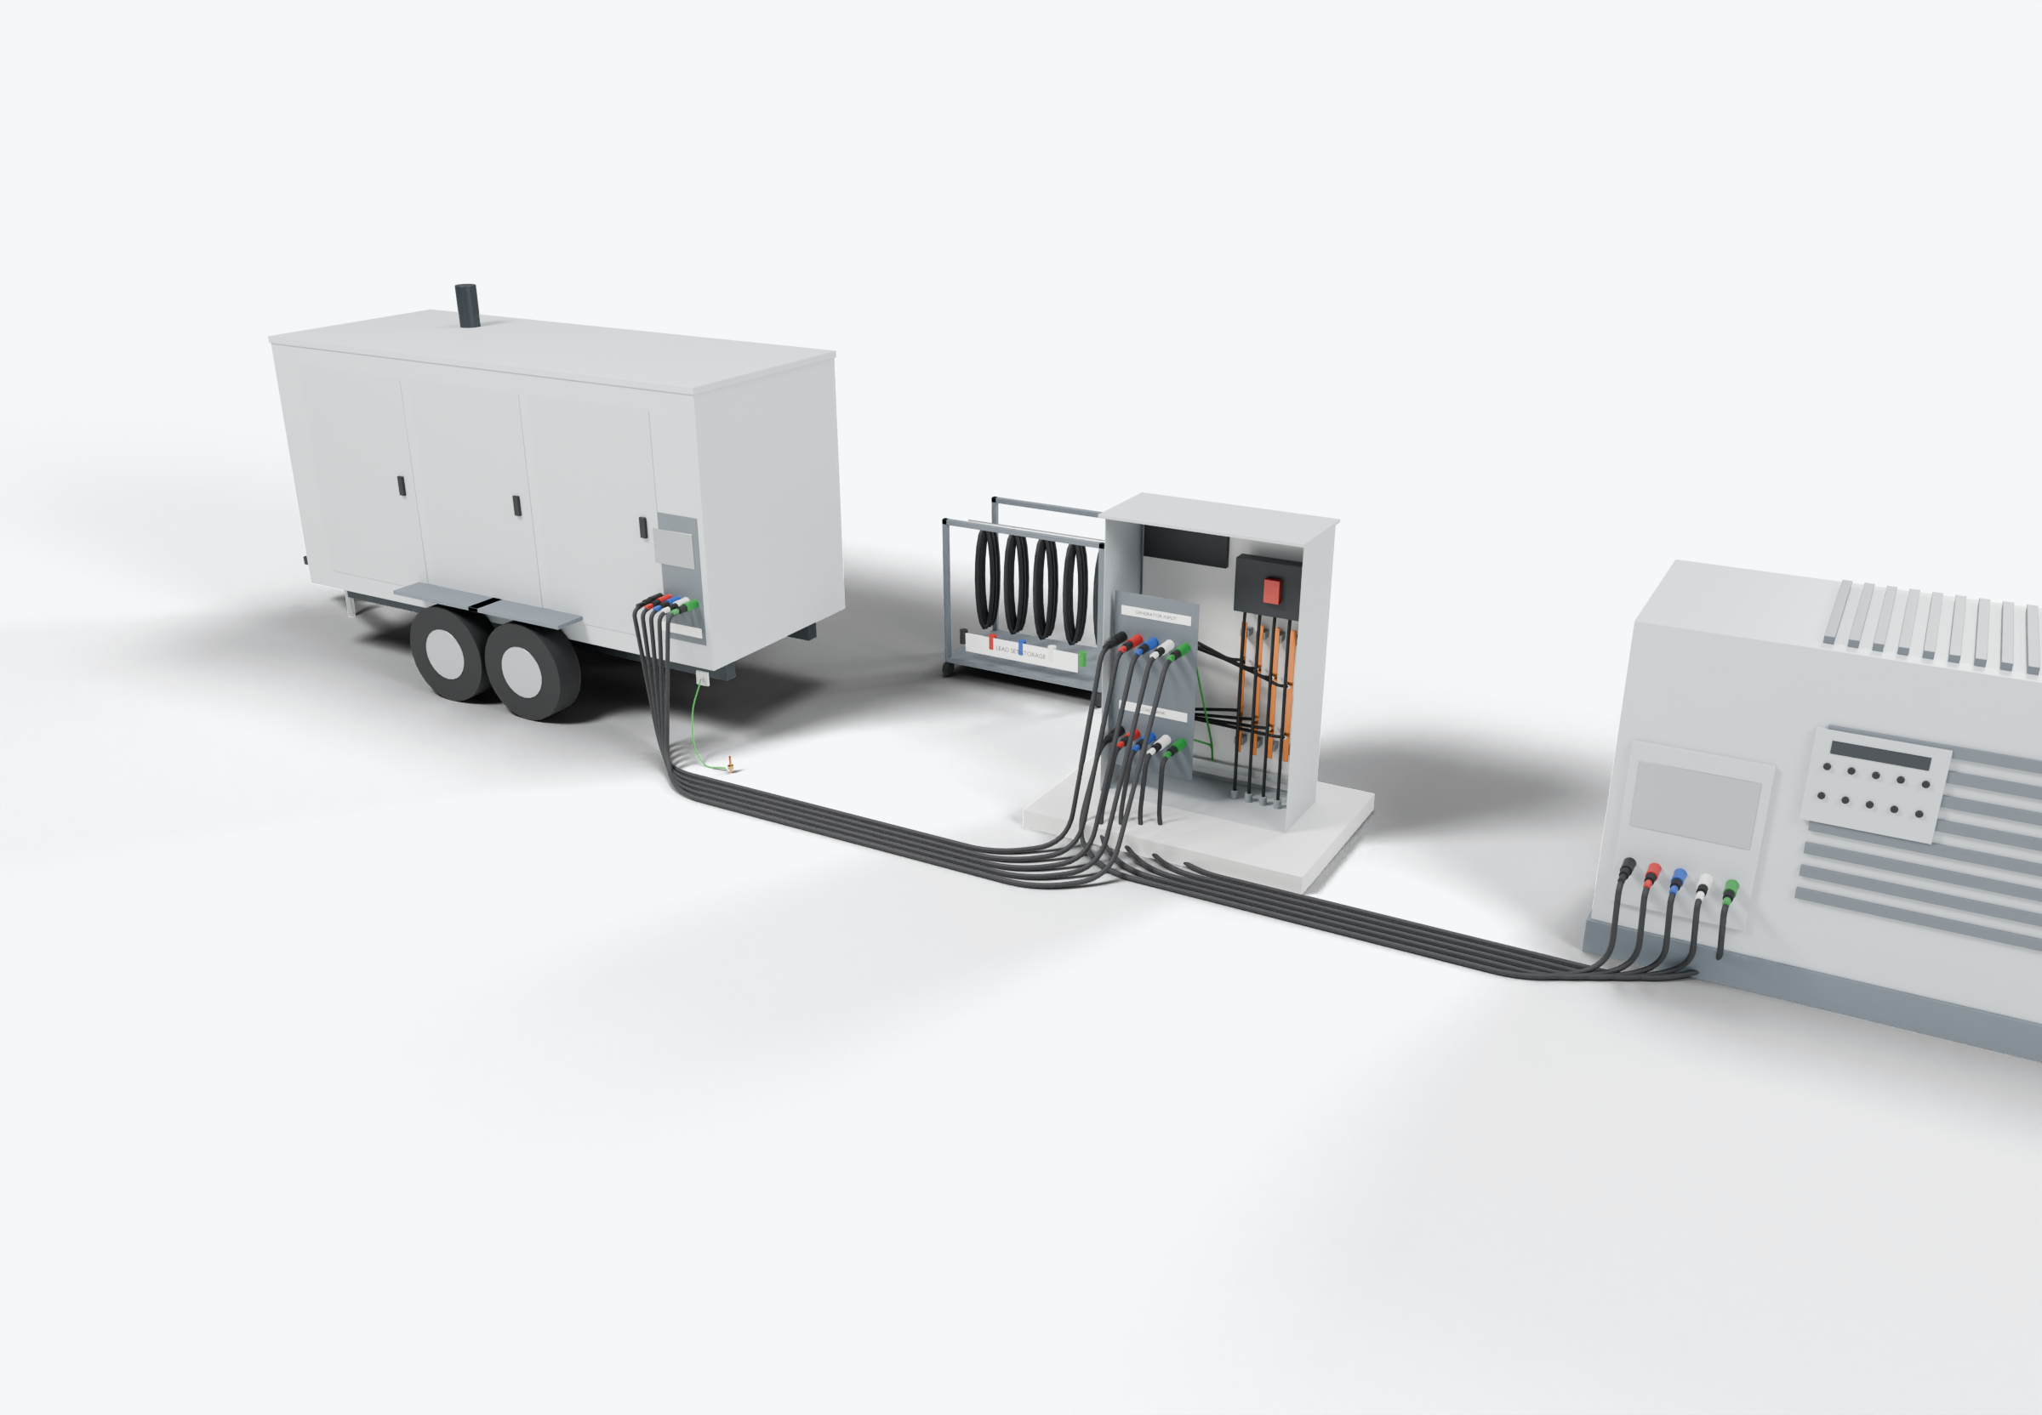
SOUTHWIRE LOGO
placeholder - insert approved artwork
POWER GENERATION SOLUTIONS
Discussion with Mosebach Load Banks
Repeatable generator-testing connection sets
Review the lead sets used to connect generators to load banks for testing, including handling, storage and replacement.
3
Lead-set storage and transport
Configurable test load
2
1
Generator-to-load-bank leads
Power conductors
Grounding / bonding
Highlight colors are for presentation only and do not indicate conductor identification.
APPLICATIONS TO EVALUATE
1
Generator-to-load-bank leads
2
Configurable test load
3
Lead-set storage and transport
Portable sets with connectors, lengths and identification matched to the load bank connection panel and typical site layouts.
The load bank is a configurable test load, connected through a dedicated port, not to facility loads.
Coiled sets, labels and inspection records kept together for repeated deployments, with a defined point for retiring worn leads.
Established: Southwire wire and cable manufacturing and supply.
For evaluation: the prepared kits, cable packages and assemblies shown are application concepts, not qualified Southwire products.
Illustrative model. Ratings, cable sizes, clearances and termination selections are subject to application engineering. No code compliance, engineering approval or certification is implied.
PROPOSED NEXT STEP
Stephan Hardt
Review duty, ratings, connectors and replacement needs for one load-bank lead set.
Director, Power Generation Solutions, Southwire
[Phone] [Email]
Notes:
View: MOSEBACH_LoadBankTest (master .blend). Discussion concept for Mosebach Load Banks; no agreement, pilot or purchase is implied. Replace the logo placeholder and the [Phone]/[Email] placeholders before use.

