Slide 1
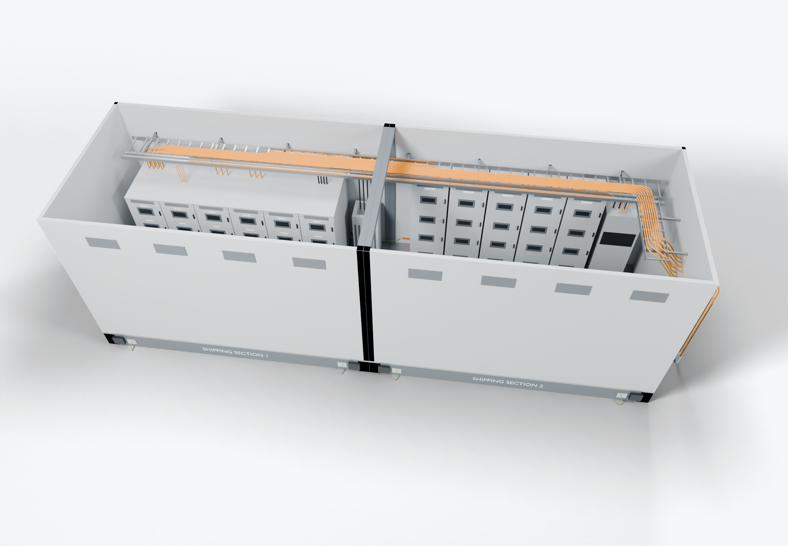
SOUTHWIRE LOGO
placeholder - insert approved artwork
POWER GENERATION SOLUTIONS
Discussion with nVent
Wiring and routing within enclosures and electrical buildings
Evaluate how tray, cable entries and internal connections could be planned and supplied together for an enclosure or building.
3
Internal equipment connections
1
Tray routing and segregation
Cable entries and transits
2
Power conductors
Completed onsite (presentation amber)
Grounding / bonding
Highlight colors are for presentation only and do not indicate conductor identification.
APPLICATIONS TO EVALUATE
1
Tray routing and segregation
2
Cable entries and transits
3
Internal equipment connections
Power and control cables run in separate tray or channel, with routes defined before assembly.
Entry plates and transits matched to the cable counts and sizes in the design, with spare capacity agreed up front.
Equipment drops prepared to length and identified to the connection list, so each landing can be checked against the drawing.
Established: Southwire wire and cable manufacturing and supply.
For evaluation: the prepared kits, cable packages and assemblies shown are application concepts, not qualified Southwire products.
Illustrative model. Ratings, cable sizes, clearances and termination selections are subject to application engineering. No code compliance, engineering approval or certification is implied.
PROPOSED NEXT STEP
Stephan Hardt
Select one enclosure or building application and define assembly ownership for tray, entries and internal cabling.
Director, Power Generation Solutions, Southwire
[Phone] [Email]
Notes:
View: NVENT_EnclosureRouting (master .blend). Discussion concept for nVent; no agreement, pilot or purchase is implied. Replace the logo placeholder and the [Phone]/[Email] placeholders before use.

